Slide 1

NORMA Lab. 4
Revision: Adding Value Constraints, Set-comparison Constraints
Adding Frequency Constraints
Adding Ring Constraints
Adding Subtyping
Adding Subtype Definitions and Constraints
Adding Textual Constraints
Reordering pages
In this lab we will enter the following 2 page ORM schema.
File: NORMA_Lab4.ppt. Author: T. Halpin. Last updated: 2009 June 9

Slide 2
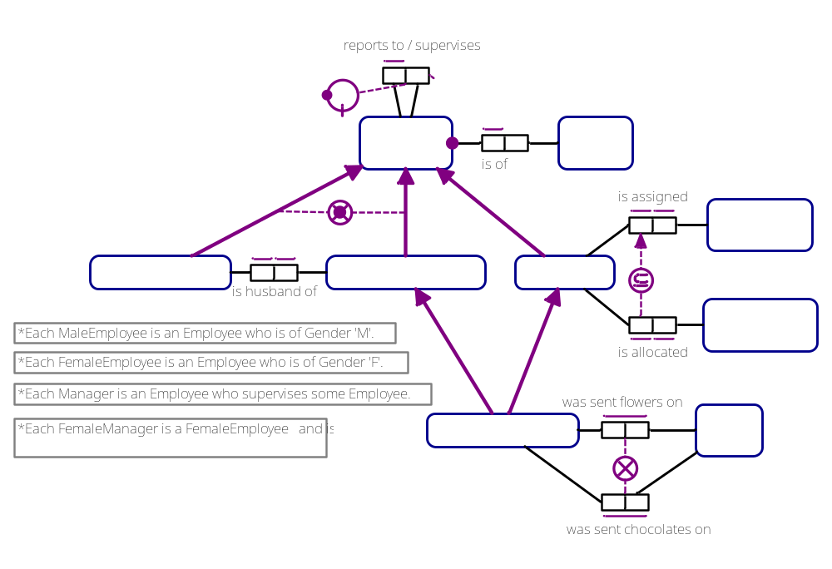
Page: Employee Subtyping

Slide 3
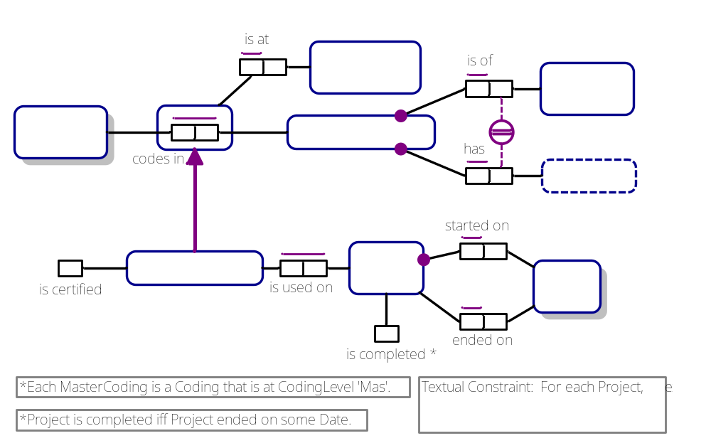
Page: Coding&Projects

Slide 4
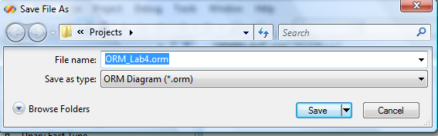
1. In Visual Studio, create a new ORM file.
File > New > File
Select General > Object-Role Modeling File.
Press Open.
2. Press the Save icon
name the file ORM_Lab4.orm
and press Save.

Slide 5


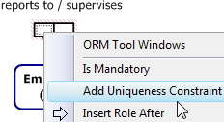

Type this fact type in the Fact Editor
and press Ctrl-Enter to diagram it.
Position the predicate reading
above the predicate shape.
Right-click the left role,
then choose
Add Uniqueness Constraint
from the context menu.
The diagram should now appear as shown.
Notes:
Note: If the tool does not default to a specified data type, Employee(.nr) will display an error. Set the Data Type to remove the error.

Slide 6

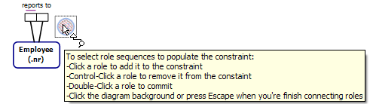
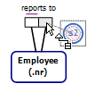

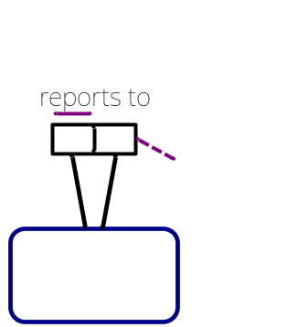

Select the
FrequencyConstraint
shape from the toolbox
and position the mouse
near the righthand role.
If needed, double-click
the constraint shape to
activate the constraint pointer¹.
Drag the constraint pointer
to the right role,
and click it (a “1” appears).
Double-click to apply the constraint,
then click outside (or press Esc)
to end. The frequency constraint
is set to ≤ 2 by default.
¹ If you click the toolbox constraint shape then click the diagram,
you do not need to double-click to activate the constraint editor.

Slide 7
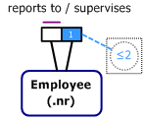
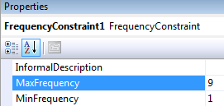
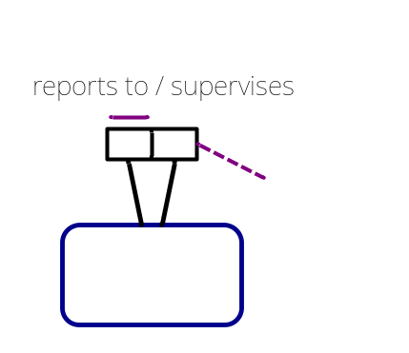
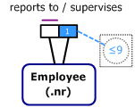

Select the constraint
then change its
MaxFrequency property
to 9,
and press Enter.
The frequency constraint
now displays as ≤ 9.
Select the
frequency constraint
and open the
ORM Verbalization Browser.
The constraint
verbalizes as shown.

Slide 8

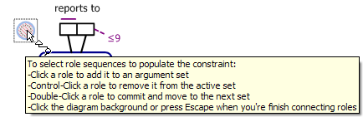
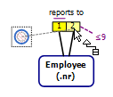
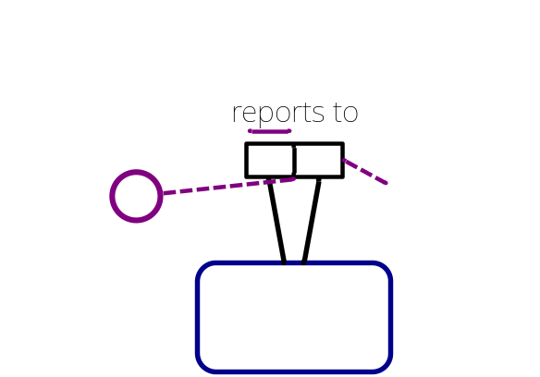

Select the
RingConstraint
shape from the toolbox
and position the mouse
near the lefthand role.
If needed, double-click
the constraint shape to
activate the constraint pointer.
Dragging the constraint pointer,
click the left role
then the right role
(“1” and “2” appear).
Double-click the right role to apply the constraint.

Slide 9
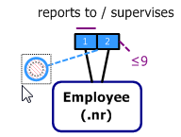
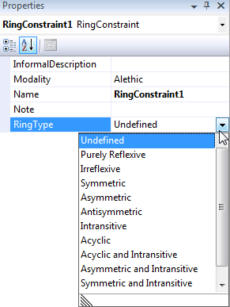
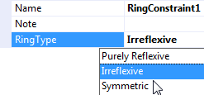
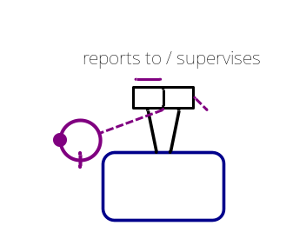

By default, the RingType
property
(type of ring constraint)
is set to Undefined.
Select the constraint
then click the RingType
property arrow to display the
drop-down list of settings.
Double-click Irreflexive
(or select Irreflexive and press Enter),
to commit this choice.
The irreflexive ring
constraint is now displayed.
Open the ORM Verbalizer
window to see its verbalization.
Note: At most one ring constraint selection may be applied to the same role pair.

Slide 10

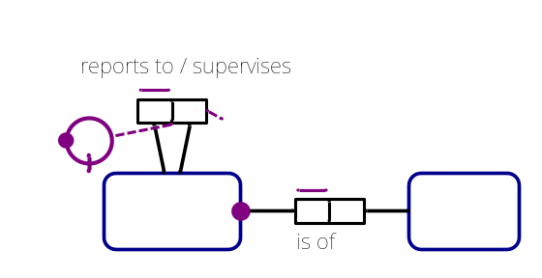
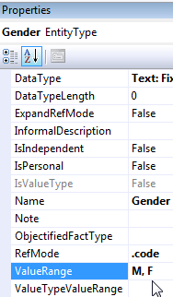


Add this fact type in the Fact Editor,
press Ctrl-Enter to display it,
right-click its left role
and select Add Uniqueness Constraint.
Additionally, right-click its left role
and select Is Mandatory.
Position and align the shapes as shown.
Select the Gender object type
then enter M, F
in its ValueRange property¹.
Reposition the
value constraint
above Gender
as shown.
¹ ValueTypeValueRange sets the values for the underlying value type rather than the role
played by the value type in the reference type. For popular reference modes, this range
is the same as ValueRange; however the ValueTypeValueRange will not display unless
the value type is explicitly displayed (instead of displaying a parenthesized refmode).
Notes:
Note: Reversing the role order may be required if we are going to display as in this slide. This is due to the default way that the tool displays the graphics.
Note: ValueTypeValueRange sets the values for the underlying value type rather than the role played by the value type in the reference type.
For popular reference modes, this range is the same as ValueRange.

Slide 11

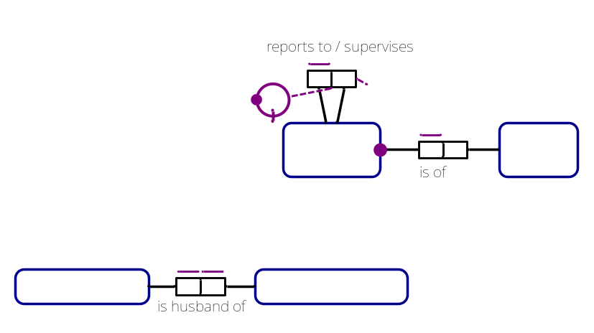

Ctrl-Enter this fact type in the
Fact Editor.
Drag the fact type into the
position shown,
add a uniqueness constraint
to each role,
then
align the fact type as shown,
by selecting the three shapes
and Align Middles (Layout toolbar)¹.
MaleEmployee and FemaleEmployee
are in an error state (red line fill) because no
reference scheme for them has been declared.
This error will be fixed as soon as we declare them subtypes of Employee
(since they will then inherit employee id as their identifier).
¹ Or choose Format > Align > Middles from the main menu.

Slide 12
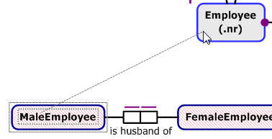

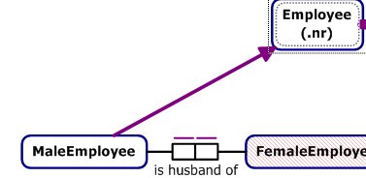
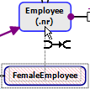
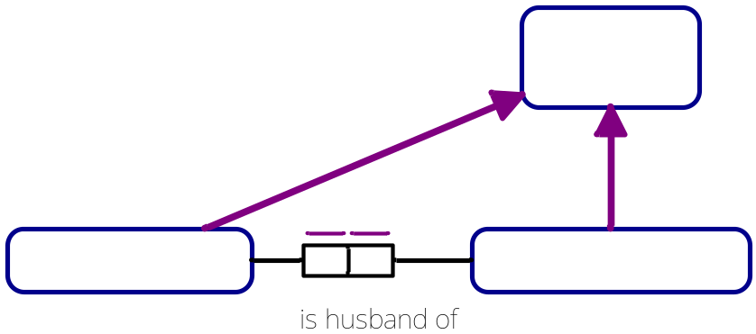
Select the SubtypeConnector
shape from the toolbox,
click MaleEmployee,
then click Employee¹.
The subtype connection now appears.
Select the Subtype Connector,
then click FemaleEmployee
then click Employee,
to add another subtype connection.
¹ Alternatively, drag the subtype connector from the subtype to the supertype.

Slide 13
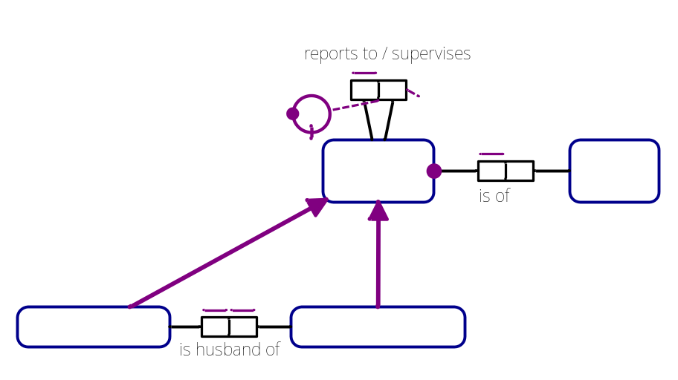
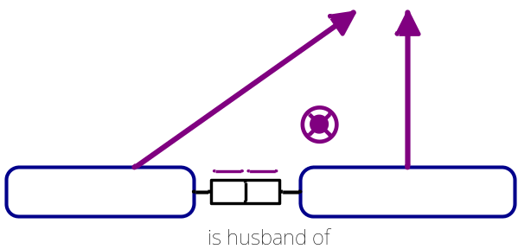

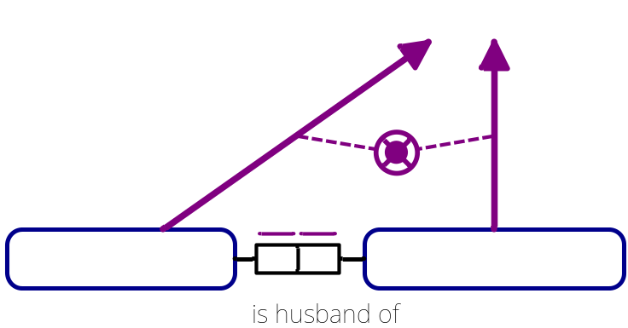
The diagram now appears as shown.
We will now display the constraints
that the two subtypes form
a partition of Employee
(i.e. the subtypes are
mutually exclusive and
collectively exhaustive).
Select the Exclusive-Or Constraint shape
from the toolbox. Place the constraint between the subtype arrows as shown. When the constraint is placed on the screen, the pointer changes to the constraint connector¹.
Click the MaleEmployee subtype arrow first, and then click the FemaleEmployee subtype arrow second. Double click the last
subtype arrow to commit the constraint.
¹If you drag the constraint shape, you need to double-click it to activate its editor.

Slide 14



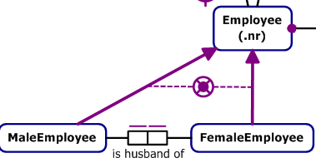
The Exclusive-Or constraint combines an Exclusion constraint and an Inclusive-Or constraint. By default, these are displayed together as a single symbol.
If you ever wish to display an Exclusive-Or constraint
as its two separate components,
right-click the constraint shape and
select ‘Split Exclusive Or Constraint’
from its context menu.
The constraints are now displayed separately.
To recombine,
select both shapes,
right-click and select
“Combine as Exclusive Or Constraint”.
They now display as a single shape.
Note: If one of the dashed connection lines fails to reappear,
just nudge the constraint shape, and the line will display again.

Slide 15


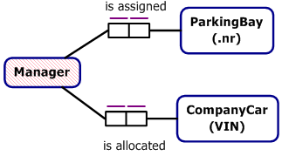
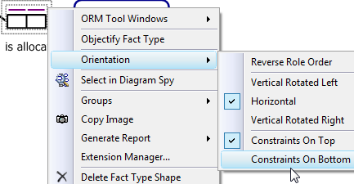

Now Ctrl-Enter these two fact types
in the Fact Editor.
Place Manager to the right of
the other subtypes, then
position the fact types and
and add uniqueness constraints
to each role as shown.
Right-click the allocation fact type
then choose
Orientation > Constraints On Bottom
to move its constraints below the predicate shape.

Slide 16
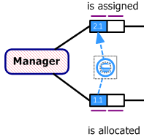
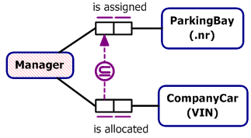
Add the subset constraint shown
(click first role then double-click,
click second role then double-click).
Align the predicates
and nudge the subset constraint shape
to the position shown¹.
Select the subset constraint and
Open the Verbalization Browser window
to see its verbalization.
¹ The layout tool bar doesn’t help for aligning the subset constraint shape.
Instead, temporarily magnify the display (Ctrl-MouseWheelUp or Ctrl-Shift-leftclick)
to help nudge the constraint shape to where you want it.

Slide 17
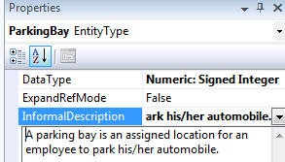

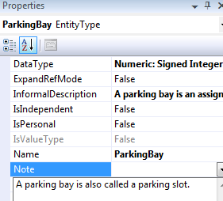
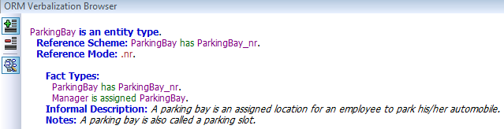
The term “ParkingBay” may require some clarification.
Click on the ParkingBay Entity Type.
In its Properties window,
add the
Informal Description
shown.
Now add a Note
for ParkingBay by entering the note
shown in the Note property.
You can view these details in the
Verbalization Browser.

Slide 18
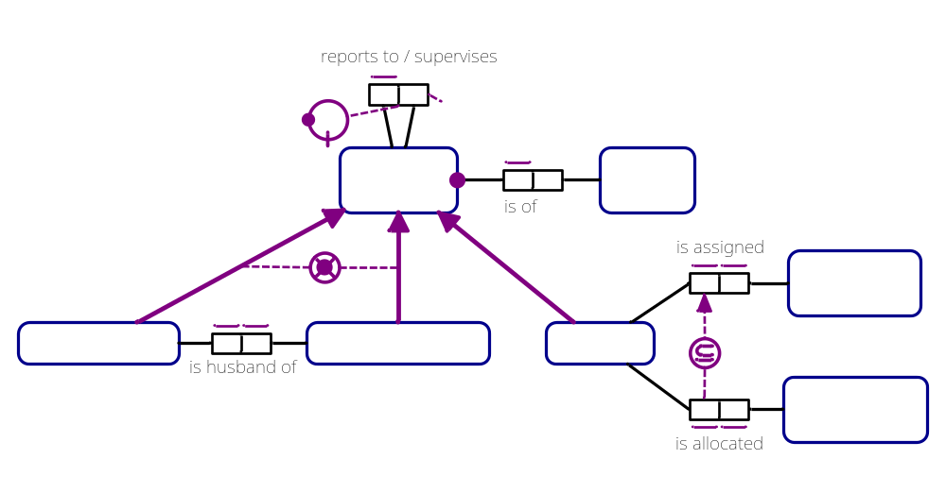
Add a subtype connection from Manager to Employee
by selecting the Subtype Connector from the tool box,
clicking Manager (the subtype),
then clicking Employee (the supertype)
to yield the following overall schema.

Slide 19

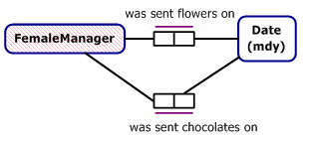
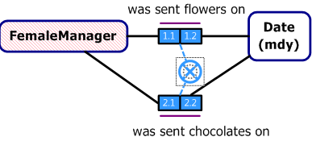
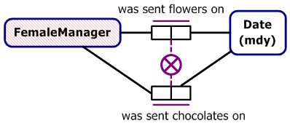
Ctrl-Enter these two fact types.
Reposition them as shown,
add spanning uniqueness constraints
to each fact type, and change the constraint display position on the lower fact type to Bottom.
Select the Exclusion Constraint
shape from the toolbox, with the constraint pointer, click both roles in the top predicate, double-click the last role to end that role sequence, click both roles in the lower predicate, double-click the last role to end that role sequence, then click white space to end.
Then select the predicates and constraint and choose
Align Centers from the Layout toolbar
(or Format > Align > Centers from the menu).

Slide 20
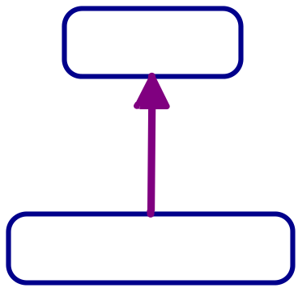
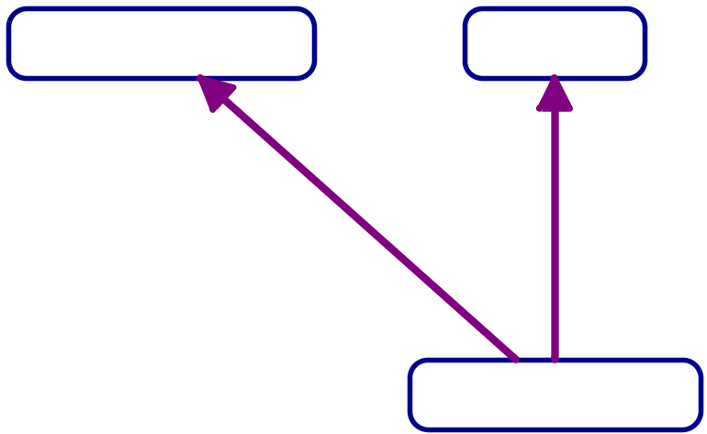
Add a subtype connection
by selecting the Subtype Connector
from the tool box,
clicking FemaleManager,
then clicking Manager.
Add another subtype connection
by selecting the Subtype Connector,
clicking FemaleManager,
then clicking FemaleEmployee.

Slide 21
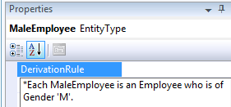


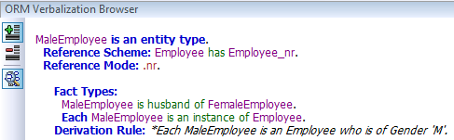
To add a subtype definition for MaleEmployee,
select the MaleEmployee shape
and enter the definition shown in
its DerivationRule property.
An asterisk is now displayed on the
MaleEmployee shape to indicate
that this subtype is derived
(rather than merely asserted or semiderived).
Select MaleEmployee
and open the Verbalizer
to see its verbalization.

Slide 22

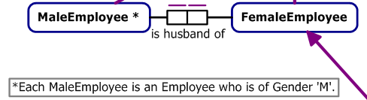
Although the subtype derivation rule displays in the Verbalizer
it does not appear on the ORM diagram in the document window,
unless you show it there as a Model Note.
To do that, first select the derivation rule and
press Ctrl-C to copy it to the clipboard.
Now drag a Model Note shape onto the document window.
Open the Notes Editor window
and Ctrl-V to paste the derivation rule there.
Then move the Model Note shape
to display the note
on the drawing window.

Slide 23
Similarly, enter the derivation rules shown for the other subtypes
and copy them to model notes.

Slide 24
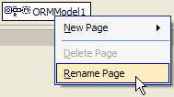

Rename the page as
Employee Subtyping.
Add a new page
and rename it
Coding&Projects
For additional practice
enter the subschema shown on the following slide to the new page.
Enter the textual constraint as a Note on Project
and then copy it to a model note in the usual way.
If you feel like it,
adjust the data types for the whole schema as you see fit.

Slide 25
Page: Coding&Projects

Slide 26

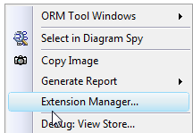
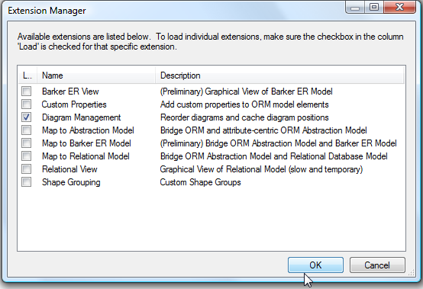
The 2 schema pages are ordered with
EmployeeSubtyping before Coding&Projects.
If you wish to reorder the pages,
right-click on the Document window
and select Extension Manager
from the context menu.
Then, check
Diagram Management
and press OK.

Slide 27

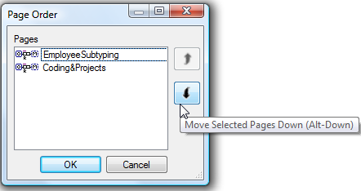
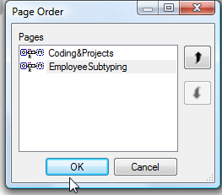


Right-click the EmployeeSubtyping tab
and select the new option
Reorder Pages
to display the Page Order dialog.
Select EmployeeSubtyping
and the down arrow button
to move that page down.
The new page order
is displayed.
Press OK to accept it.
The document window tabs
now display in the new order.
Save your work
then Exit to finish the lab.

