Slide 1

NORMA Lab. 5
Duplicating Object Type and Predicate Shapes
Finding Displayed Shapes
Using the Diagram Spy
Using Multiple Windows
Using the Context Window
File: NORMA_Lab5.ppt. Author: T. Halpin Last updated: 2009 June 2

Slide 2
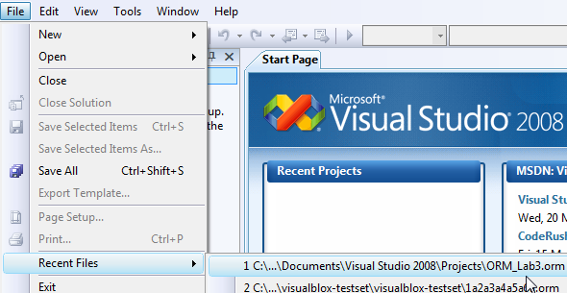
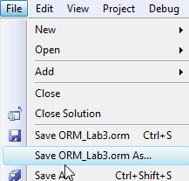
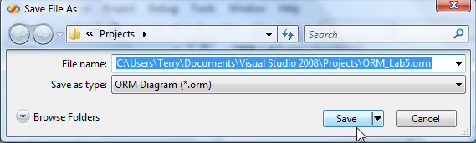
In Visual Studio, open the ORM file you worked on in Lab 3.
File > Recent Files > ORM_Lab3.orm
Save this new version as ORM_Lab5.orm:

Slide 3
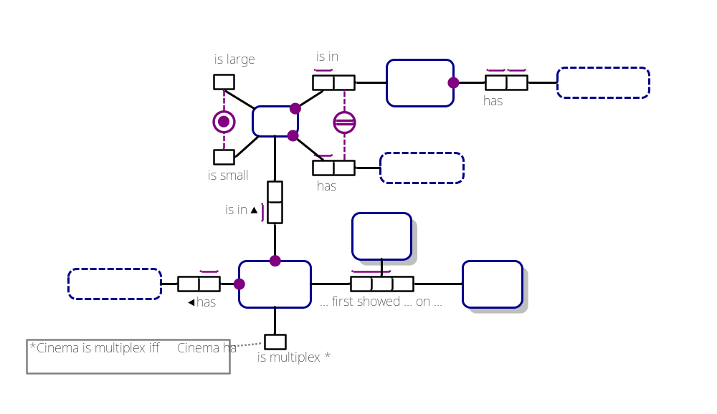
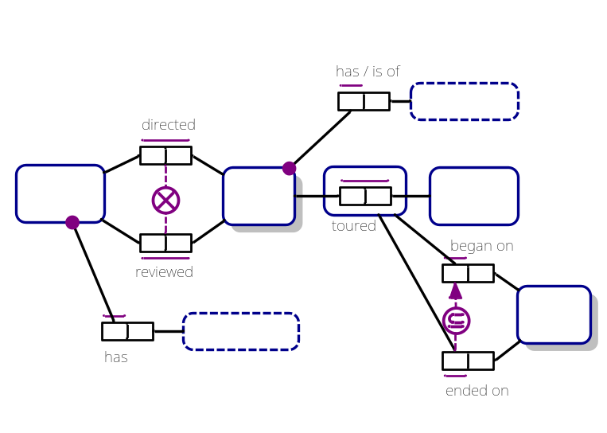
The ORM schema displays as the following 2 pages
(select the relevant document window tab to see the relevant page):
Cinema:
Movie:

Slide 4
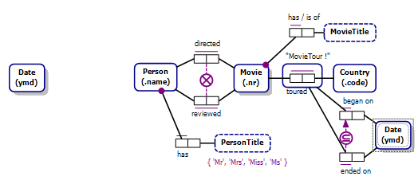
Duplicating a Shape on the Same Page
Select the Movie page.
Select the schema on that page and drag it to the right
to make space on the left for adding a new fact type.
Select the Date shape,
hold the Ctrl key down, and drag a copy of that shape
to the left of the Person shape as shown¹.
Although Date is now displayed twice
on this page, and also once on the
other page, its underlying model element
occurs only once in the actual model.
¹ To drag many shapes at once, select them all and Ctrl-drag to the desired position.

Slide 5



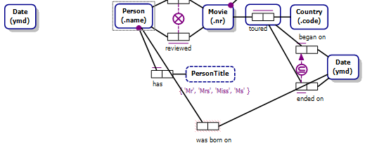

Select the Person shape to display its textual
form “Person(.name)” in the Fact Editor.
Complete the fact type by adding
“was born on Date” and press Ctrl-Enter
to add it to the model and display it.
If the fact type displays
as shown connected to
the original Date shape,
it looks untidy because of
line crossings.
To fix this, simply drag the predicate
to place it between Person and the
copy you made of the Date shape.
The predicate now connects to this
Date shape.

Slide 6
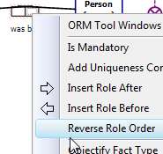


Right-click a role in the predicate
and select Reverse Role Order
to reverse the reading direction¹.
The predicate reading now displays
with a left arrow-tip indicating its
reading direction is now right to left.
Right-click the role played by Person,
add uniqueness and mandatory role constraints
by selecting from the context menu,
then move and align the fact type shapes horizontally
by selecting Align Middles from the Layout toolbar
(or Format > Align > Middles from the main menu).
¹ Alternatively, select the whole predicate shape, and then
select Orientation > Reverse Role Order from its context menu.

Slide 7
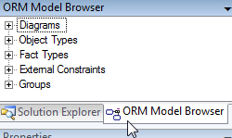

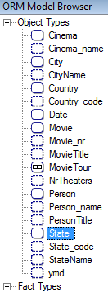
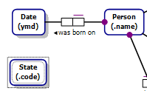
Duplicating a Shape from Another Page
Open the ORM Model Browser
either by selecting its tab
or by right-clicking a space in the
the document window
and selecting
ORM Tool Windows > ORM Model Browser.
Expand Object Types,
select State
and drag it onto the document window
placing it below the Date shape as shown.

Slide 8

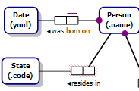
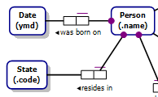
Select the Person shape to display
its textual form in the Fact Editor,
then add “resides in State”
and Ctrl-Enter to add the fact type.
Right-click a role in the predicate and select
Reverse Role Order to display it as shown.
Right-click the righthand role, then
add uniqueness and mandatory role constraints
by selecting from the context menu.

Slide 9
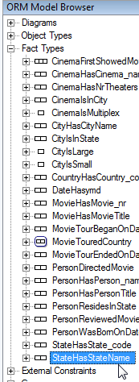
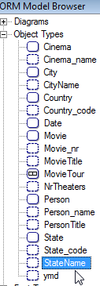
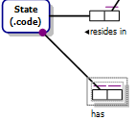
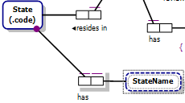
In the Model Browser
collapse Object Types,
expand Fact Types
and select State has StateName.
Drag it onto the document window
placing it below the “resides in”
predicate shape.
A copy of the predicate shape¹
for the StateName fact type is
displayed, connected to State, as shown.
In the Model Browser
collapse Fact Types, expand Object Types,
then select StateName
and drag it in place as shown.
A full copy of the fact type is now
displayed, with all its connections.
Note: It is easier to copy fact types from
the ORM Diagram Spy Window (see later).
¹ The shape is shadowed, indicating a copy.

Slide 10
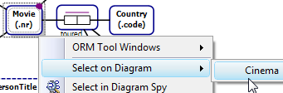
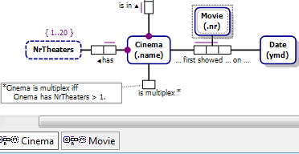
Finding Displayed Shapes
With large schemas, the same model element might be
displayed on many diagrams (one diagram per page).
A shadow on a shape indicates its display is duplicated somewhere.
You can find where using the Select on Diagram option.
On the Movie page,
right-click the Movie shape
then select
Select on Diagram > Cinema¹.
The Cinema page now displays
with the Movie shape
highlighted.
¹ If in a larger schema, Movie appeared on several other pages, all of those pages would
be listed so you could choose which one to go to.

Slide 11
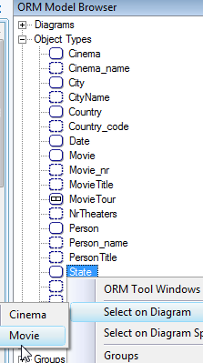
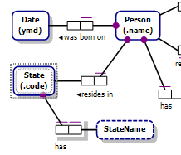
You can also access the Select on Diagram
feature from the Model Browser.
In the Model Browser,
expand Object Types,
then right-click State
and choose Select on Diagram
from its context menu.
Both pages are now listed indicating the
State shape appears on both pages.
Select Movie.
The Movie page now opens
with State highlighted.

Slide 12
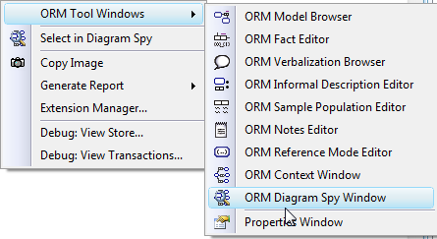
Using the Diagram Spy
The ORM Diagram Spy Window allows hyperlink navigation
through a model without changing the primary document window(s).
To open the Diagram Spy Window,
right-click a space in the Document Window
and from the context menu select
ORM Tool Windows > ORM Diagram Spy Window.

Slide 13
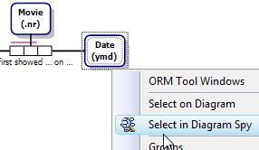
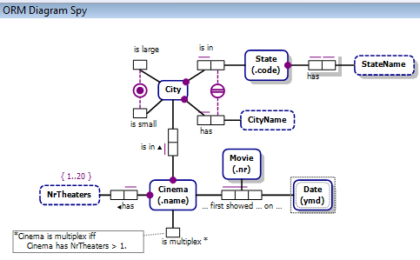
Select the Cinema page,
then right-click Date
and from its context menu
choose
Select in Diagram Spy.
The Cinema page now displays
in the ORM Diagram Spy Window
with the Date shape highlighted.
The Diagram Spy Window
respects the original diagram layout
and may be used to edit the
actual ORM model
unlike the Context Window
discussed later.

Slide 14

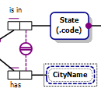
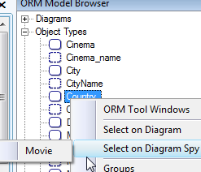

While in the Diagram Spy,
you can select any shape and
navigate to it on the document window,
e.g. right-click Cityname
and from its context menu select
Select in Document Window.
The CityName shape is now
highlighted in the document window.
You can also access the Diagram Spy Window from the Model Browser, e.g.
right-click Country then choose
Select on Diagram Spy > Movie.
Country is now highlighted in the
Diagram Spy Window.

Slide 15
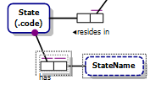


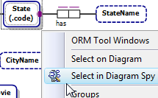

The Diagram Spy often provides the easiest way to
copy part of a model diagram onto another diagram¹.
On the Movie page in the document window
delete the predicate and object type shapes
duplicated earlier for “has StateName”
by selecting them and pressing the Delete key.
This removes the shapes, but
leaves model elements in the underlying model.
Open the Cinema page
right-click State,
and choose Select in Diagram Spy.
This opens a copy of the Cinema page
in the Diagram Spy with State selected.
¹ You can also use Window > New Window to open multiple views of the document
window, create new horizontal or vertical tab groups (see later), and copy elements
between these windows simply by dragging them.

Slide 16

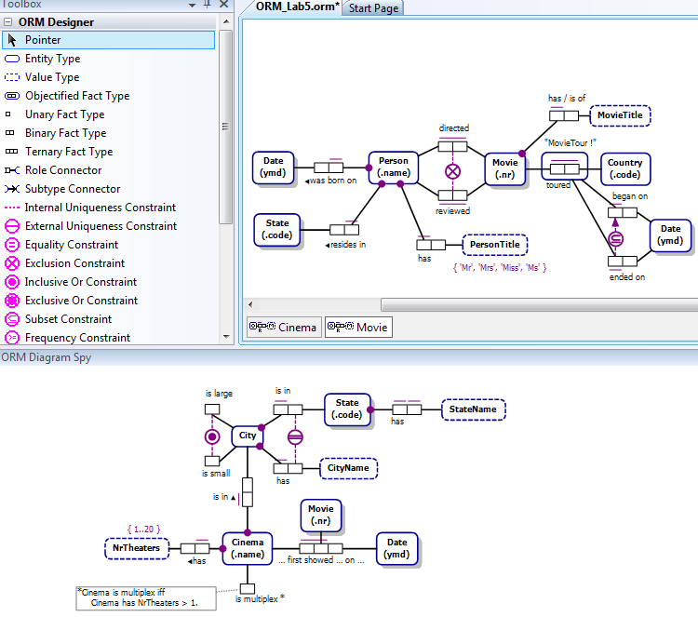
Select the Movie tab in the document window.
The Movie page now displays in the document window
while the Cinema page displays in the Diagram Spy.

Slide 17

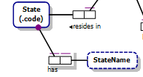
You can drag a copy of whatever shapes you like
from the Diagram Spy to the document window
simply by selecting them and dragging them there.
In the Diagram Spy, select just the shapes for
“has StateName” as shown
(do not select State).
Drag this selection onto the document window
positioning them as shown.
The shapes will automatically connect to State
as shown to complete the display of the fact type.
This is easier than dragging the predicate and
StateName shapes separately from the Model Browser
as we did earlier.

Slide 18
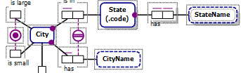
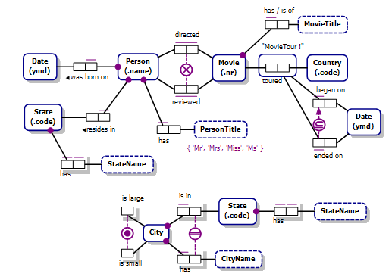
In the Diagram Spy,
select all the shapes shown here.
For practice,
drag them onto the document window.
Notice that the State has StateName
is now displayed twice on the same page.
We don’t really want those
extra shapes on the
Movie page,
so delete them
either by pressing Ctrl-Z
(or Edit > Undo from the menu)
or by selecting the shapes
and pressing the Delete key.

Slide 19
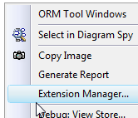
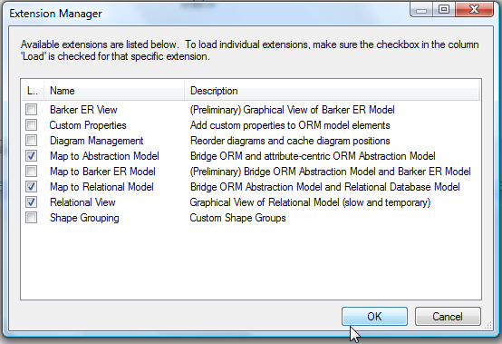

Using Multiple Windows
Right-click empty space on the document window,
choose Extension Manager form the context menu,
check the three boxes shown,
then press OK.
Select the Relational View
tab on the document
window
to view a
diagram of the
relational schema
generated.
Don’t worry about poor
generated names -- a later
Lab details how to
obtain better names.

Slide 20
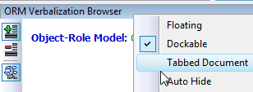
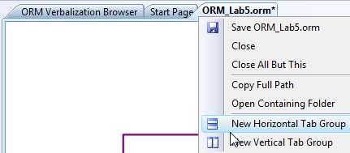
Change the Verbalizer window to
a Tabbed Document window
by right-clicking its header
and selecting Tabbed Document
from the context menu.
Right-click the header tab of the
main document window
and select
New Horizontal Tab Group.
Select the tab of the Verbalizer
window to see it displayed
above the relational diagram.

Slide 21
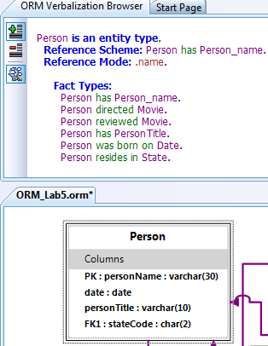
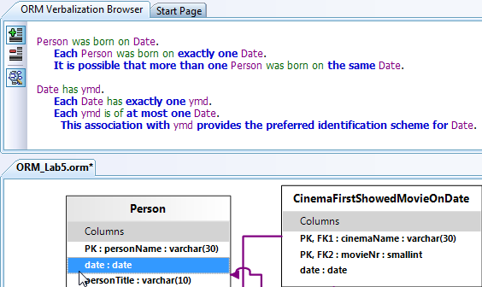
Select the Person table shape
in the relational view.
The ORM subschema underlying
this table scheme is now verbalized.
Select just the “date” column
to display its ORM verbalization.
Clearly, a better name for this column
would be “birthdate”.

Slide 22



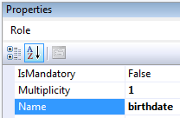

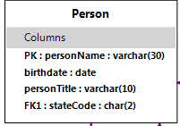
In the Verbalizer window
click the “was born on” predicate.
Though not shown here,
the cursor changes to a hand shape,
indicating this is hyperlinked.
The predicate now displays as
selected in the Diagram Spy.
In the Diagram Spy,
click the left-hand role.
In the Name field of its
Properties window
type “birthdate” as its role name
and press Enter to commit.
The new role name appears
on the Diagram Spy diagram
and replaces the old column
name in the relational view.

Slide 23


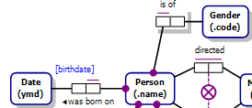
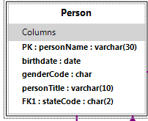

Now select Person in the Diagram Spy,
open the Fact Editor window and
complete the fact type entry shown
pressing Ctrl-Enter to commit.
In the Diagram Spy,
right-click the left-hand role of this
new fact type and use its context menu
to add a mandatory role and uniqueness
constraint to it. Then move and align the
shapes to the positions shown.
The Person table in the relational view is
automatically updated with an extra column
to cater for this new fact type.
Click the Movie tab of the document window
and note that the diagram there has been
updated to match the diagram in the
Diagram Spy.

Slide 24
This gives you some idea of the usefulness of viewing
multiple windows at once to see how they relate to one another,
and of using hyperlinks in the Verbalization Window
and Diagram Spy to navigate within models.
A later Lab will explain how to get finer control over
the names generated for tables and columns
in the relational schema.
NORMA supports the Windows Management features
that are standard in Visual Studio.
More details about these features may
be found in the Readme.htm help file
that is in the same folder to which you
extracted the NORMA setup files during installation.

Slide 25
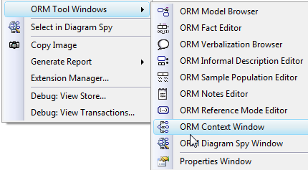
Using the Context Window
Large ORM Models may span many pages,
so it is handy to have easy ways to browse them.
The Context Window displays a subschema
based on one object type that is selected as the focus.
The Context Window is essentially Read-Only
so can’t be used to actually edit an ORM schema.
Open the Context Window
by right-clicking a space
in the Document Window
and selecting
ORM Tool Windows > ORM Context Window.

Slide 26


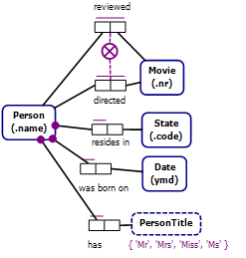
Now select the Movie page,
then select the Person shape.
By default, the Generations setting in the
Context Window is set to 1,
so the display shows all and only those
fact types in which the selected object type
(in this case Person) participates.
The autolayout is primitive,
so drag the shapes around
to make a neater display,
as shown.

Slide 27

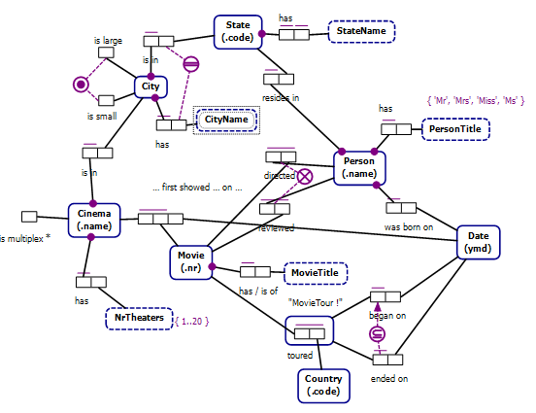
Change the Generations to 2.
The context expands to display more fact types further away from Person.
Again, the autolayout is poor, so move the shapes around as preferred.
Generations 0..3 are supported (0 displays just the focus object type).

Slide 28
You may also select the focal object for the Context Window
by selecting it in the Model Browser.
Shapes may also be copied from the Context Window
to the document Window
by dragging the selected shapes there from the Context Window.
This is especially useful when reverse engineering or importing a model,
as it provides a quick way to draw the diagram
(select the relevant focal element in the Model Browser,
select the shapes desired in the Context Window,
then drag them onto the relevant page of the Document Window).
Note: The current implementation of the Context Window performs
poorly with very large models, especially for selection changes.
It is generally best not to keep the generation set above 1 for any model.

