Slide 1

NORMA Lab. 6
Adding Sample Populations
Controlling Error Message Display
File: NORMA_Lab6.ppt. Author: T. Halpin. Last updated: 2009 June 12

Slide 2
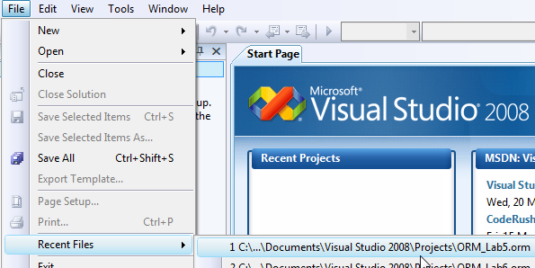
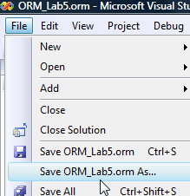
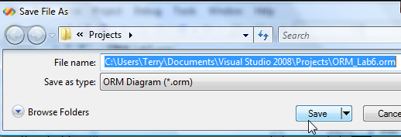
In Visual Studio, open the ORM file you worked on in Lab 5.
File > Recent Files > ORM_Lab5.orm
Save this new version as ORM_Lab6.orm:

Slide 3
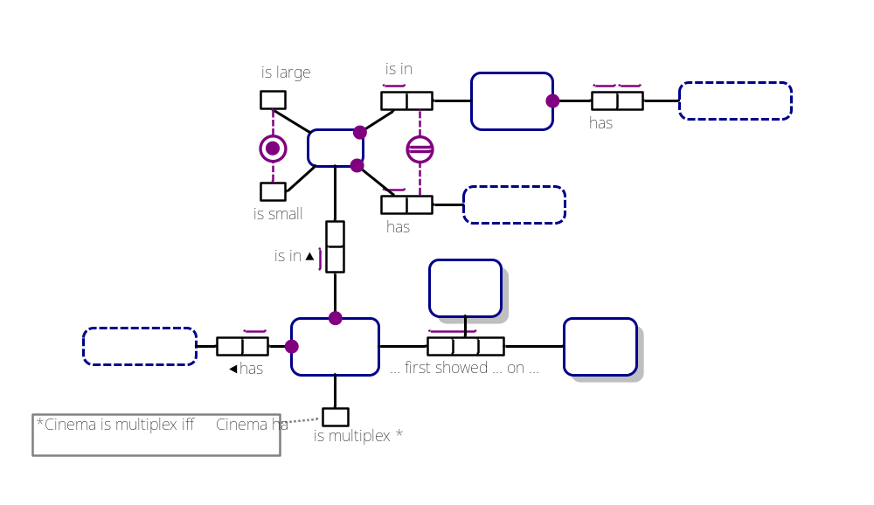
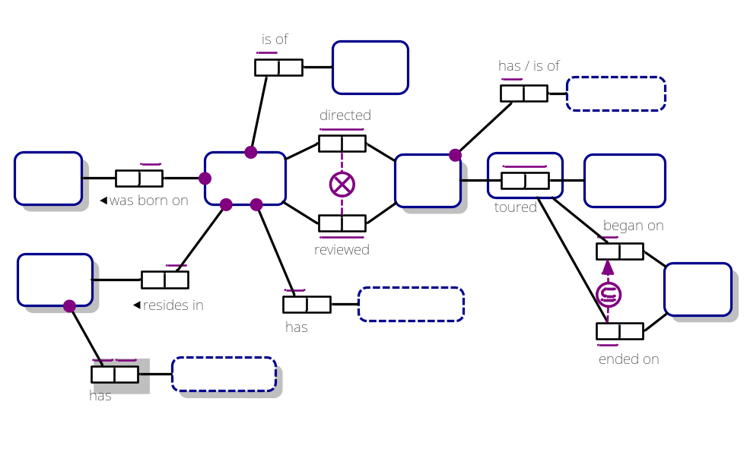
The ORM schema displays as the following 2 pages
(select the relevant document window tab to see the relevant page):
Cinema:
Movie:

Slide 4
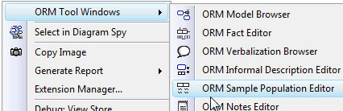

Adding Sample Populations
The ORM Sample Population Editor allows you to enter sample data
for both object types and fact types. Along with verbalizations,
sample populations can help you validate models with domain experts.
If the Sample Population Editor is not already available via a window tab,
open it by right-clicking an empty space in the document window
and choosing
ORM Tool Windows > ORM Sample Population Editor.
A window for this editor now appears.

Slide 5




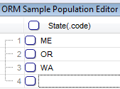
On the Cinema page of the document window,
select the State entity type.
The Population Editor displays an entity type shape
and its reference scheme “State(.code)”,
with row 1 ready for you to enter a sample instance.
Type “ME” (for the US state of Maine) on row 1,
then press the Enter key to add it.
NORMA accepts the entry and displays a new row
(row 2) for you to add another state code.
In a similar manner,
enter “OR” (for Oregon)
and “WA” (for Washington State).
NORMA displays row 4 ready for another entry,
but just leave it empty for now.
You can display a type’s population at any time later
by selecting the type and viewing the population editor.

Slide 6


State’s role in the fact type State has StateName
now displays with red fill, indicating an error.
Can you guess why?
Right-click the role, and select Validation Errors to see the error message.
Because this role is mandatory, each instance in the population of State
must have a StateName. But we have violated this rule three times.
To correct the error, we must supply a name for each state.
You could enter the three relevant state names by populating the
object type StateName (the population editor would then display
a dashed shape indicating a value type).
But this would not be enough,
because we have to associate each state with a state name.
So we need to populate the fact type itself,
by populating each of its roles.

Slide 7


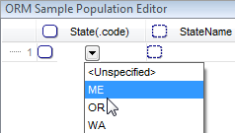


Select just the predicate shape
(not the whole fact type).
The Population Editor now displays a column
for each of the two roles. You can adjust the
width of the table and columns by dragging their
boundary lines.
Place the cursor in the State cell of row 1.
Enter “ME” using any of these three ways:
  Type “ME” and press Enter.
  Select “ME” from the drop-down list
  and double-click it.
  Select “ME” from the drop-down list
  and press Enter.
In the StateName cell on row 1,
type “Maine” and press Enter to complete
the first fact instance.

Slide 8
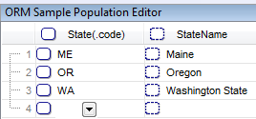

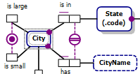

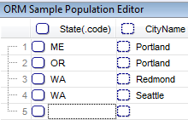
Similarly, enter the other two fact instances
shown.
Each of the three sample states now has a name.
So the error state has been corrected,
and the red error fill vanishes.
As shown in the schema,
each city is identified by combining
its state with its city name.
Select City.
The Population Editor displays two columns,
one for each part of a city’s identifier.
Enter the state code and city name
for the four cities shown.

Slide 9
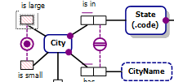
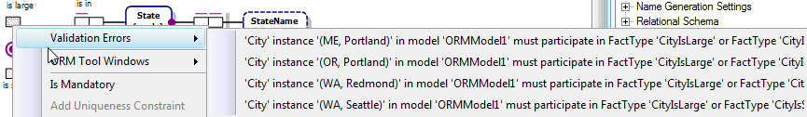
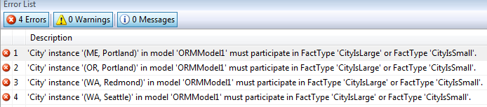
The unary predicates played by City
are now in an error state.
Why?
The inclusive-or constraint (circled dot)
requires each city to be large or small.
If you right-click one of the roles, and choose Validation Errors,
you get a truncated error message:
To see the full error message, open the Error List window at the bottom.

Slide 10
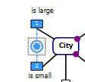
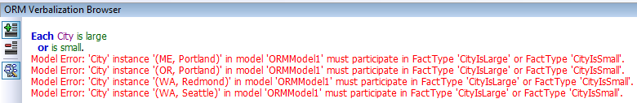
Select the inclusive-or constraint
and open the Verbalization Browser.
The constraint is verbalized,
and the model errors are listed.
In the verbalization, “or” means inclusive-or,
which allows a city to be simultaneously small and large.
This is not possible, so we should strengthen the inclusive-or
to an exclusive-or.
To do this, we could delete the inclusive-or
and replace it with an exclusive-or constraint,
but let’s instead just add an exclusion constraint
and then collapse the two constraint shapes to one
(see next slide).

Slide 11
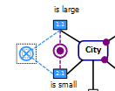




Drag an exclusion constraint shape
from the toolbox and apply it to the two roles
(as explained in Lab 4).
Then shift-select both roles,
right-click, then from the context menu choose
Combine as Exclusive Or Constraint.
The exclusive-or constraint now displays
as a single shape.
Select the xor constraint
and view its verbalization.
This is what we want¹,
so we will now populate the unary predicates,
ensuring that each of our 4 cities
is entered for exactly one (one and only one)
of the “is large” and “is small” roles.
¹If you want more city sizes, add another unary (e.g. is medium size) under the xor constraint,
or replace the unaries by a single binary City has CitySize(.name) { ‘small’, ‘large’, ‘medium’}

Slide 12

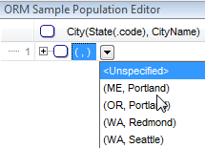

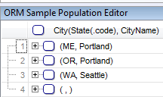
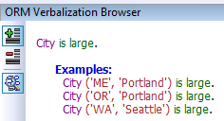
Select the “is large” predicate
then select Portland, Maine
(ME, Portland)
from the drop-down list in the
Sample Population Editor
and press Enter
(or double-click it)
to add it to the role population.
Similarly, add
(OR, Portland) and
(WA, Seattle)
to the population of large cities.
Open the Verbalization Browser
to see the fact type verbalized
together with its three
fact instances.

Slide 13

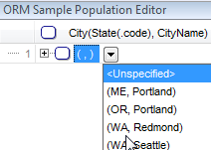

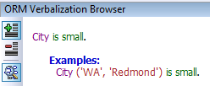
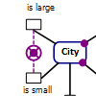
Select the “is small” predicate
then select Redmond, Washington State
(WA, Redmond)
from the drop-down list in the
Sample Population Editor
and press Enter
(or double-click it)
to add it to population
of small cities.
View its verbalization.
Note that the error fill on the unary
predicates has disappeared,
since the exclusive-or constraint
is now satisfied by the sample data.

Slide 14


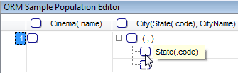


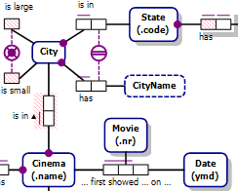
Select the fact type “Cinema is in City”.
In the Sample Population Editor,
click the “+” symbol in the City field
to expand its inline identifier to see
shapes for both component object types.
Hovering the cursor over a shape
displays its meaning.
Enter “GA” (for Georgia) in the State field.
Enter Atlanta” in the Cityname field.
Notice the red fill indicating that
four predicates are now in an error state,
because you just entered a city and a state
without satisfying their mandatory role
constraints, and you entered just part of
a “Cinema is in City” fact
(the entry for Cinema is missing).

Slide 15

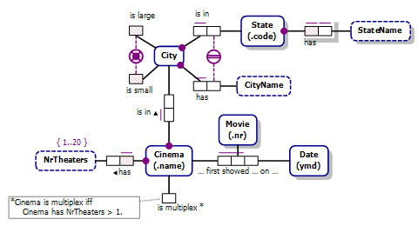
Enter “Plaza Theatre” in the Cinema field
to complete the sample fact instance.
This removes the red error fill on Cinema’s role in that fact type
(since its mandatory role constraint is now satisfied)
but a new error is displayed on Cinema’s role in the NrTheaters
fact type, because its mandatory role constraint is violated.
We will now fix those four population errors.

Slide 16

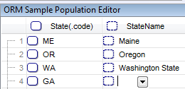
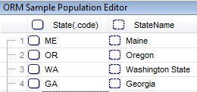




Double-click State’s role in
State has StateName.
NORMA automatically inserts “GA”
in the State column, and places the
cursor in the StateName column
ready for you to enter a state name.
Type “Georgia”
and press the Enter key.
The error fill on the StateName
fact type disappears,
since its mandatory role constraint
is no longer violated.
Similarly, double-click Cinema’s role
in the NrTheaters fact type,
and enter “2” in the NrTheaters field
to complete the fact instance,
thus removing another error.

Slide 17


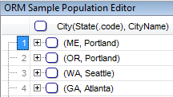

The “is large” and “is small” roles still have red fill,
because the inclusive-or part of the
exclusive-or constraint is violated
(The city Atlanta, Georgia is not classified as large or small).
Atlanta, Georgia is a large city,
so we need to add it to the population of
City is large.
Double-click the “is large” role
to automatically populate it with
the city whose absence is causing the error
(in this case, Atlanta, Georgia)¹.
The error is now fixed.
Pretty cool, eh?
¹ In general, double-clicking an error display performs the same action as
selecting an error that supports automatic activation from the dropdown list.
You can also activate errors using hyperlinks in the Verbalization Browser,
or by double-clicking in the Error List.

Slide 18



Now, select the Movie tab
on the Document Window
to display the Movie page.
Then select MovieTour.
All compositely identified entity types,
whether co-referenced (e.g. City)
or objectified (e.g. MovieTour)
may be populated in a similar way.
With MovieTour selected,
the Sample Population Editor
displays two columns,
one for each component.
If you wish, you could populate it in
similar way to how we populated City.

Slide 19

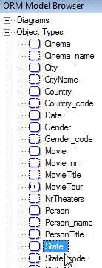


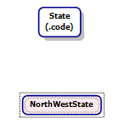
To see how to populate subtypes,
let’s add a subtype to the model.
Open a new ORM diagram page
by right-clicking the Movie tab
then selecting New Page > ORM Diagram.
Drag a copy of State
from the Model Browser
to this new page.
Open the Fact Editor
type “NorthWestState”
and press Ctrl-Enter to add it
as an entity type to the model,
then move the new shape
below the State shape
as shown.

Slide 20

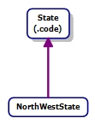

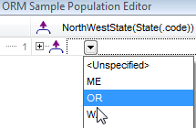

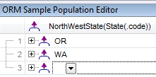
Select the Subtype Connector
from the Toolbox,
then click NorthWestState
then click State
to add the subtyping relationship shown.
Select NorthWestState
and open the Sample Population Editor.
It now displays a subtyping shape
to indicate a subtype is to be populated.
Click the down-arrow to open
the drop-down list, and you will see
the supertype (State) instances listed.
Double-click “OR” to enter Oregon
as a northwestern state.
Similarly, add Washington State (WA)
to the population of northwestern states.

Slide 21
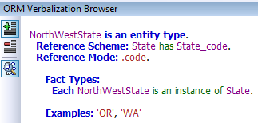
Do not add Maine (ME) or Georgia (GA) to this population
since they are respectively northeastern and southeastern states.
With NorthWestState selected,
open the Verbalization Browser
to see the verbalization
of the subtyping connection
as well as the instance data.
In this case, NorthWestState is an asserted subtype
(its instances are simply asserted rather than derived)
which is obvious from the lack of an “*” on the Subtype.
If desired, you could add a fact type such as
State is in Region(.code)
and provide a derivation rule
(e.g. *Each NorthWestState is a State that is in Region ‘NW’.)
to make the subtype derived instead of asserted.

Slide 22

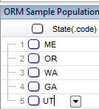
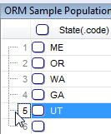
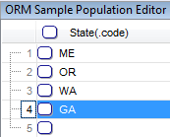
Deleting entries in the Population Editor
is straightforward. Let’s practice that now.
Select State.
Add “UT” (for Utah) to its population.
Place the cursor in the row number column
beside the “UT” entry.
Press the Delete key,
to delete the entry.
Alternatively, select the cell with the entry
and press Delete.
As a final note on the Population Editor, function key F2 may be used
to activate in-place editing (it works in the Model Browser as well).
Using F2 (plus Alt-Down to open the dropdowns)
allows full keyboard navigation without touching the mouse.

Slide 23
Controlling Error Message Display
Although sample data are useful for validating models,
it can be annoying to see the model in an error state
simply because you haven’t supplied sufficient data to
satisfy all the constraints.
Similarly, you might know the model is in an incomplete state
(e.g. you just introduced an entity type with no reference scheme,
but you plan to add that later)
and don’t want NORMA to display this as an error state.
By default, NORMA displays all errors.
However, it allows you to toggle on/off
the display of various categories of errors.

Slide 24



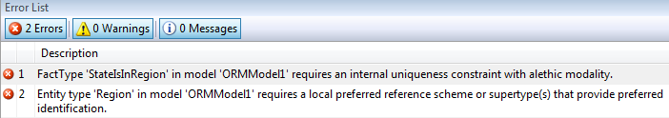
Select the State shape on the new page,
open the Fact Editor
and complete the fact type entry
“State(.code) is in Region”
without giving Region a reference scheme.
Press Ctrl-Enter to commit.
The predicate displays with red lines around it
and Region displays with red fill,
indicating errors.
You may view the two error messages
in the Error List window.

Slide 25

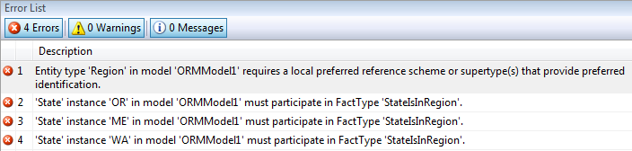
Right-click the left role,
and use its context menu
to add uniqueness and mandatory role
constraints to it, as shown.
This removes the first error (missing uniqueness constraint)
but added three more errors because the population includes
three states that do not play the mandatory role.

Slide 26
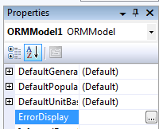
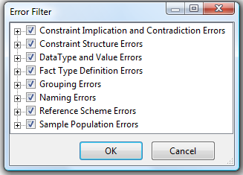
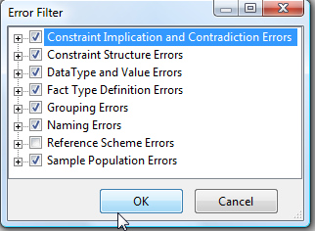

To control error display on the diagram,
click any empty space on the Document Window,
then in the Properties Window
click the ellipsis “…” button
at the right of the ErrorDisplay field.
The Error Filter dialog is now displayed.
To turn off display of all reference scheme
errors, uncheck the check box for
Reference Scheme Errors
and press OK.
Region now displays without red error fill,
and the missing reference scheme error
message is removed from the Error List
display.

Slide 27
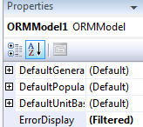
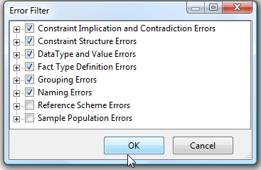


The ErrorDisplay field in the Properties Window
now indicates “(Filtered)”
to indicate not all errors are displayed.
Press the “…” button again,
uncheck Sample Population Errors
and press OK
to suppress display of population errors.
The predicate now displays with no
red error marks,
and the Error List displays as empty.

Slide 28
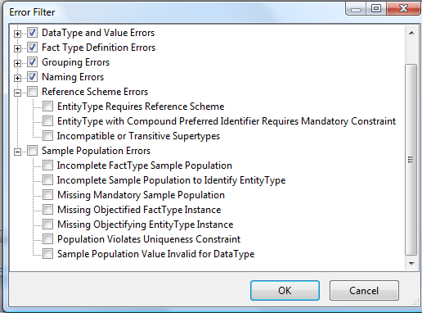
You can gain finer control of error display
by expanding the top level error categories
(click the “+” in front of the error category)
and unchecking just some of the subcategories.
e.g. the subcategories for reference scheme and
sample population errors are as shown.

Slide 29
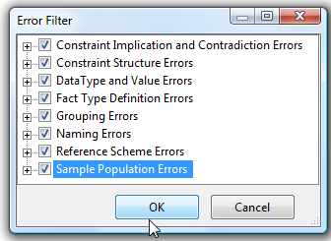

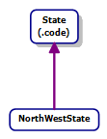
Turn all error display on again
by checking the relevant options
and pressing OK.
The red fill reappears and the
error messages reappear in the
Error List.
As this was just for practice,
delete “is in Region”
by selecting it, pressing Delete,
and answering Yes to the two
delete prompts.
Now save your work
and exit to complete Lab 6.

