Slide 1

NORMA Lab. 7
Generating Reports
More Display Options
File: NORMA_Lab6.ppt. Author: T. Halpin. Last updated: 2009 June 9

Slide 2
In Visual Studio, open the ORM file you worked on in Lab 4.
File > Recent Files > ORM_Lab4.orm
If this file is not listed in your recent files,
use Windows Explorer to locate the file
(e.g. in the Projects folder
within the Visual Studio 2008 (or 2005) folder)
then double-click the file to open it.

Slide 3
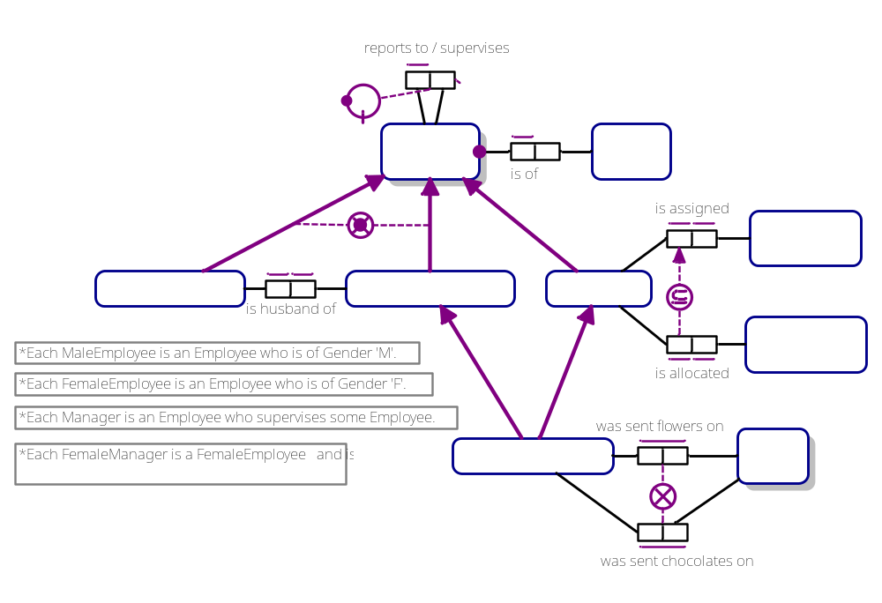
The ORM schema displays as the following 2 pages
(select the relevant Document Window tab to see the relevant page):
EmployeeSubtyping:

Slide 4
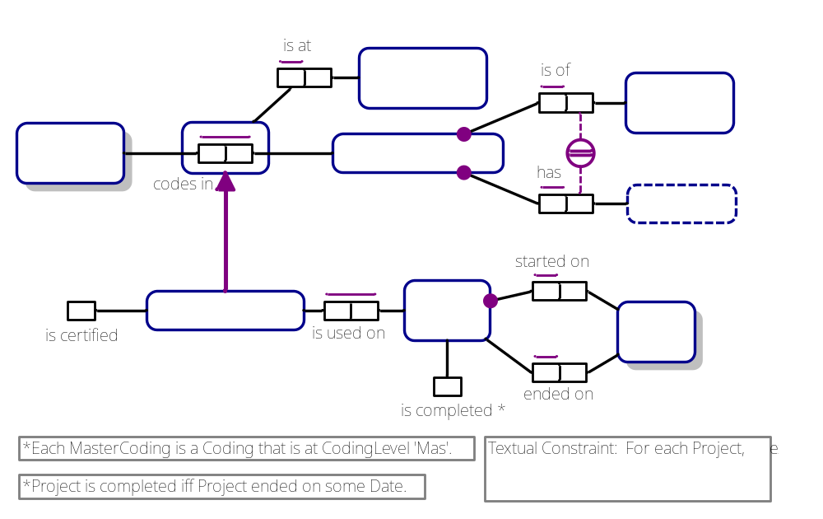
Coding&Projects:

Slide 5
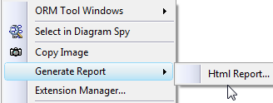
Generating Reports
For the purposes of model review and validation by domain experts,
the Verbalization Report Generator can be used to verbalize and
print ORM models in a textual form that can be readily understood.
Check boxes are included to indicate agreement.
Let’s first create a folder to store your NORMA Reports.
In Windows Explorer, right-click a parent folder of your choice
(e.g. Documents) then from the context menu
choose New > Folder
then rename the folder called “New Folder”
as “NORMA Reports” (or whatever you wish).
To open the Report Generator,
right-click an empty space
in the Document Window,
and from its context menu
select Generate Report > Html Report…

Slide 6
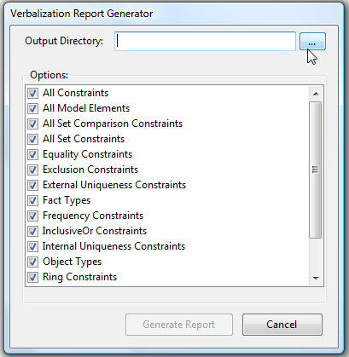
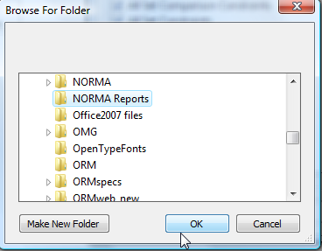
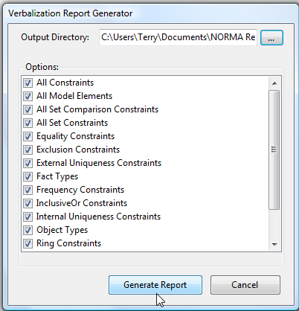
The
Verbalization Report Generator
dialog appears.
Press the “…” button,
browse to your reports folder,
then press OK.
Your report folder is
now listed as the
Output Directory.
Check boxes allow you to
control what is included
in the report.
By default, all boxes are checked.
Accept this default,
and press the
Generate Report button.

Slide 7
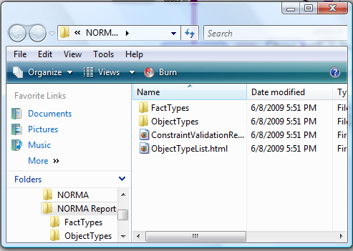
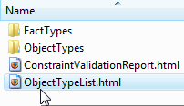
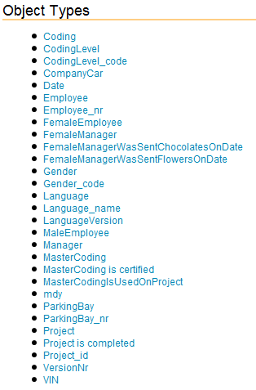
The report is now generated
(it might take a few seconds).
An Explorer Window appears
with the generated results
placed in your report folder.
Double-click the file
ObjectTypelist.html
to open the
Object Type List.
A list of the object types
in your model
is now displayed
in alphabetical order
in your Web Browser.

Slide 8

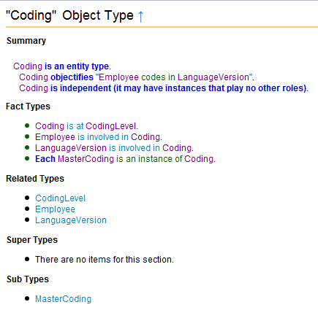
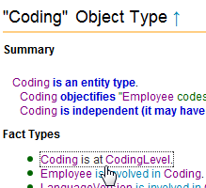
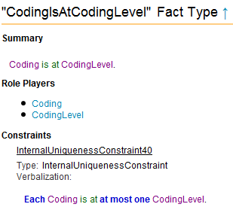
The report contains hyperlinks for navigating around the ORM model.
If the cursor becomes a hand shape when you hover over a model element,
you can simply mouse-click to jump to details for that element.
For example, click “Coding”.
A page about Coding now appears.
Click “Coding is at CodingLevel”.
A page about that fact type appears.

Slide 9
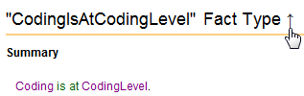
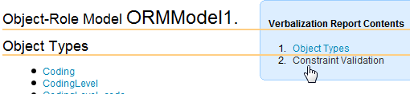
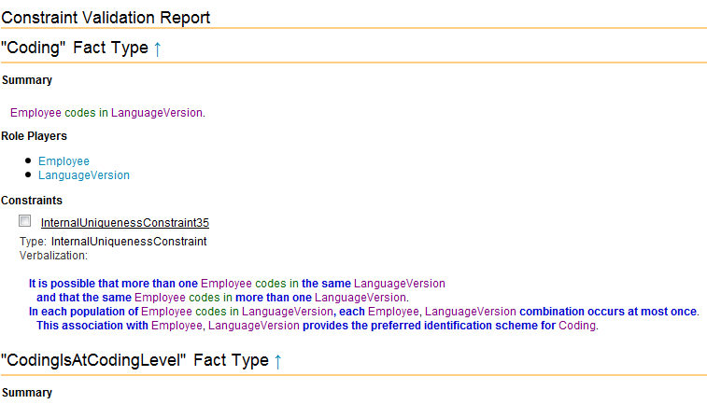
Click the up-arrow on the header
to return to the top level of the report.
Click “Constraint Validation”
to open the
Constraint Validation Report¹.
All the fact types in the model are listed in alphabetical order,
as well as their constraints.
A check box is placed
beside each constraint
so the reviewer may
indicate whether he or she
agrees with the constraint.
¹ You can also open this report by double-clicking ConstraintValidationReport.html
in the report folder.

Slide 10
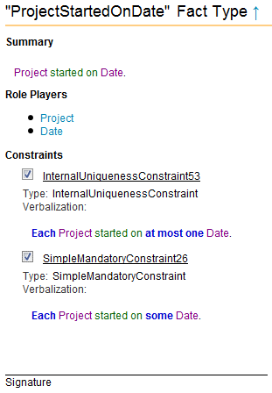
As with the Object Type report,
you can navigate via hyperlinks
by clicking the desired element.
Scroll to the bottom of this report.
For practice,
check the two constraints
to show you agree with them.
Notice the Signature line.
This is for the reviewer to
sign on a printed version
of the report,
after checking all the boxes
for the constraints that he or she
agrees with.

Slide 11
You can print the html report
from your Web Browser.
If you wish to have a copy of the
report in other formats,
return to the top level of the report,
press Ctrl-AC to copy it to the clipboard,
open your word processor (e.g. Microsoft Word)
and paste the report into it.
You can now save and print the report
from your word processor.

Slide 12
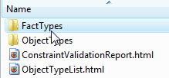

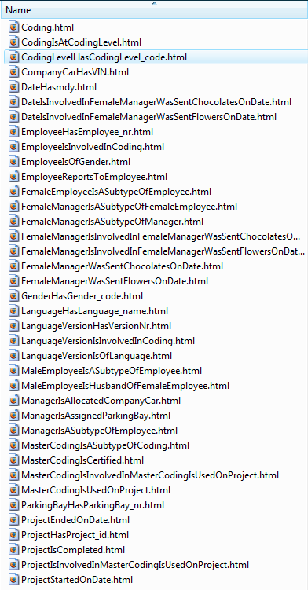
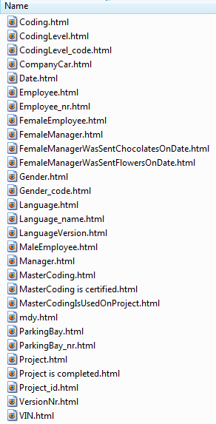
The Reports folder
includes two subfolders,
one for fact types
one for object types.
Double-click a folder
to get a list of its
element files.
Double-click any file
to view its details.

Slide 13
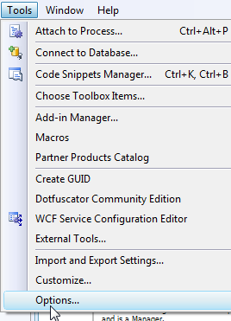
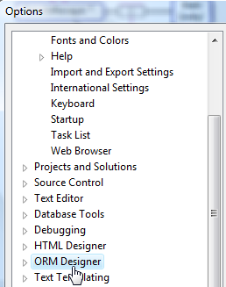
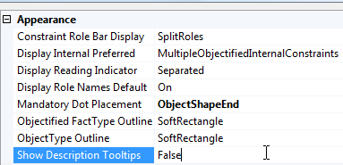
More Display Options
In Visual Studio, with ORM-Lab4 open,
from the main menu choose
Tools > Options…
to open the Options dialog.
Scroll down, and select ORM Designer.
In the ORM Designer pane, scroll to Appearance,
and double-click the Show Description Tooltips property
to toggle it from False
to True, then press OK.

Slide 14

On the EmployeeSubtyping page,
hover the mouse over the ParkingBay shape.
A tool tip now appears to display the
Informal Description for ParkingBay
that your entered in Lab 4.
If you add informal descriptions to
other shapes,
you can display them too by a mouse hover.

Slide 15
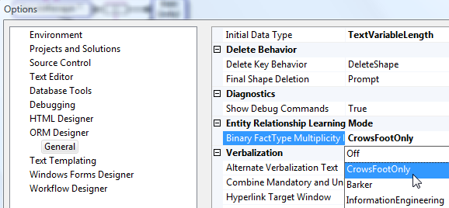
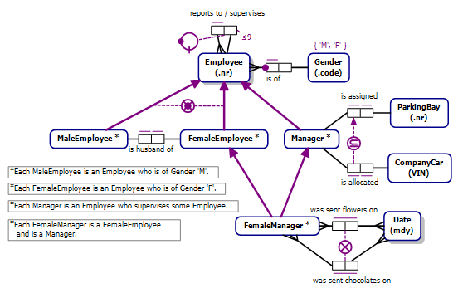
Open the ORM Options dialog again
(Tools > Options > ORM Designer)
and select the property
BinaryFactTypeMultiplicity.
By default, this is turned Off.
Select CrowsFootOnly
from the drop-down list
and press OK.
Binary fact types on the model
now display with a crowsfoot
to indicate the “many”
end of the relationship.
This is sometimes helpful
for people more familiar
with Entity Relationship
(ER) modeling.

Slide 16
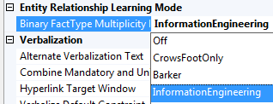
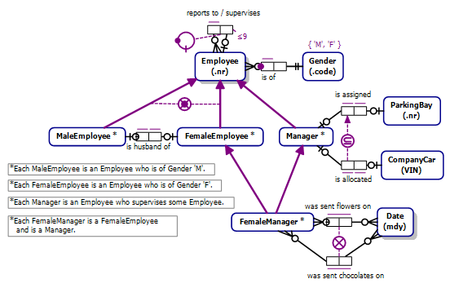
Go to the ORM Options dialog again
and this time select
InformationEngineering.
In addition to crowsfeet,
O and 1 symbols are added to
indicate minimum and maximum
multiplicities.
This can be helpful
for users more familiar
with IE notation.

Slide 17
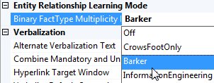


Go to the ORM Options dialog again
and this time select
Barker.
In addition to crowsfeet,
a dashed line indicates an optional role
and a solid line indicates a mandatory role.
This can be helpful
for users more familiar
with Barker ER notation¹.
Change the option setting
back to Off
to return to the usual
ORM display.
Exit to complete the Lab.
1 An incomplete Barker ER view can also be seen by checking Barker ER View
in the Extension Manager, but this is still a work in progress.

