Slide 1

NORMA Lab. 1 (new)
Installing Visual Studio 2017, 2019 or 2022
Installing NORMA 2017, 2019 or 2022
Entering a simple ORM schema
Generating a Relational View
Generating DDL code
Generating other code
Notes:
This new lab focuses on NORMA for Visual Studio 2017, 2019 and 2022.
For earlier versions of NORMA, use the old NORMA Lab 1, which was
designed using NORMA for Visual Studio 2015.
Some of these slides have additional comments.
File: NORMA_Lab1_new.pptx. Author: T. Halpin. Last updated: 2025 July 24

Slide 2

Installing Visual Studio 2017, 2019 or 2022
Natural ORM Architect (NORMA) supports ORM 2 (Object-Role Modeling, version 2).
NORMA requires prior installation of Microsoft Visual Studio
(2005 or later, viz. 2008, 2010, 2012, 2013, 2015, 2017, 2019, or 2022).
The Community Edition of Visual Studio 2015 through 2022 is freely available for most users, and may be downloaded from
https://visualstudio.microsoft.com/vs/community/
Download the 2022 version unless you want an earlier version.
Right-click the downloaded file,
and choose Run as administrator.
During the installation, include any additional workloads of interest to you, e.g.
.NET desktop development
ASP.NET and web development

Slide 3
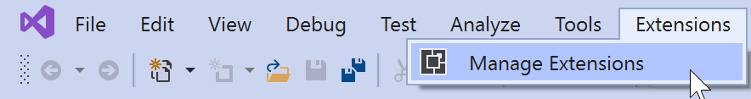
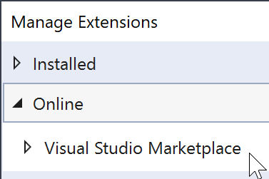
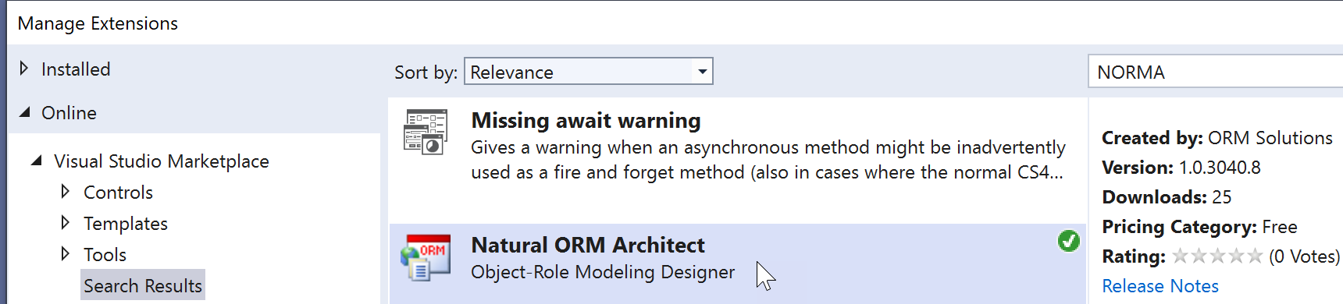
Installing NORMA 2017, 2019 or 2022
Public builds of NORMA are available as a free plug-in to Visual Studio.
The official version of NORMA from ORM Solutions (https://ormsolutions.com/) is compiled from open-source code at https://github.com/ormsolutions/NORMA. You can also enter discussion issues there, and this is the quickest way to get feedback on changes.
To install NORMA 2017, 2019 or 2022 from ORM Solutions, proceed thus.
Open Visual Studio
Click Extensions >
> Manage Extensions
> Online > Visual Studio Marketplace
Enter “NORMA” in the Search field and select Natural ORM Architect.

Slide 4
Entering a simple ORM schema
Reference schemes: Patient(.Nr); PatientName(); Drug(.Name)
Fact types: Patient has PatientName.
Patient smokes.
Patient is allergic to Drug [allergy].
Constraints:
Each Patient has exactly one PatientName.
It is possible that the same Patient is allergic to more than one Drug
and that more than one Patient is allergic to the same Drug.
Notes:
Consider the sample forms about medical patients. Conceptually, each form involves 3 elementary fact types, as shown. Each patient has exactly one (at least one and at most one) patient name. A check box is used to indicate whether a patient smokes. A person may have zero or more drug allergies, and vice versa – this many-to-many nature of the relationship may be verbalized as shown. The ORM conceptual schema is specified in textual form.

Slide 5
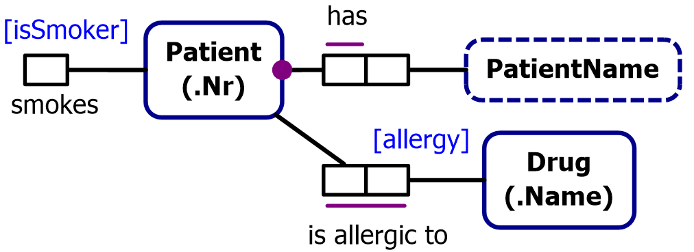
This is the ORM schema.
We will now enter it into NORMA
and then generate a database schema from it.
We will begin by creating the ORM file,
and later adding it a project (needed to generate DDL code).

Slide 6
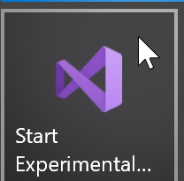
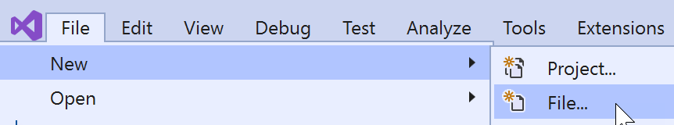
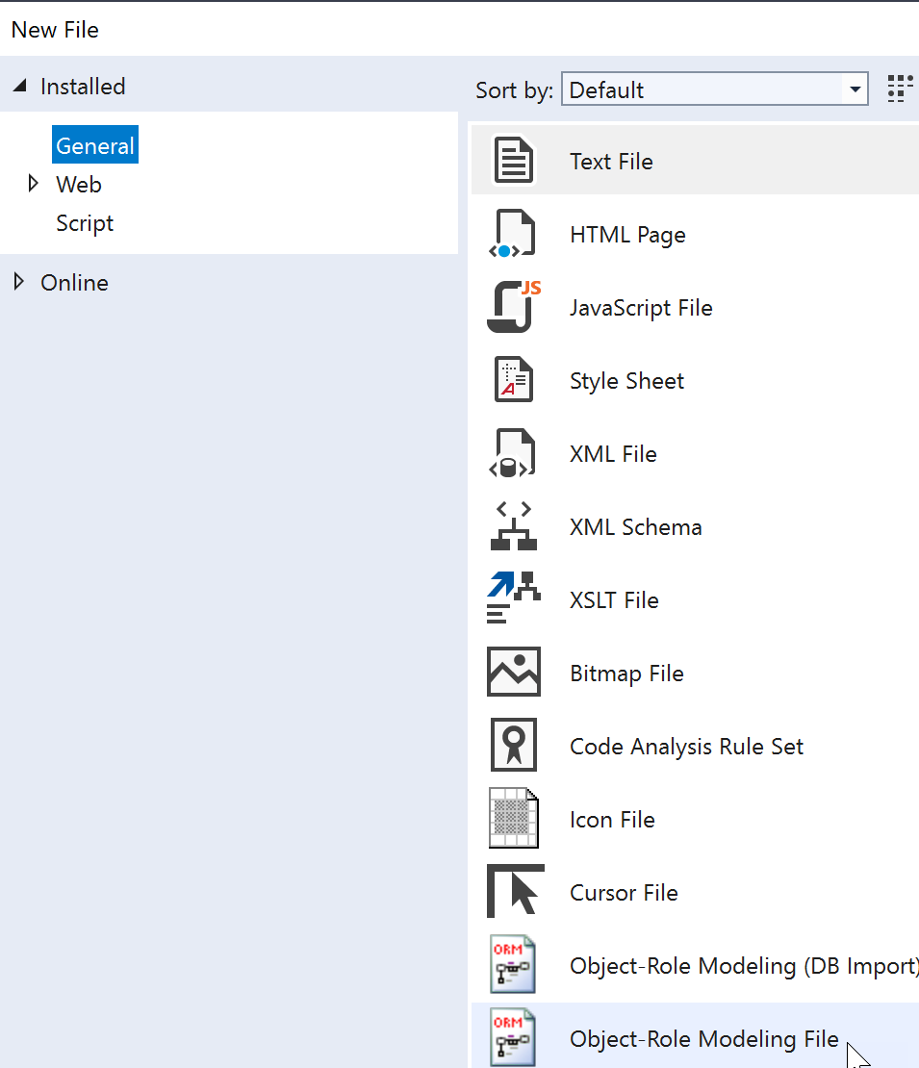

Launch Visual Studio.
Select File > New > File.
Select General
> Object-Role Modeling File.
Then click Open.

Slide 7
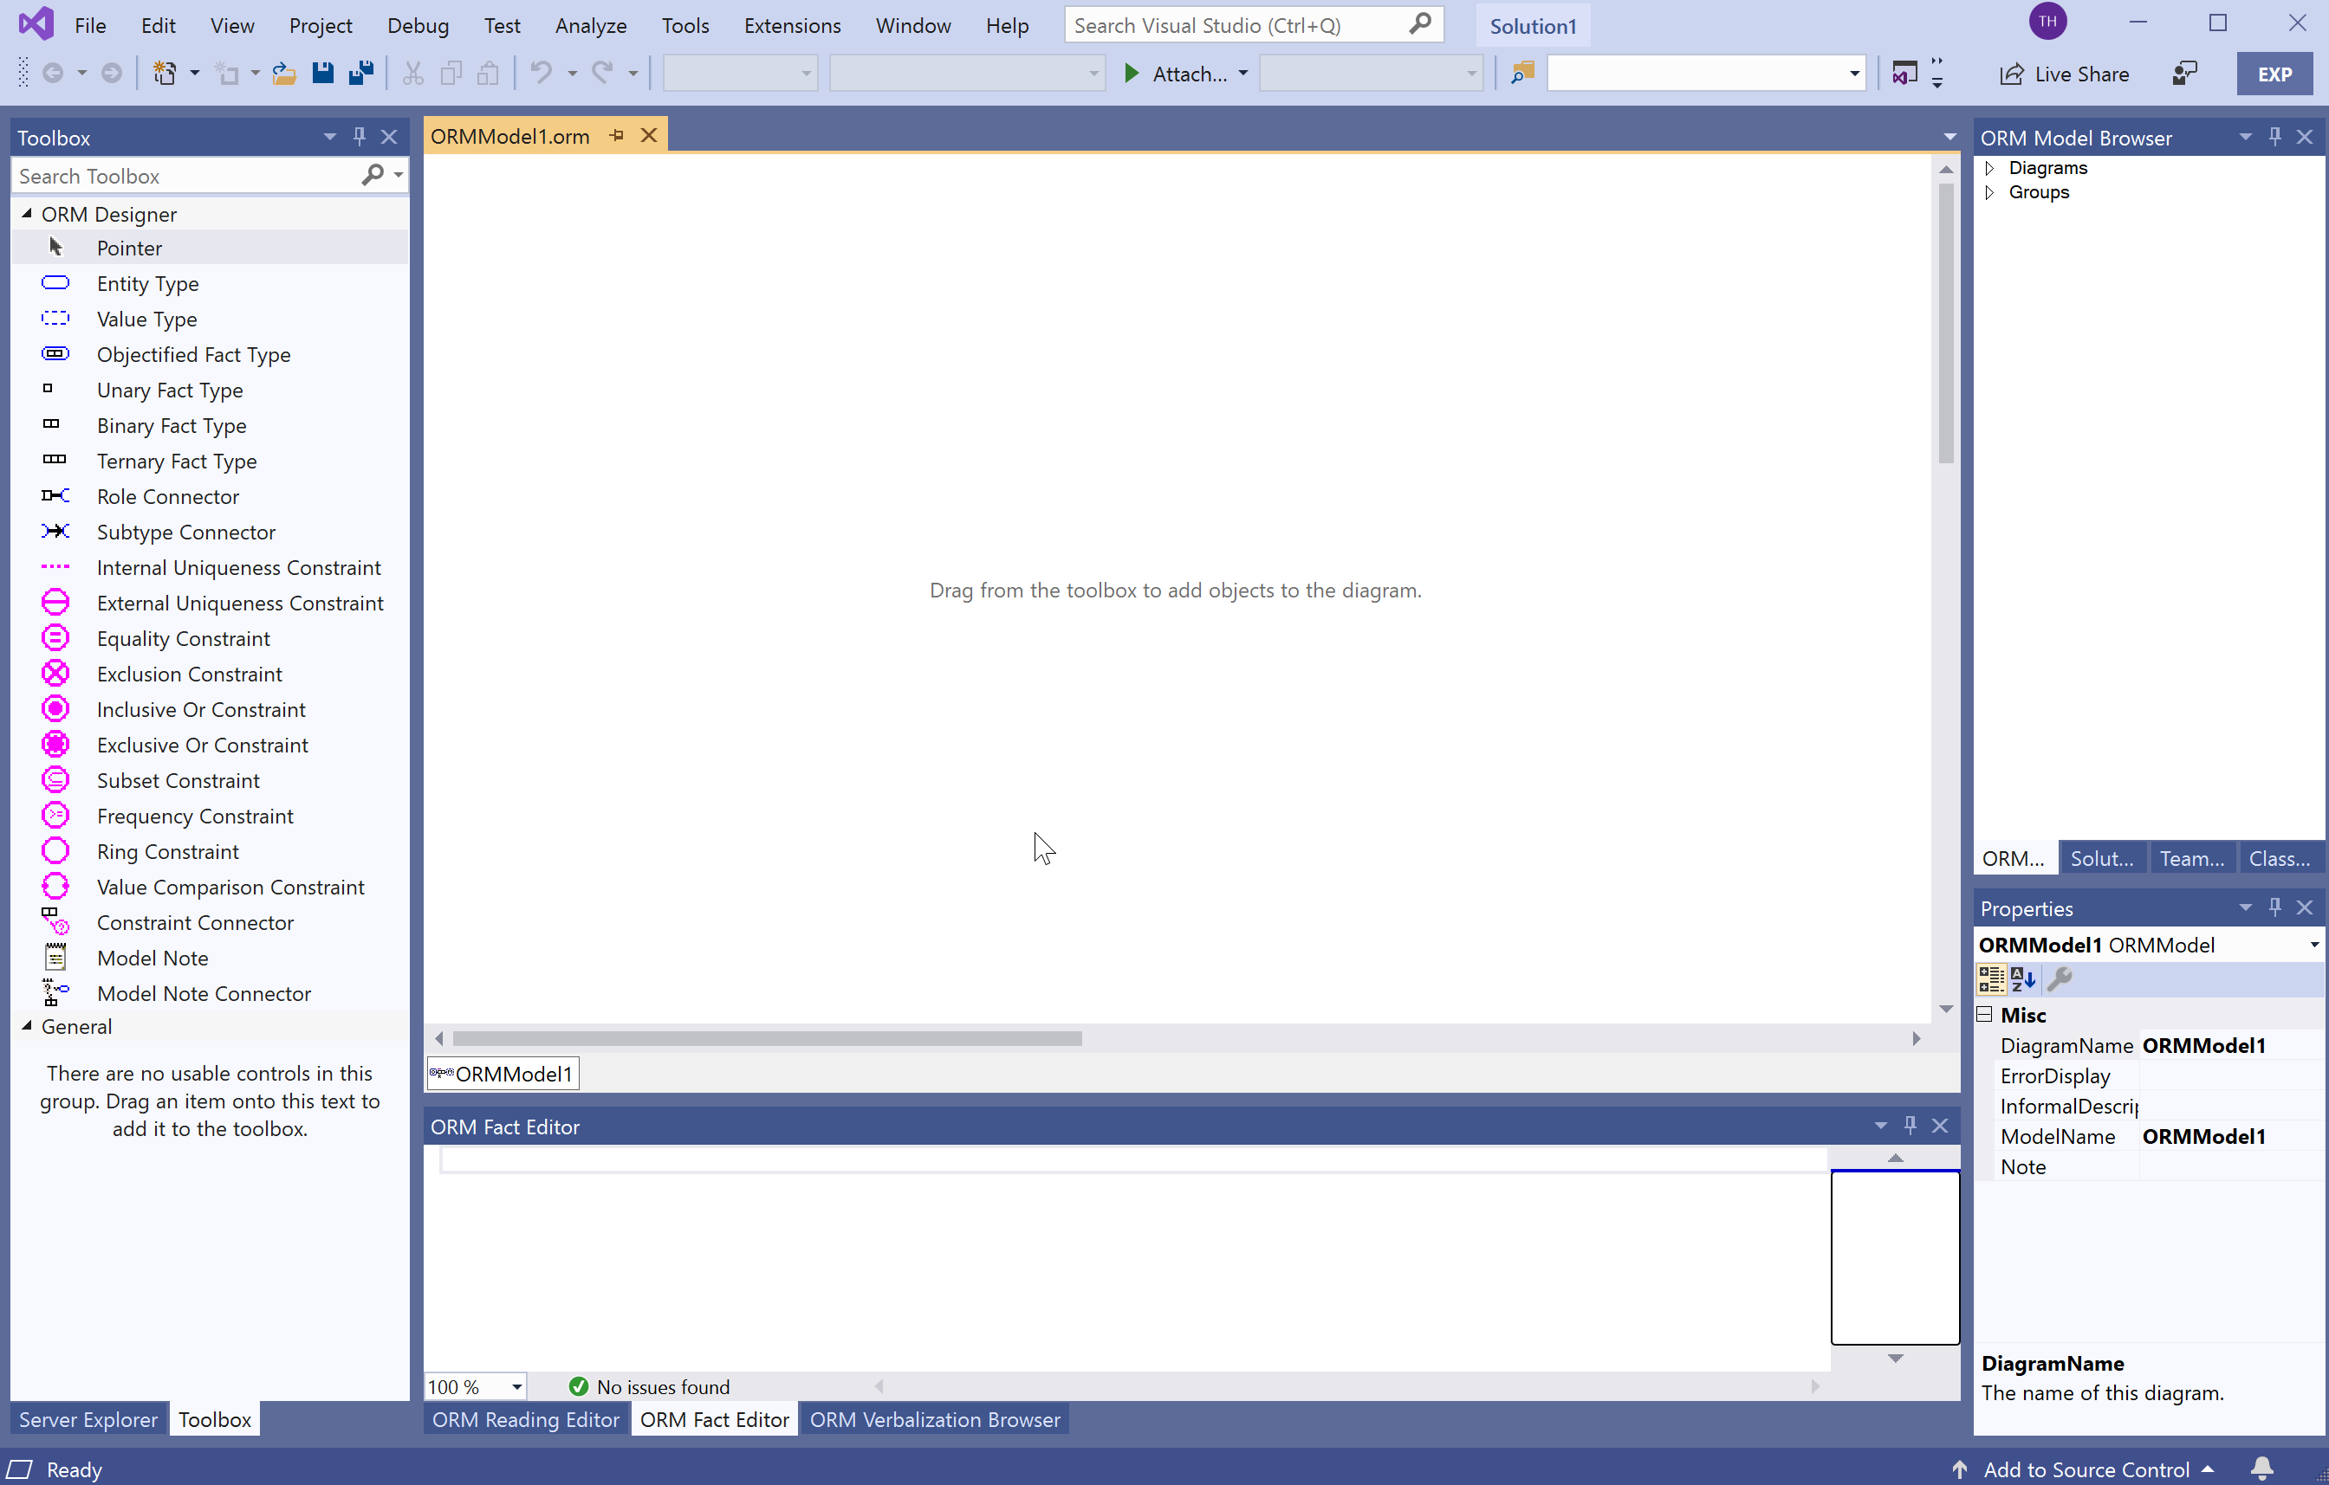
This displays the ORM Document Window,
and possibly the ORM Toolbox and other windows if used previously.
This is the Document Window
for displaying the ORM diagram.

Slide 8
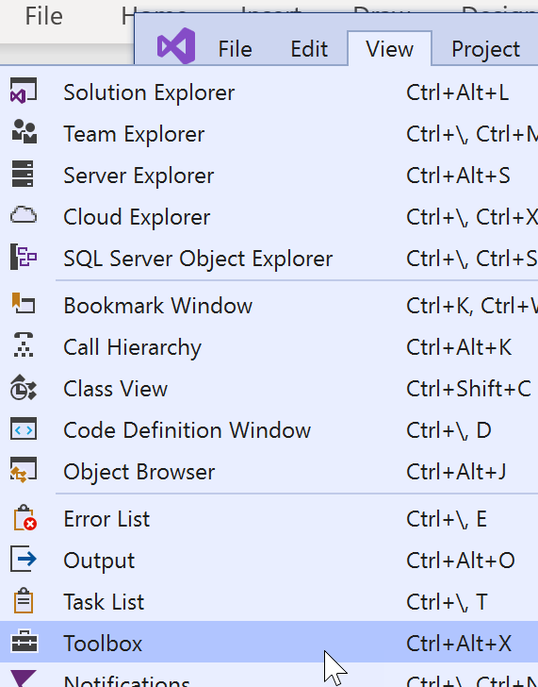
The first time you open NORMA,
you won’t see the Toolbox and some additional windows.
To open the ORM Toolbox, go to the main menu at the top
and select View > Toolbox.

Slide 9
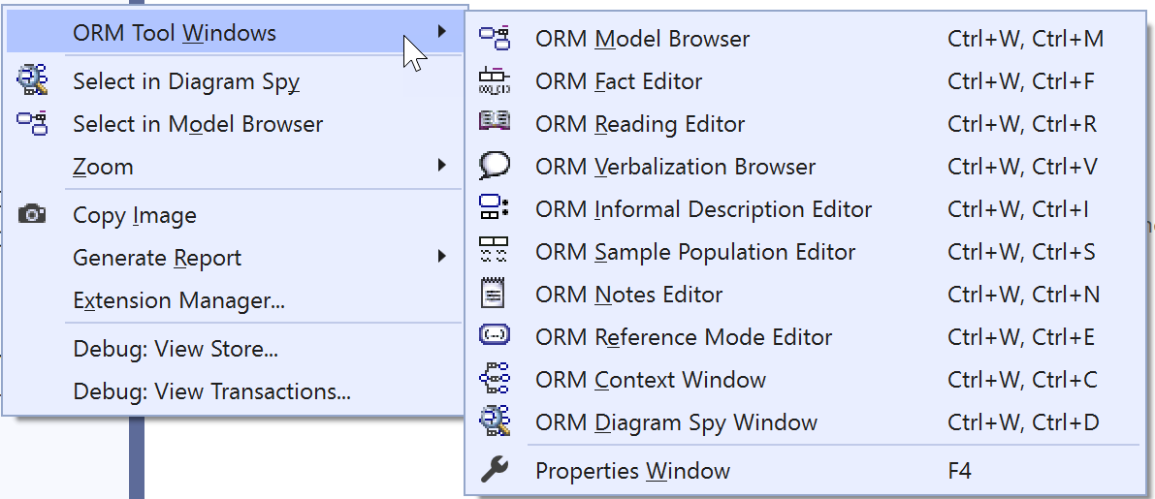


To see all available windows, right-click an empty space in the document window.
This context menu appears.
If the ORM Model Browser, Fact Editor, Verbalization Browser and Properties Window don’t already appear, select them now to display them.

Slide 10
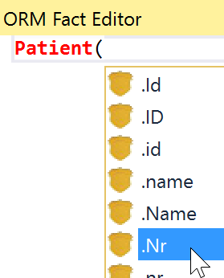


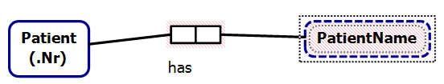
In the Fact Editor, enter the fact type
Patient(.Nr) has PatientName()
as follows:
Type “Patient(”
Click .Nr from the drop-down list
Type the closing parenthesis “)”
Type “ has PatientName()”
(5) Press Ctrl-Enter
The fact type should now be
displayed in the document window.

Slide 11
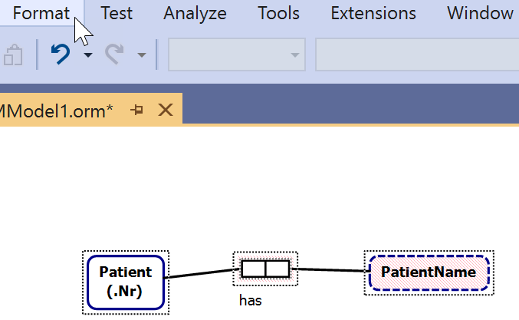
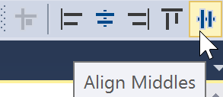
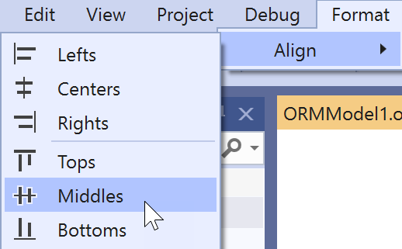
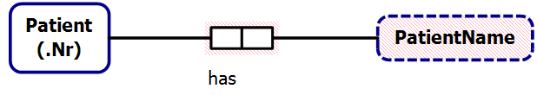
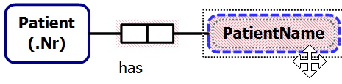
Dragging the mouse to select
the whole fact type (both the predicate and the object types)
causes the Format option to appear in the top menu.
To align these shapes horizontally
choose the menu options
Format > Align > Middles.
The alignment is based on
the last shape selected.
Nudge Patient closer to the predicate
by selecting Patient and
pressing the right-arrow key.
Similarly, nudge PatientName closer
using the left-arrow key.
Notes:
Alignment is activated if multiple top-level items are selected AND one of the top level items is the primary selection (indicated by a dotted line inside and outside the shape border). If a non-top level shape is the primary selection then alignment is not activated. You can shift-click on a selected element to make it primary, or Control-Click twice to turn selection off and back on for the element. Note that selecting the fact type (as opposed to one of its roles or internal uniqueness constraints) is tricky. Make sure the move cursor (4 arrow tips) is showing when you click the fact type to select it.

Slide 12
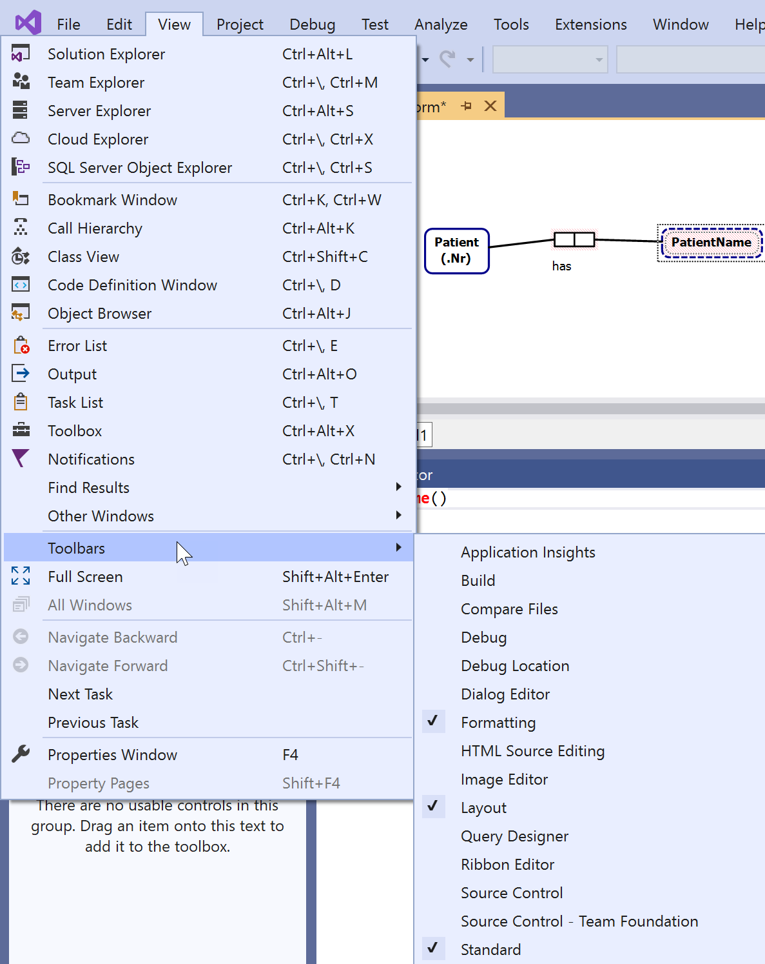

You can also access the alignment options from the Layout Toolbar
if displayed.
It usually best to ensure at least these three toolbars
are displayed:
Formatting
Layout
Standard
To display these toolbars,
go to the main menu and click the following options:
View > Toolbars > Formatting
View > Toolbars > Layout
View > Toolbars > Standard
Access icons for these 3 toolbars
are now added to the main menu.

Slide 13
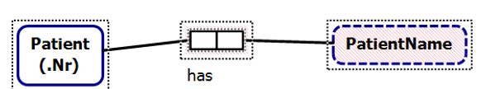
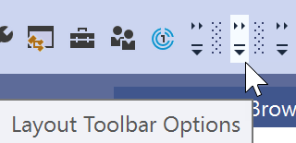
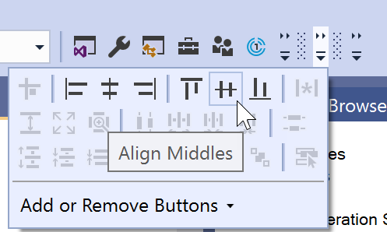
To use the Layout Toolbar,
first select the relevant model elements,
e.g. the earlier (misaligned) fact type
then click the access icon for the layout toolbar,
then align these shapes horizontally
by choosing Align Middles.

Slide 14
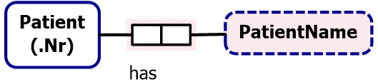
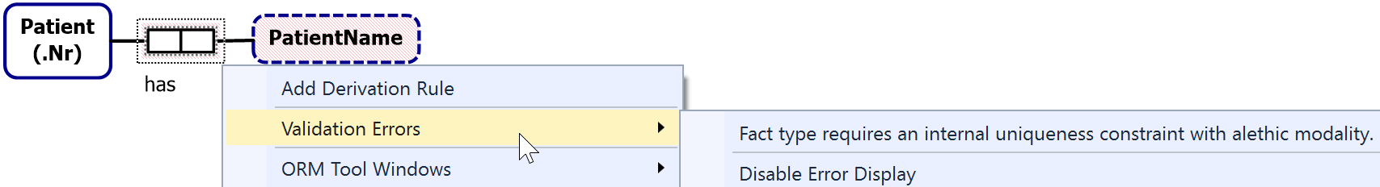
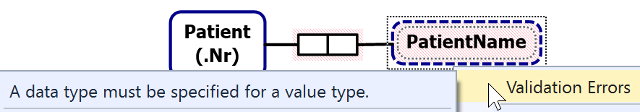
The predicate and PatientName shapes are displayed with
a red line fill or outline, indicating an error state,
e.g. the binary predicate is illegal
because it has no alethic uniqueness constraint.
To view errors on a model element, right-click the element’s Context-menu
and select Validation Errors.
E.g. for the predicate we get
and for the PatientName value type we get
We will add the required constraint and data type later,
and at that point the red error fill will disappear.
Notes:
You can also double-click any shape (see notes in previous slide on where to click a fact) to activate the first error that supports activation. Error activation puts the editor in the state required to fix the error. In this case a double-click on the fact type (or selecting the error) will add an internal uniqueness constraint with no selected roles and activate it for editing. A second double click on the first role will add that role to the constraint and commit the change.
To be less invasive, the error fill color is actually pink rather than red, but think of it as red to associate it with the color commonly used for warning signs.

Slide 15
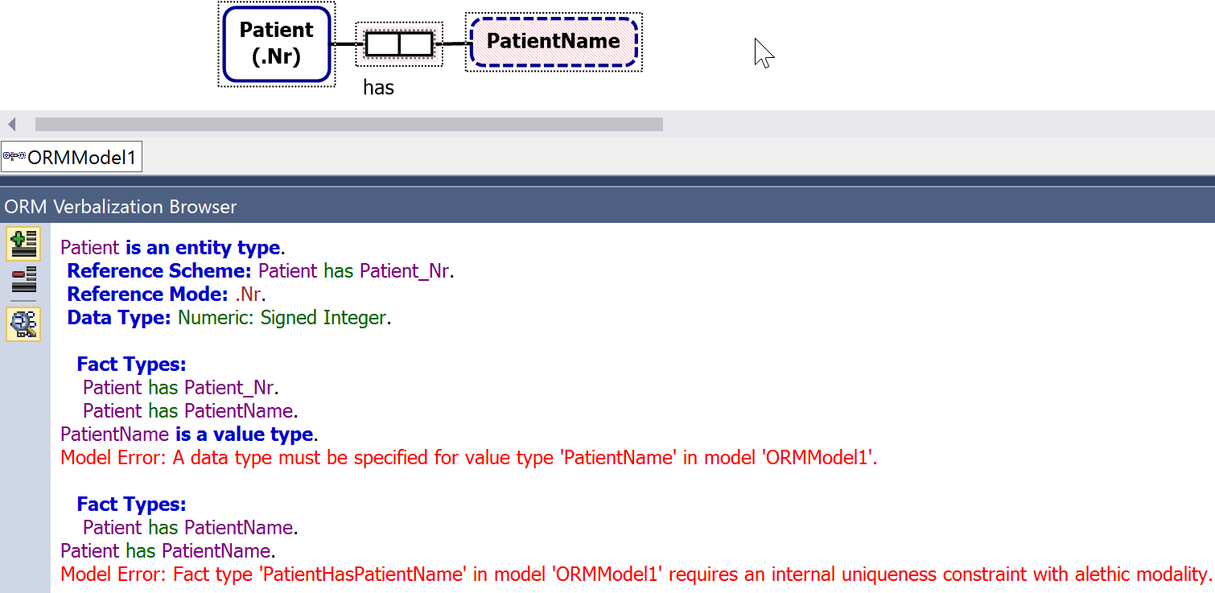
Alternatively, to view all the errors on the fact type,
select the whole fact type (not just the predicate)
and open the Verbalization Browser.
The model errors are displayed in red.

Slide 16
The document window has two scroll bars.
Use the bottom scroll bar to scroll horizontally.
Use the side scroll bar to scroll vertically.
To reposition any part of the diagram, select it,
then either drag it
or use the arrow keys to nudge it.
To select all of the diagram, press Ctrl+A.
To zoom in (magnify), press Ctrl+WheelUp -- wheel mouse
or press Ctrl+Shift+LeftClick.
To zoom out, press press Ctrl+WheelDown --wheel mouse
or press Ctrl+Shift+RightClick.
Notes:
You can see two parts of one diagram at the same time with the Window > New Window command. You can also add additional diagrams to the document.

Slide 17
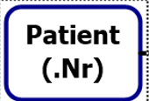


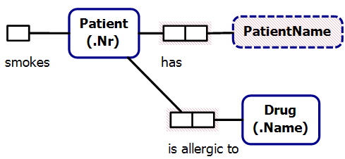

The full ORM schema includes two more fact types:
Patient smokes.
Patient is allergic to Drug(.Name).
The Fact Editor provides the best and fastest way to enter fact types or object types, so it’s best to enter these two fact types in the Fact Editor.
Open the Fact Editor.
Selecting the Patient shape,
displays it in the Fact Editor.
Add the rest of the fact type reading in the Fact Editor,
and press Ctrl-Enter to have the fact type displayed on the diagram.

Slide 18
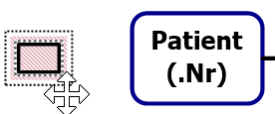

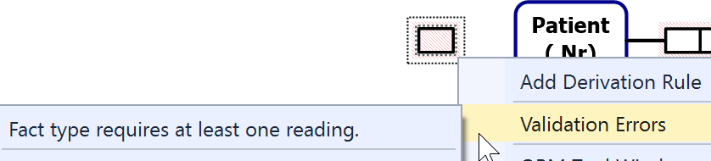

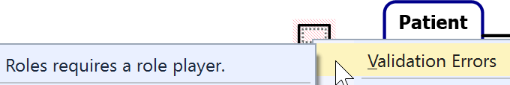
Only if you wish to appreciate how much extra work it is to enter fact types graphically, do that now, after deleting the “smokes” and “is allergic to Drug” additions just made (select then delete them).
Select the unary fact type
(click just above its right top corner).
The Move Cursor appears to show the predicate is selected
(not the role).
Now right-click to see the validation error for the predicate.
Now select the role
(click inside it)
then right-click to see the validation error for the role.

Slide 19
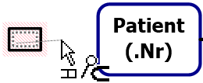
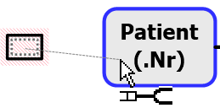
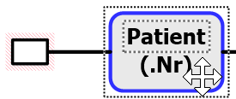
To connect the role to the Patient shape
select the role,
then drag the mouse pointer
(which now displays as a role connector pointer)
onto the Patient shape
then release the mouse.
Alternatively,
click the Role Connector shape in the Toolbox
then click the role and the Patient shape.
For practice, use Undo (select from the menu, or type Ctrl+Z)
to remove the connection,
then use the alternative method to restore the connection.
Notes:
You can also select the role and use the Properties Window to set the RolePlayer property.

Slide 20
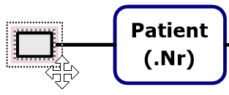
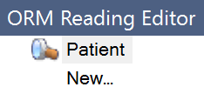

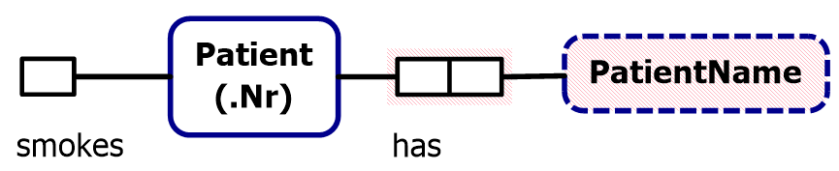
To add a predicate reading,
select the unary predicate shape
(not the role)
and double-click it to open
the ORM Reading Editor.
To reposition a predicate reading in the document window
select it then drag it to where you want.
Use Format > Align > Middles to align the shapes horizontally.
To change a predicate reading, select the reading on the predicate shape,
then select the reading in the Reading Editor, then edit as needed.
Type “smokes” after Patient
and press the Enter key.
The predicate reading should
now appear next to the role.
Notes:
Activating the error will make the correct selection in the ORM Reading Editor and activate the control for editing.

Slide 21
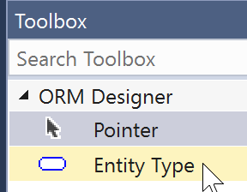
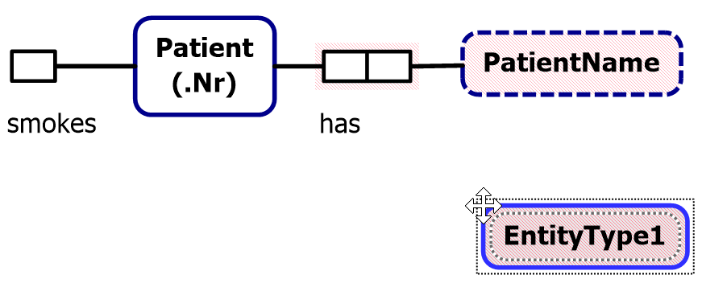
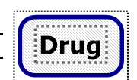
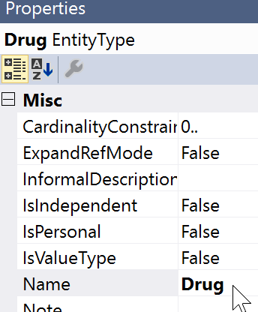
To add the Drug entity type,
drag the Entity Type shape from the Toolbox to the document window.
It initially displays with a default name, e.g. “EntityType1”.
Change the name to “Drug”,
either by editing it in place
or by editing the Name entry
in the Properties window.
Notes:
F2 can be used to activate any in-place editing.

Slide 22
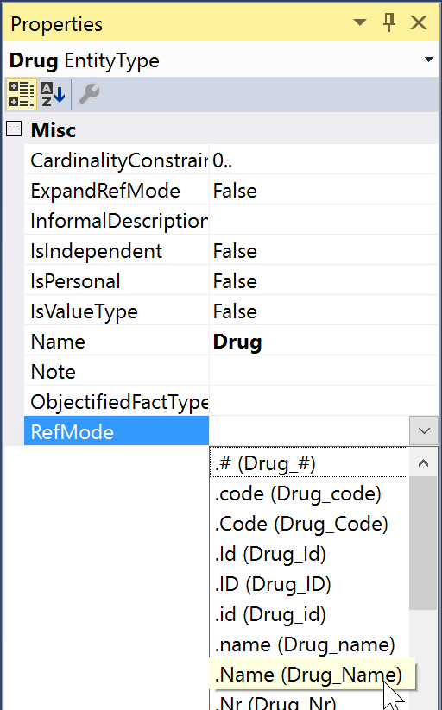
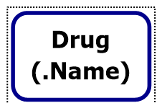
Add the reference mode “Name”
in the RefMode property
either by typing it and hitting Enter
or
by selecting it from the drop-down list
of pre-defined reference modes.
The reference mode is now displayed
on the diagram.
Notes:
Double-click the Drug entity type to automatically open the RefMode dropdown.

Slide 23
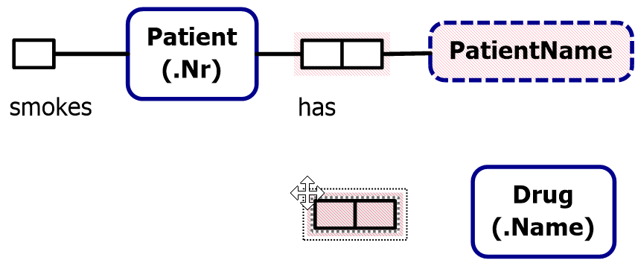
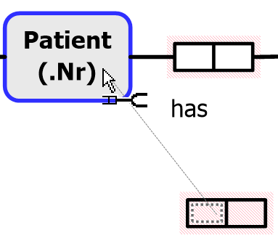
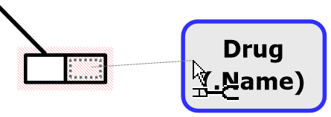

Click the Binary Fact Type shape in the Toolbox
then click where you want to position it
(alternatively,
drag the shape from the Toolbox)
To connect the left role, select it
(click the mouse pointer inside it),
then drag the mouse pointer
to the Patient shape.
Similarly,
select the right role
and drag the pointer to connect it.

Slide 24

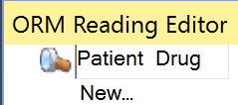
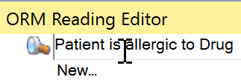
To add a reading for the new predicate,
first select it (click its border so that
the mouse pointer displays as )
Double-click the predicate,
to invoke the ORM Reading Editor
then enter forward predicate reading
“is allergic to” between
“Patient” and “Drug”.
The reading now displays
on the diagram.
Notes:
The ORM Reading Editor is available with any selection that is associated with a fact type (role, reading, constraint, rolename, fact type, etc).

Slide 25
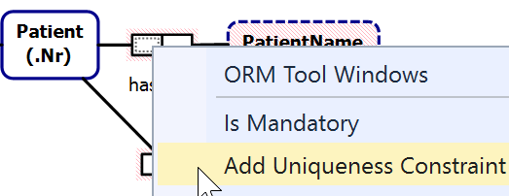


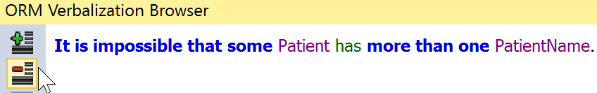
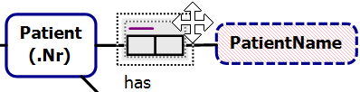

While fact types are best entered textually in the Fact Editor
constraints must be added graphically.
Select the left role
of the PatientName fact type,
right-click to open its context menu
and click Add Uniqueness Constraint.
The constraint is now displayed.
Select the constraint, and click the
ORM Verbalization Browser
to see the positive verbalization.
Click the button
to see the negative verbalization.
Select the whole predicate.
Click the + button to
verbalize the fact type
and uniqueness
constraint.

Slide 26




Select the left role
of the name fact type,
right-click to open its context menu
and click Is Mandatory.
The mandatory role constraint
is now displayed
and its verbalization is added.
Click for the
positive verbalization.
Click for the
negative verbalization.
Notes:
The IsMandatory property is also available in the Properties Window. In addition, for binary facts, the Multiplicity property on a role can be used to add uniqueness and mandatory constraints.

Slide 27



Select one role of the drug fact type then hold the Shift key down and select the other role, right-click to open its context menu
and click Add Uniqueness Constraint.
The constraint is now displayed.
In the Verbalization Browser, view
the positive and negative verbalizations.
Notes:
The toolbox gesture for this is:
Select Internal Uniqueness Constraint
Click the fact to add it to. The constraint will be added activated with no constraints.
Click the first role
Double click the second role to add it and commit the constraint
To extend a single role constraint:
Double-click the constraint to activate it for editing
Double-click the role to add
To make a double-role constraint a single
Double-click the constraint to activate it for editing
Control-Double-Click the role to remove

Slide 28




By default, NORMA places the mandatory role dot
at the role end
instead of at the object type.
This helps to disambiguate the constraint
when role attachments are very close together.
E.g.
this diagram is ambiguous
but this is unambiguous.
For unambiguous cases, I prefer to display the mandatory dot at the object type end. Let’s see how to chose that option.

Slide 29


To change this default (as well as many other options)
open the Options Window (main menu: Tools > Options…)
Then select ORM Designer,
and scroll to
Mandatory Dot Placement.

Slide 30



Double-click the field entry for Mandatory Dot Placement
to toggle its value (from RoleBoxEnd to ObjectShapeEnd).
Alternatively, choose the desired
option from the drop-down list.
To activate this choice,
press OK
(this remains your default
preference until you change it).
The mandatory role dot is now
displayed at the object type end.
Notes:
Note that these are machine-specific settings. All diagrams display according to the users settings.

Slide 31




By default, NORMA sets data types
to Unspecified
until you assign a specific data type.
As ORM schemas often include many value types
that are based on string data types,
you can save yourself some work by setting the
default data type to TextVariableLength.
To do this, use the Tools > Options dialog to
set the Initial (default) Data Type
to TextVariableLength
then press OK.

Slide 32





Setting the default data type
has no impact on the three object types,
since you created them earlier.
To set the data type for PatientName,
select the PatientName shape,
then in its Properties grid
select the DataType property
and choose
Text: Variable Length
from the drop-down list.
Then enter 30 in the
DataTypeLength property.
This sets the data type
to varchar(30).
The red error fill disappears,
since the data type is set.

Slide 33



Select the Patient entity type
and ensure its data type is to
Numeric: Unsigned Integer.
If you earlier selected the “.Name” RefMode
for Drug from the drop-down list,
its data type is already set to variable length text.
If not, select Drug and change its data type to that now.
Regardless,
you still need to
set the data type length
(e.g. to 20).

Slide 34



Let’s add the role name “allergy”
to the role hosted here by Drug.
To do this, select the role
and then add the role name
“allergy” in the Name property
in the Properties window.
The role name is displayed
in square brackets
on the diagram.
Select then drag the role name
to your preferred position
near the role box.

Slide 35




If desired, select the smokes role,
and add the role name isSmoker.
This is purely to predetermine
a better choice of attribute name
for the relational schema
and code generation.
If you wish to suppress display of role
names, expand LocalDisplayOptions in the
Properties window, and toggle the
RoleNames option off.
To make this a global rather than local
setting use GlobalDisplayOptions.
For further display options and recent updates, see
https://ormsolutions.com/norma/readme.htm#Diagram%20Display%20Options%202022-08

Slide 36

Let’s now reposition the uniqueness constraint bar on the
“Patient is allergic to Drug” fact type below the predicate shape.
Right click the predicate, then choose
Orientation > Constraints on Bottom.
If you wish, nudge and
realign the shapes to
give a neater layout.

Slide 37



The allergy fact type is m:n
(i.e. many-to-many)
so will map to a table by itself
when we generate a relational schema.
The table name will be the name of
the fact type, which by default
is the fact type’s primary reading
“PatientIsAllergicToDrug”.
Select the fact type, and look at its
name in the Properties window.
Edit the Name property
to “DrugAllergy”.
This will now be used as the
generated table name.

Slide 38

Make any fine adjustments
you like to the figure
and then save the file
either
by pressing the Save icon
on the main menu
or by choosing the relevant Save option
from the File menu.
If desired, choose SaveAs
to save another copy of the model
(entering your desired filename (e.g. Patient1.orm) and folder destination).
You may also choose Save All to save all the open files.

Slide 39



For practice, Exit Visual Studio by clicking the Close icon.
Now open Visual Studio again (if needed, choose “continue without code”)
and reopen your saved file by choosing File > Recent Files
and selecting the file you wish to work with.
Alternatively,
choose File > Open > File…
then select the file in File Explorer
and press Open.
Note: If you later rename a saved file in File Explorer, it won’t appear as a recent file,
so you need to open it using File > Open or by double-clicking it in File Explorer.

Slide 40
NORMA supports mappings to/from various implementation artifacts,
for example:

Slide 41
Generating a Relational View

Slide 42



To generate a relational view
right-click in the document window
and choose Extension Manager …
In the Extension Manager
dialog, select the
“Relational View”
check box as shown
(this will automatically turn
on the “Map to Abstraction
Model” and “Map to
Relational Model”
check boxes)
and then press OK.
Note: The Multiple Page Relational View option is available only in the Professional version of NORMA

Slide 43



A Relational View tab now
appears next to the ORM Model
tab below the Document Window.
Select this tab to see the
relational diagram view.
Reorder the column display in the DrugAllergy table
to show the patientNr attribute at the top.
To do this, select the patientNr attribute and drag it to the top position.

Slide 44

Drag the Patient and/or DrugAllergy table shape(s)
to improve the layout, as shown.

Slide 45

The Verbalization Browser also works with the Relational View,
helping to clarify the underlying semantics of the relational schema.
For example, selecting the patientNr attribute of the Patient table
displays the verbalization shown below.

Slide 46

The ORM Model Browser
now includes a Relational Schema
node.
Expand the tree by toggling the
“ ” expand buttons to see the
relational schema details, as shown.
Mandatory columns are displayed in bold.
The relational schema is implemented
as a view of the ORM schema, so changes
in the ORM schema are reflected in the
relational schema.
Changing names and mandatory role
settings in the ORM schema are reflected
immediately. Other changes currently cause
the tree to contract, so to see those
changes you need to re-expand the tree.
Now save your work.

Slide 47

Generating DDL code
To generate code from an ORM schema,
Open Visual Studio and select create a new project.

Slide 48






Alternatively, click “continue without code” then from the main menu choose File > New > Project.
In the Create Project window, select the
target Language (e.g. C#),
Platform (e.g. Windows),
and Project Type (e.g. Console)
Select the .NET Framework app.
Press Next.

Slide 49

Click the … button
to browse to
the folder for
your project

Slide 50

Browse to your project folder and press Select Folder.

Slide 51


Press Create to create your new project.
The project now
appears in Solution Explorer.

Slide 52



Right-click the Project name
in the Solution Explorer,
then choose
Add > Existing Item….
In the Add Existing Item dialog,
browse to your ORM file folder,
set “Files of type:” to
All Files (*.*) to include .orm files, then select your ORM
File (e.g. Patient.orm)
and press Add to add
a copy of your ORM file
to the project.
If you later want to
Make changes to the
ORM File inside the
project, do it to that
copy.

Slide 53

Your ORM file now appears in
Solution Explorer.
Recall that the ORM schema maps to
the 2 table relational schema shown.
To generate the DDL code to create the relational schema,
proceed as follows.

Slide 54


To generate code from the ORM model,
first select the ORM file in Solution Explorer.
In the Properties window,
check that “ORMCustomTool”
is the value for the CustomTool property.
(This should be there by default)
The ORMGeneratorSettings
property should be visible in
the dialog
(if not, click a different item
In Solution Explorer and
reselect your ORM file).
Now click the button at the right.

Slide 55

The ORM Generator
Selection dialog
now appears in Solution Explorer.
Now select
the target(s)
for code generation.
For this example,
let’s choose
SQL Serve > DDIL to SQL Server.
Press Save Changes.
After clicking Save Changes, the generation takes a little while.
When generation is complete, the dialog closes.

Slide 56


In Solution Explorer
press the expand button
for the ORM file
to view the files below it.
Now select the relevant code file
(e.g. Patient.SQLServer.sql).
To view the code generated
double-click the file
(or right-click the file and choose
Open from its context menu).

Slide 57

The SQL code generated now appears.

Slide 58

If the SQL code is not word-wrapped, you can arrange this
by pressing Ctrl-EW (hold the Control key down as you press E then W),
which toggles word-wrap between ON and OFF.
For long lines of code, you can usually improve the layout by
manually inserting control-breaks and spaces at various points,
e.g. the code for the patient allergy table looks neater thus:

Slide 59
Generating other code

Slide 60

To see code generation for
other targets, repeat the procedure for ORM Generator Settings
(press button),
select desired options,
press Save Changes
and open the relevant files to see the code generated.
*** Generation options may change between versions.***
To generate C# code.
choose PLiX_Implementation.

Slide 61



To see the C# generated, select the ORM
file in Solution Explorer, expand the abstract
PLiX entry and double-click the .cs file under it.
A fragment of the code is shown below.
To see more code,
click the relevant
expand “+” buttons.

Slide 62
C# was generated because
we initially set up our project as a C# project.
If we had instead created a Visual Basic project,
then VB code would have been generated
(with code file suffix .vb).
In a VB project, ‘Show All Files’
needs to be selected in the Solution Explorer toolbar.
DO NOT delete generated files from Solution Explorer.
To remove generated files, open the ORM Generator Settings dialog from the properties window of the ORM file. Deselect the generator types that you do not want, and then click Save Changes. The unwanted generated files will then be removed.

Slide 63
That concludes laboratory session 1.
Lab 2 introduces ternary associations, external constraints, value constraints, and derived fact types.

