Slide 1
Object-Role Modelling:
An Historical Overview
Terry Halpin
e-mail: t.halpin@live.com
web: www.orm.net
1

Slide 2
Contents
Object-Role Modelling (ORM): Main features
Fact-Oriented Modelling Origins and Development
ORM Graphical and Textual Notation
ORM mapping procedures
Open/Closed World semantics options for ORM
Conclusion
2

Slide 3
Object-Role Modelling (ORM) – Main features
A conceptual approach (languages plus procedures) for modeling, querying, and transforming information that is fact-oriented (attributes are not used as primitive components)
An object is any individual thing of interest (other than null) and may be an entity (e.g. the Country named ‘Canada’), a domain value (e.g. the CountryCode ‘CA’) or a data value (e.g. the character string ‘CA’).
A type is a set of all possible instances. Each domain value type has a data type. Values are unchanging and are identified by an individual constant of a given type. Entities typically change over time and are identified by a definite description.
A fact is an atomic proposition taken to be true by the user community.
Fact types are modeled using predicates of arity ≥ 1 (unary, binary, ternary, …)
e.g.
Person smokes -- instead of Person.isaSmoker
Person was born on Date -- instead of Person.birthdate
Store in Month sold Product in Quantity -- instead of binarizing

Slide 4

All entities must have a declared reference scheme used in human communication in the business domain.
All structures must be easily populated with concrete examples.
Facts, constraints, and derivation rules may be expressed naturally in a controlled natural language
    Facilitates validation by verbalization,
    enabling non-technical domain experts
    to understand the model and check how
    well it captures the business domain.
Richly expressive graphical constraint language
(compared with industrial ER, or UML class diagrams)
  Enables the modeler to easily visualize complex constraints, and to rigorously transform models to better alternatives

Slide 5


Fact-Oriented Modeling – Origins and Development
1974 paper ‘Data Semantics’: All data structures must be defined using sets, binary relations, and functions.
Attributes are functions (e.g. age : Person -> Integer)
Jean-Raymond Abrial (1938 –2025)
Michael Senko’s 1975 paper: “Information Systems: Records, Relations, Sets, Entities, and Things” also uses sets and relations as foundational primitives.
1973 paper and 1975 PhD thesis (University of Stuttgart) “Concepts for the Structuring and Representation of Information in Data Base Systems”
Object-Role Model: objects playing roles;
n-ary and nested relationships;
roles depicted with arrowed lines.
Eckhard Falkenberg (born 1942)
5

Slide 6

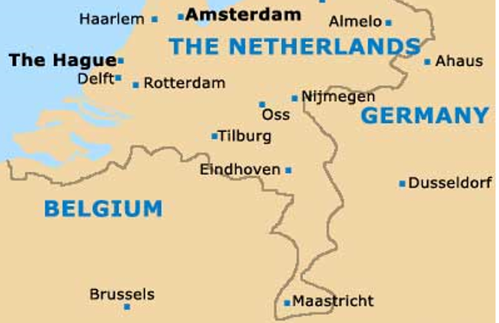
In 1976-1977, Nijssen adapted Falkenberg’s model using circles for object types and boxes for roles and added a linguistic orientation and the design procedure ENALIM (Evolving NAtural Language Information Model).
“Sjir” Nijssen (born 1938)
At Control Data in Brussels, Nijssen led a team of researchers to extend the method (e.g. Franz van Assche classified object types, and Robert Meersman added subtyping and worked with Falkenberg and Nijssen on the RIDL (Reference and Idea Language) query language and the RIDL* modelling tool.
By 1982 the modelling approach was renamed “NIAM” (aN Information Analysis Method). “NIAM” was later given the nickname “Nijssen’s Information Analysis Method” but is currently known as the “Natural Information Analysis Method”.
6

Slide 7

In 1982, Nijssen (as professor) and Falkenberg (as senior lecturer) moved to the computer science department at the University of Queensland (UQ)
(https://uq.edu.au) .
I was then a lecturer at a nearby college. After attending some lectures by Nijssen and Falkenberg, I began teaching their modelling approach. In1986, I was a computer science lecturer at UQ, working with Sjir and Eckhard to teach and improve the modelling method. At Sjir’s request, I changed the focus of my PhD research to a formalization of NIAM. In 1989, Sjir and I coauthored Conceptual Schema and Relational Database Design, and I submitted my PhD thesis (approved in 1990).
Also in 1989, Sjir and Eckhard returned to The Netherlands. Sjir founded the PNA group and worked on cogNIAM (now implemented in the iKnow tool). Other fact-based modelling approaches were later developed in The Netherlands, e.g. PSM (Predicator-Set Model) and FCO-IM (supported by the CaseTalk tool).

Slide 8
In the early 1990s, Jim Harding in Bellevue, WA, USA asked me to provide a metamodel for a fact-based modeling tool being developed at ServerWare. For the modelling approach, he wanted a name different from “NIAM”. In respect to Eckhard’s original work, I called it “Object-Role Modelling” (ORM).
In 1993, ServerWare was acquired by Asymetrix Corporation (a Paul Allen company), which funded the Asymetrix Research lab at UQ which I directed with talented researchers (e.g., Erik Proper, Linda Campbell). The lab’s research on ORM and user-friendly query formulation fed directly into Asymetrix’s commercial tools (InfoDesigner, InfoModeler, InfoAssistant, ActiveQuery).
In 1995-6, I took leave from UQ to head the database products division at Asymetrix. Anthony Bloesch joined as a programmer, and worked with me on ORM-based conceptual query languages (ConQuer, Conquer-II). In 1998, I left UQ to direct research at InfoModelers Inc., which was then acquired by Visio Corp. in Seattle. InfoModeler was renamed “VisioModeler” and I became Director of Database Strategy.
In 2000, Visio Corp was acquired by Microsoft Corporation (Redmond, WA, USA) and I became program manager in database modelling in the Visual Studio unit. In 2001, I authored Information Modeling and Relational Databases. The Visio tool became Microsoft Visio, and its ORM solution was implemented as Visio for Enterprise Architects (discontinued in 2003).

Slide 9
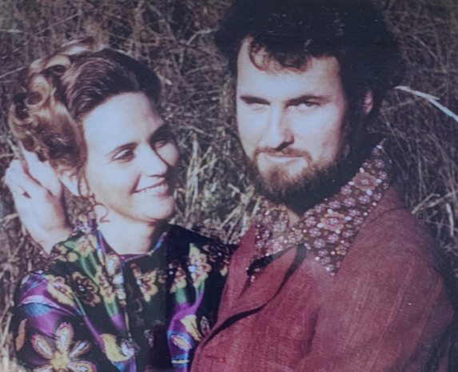
In 2002, I became a professor of computer science at Neumont University (Salt Lake City). Here we developed the ORM tool called “NORMA” (Natural Object-Role Modeling Architect) that I named after my wife NORMA.
The NORMA tool runs as a free plug-in to Visual Studio.
Matt Curland and I formed ORM Solutions LLC to further
develop NORMA and the NORMA Professional tool.
In 2008, Professor Tony Morgan and I co-authored the second edition of Information Modeling and Relational Databases. Tony also related state and process modelling to ORM. Andy Carver and I developed the ORM stencil and template for drawing ORM schema diagrams in Visio.
2009-2015: Tony and I worked as professors of computer science at INTI International University, Malaysia. I also worked part-time as a research scientist mapping ORM to LogiQL a logic programming language at LogicBlox. After LogicBlox was acquired by Predictix in 2014, some key staff moved to RelationalAI to develop the Rel language for deductive databases and knowledge graphs.

Slide 10
In 2016-2018, I was an ORM consultant at the European Space Agency and adjunct research professor at INTI university. In 2019 I was part-time professor at Queensland University of Technology. Later, Tony Morgan and I extended the approach in many directions as discussed in the 3rd edition of Information Modeling and Relational Databases (2024), and Enrico Franconi and I worked with Jan Hidders and others to provide an abstract syntax and semantics for ORM (accessible at www.orm.net/resources).
The early fact-based modeling tools LISA-D and RIDL* developed in Belgium and The Netherlands are no longer available. Fact-based modeling tools now available include:
NORMA
CaseTalk (FCO-IM)
iKnow (cogNIAM)
ActiveFacts
DogmaModeler
Factum
Boston and FactEngine

Slide 11
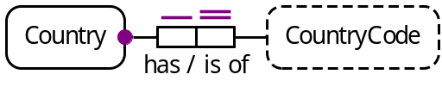
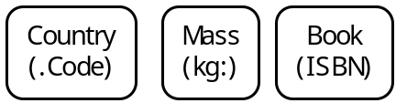
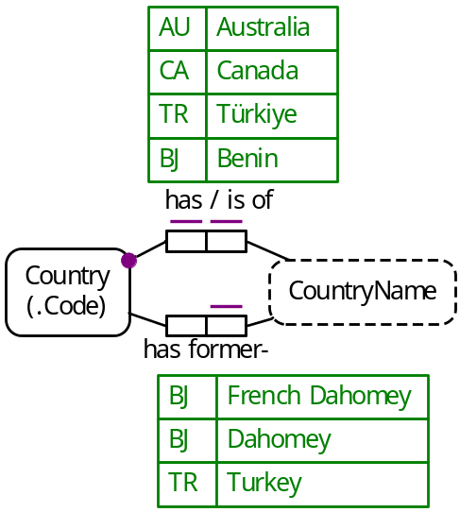
ORM Graphical and Textual Notation
A simple, preferred reference scheme between an entity type and a domain value type.
ORM models may be specified textually in FORML (a controlled natural language). The NORMA tool automatically provides the verbalization, e.g. the mandatory role and uniqueness constraints on Country’s role verbalize thus:
Each Country has exactly one CountryCode.
Simple reference schemes may be abbreviated using reference modes (popular, unit-based or general), e.g.
Object types and Fact types may be populated with instances,
e.g. using ISO-3161-1 alpha-2 country codes
The population is a unique list of instances
(no duplicates allowed), so each fact type predicate has an implied spanning uniqueness constraint.
11
Notes:
Entity types are depicted using named soft-rectangles, and value types as named soft-rectangles with dashed lines.
Mandatory role constraints are denoted by a solid dot. Uniqueness constraints (UCs) are denoted by lines above or below the relevant role boxes.
A preferred uniqueness constraint displays with double line.

Slide 12
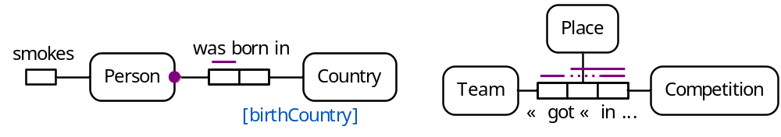
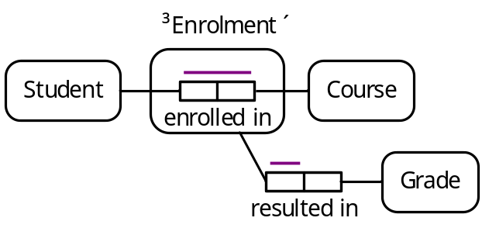
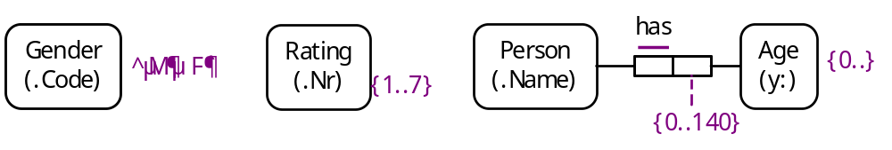
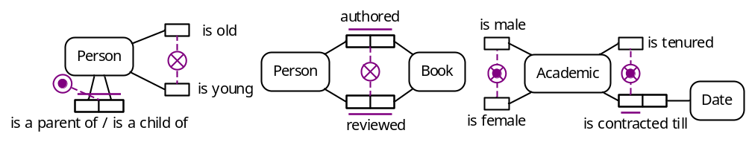
Fact types may be unary, binary, ternary, quaternary etc.
UCs on unaries are implied so are not displayed.
Object types may be declared independent.
Fact types may be objectified.
Value constraints on object types and roles.
inclusive-or constraints, exclusion constraints, exclusive-or constraints.
12
Notes:
Unary predicate readings use prefix notation, binaries use infix notation, and higher arity predicate readings use mixfix notation.
The ternary example assumes no ties are allowed.

Slide 13
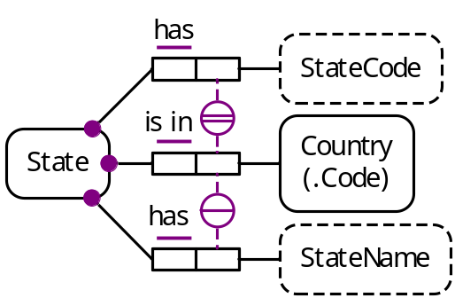
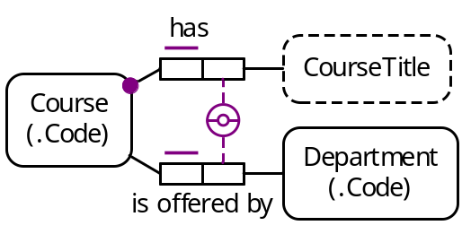
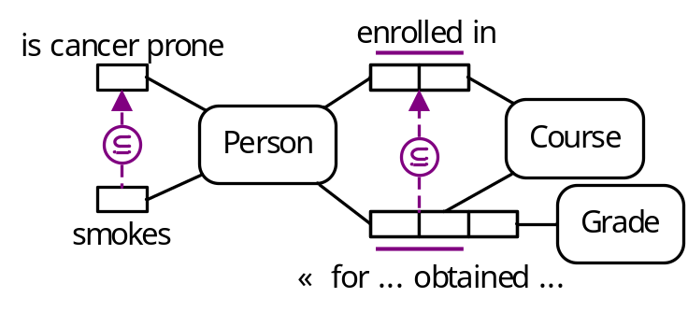
External uniqueness constraint
(inner-join semantics)
(outer-join semantics)
For each CourseTitle and Department,
at most one Course has that CourseTitle and is offered by that Department.
For each CourseTitle
at most one Course has that CourseTitle and is offered by no Department.
Subset constraint
13
Notes:
With outer join semantics, nulls produced in the outer join are treated as actual values.

Slide 14
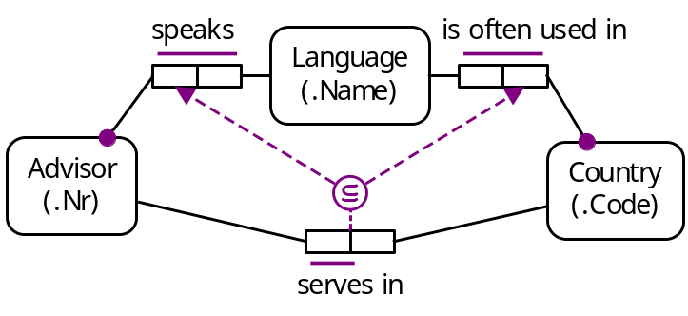
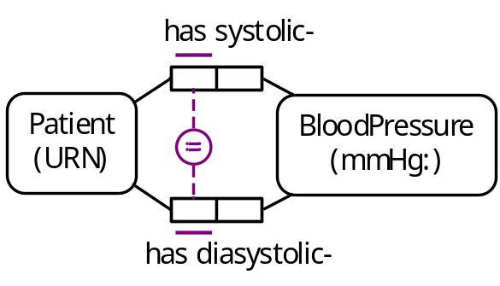
Join subset constraint
Each Advisor who serves in some Country speaks some Language
that is often used in that Country.
Equality constraint
14

Slide 15
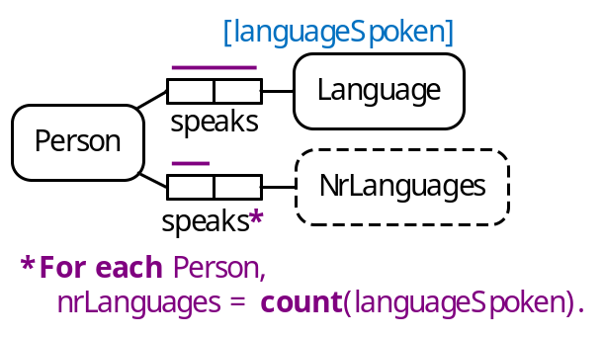
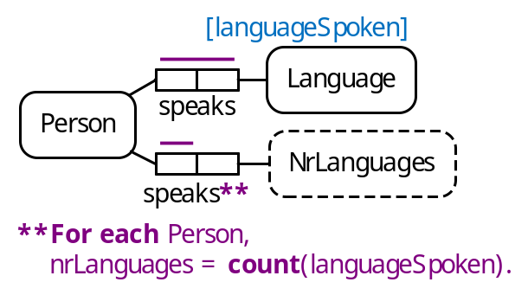
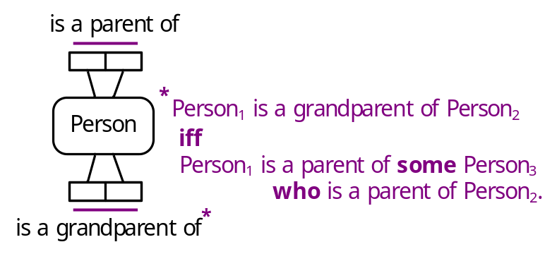
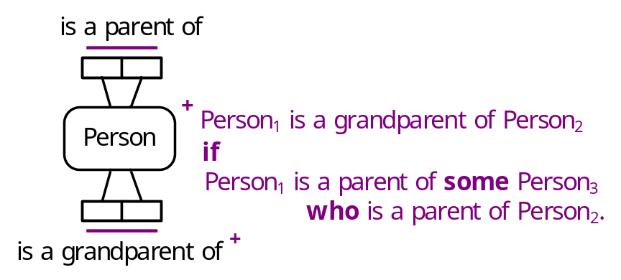
Derived fact type, and derivation rule
eager evaluation (derive on update)
Semiderived fact type, and derivation rule
15

Slide 16
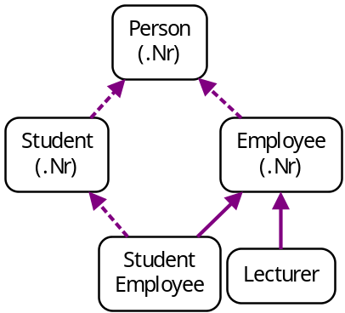
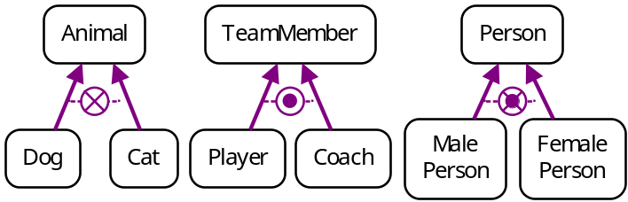
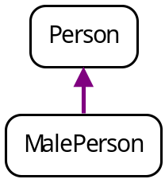
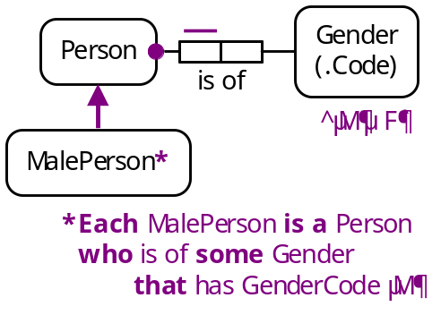
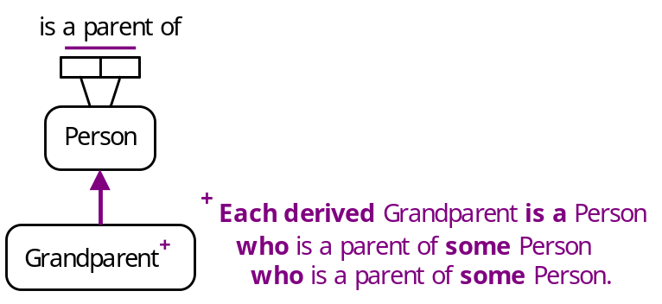
Subtyping
All subtypes are proper subtypes. Subtyping link shown by an arrowed line (solid arrow if the subtype inherits its identification scheme from its immediate supertype;
dashed arrow if subtype has another preferred id scheme).
Subtyping constraints
Asserted subtype
Derived subtype
Semiderived subtype
16

Slide 17
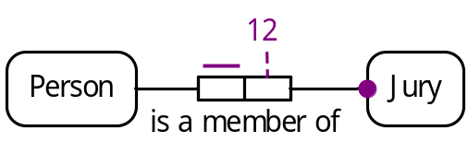
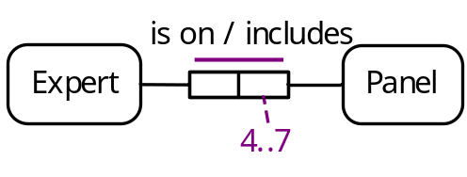
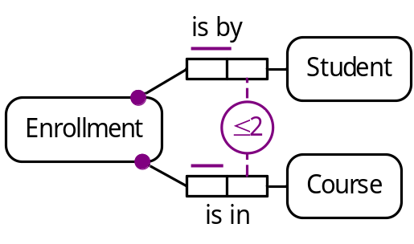
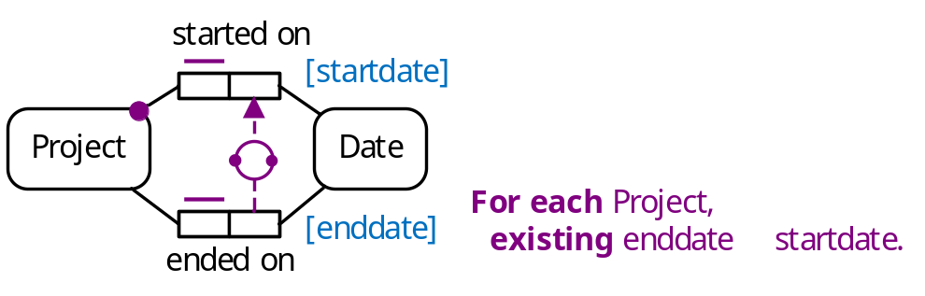

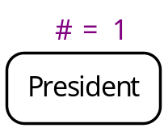


Internal frequency constraints
External frequency constraints
Value-comparison constraints
Object cardinality constraints
Role cardinality constraints
17

Slide 18
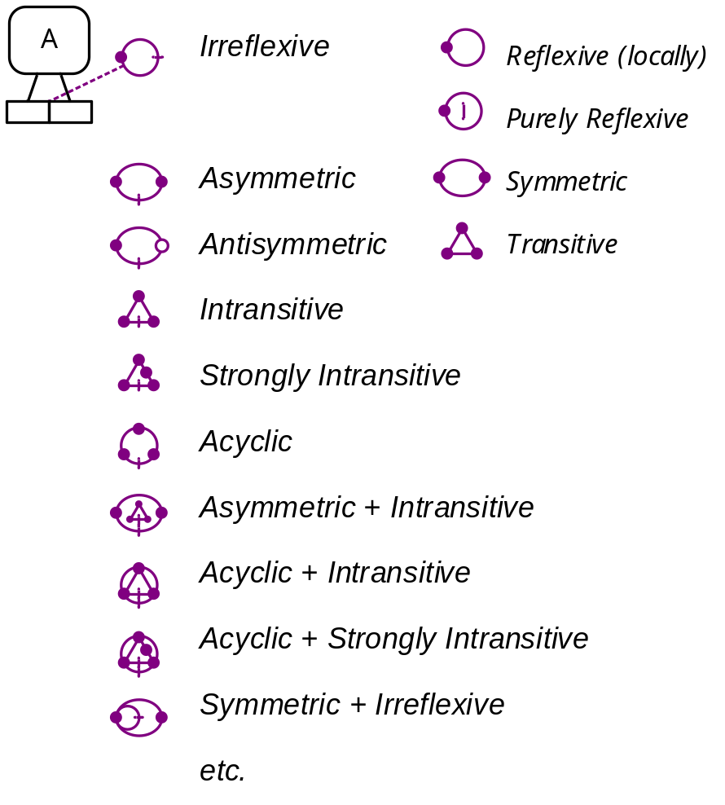
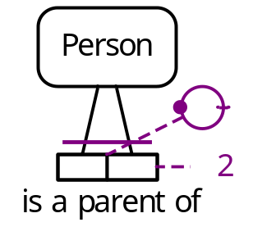
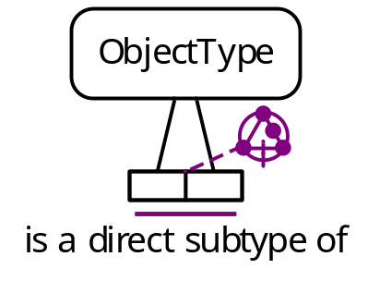
Ring constraints
E.g.
18
Notes:
The strongly intransitive constraint example means(no object type A can be both a direct subtype of another type B and an indirect subtype of B, where indirect subtyping means there is a chain of two or more subtyping relationships that lead from A to B.

Slide 19
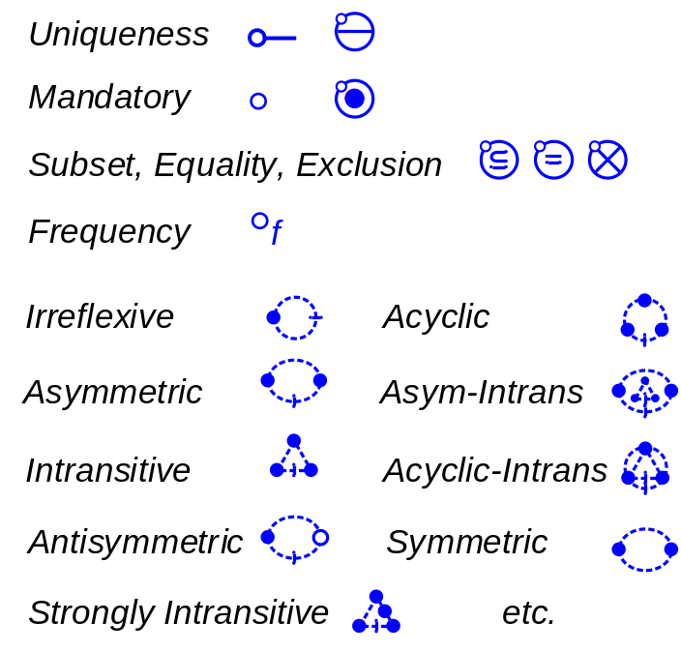
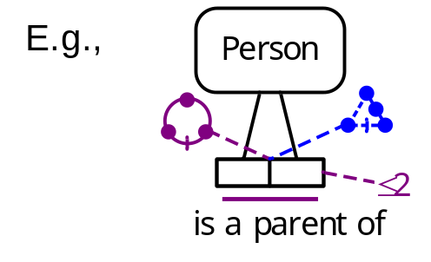
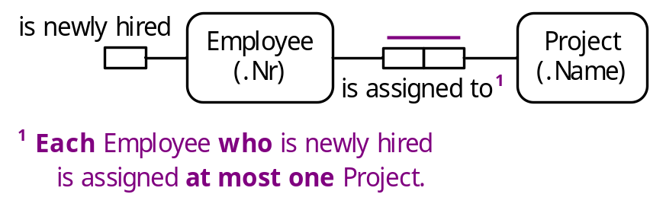
Deontic constraints ought to be obeyed
Textual constraints
19

Slide 20
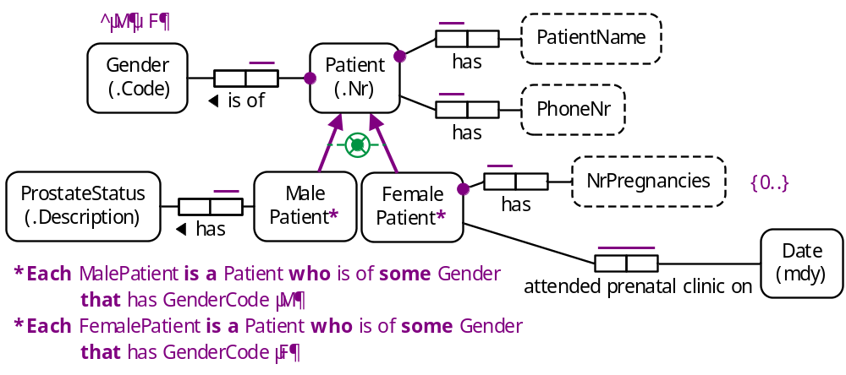

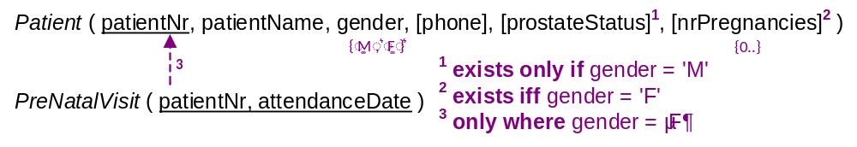
ORM Mapping Procedures
The Rmap algorithm maps ORM conceptual schemas to relational database schemas, e.g.
The NORMA tool performs the mapping automatically.
20
Notes:
The exclusive-or constraint is coloured green to indicate that it is derivable (as implied by the derivation rules and the constraints on the Patient has Gender fact type and the value constraint on GenderCode). NORMA does not yet support derivable constraints.

Slide 21
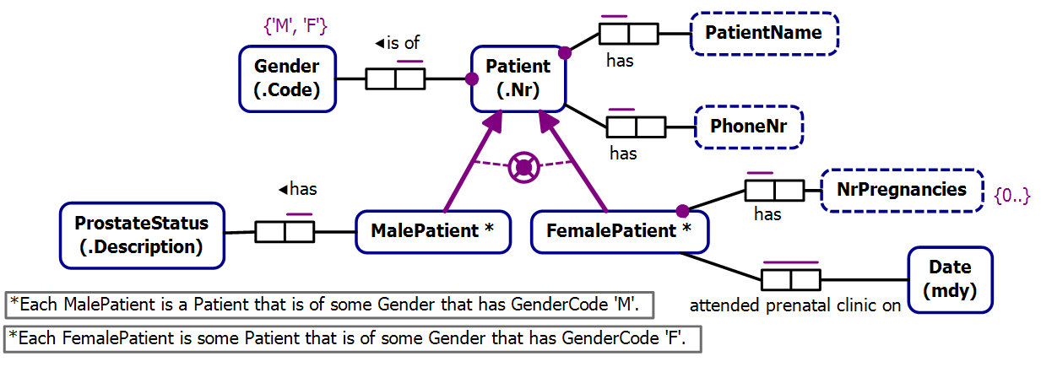
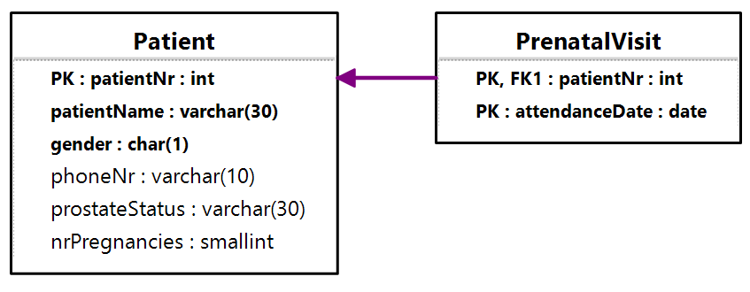
ORM schema display in NORMA
Relational schema display in NORMA
21

Slide 22
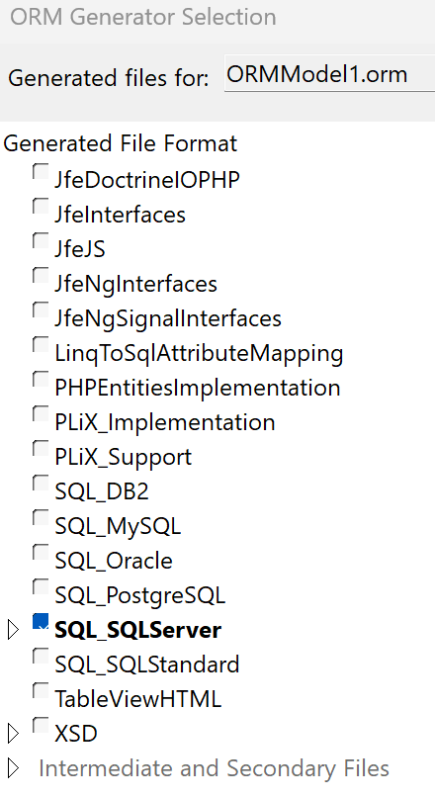
NORMA maps ORM schemas to various implementations
CREATE SCHEMA ORMModel1
GO
GO
CREATE TABLE ORMModel1.Patient
(
patientNr int NOT NULL,
patientName nvarchar(30) NOT NULL,
gender nchar(1) NOT NULL,
phoneNr nvarchar(10),
prostateStatus nvarchar(30),
nrPregnancies smallint CHECK (nrPregnancies >= 0 AND nrPregnancies >= 0),
CONSTRAINT Patient_PK PRIMARY KEY(patientNr),
CONSTRAINT Patient_gender_RoleValueConstraint1 CHECK (gender IN (N'M', N'F'))
)
GO
CREATE TABLE ORMModel1.PrenatalVisit
(
patientNr int NOT NULL,
attendanceDate date NOT NULL,
CONSTRAINT PrenatalVisit_PK PRIMARY KEY(patientNr, attendanceDate)
)
GO
ALTER TABLE ORMModel1.PrenatalVisit ADD CONSTRAINT PrenatalVisit_FK FOREIGN KEY (patientNr) REFERENCES ORMModel1.Patient (patientNr) ON DELETE NO ACTION ON UPDATE NO ACTION
GO
GO
22

Slide 23
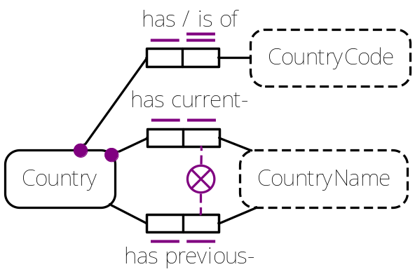
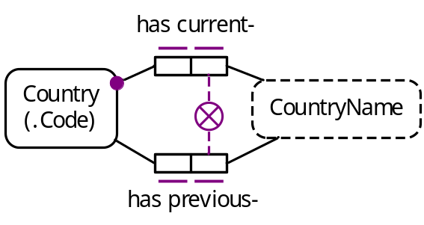
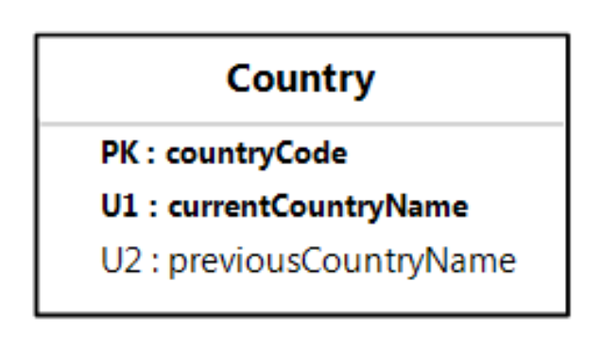
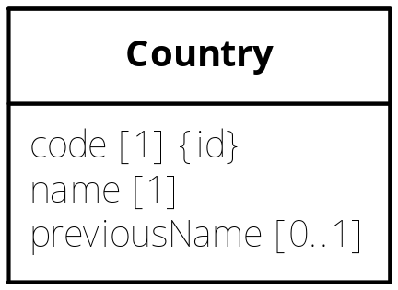
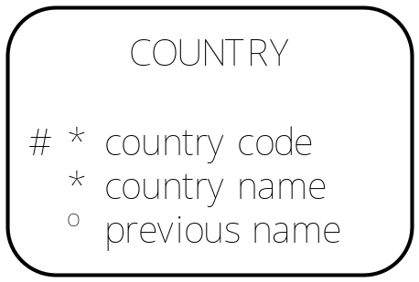
The third edition of Information Modeling and Relational Databases, includes procedures to map ORM models to other modelling notations and data file formats, e.g. ER, UML, OWL, NoSQL and other Nonrelational databases (e.g. deductive databases, web ontology languages).
ORM:
≡
RDB:
Barker ER:
UML:
Only ORM captures the exclusion constraint graphically.
Barker ER and UML also fail to graphically capture the uniqueness constraints
on current and previous country names.
23

Slide 24
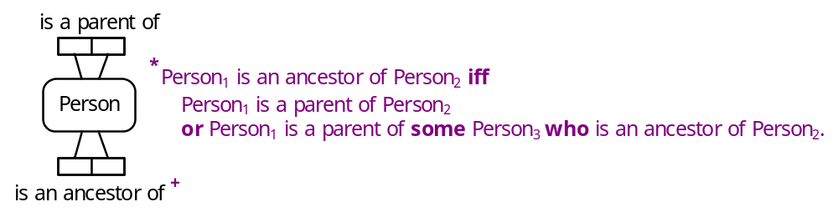
Most aspects of ORM models including recursive derivation rules can be mapped to logic programming languages such as Prolog, Datalog and modern deductive database languages such as Rel (from RelationalAI).
E.g.
The ancestorhood derivation rule may be expressed in Rel thus:
def isanAncestorOf(x,y): isaParentOf(x,y) or
exists((z) | isaParentOf(x,z) and isanAncestorOf(z,y)).
The join-subset constraint is expressed in Rel thus:
ic(a, c) requires servesinCountry(a, c) implies
(speaksLanguage(a, l) and isaLanguageUsedBy(l, c)).
24

Slide 25

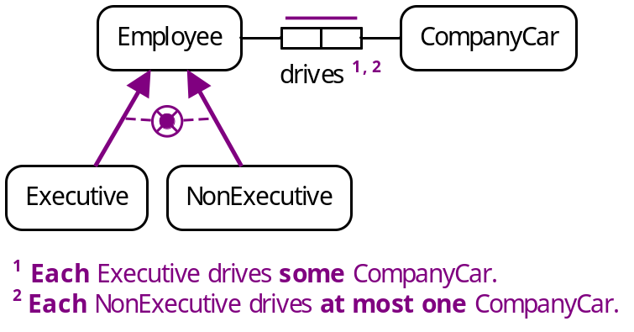
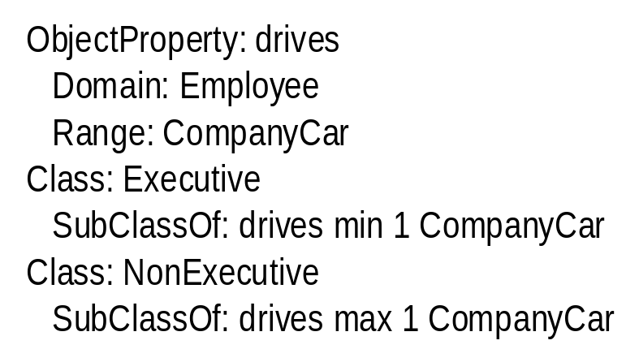
Most aspects of ORM models can be mapped to semantic web languages, such as the Web Ontology Language (OWL).
OWL has no standard graphical notation, but has 5 textual languages of which Manchester syntax is the most readable.
Consider this ORM schema.
The footnotes express a restricted mandatory role constraint and a restricted uniqueness constraint.
This ORM schema may be expressed in the Manchester syntax for OWL as shown.
25

Slide 26
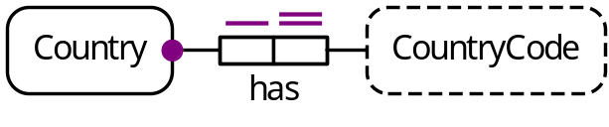

In OWL, entities may be named individuals (identified by an IRI) or unnamed individuals (represented by blank nodes).
Class: Country
HasKey: hasCountryCode
Individual: JuliaGillard
Facts: wasBornInCountry _:c1
Individual: _:c1
Facts: hasCountryCode "GB"
Individual: TheUK
Facts: hasCountryCode "GB"
Will an OWL reasoner now infer this?
  Individual: JuliaGillard
  Facts: wasBornInCountry TheUK
This HasKey UC applies only to
named individuals
No! HasKey declarations apply only to named individuals
(unlike InverseFunctional declarations).
OWL allows that there could be many unnamed individuals
that have the country code “GB”, not just the named individual TheUK.
26
Notes:
Julia Gillard was born in Wales, and she was Prime Minister of Australia from June 2010 to June 2013.

Slide 27

Typical databases adopt closed world semantics, treating declarations such as “Each person was born in some country” as constraints, so an update attempt to record a person without his/her birth country will be rejected.
In contrast, OWL adopts open world semantics, and treats many declarations
simply as propositions, not as constraints.
e.g.
  ObjectProperty: wasBornInCountry
  Domain: Person
  Range: Country
  Characteristics: Functional
  Class: Person
  SubClassOf: wasBornInCountry min 1
The OWL code declares that each recorded person was born in exactly one country, but it does not require that the system knows which country that is.
Care is required when mapping data modelling approaches to OWL. Some recent proposals have made to extend OWL to cater properly for constraints.
27
Notes:
The OWL code declares that in the real world (domain being modelled) each person was born in some country, but does not require this in the recorded world, since our information about the real world may be incomplete.

Slide 28
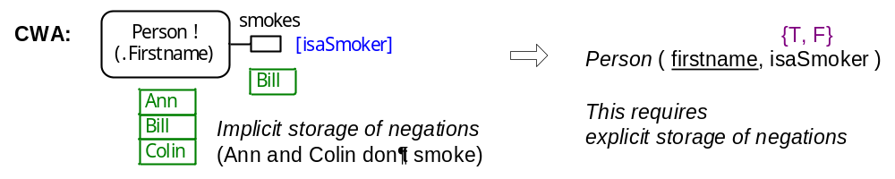
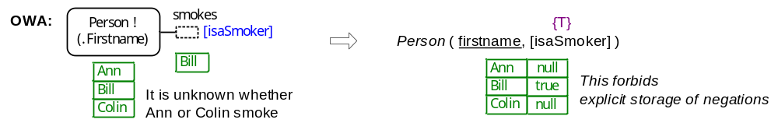
Open/Closed World semantics options for ORM
ORM adopts the Partial-Closed World Assumption allowing some parts of an ORM model to adopt the Closed World Assumption (CWA) and other parts to adopt the Open Word Assumption (OWA).
Currently, ORM assumes CWA by default, allowing OWA only for unary fact types. In the past, open world unaries were depicted with dashed role boxes.
28

Slide 29



In 2024, Matt Curland (https://ormsolutions.com/whitepapers) changed unary fact types in NORMA by requiring a unary pattern choice for how to map the unary to an implementation e.g. True/False (= CWA), True/Unspecified (= OWA), True/False/Unspecified (= OWN).
Mapping choices are not conceptual issues, so should not be part of the conceptual schema. This approach is confusing, as it changes the meaning of an object playing a role just for unaries.
For example, the verbalization of this exclusive-or constraint implies that each light is recorded to be on or off. But since the negation pattern for these unaries is True/Unspecified, saying a light is on or that a light is off includes the unknown case (see relational schema).
29

Slide 30



For each factbase state, the population (stored or derived) of a closed world fact type is assumed complete for the population of its object types (i.e. it contains all the facts of that type that are true in the UoD state under discussion where the objects in each fact belong to the factbase population).
I now think ORM’s default setting should be OWA, and that OWA/CWA/CWN choices should be allowed for n-ary fact types (n ≥ 1).
With this approach, OWA fact types have solid (undashed) role boxes.
Predicate readings in CWA fact types are enclosed in “[[…]]”,
Predicate readings in CWN fact types are prepended by “+~” (shortcut for displaying both positive and negated predicates).
30

Slide 31
Conclusion
Object-Role Modelling (ORM) is a formally defined approach for modeling information structures that is fact-oriented, expressing facts in terms of objects playing roles in unary, binary or longer relationships.
All entities are identified by a definite description used in human communication.
Facts, constraints, and derivation rules are expressed in a controlled natural language, enabling non-technical domain experts to understand the model.
ORM has been used successfully for many years in many real-world applications.
ORM’s graphical notation is more expressive than the graphical notation of other popular approaches, such as ER and UML.
ORM models may be mapped to various alternative structures, such as relational databases, ER diagrams, UML class diagrams, deductive databases, and ontology models (e.g. OWL).
31

Slide 32

Selected References and Websites:
Halpin, T. 2015, Object-Role Modeling Fundamentals, Technics Publications, NJ.
Halpin, T. 2016, Object-Role Modeling Workbook. Technics Publications. NJ.
Halpin, T. 2019, ‘Reference Scheme Modeling’, New Perspectives on
Information Systems Modeling and Design, IGI Global, Hershey, pp. 227-254.
Halpin, T. & Morgan T. 2024, Information Modeling and Relational Databases,
3rd edition, Morgan Kaufmann.
www.orm.net -- my website
www.ORMsolutions.com -- NORMA tool, browser-based model viewer
www.casetalk.com -- CaseTalk modeling tool
www.pna-group.com -- PNA group, iKnow knowledge management tool
www.dataconstellation.com/ActiveFacts -- Data Constellation website
www.factum-orm.com -- Factum modeling tool for ORM 2
www.jarrar.info/Dogmamodeler -- Dogma Modeler tool
www.relational.ai -- RelationalAI and the Rel language
www.BRcommunity.com -- Business Rules Journal
www.omg.org/spec/UML/ -- UML specification (current version 2.5.1)
www.w3.org/TR/owl2-direct-semantics -- OWL 2 direct semantics
32

