Slide 1
CHF OF ATF MATERIALS PREDICTION
By Tensorflow with Deep Machine Learning
Jun Wang, Emilio Lewis Gutierrez

Slide 2
CONTENT
Neural Network
Lasso Regression

Slide 3
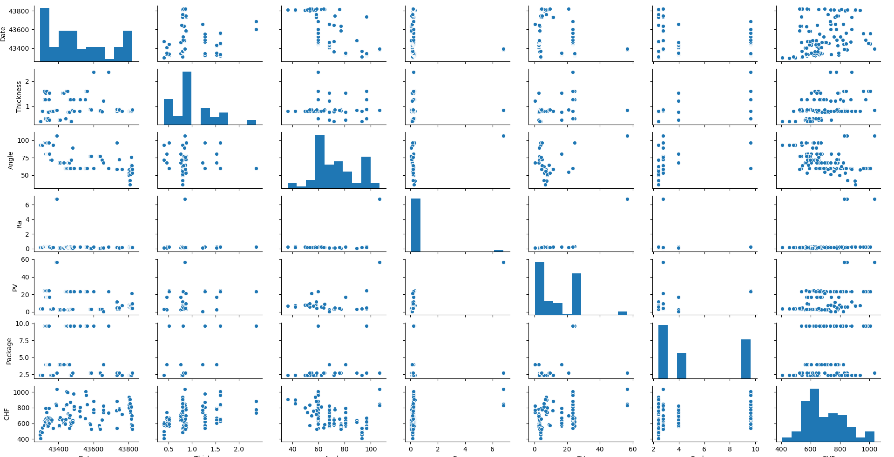
Data Pre-analysis

Slide 4

CHF VS. Package
Package = ( Density * Thermal C * Specific H ) ^ 0.5
Package
CHF
It is hard to summary the relationship between Package and CHF

Slide 5
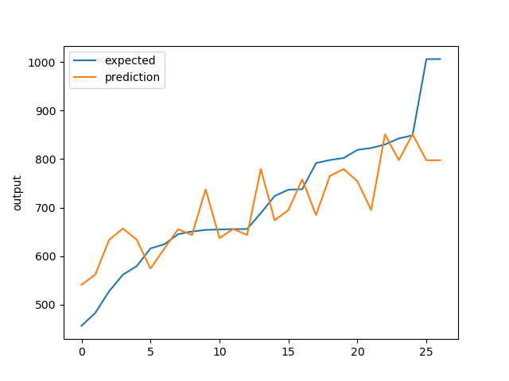
Neural Network
Not good

Slide 6
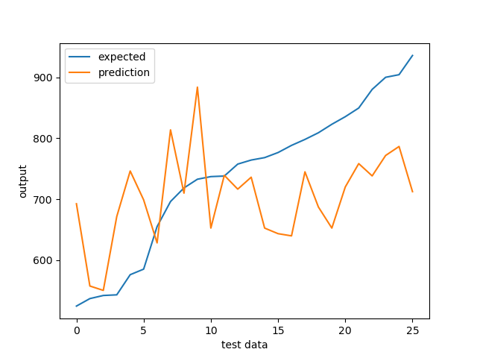
Lasso Regression
Not good

Slide 7
Specific Data
Select some Specific Data to improve predict quality

Slide 8
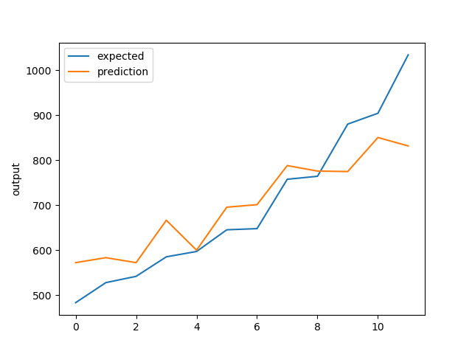
Zircaloy Only
Neural Network
Quality improved a lot

Slide 9
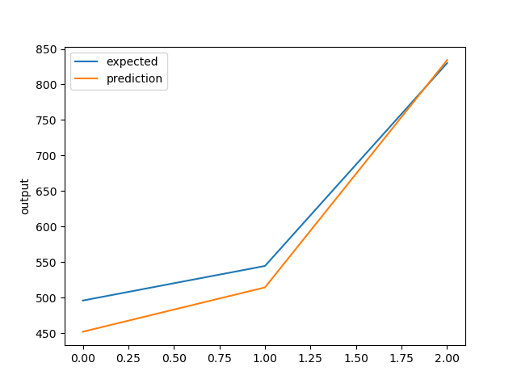
Zircaloy unpolished only
Neural Network
Quality improved a lot

Slide 10
BRASS Data
TestID | Date | Materials | Thickness | Surface | Angle | Ra | PV | Package | Oxidized | CHF
0.05''_Brass_1 | 43319 | Brass | 1.27 | Un-polished | 96.5 | 0.299333 | 24.44767 | 9.642016 | no | 575.6864
0.063''_Brass_1 | 43320 | Brass | 1.6 | Un-polished | 96.5 | 0.299333 | 24.44767 | 9.642016 | no | 629.9868
0.02''_Brass_1 | 43325 | Brass | 0.508 | Un-polished | 96.5 | 0.299333 | 24.44767 | 9.642016 | no | 620.3
0.05''_Brass_2 | 43326 | Brass | 1.27 | Un-polished | 96.5 | 0.299333 | 24.44767 | 9.642016 | no | 624.1421
0.063''_Brass_2 | 43328 | Brass | 1.6 | Un-polished | 96.5 | 0.299333 | 24.44767 | 9.642016 | no | 655.95
0.063''_Brass_3 | 43332 | Brass | 1.6 | Un-polished | 96.5 | 0.299333 | 24.44767 | 9.642016 | no | 650.8201
0.02''_Brass_2 | 43333 | Brass | 0.508 | Un-polished | 96.5 | 0.299333 | 24.44767 | 9.642016 | no | 671.8594
0.02''_Brass_3 | 43340 | Brass | 0.508 | Un-polished | 96.5 | 0.299333 | 24.44767 | 9.642016 | no | 615.9993
0.02''_Brass_4 | 43341 | Brass | 0.508 | Un-polished | 96.5 | 0.299333 | 24.44767 | 9.642016 | no | 568.712
0.05''_Brass_3 | 43346 | Brass | 1.27 | Un-polished | 96.5 | 0.299333 | 24.44767 | 9.642016 | no | 624.5236
The data seems not perfect

