Slide 1
Democratizing Sustainable Innovation
Integrating AutoML and AI-Driven Learning Ecosystems to Bridge STEM in Applied and Vocational Education
Dr. Tertsegha Joseph Anande, PhD, FHEA
Lecturer – Computing | Deputy Programme Leader QAHE–Ulster University, Birmingham, UK Tertsegha.Anande@qa.com | www.drtertseghaanande.com
ICRIEMS 2026 | Invited Keynote

Slide 2
Keynote Overview
1
The Democratisation Imperative
Why vocational AI education is structurally broken — and why AutoML can help fix it
2
MoSELA AutoML
A modular, open-source framework — workflow diagram & research evidence
3
Digital Transformation Studio
AI-powered formative learning at scale — system architecture & 98%+ pass rate data
4
Responsible AI in the Curriculum
Explainability, reproducibility and ethical reasoning as core competencies
5
Pedagogical Framework
A four-layer model for scalable AutoML-integrated STEM education
6
Implications & Future Directions
Policy, practice, and open research questions

Slide 3
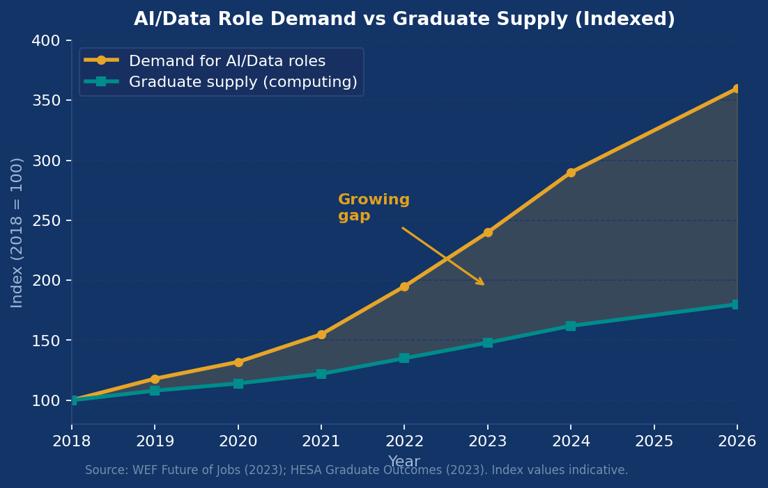
The Structural Gap: Why Vocational AI Education Is Falling Behind
The Problem Space
Math-heavy curricula gatekeep learners without strong pre-university STEM backgrounds
Curriculum review cycles lag 2–3 years behind industrial tool evolution
Assessments reward recall over adaptive, interdisciplinary reasoning
Non-traditional students face disproportionate access barriers
Graduates arrive in industry ill-equipped for AI-assisted pipelines
Source: WEF Future of Jobs (2023); HESA Graduate Outcomes (2023)
SDG 4: Quality Education
SDG 9: Innovation
SDG 17: Partnerships

Slide 4
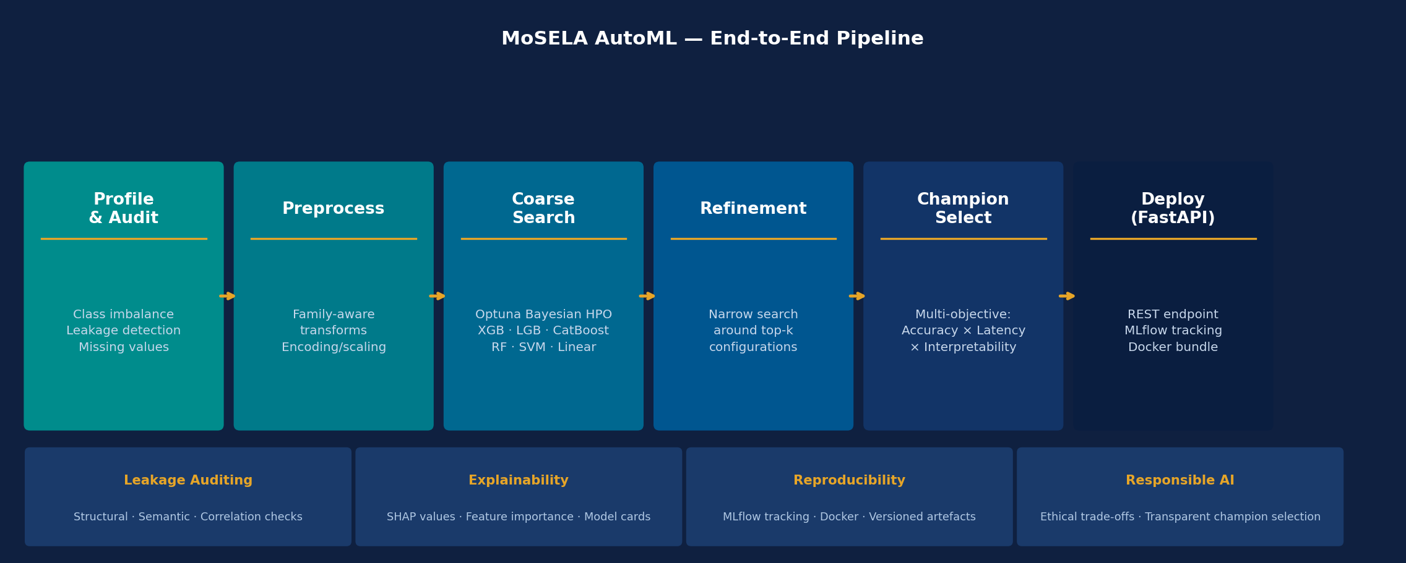
AutoML as a Democratising Force — MoSELA Pipeline
github.com/Tertsegha1/mosela-automl
AutoML redistributes cognitive load — moving learners from mechanical implementation to meaningful interpretation.

Slide 5
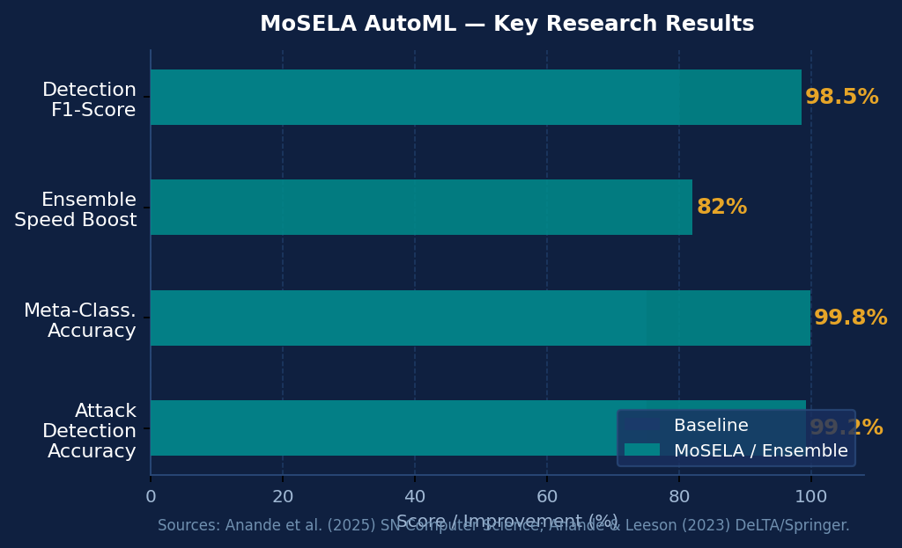
MoSELA AutoML — Research Outcomes
>99%
~100%
>80%
5+
Attack detection accuracy
Meta-classification accuracy
Learning performance boost
Peer-reviewed publications
multi-class network traffic (Anande et al., 2025)
imbalanced datasets (Anande & Leeson, 2023)
Stack Ensemble Meta-Learning (Anande et al., 2025)
ML & cyber-physical security
Publication Stack
Anande et al. (2025). Boosting Ensemble Meta-Learning + Optuna. SN Computer Science.
Anande & Leeson (2023). GANs + XGBoost for APT Classification. DeLTA, Springer.
Alsaadi, Anande & Leeson (2024). 1D-CNN vs 2D-CNN for Network Intrusion. EIDWT, Springer.
Anande & Leeson (2022). GANs Survey: Network Traffic Generation. IJMLC 12(6).

Slide 6
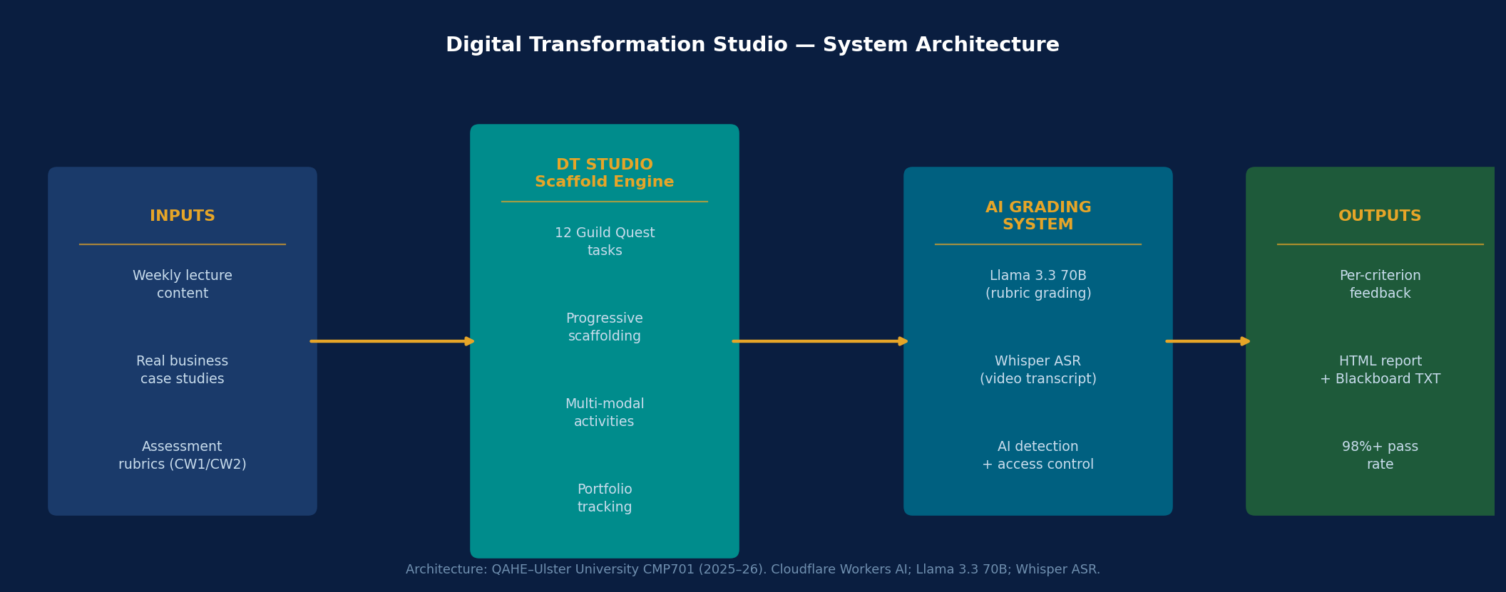
Digital Transformation Studio & AI-Powered Assessment
System Architecture
12 Weeks
Formative scaffold
Llama 3.3 70B
Grading engine
Zero Cost
Server infrastructure
98%+
Pass rate achieved

Slide 7
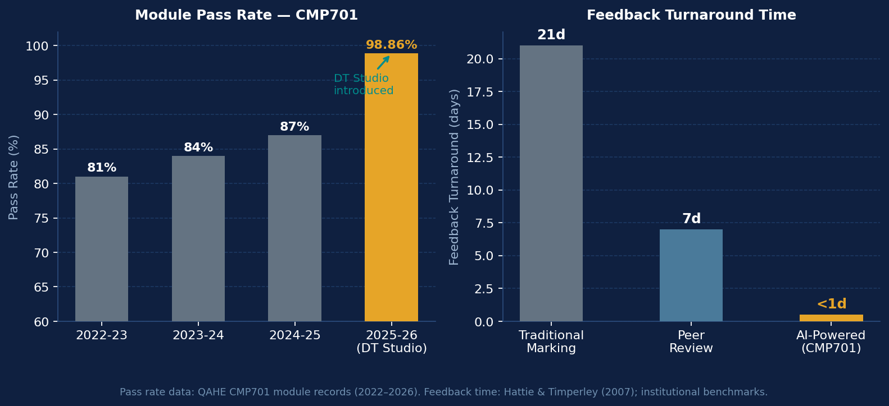
Evidence: CMP701 Outcomes — MSc Digital Transformation 2025–26
98%+
1.14%
12 wks
Zero
Module Pass Rate
Failure Rate
Formative Scaffold
Server Cost
2025–26 cohort
vs ~13–19% prior
Guild Quest cadence
browser-only system
Student Voice
"Instant feedback meant I could improve before I forgot."
"Guild Quests kept me accountable — I didn't fall behind for the first time."
"The AI feedback was more detailed than I expected and very fair."
Hattie & Timperley (2007): feedback immediacy is one of the highest-effect educational interventions.

Slide 8
Responsible AI in the Curriculum: Beyond Tooling to Disposition
Explainability
Reproducibility
Ethical Deployment
SHAP value outputs + feature importance are first-class pipeline artefacts. Learners must answer: Which features drive predictions — and are they substantively appropriate?
MLflow logs every config, metric and artefact. Docker ensures consistent execution. All results must be fully replicable by a peer reviewer.
Champion selection requires explicit accuracy–interpretability trade-offs. Leakage audits prompt reflection on data provenance and potential downstream harm.
Regulatory Context
EU AI Act (2024): high-risk systems must demonstrate transparency & auditability
UK AI Safety Institute: reproducibility & explainability are foundational to safe deployment
QAA Computing Benchmark (2023): responsible practice is a required graduate attribute

Slide 9
A Four-Layer Pedagogical Framework for AutoML-Integrated STEM Education
1
2
3
4
Contextualisation
Scaffolded Exploration
Critical Reflection
Applied Production
Frame a sustainability problem (energy, cities, health). Articulate it as an ML task. Stakeholder analysis + data ethics first.
Use MoSELA AutoML with guided prompts. Attention to profiling reports, leakage warnings, SHAP values. Scaffolding fades as competence grows.
Does the model generalise? Are features ethically appropriate? What are the consequences of errors in this context? Written/verbal defence.
Deploy via FastAPI. Document for a non-technical stakeholder audience. Connects computation to real-world value creation.
SDG Alignment: SDG 4 (Quality Education) · SDG 9 (Industry & Innovation) · SDG 17 (Partnerships for the Goals)
WEF Future of Jobs (2023): Analytical thinking, AI literacy & creative problem-solving — top 3 fastest-growing competency demands. This framework addresses all three.

Slide 10
Implications & Future Directions
For Educators & Curriculum Designers
For Institutional Leaders & QA
Open Research Questions
AutoML integration is structural, not enrichment
AI-powered assessment demonstrably improves outcomes
Longitudinal tracking of AutoML-educated graduate outcomes
Create space for iterative, tool-mediated learning
Invest in staff capacity to evaluate AI-generated feedback
Differential effects by demographics — does it reduce gaps?
Critical AI literacy must accompany technical skills
Design assessments that remain meaningful with AI
Sector-wide benchmarking for AI assessment tools
AI assessment tools close the feedback gap at scale
Equitable AI tooling access is a widening-participation issue
Extend MoSELA to multimodal & time-series domains

Slide 11
Conclusion
AutoML lowers barriers without lowering standards — it redistributes cognitive load toward interpretation & reasoning.
AI-driven learning ecosystems (DT Studio + automated grading) deliver measurable, scalable improvements in learner outcomes.
Responsible AI competencies — explainability, reproducibility, ethical deployment — can and must be taught through doing.
The four-layer model provides a practical curriculum template for any applied STEM programme.
The future of vocational STEM education is intelligent, scalable, and inclusive. And it is already underway.
"The future of vocational STEM education is intelligent, scalable, and inclusive."

Slide 12
Key References & Contact
Anande, T.J., Alsaadi, S. & Leeson, M. (2025). Enhanced Modelling with Boosting Ensemble Meta-Learning + Optuna. SN Computer Science, 6.
Anande, T.J. & Leeson, M.S. (2023). Synthetic Network Traffic Data Generation & APT Classification (GANs + XGBoost). DeLTA, Springer.
Alsaadi, S., Anande, T.J. & Leeson, M.S. (2024). 1D-CNN vs 2D-CNN for Network Intrusion Detection in SDN. EIDWT, Springer.
Anande, T.J. & Leeson, M.S. (2022). GANs: A Survey of Network Traffic Generation. IJMLC, 12(6), 333–343.
Hattie, J. & Timperley, H. (2007). The power of feedback. Review of Educational Research, 77(1), 81–112.
World Economic Forum (2023). Future of Jobs Report 2023.
UNESCO (2021). Reimagining our futures together: A new social contract for education.
Dr. Tertsegha Joseph Anande, PhD, FHEA | QAHE–Ulster University, Birmingham
ICRIEMS 2026
Tertsegha.Anande@qa.com | www.drtertseghaanande.com | github.com/Tertsegha1

