Slide 1






ASYNCHRONOUS JOB + WORKER + HTTP 202
By Teryn Guzman

Slide 2
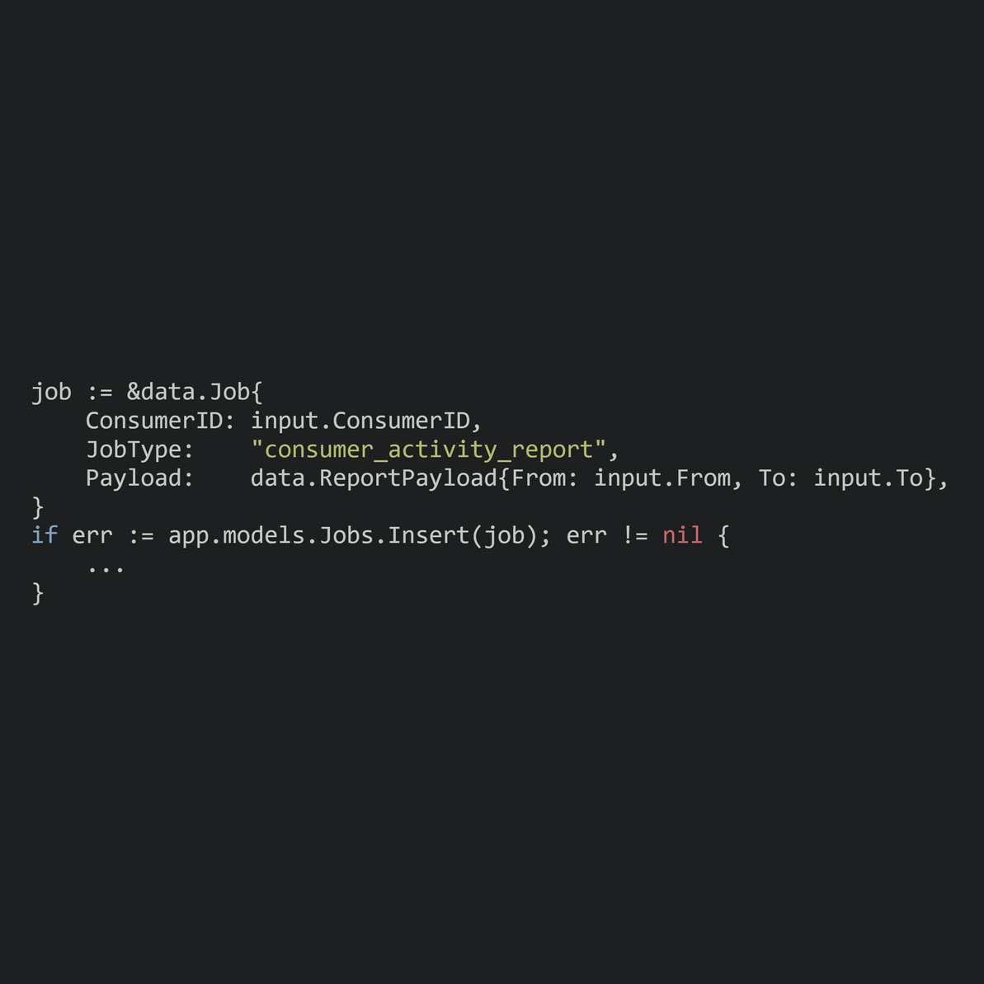
THE PROBLEM AND REQUIREMENT
WHY NOT DO REPORT GENERATION INLINE?
Synchronous processing makes the client wait.
Longer reports increase acknowledgement latency.
Long requests can risk HTTP timeouts.
Asynchronous processing accepts the work first.
Request lifetime and work lifetime are separated.
POST RETURNS QUICKLY --> WORKER PROCESSES THE REPORT IN THE BACKGROUND

Slide 3

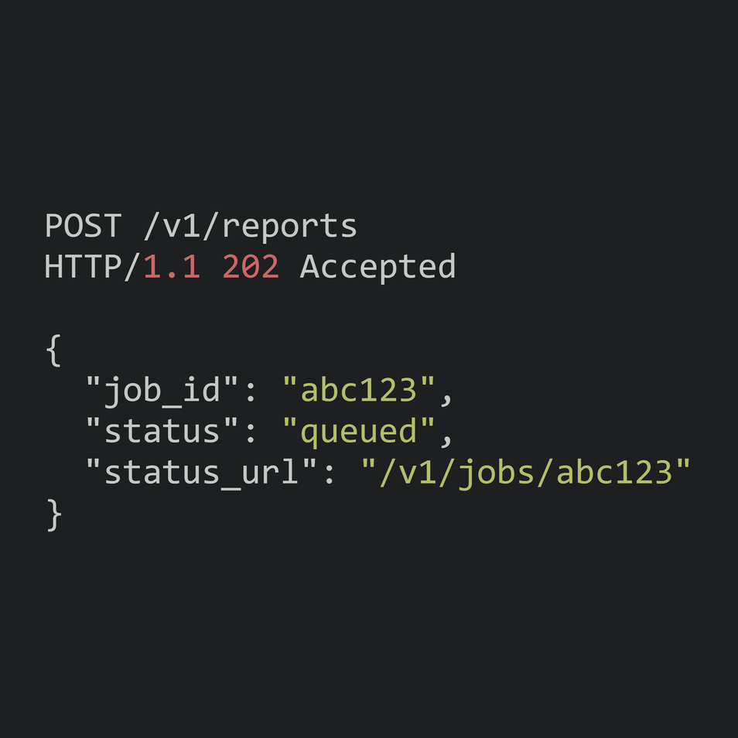
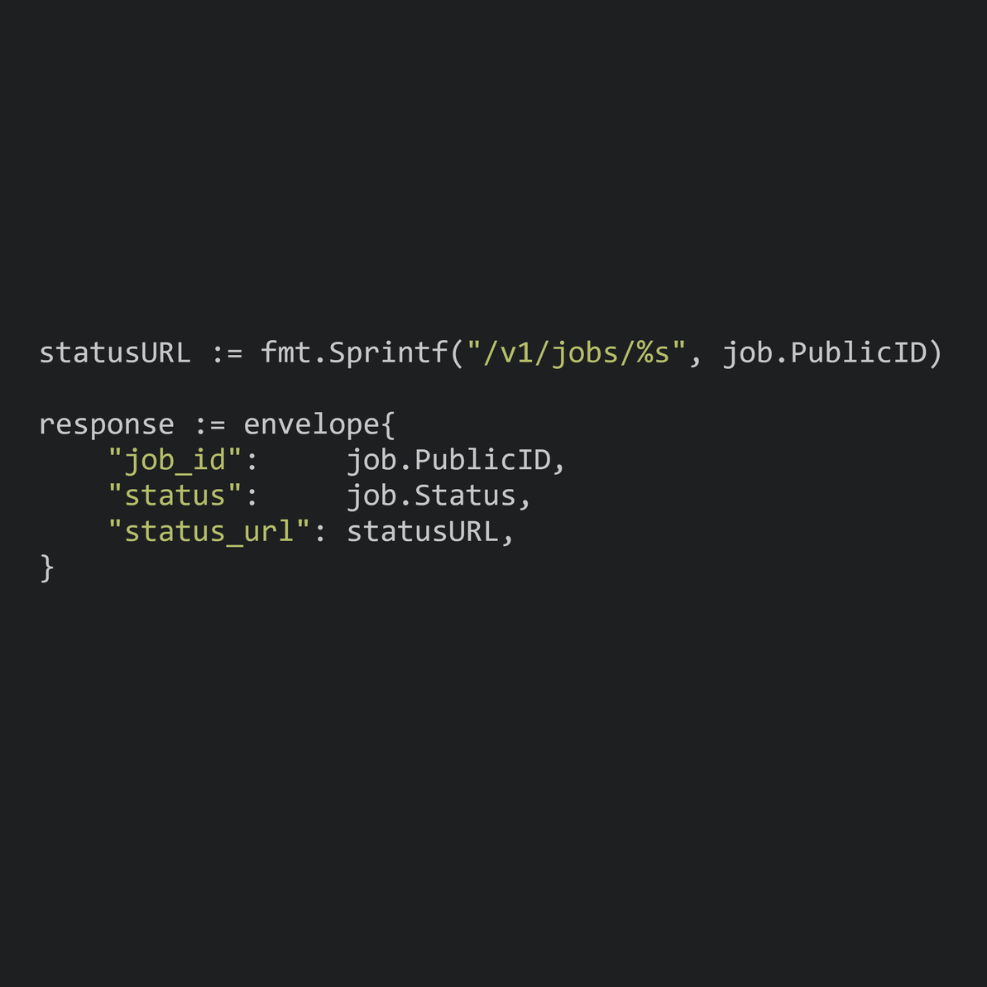
HTTP CONTRACT
POST RETURNS 202 ACCEPTED, NOT A FINISHED REPORT
Client sends consumer_id, from, and to.
Server validates the request.
A job is created with status queued.
Server immediately returns 202 Accepted.
Response provides job_id and status_url.
EXAMPLE
202 ACCEPTED = WORK ACCEPTED FOR LATER PROCESSING

Slide 4
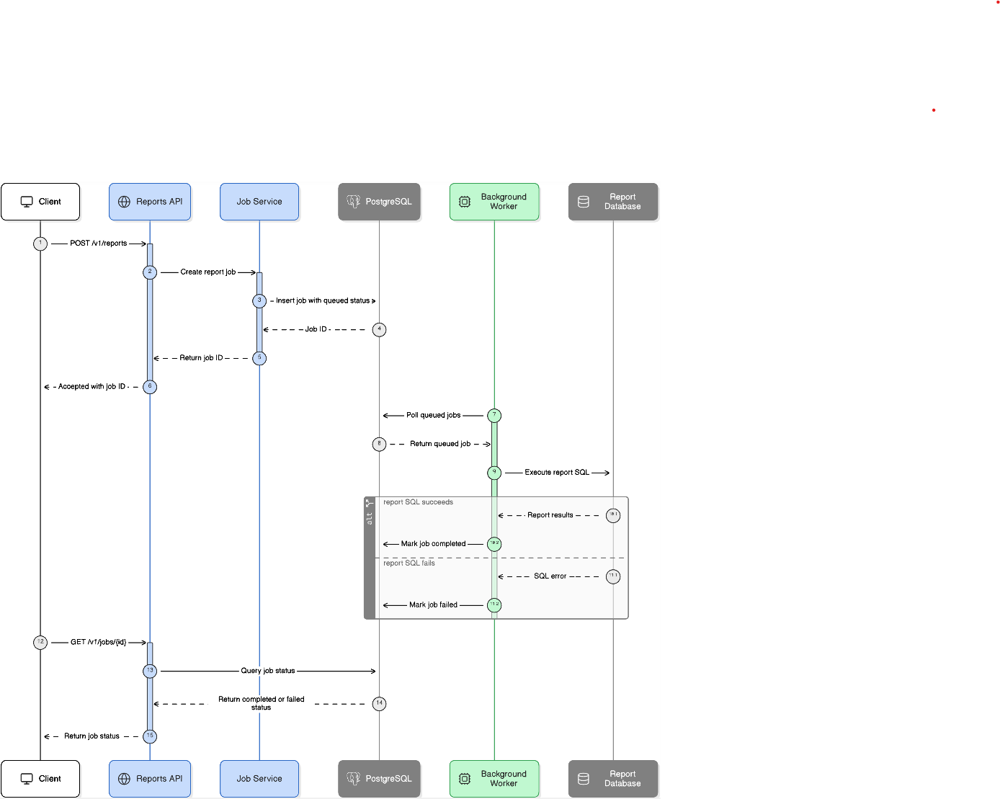
SYSTEM ARCHITECTURE
RESPONSIBILITIES
Request Handler → accepts the work
PostgreSQL → stores job state
Worker → executes the job
GET Handler → observes job state

Slide 5

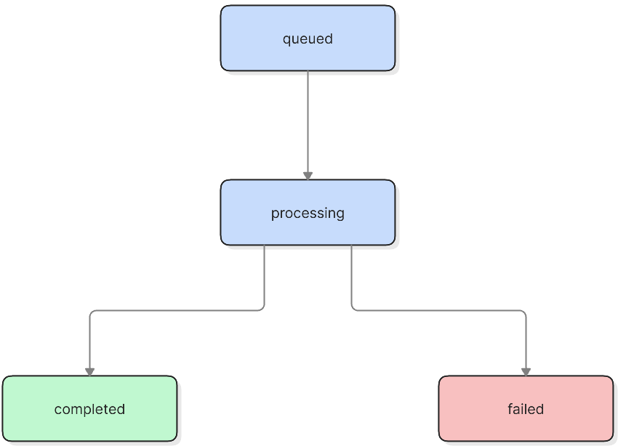

JOB STATE TRANSITIONS
STATES
Queued --> waiting to be claimed
Processing --> worker has claimed the job
Completed --> report generated successfully
Failed --> report or serialization error
FUNCTIONS
Insert --> queued
ClaimNext --> processing
MarkCompleted --> completed
MarkFailed --> failed
JOB STATE TRANSITIONS

Slide 6


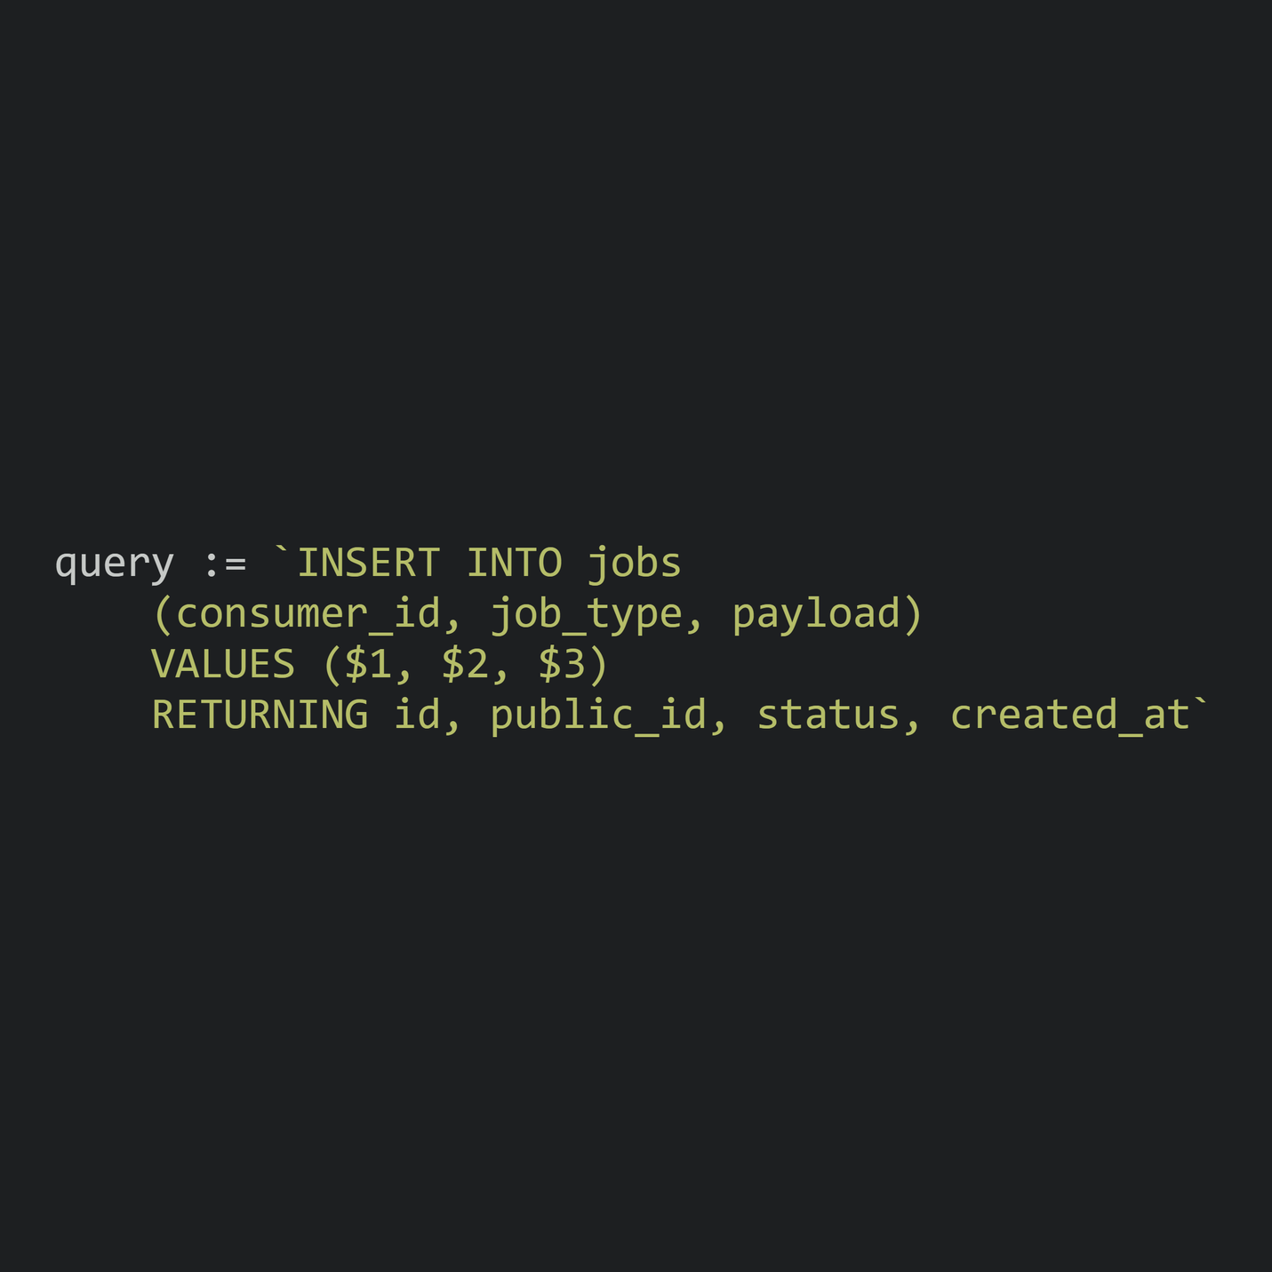
CREATING & STORING THE JOB
JOB CONTAINS
consumer_id
job_type
payload
status
result
error_message
timestamps
IMPORTANT POINTS
Payload is stored as JSON.
RETURNING gets database-generated values.
PublicID is exposed to the client.
Internal ID stays hidden.

Slide 7
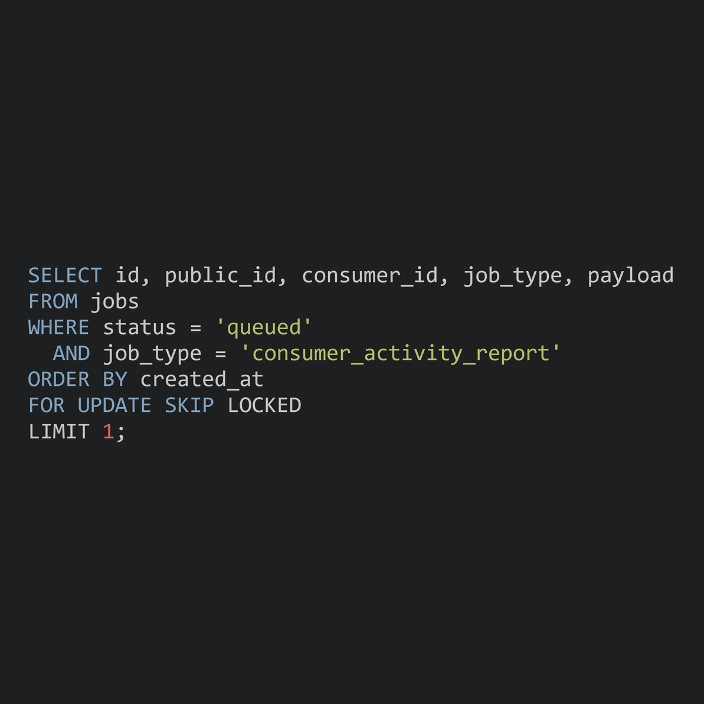
SAFE WORKER ACQUISITION
SAFE WORKER ACQUISITION WITH POSTGRESQL LOCKING
Claim runs inside a transaction.
WHERE status = 'queued' selects waiting jobs.
ORDER BY created_at prioritizes older jobs.
FOR UPDATE locks the selected row.
SKIP LOCKED prevents other workers from blocking.
PREVENTS TWO WORKERS FROM CLAIMING THE SAME JOB.

Slide 8
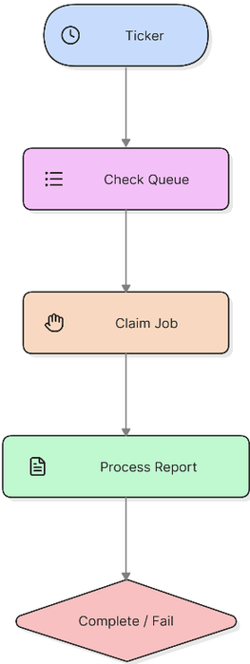
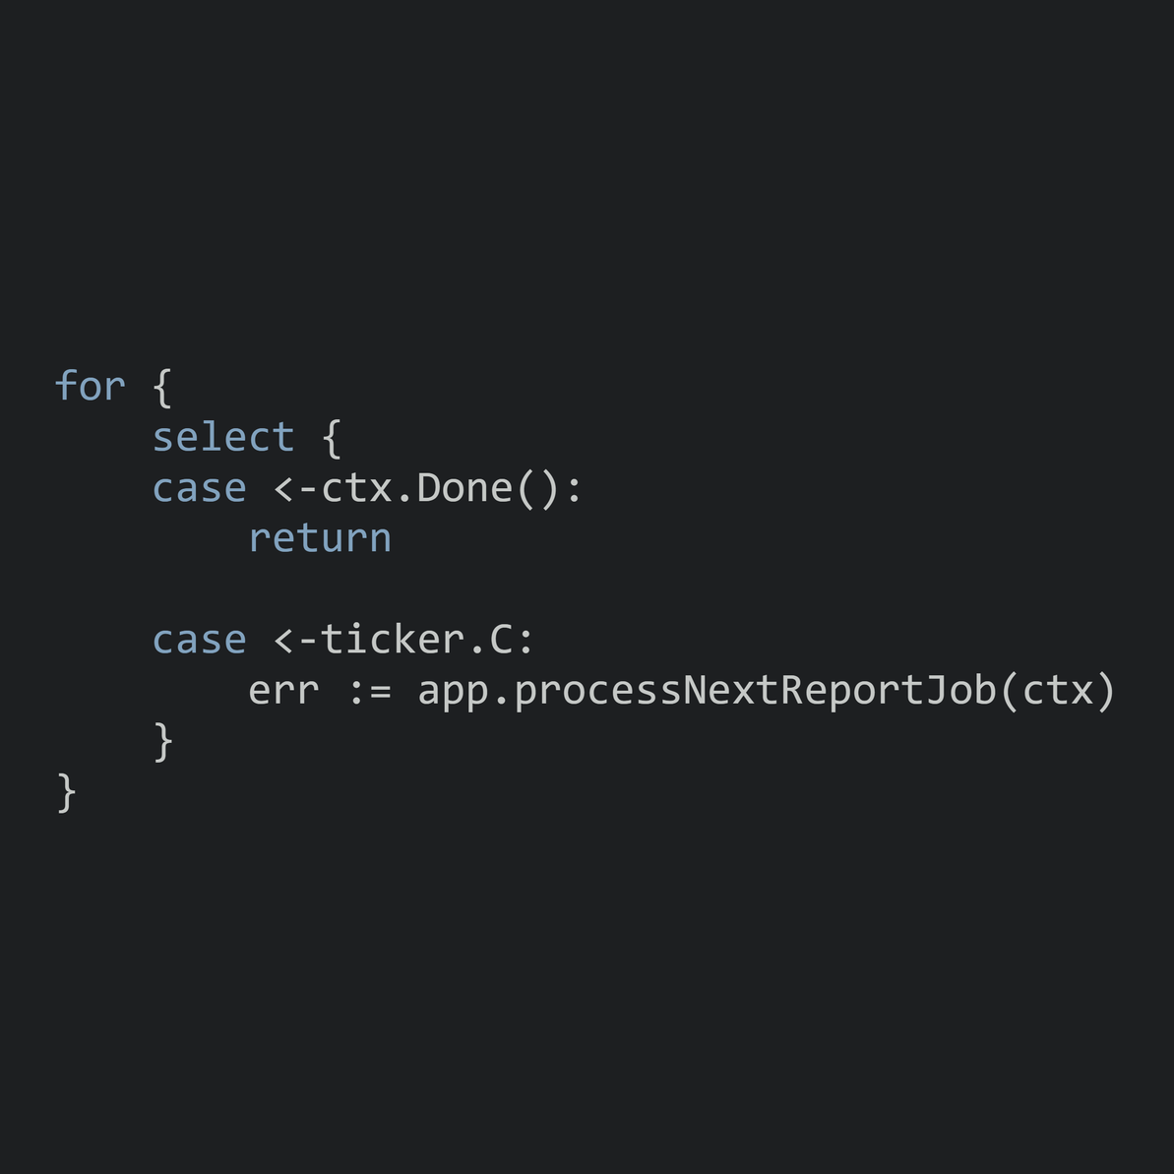
WORKER BEHAVIOR
WORKER FLOW
THE WORKER POLLS, WAITS & CANCELS SAFELY
One worker runs independently from HTTP requests.
A goroutine runs the polling loop.
A ticker checks for new jobs periodically.
ctx.Done() allows the worker to stop.
Artificial delay runs in the worker, not POST.
Cancellation can interrupt the delay.

Slide 9
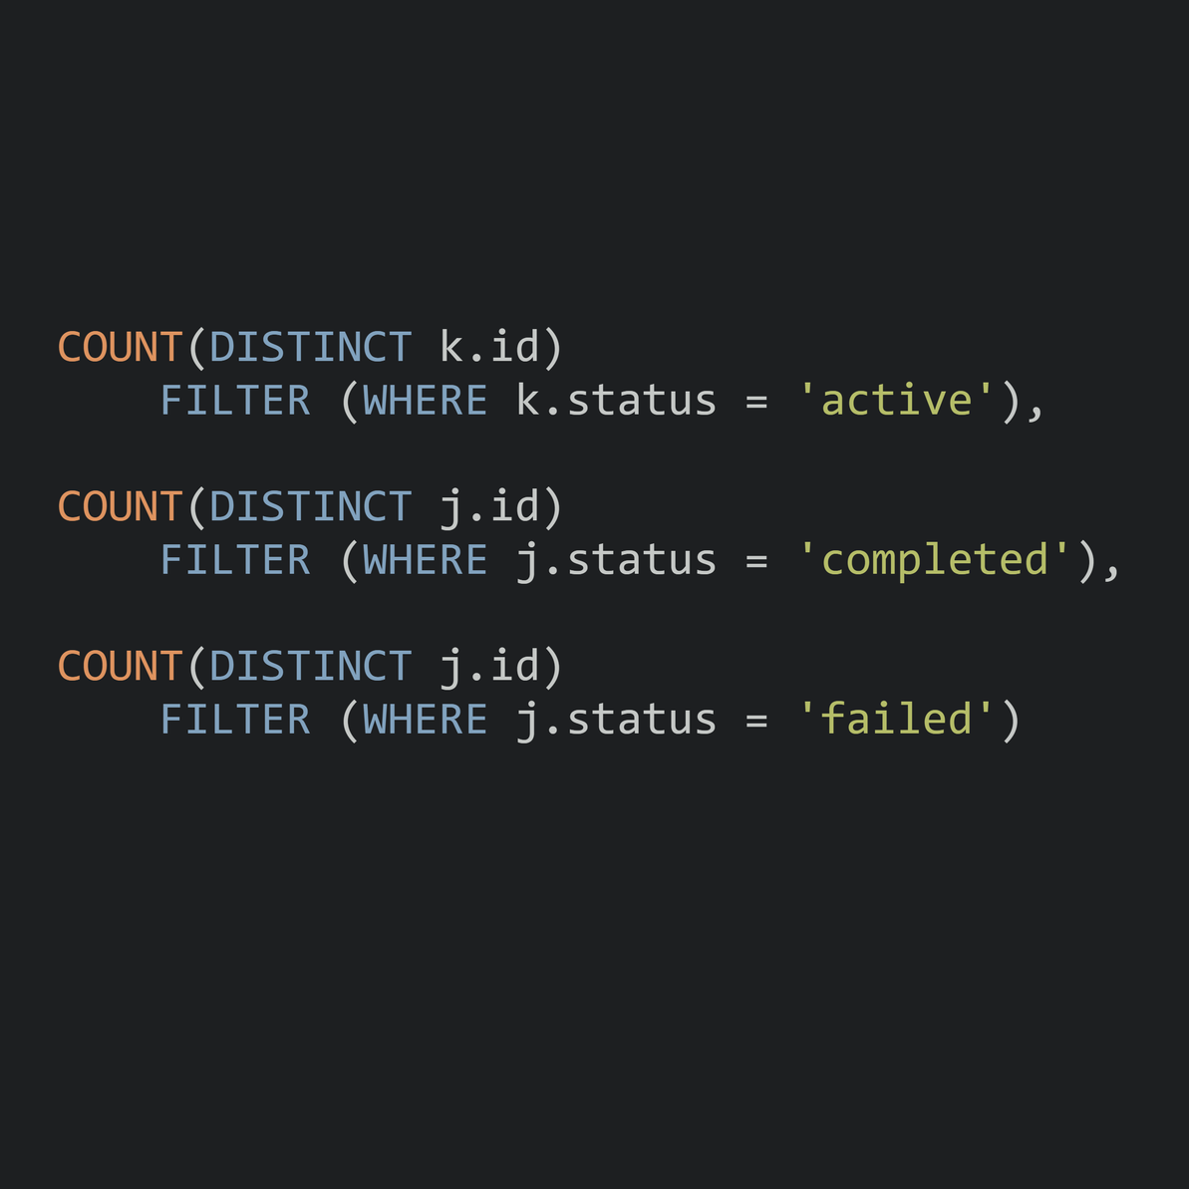
REPORT SQL
CONSUMER ACTIVITY REPORT QUERY
LEFT JOIN keeps the consumer even without child records.
COUNT(DISTINCT ...) prevents inflated counts.
FILTER (WHERE ...) separates status counts.
Date range uses >= start and < end.
GROUP BY produces one result per consumer.
OUTCOME
SUCCESS --> MARKCOMPLETED()
FAILURE --> MARKFAILED()

Slide 10
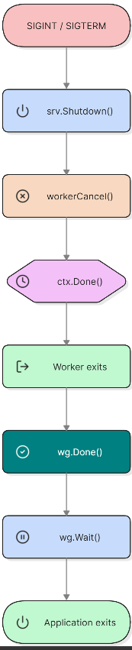
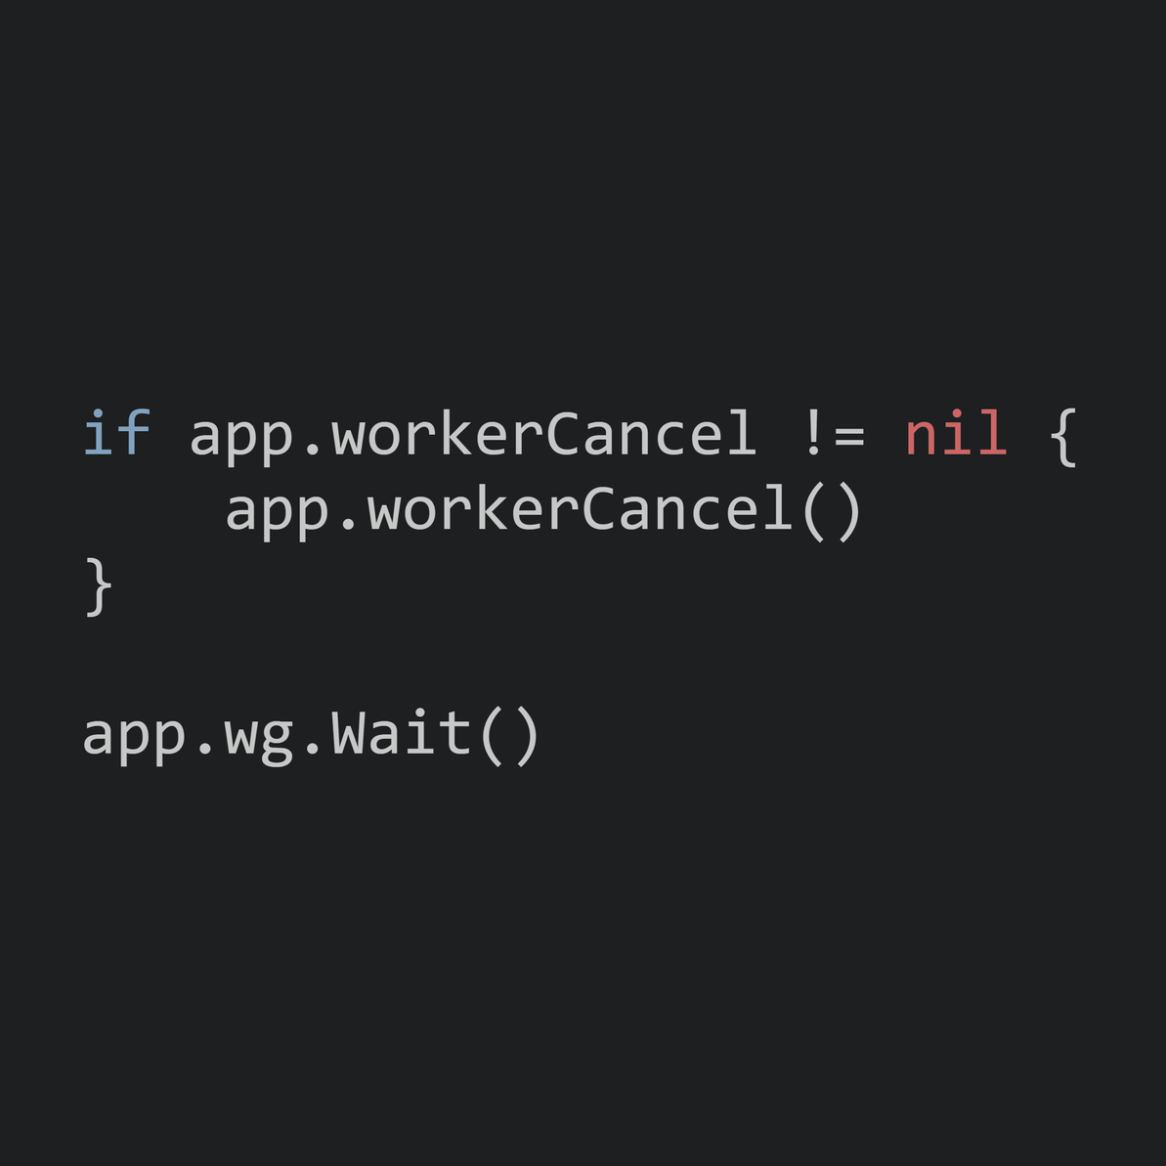
GRACEFUL SHUTDOWN
CTRL+C SHUTDOWN SEQUENCE
WHY?
srv.Shutdown() stops new HTTP work.
workerCancel() tells the worker to stop.
ctx.Done() causes the worker loop to exit.
wg.Wait() waits for the worker to finish.
Prevents a race during shutdown.

Slide 11
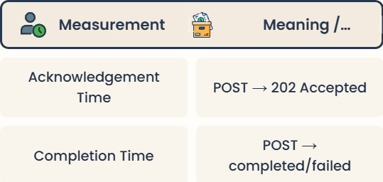
MEASUREMENT & INTERPRETATION
EXPERIMENT
Run with reportDelay: 0s, 3s, 7s, 12s
Measure acknowledgement time.
Measure completion time.
Compare the results.
WHY ACKNOWLEDGEMENT AND COMPLETION DIFFER
EXPECTED RESULT
Acknowledgement stays relatively fast.
Completion time increases with reportDelay.
KEY TAKEAWAY
Fast acceptance + slow background execution

Slide 12










THANK YOU

