Slide 1
Bitcoin Miner Implementation Using Nvidia CUDA
Eleftherios Amperiadis
City College of New York
Senior Design II
Spring 2019

Slide 2
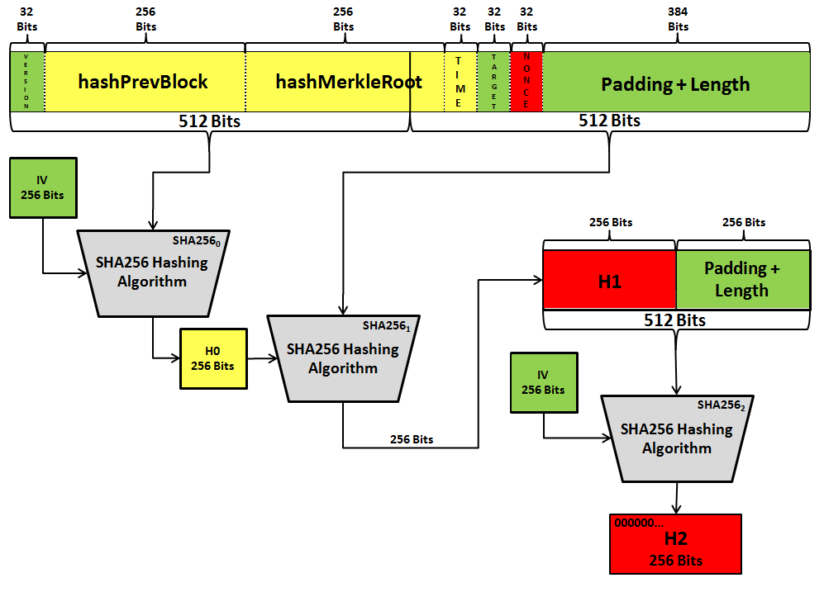
What is Bitcoin Mining?
It is the process of applying three rounds of the SHA256 hashing algorithm to a 640-bit long block header to get a 256-bit output H2.
If H2 is less than or equal to the difficulty vector, the mining is a success.

Slide 3
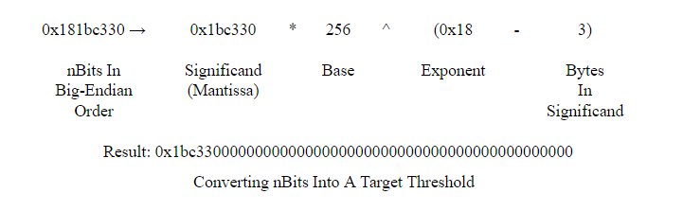
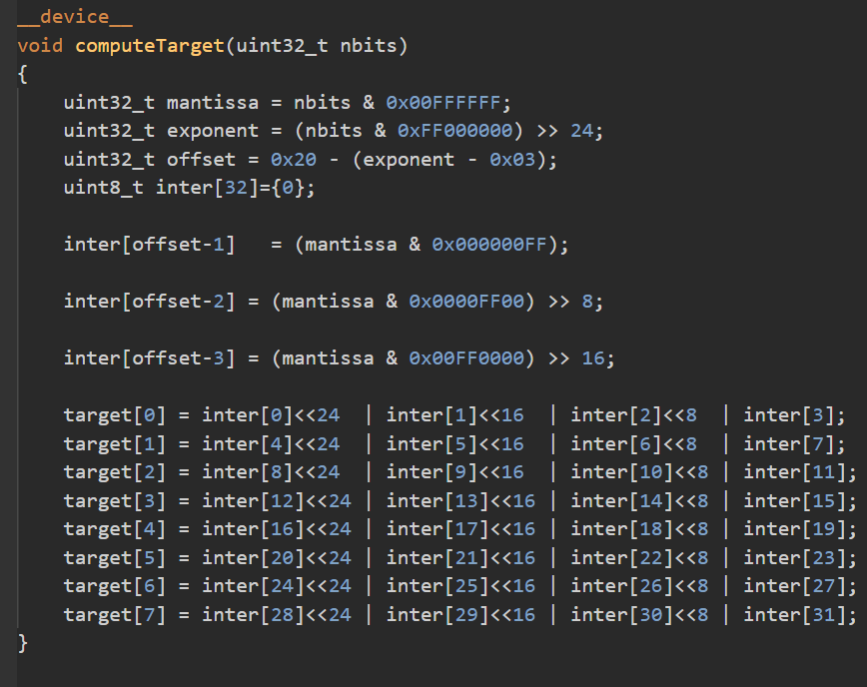
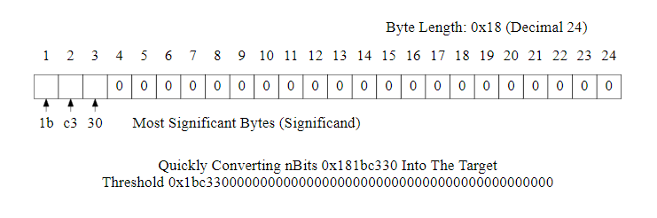
Difficulty Vector
The 32-bit long target in the block header is expanded into a 256-bit difficulty vector.
On the left is the specification of this expansion as shown in the Bitcoin developers manual.
On the right is my implementation of this operation. It is similar to the way floating point numbers are encoded.

Slide 4
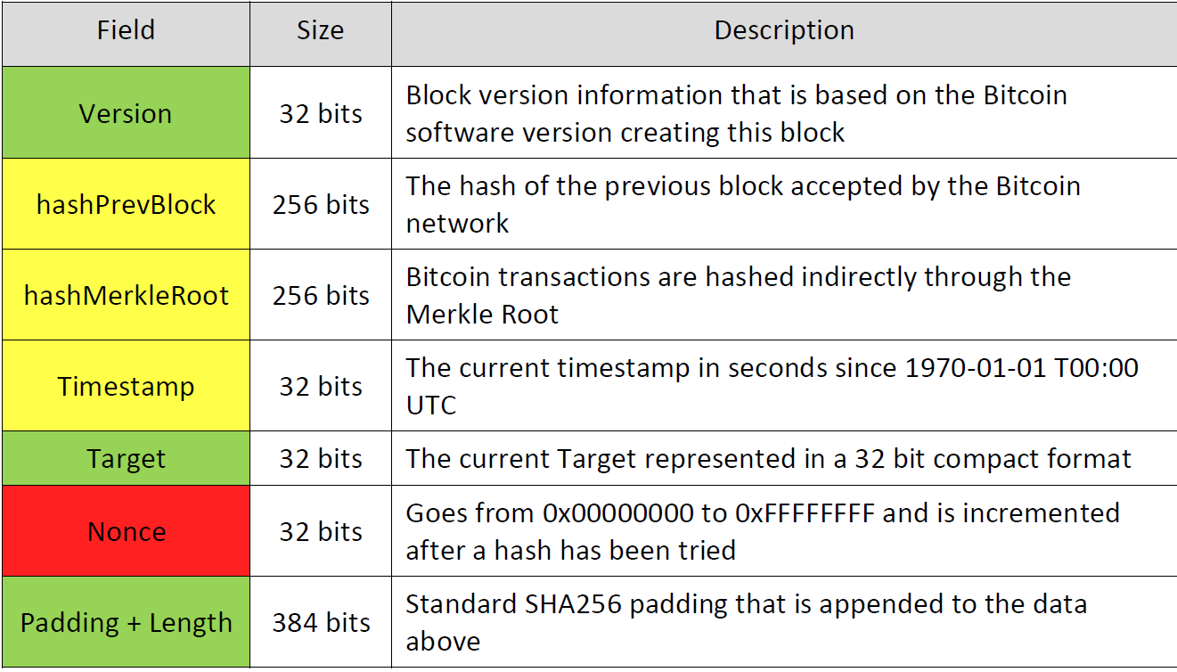
The Bitcoin Block Header in Detail
The fields in Green rarely change.
The fields in yellow change, but not frequently.
The fields in red change after every attempted hash.
This analysis is important for optimizing the miner in later sections. Some rounds of SHA256 do not have to be repeated, which saves computations.

Slide 5
Why is Bitcoin mining needed?
The process of mining is to solve a proof-of-work problem.
The collective of miners attempting to solve this problem are all in a competition to solve the problem first.
Throughout this process, miners are confirming, recording and validating transactions of Bitcoin which is a valuable service to the Bitcoin network.
The miner who solves the proof-of-work problem is rewarded with Bitcoin as an incentive.

Slide 6
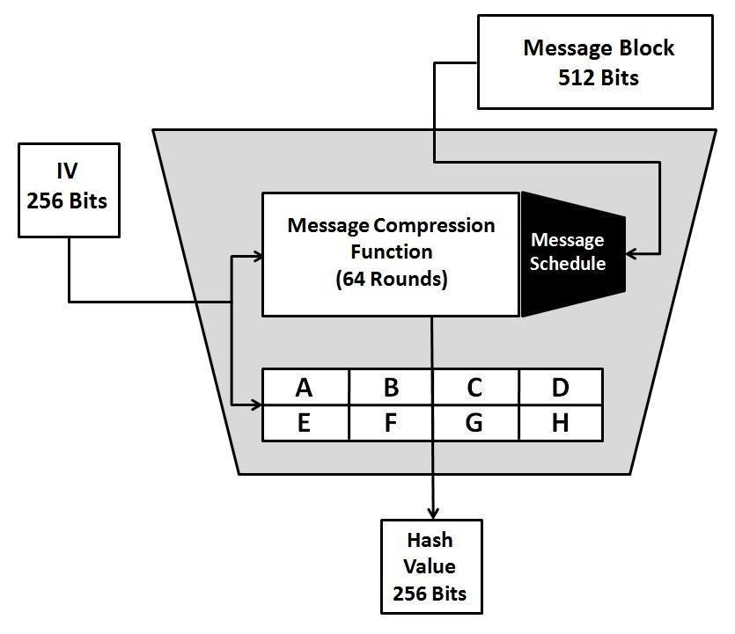
The SHA256 Hashing Algorithm
SHA256 is part of a family of cryptographic hash functions developed by the National Security Agency.
The SHA256 algorithm can accept strings up to 2⁶⁴-1 bits long and will compress these strings down to 256-bit output.

Slide 7
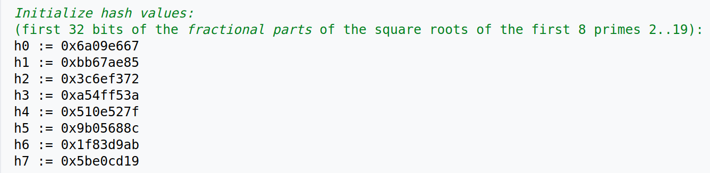
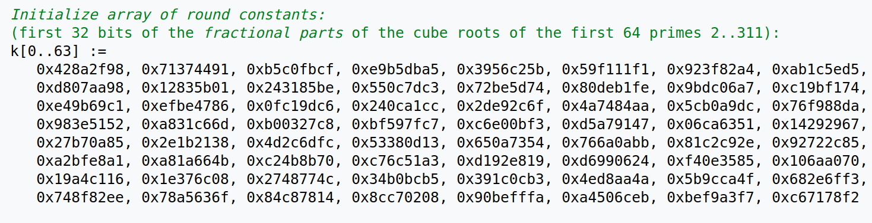
SHA256 Constants

Slide 8
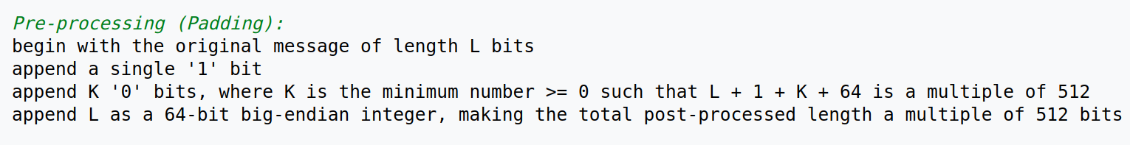
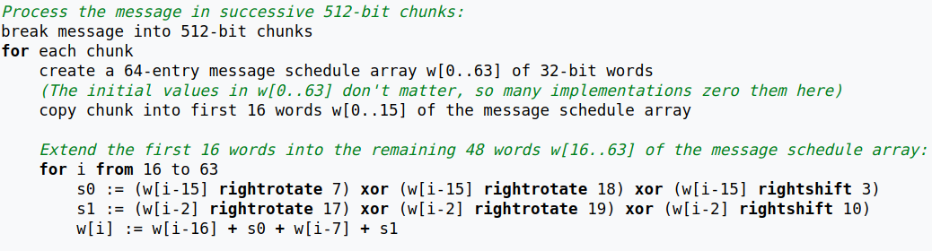
SHA256 Padding and Schedule Array Generation

Slide 9
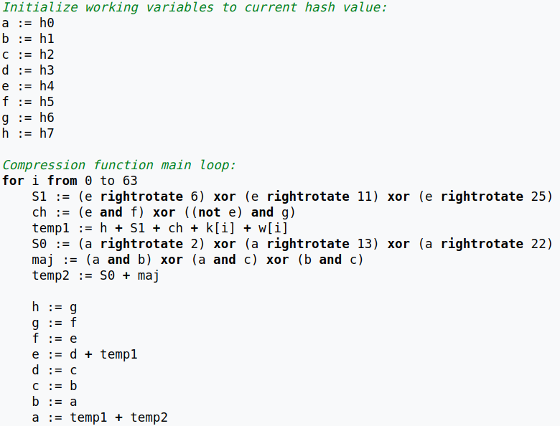
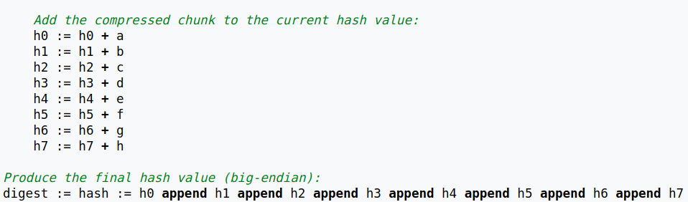
SHA256 Compression Function

Slide 10
Development Process
First, an SHA256 Nvidia CUDA kernel was created.
Over the course of several months, this kernel was continuously optimized.
Seven major versions of the kernel exist, each better than the last.
Version 8 has the complete Bitcoin miner using version 7’s SHA256 kernel as an engine.

Slide 11
Why use Nvidia CUDA?
Because of the computationally intensive nature of generating a hash of a string using SHA256, a parallel computation devices such as a Graphics Processing Unit (GPU) is advantageous.
A single SHA256 hash can not be computed in parallel, however multiple computational cores such as those present in a GPU can solve multiple hashes per clock cycle iteration.

Slide 12
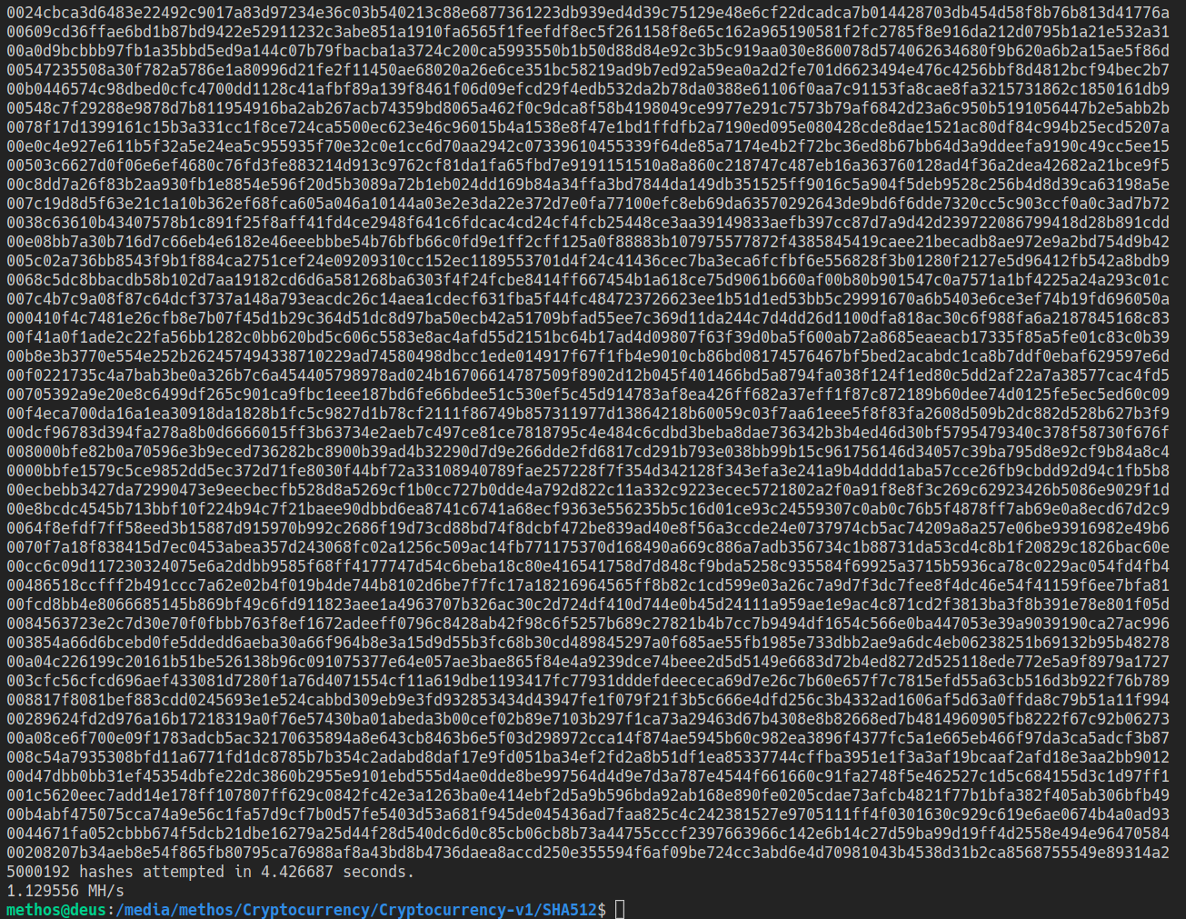
SHA256 Implementation Version 1
The first version of the SHA256 CUDA kernel achieves about 1 MH/s.
In this context, MH/s refers to 1,000,000 hashes per second.

Slide 13
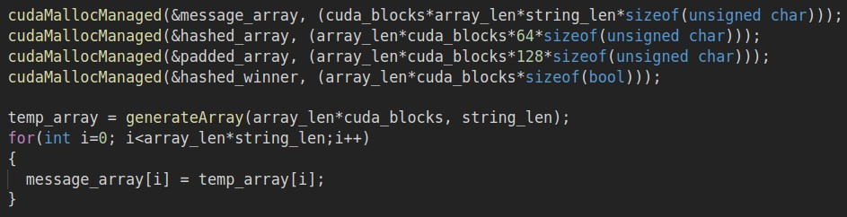
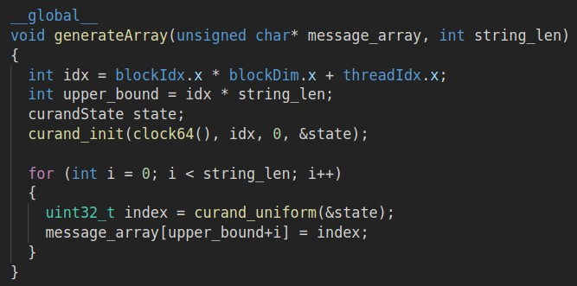
SHA256 Implementation Version 2
The function that generates random strings that feeds the SHA256 Kernel was moved from the host(CPU-top) to the device(GPU-bottom).
Curand CUDA library was used to generate random uint32_t values.
Performance improved up to 8.5 MH/s.

Slide 14
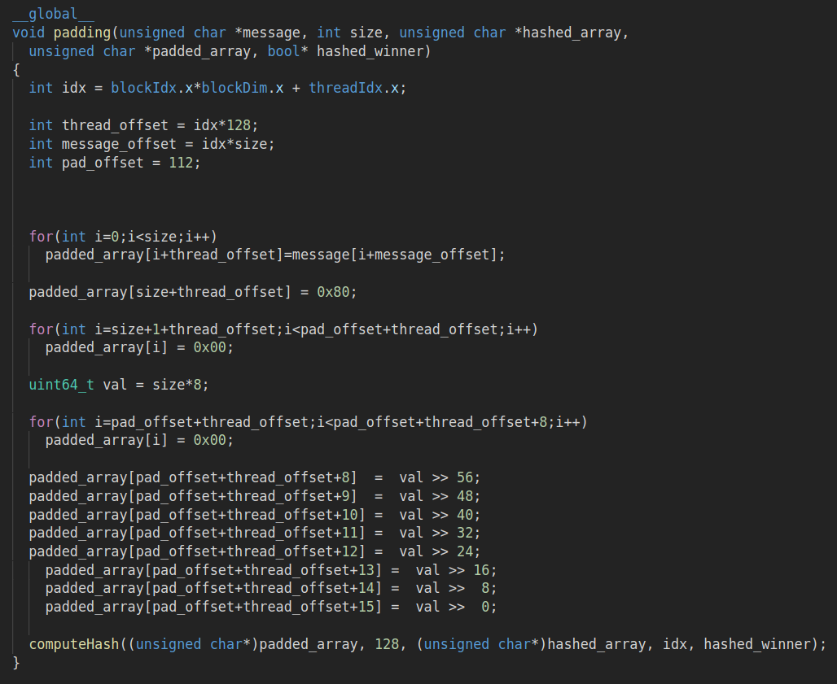
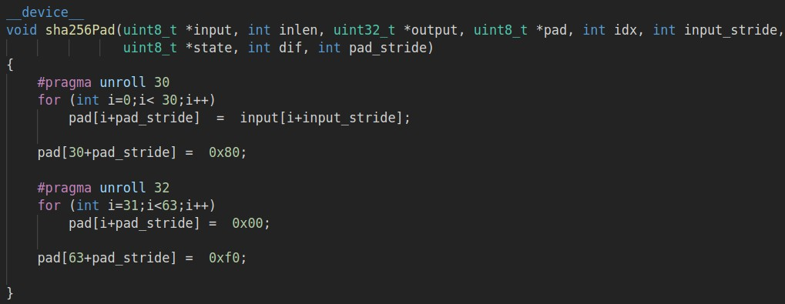
SHA256 Implementation Version 3
Padding was optimized to be more streamline from v.2 (left) to v.3 (bottom).
The #pragma unroll directive was used to unroll loops.
Performance increased to 24 MH/s.

Slide 15
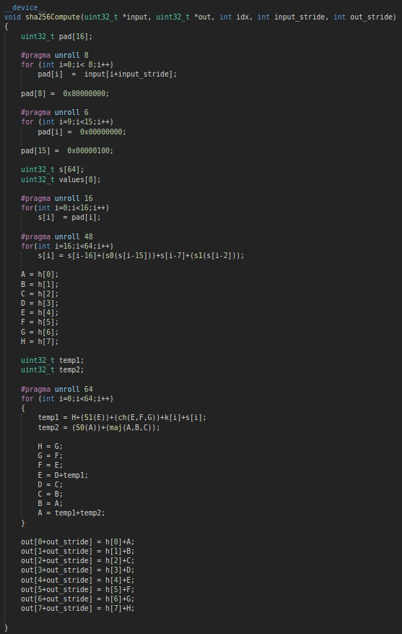
SHA256 Implementation Version 4
v.4 combines the padding and compression functions, thus reducing per thread function calls.
It also uses the same word sizes, which allows for fewer read-writes from memory by transferring 32-bits at a time instead of 8-bits. Total looping goes from 64 down to 16 for padding.
Performance went up to 28 MH/s.

Slide 16
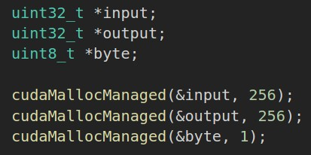
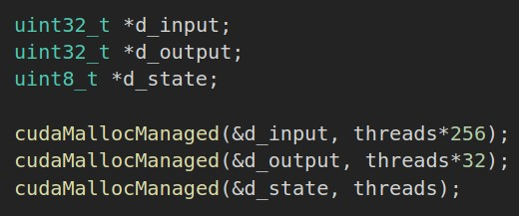
SHA256 Implementation Version 6
Minimized memory transfer from host to device by statically allocating the memory on the device.
We are only interested in a single input and output, not all inputs and outputs. This allows us to only transfer 512 bits total, down from 512 bits times thread count.
Top left is v.6. Bottom left is all prior versions.

Slide 17
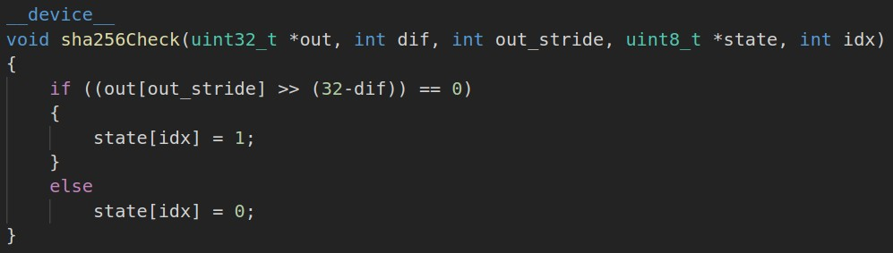
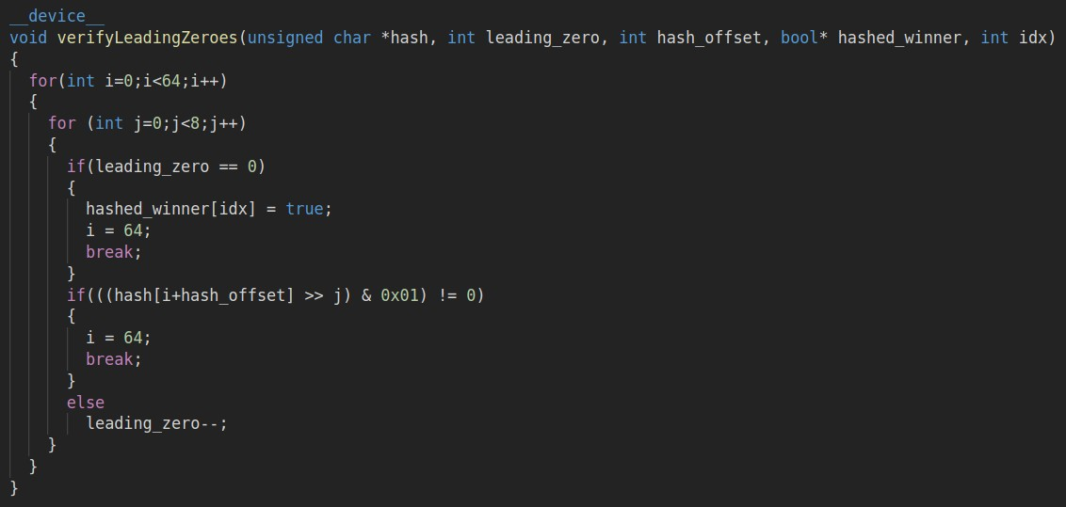
Version 6 Continued
Function for checking which H2 is valid was simplified. Instead of iterating through each bit using loops, bit-wise shift operations were used to quickly compare values.
Top left is v.6. Bottom left is all prior versions.

Slide 18
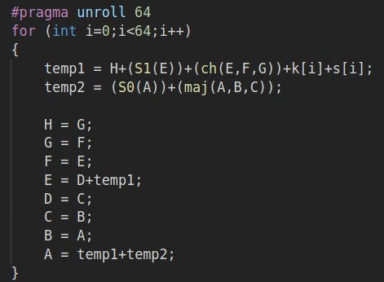
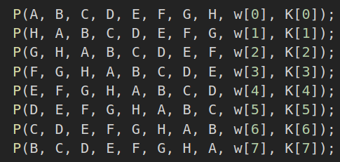
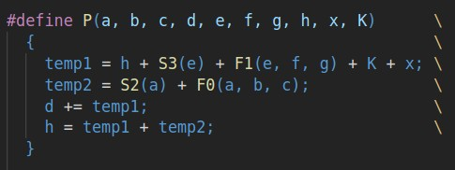
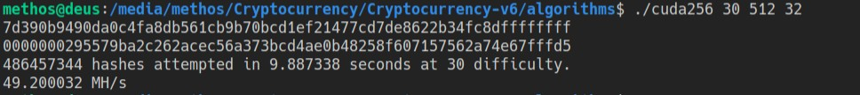
Version 6 Continued
Memory write and read operations heavily reduced by shifting the values in each subsequent call to P in the compression function.
Performance went up to 49 MH/s.

Slide 19
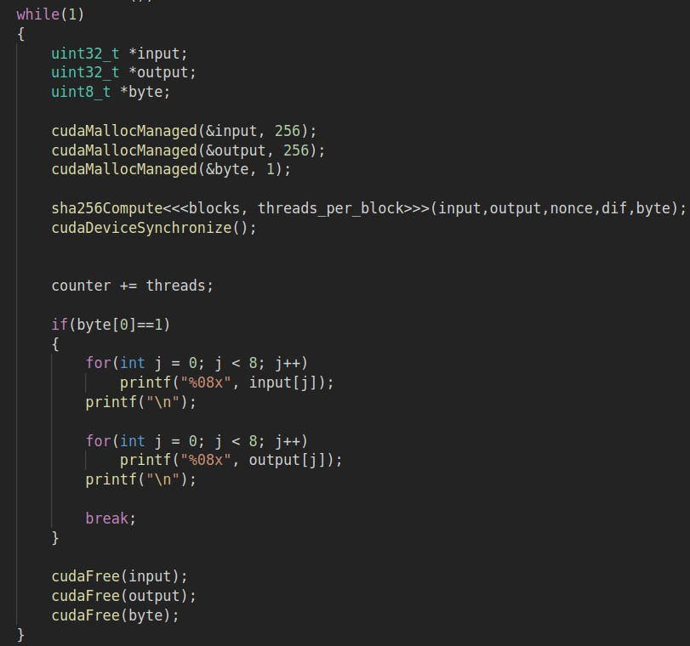
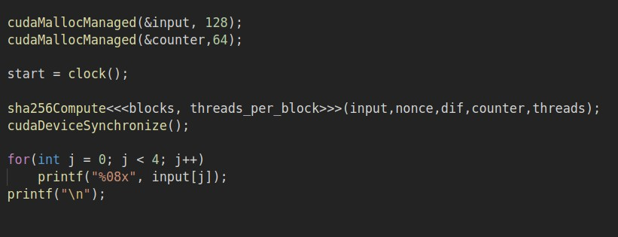
SHA256 Implementation Version 7
All looping is moved from host to device. Every time cudaMallocManaged or a kernel invocation is called, a large amount of overhead exist because memory transfers from host to device.
Main function version 7 is on the bottom left, main function of older functions is on the top left.
Performance increased to 1700 MH/s.

Slide 20
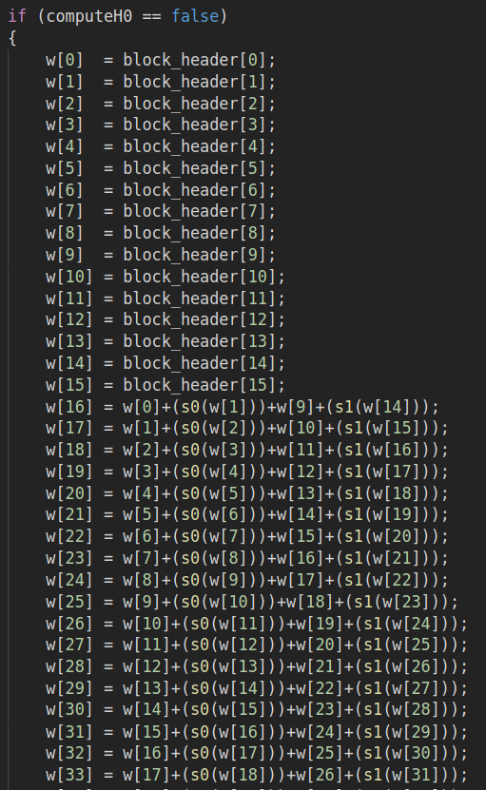
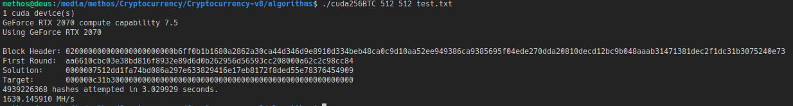
Bitcoin Miner
H0 from slide 2 only needs to be calculated once per block, the code on the left handles this optimization by using a flag.
Final performance is 1630 MH/s.

