Slide 1

Convex Optimization
Part II Chapter 4 Applications
Assoc. Prof Yang Ping (杨平)
yang.ping @uestc.edu.cn
NLC, UESTC, Chengdu, China

Slide 2
Outline
4.1 Approximation
4.2 Filter Design
4.3 Sparse Optimization
4.4 Tensor Optimization
4.5 Deep Learning
4.6 Other Advance Applications

Slide 3
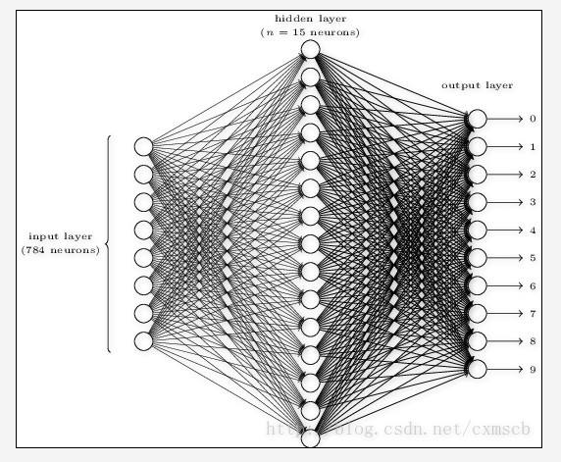

What is Deep Learning?
AlphaGo, Amazon Go, Prisma… (Based on DL)
Deep Learning is a multi-layer artificial neural network
Deep Learning contains millions of parameters
Deep Learning is supported by big data
Deep Learning requires high-performance parallel computation devices (AlphaGo has 1202 CPUs and 176 GPUs)
<number>/42
Notes:
AlphaGo is a computer program that plays the board game Go. It was developed by Alphabet Inc.'s Google DeepMind in London. AlphaGo had three far more powerful successors, called AlphaGo Master, AlphaGo Zero and AlphaZero. use a Monte Carlo tree search algorithm to find its moves based on knowledge previously "learned" by machine learning, specifically by an artificial neural network (a deep learning method) by extensive training, both from human and computer play.
Amazon Go is a new kind of store. According to a promotional video published by Amazon, the store concept uses several technologies, including computer vision, deep learning algorithms, and sensor fusion to automate much of the purchase, checkout, and payment steps associated with a retail transaction.
Prisma is a photo-editing app that creates amazing photo effects, transforming photos into paintings. Prisma uses artificial neural networks that enable users to make photos appear like they were painted by Picasso.

Slide 4
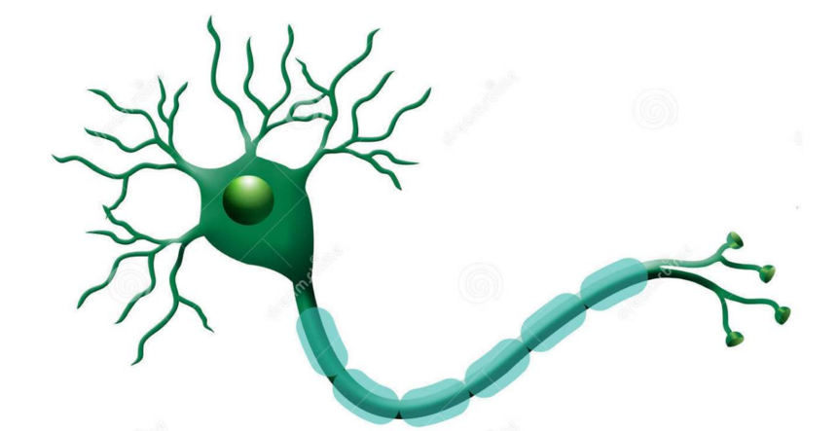
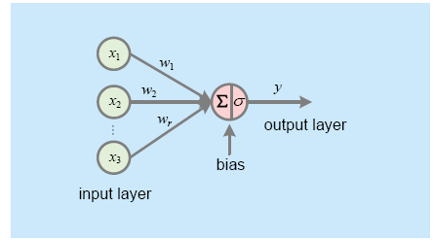
What is Deep Learning? (history)
Langly(1996) defined ML as a branch of artificial intelligence that aimed to improve performance by experience.
After long-standing research from 20th century, various algorithms have been proposed.
such as decision tree, support vector machine (SVM) and neural network (NN)
An outstanding algorithm belonging to NN, DL is originally derived from neuron model that simulates biological neural system. (Commonalities with real brains)
<number>/42

Slide 5
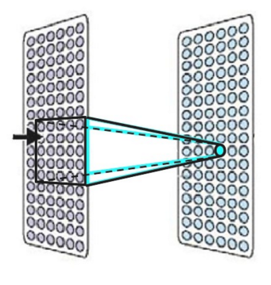
What is Deep Learning? (From the view of real brain)
Commonalities with real brains:
Each neuron is connected to a small subset of other neurons.
Based on what it sees, it decides what it wants to say.
Neurons learn to cooperate to accomplish the task.
<number>/42

Slide 6
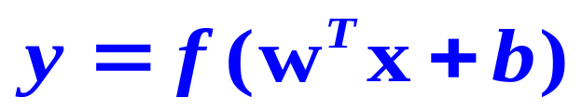
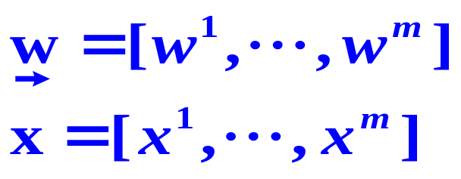
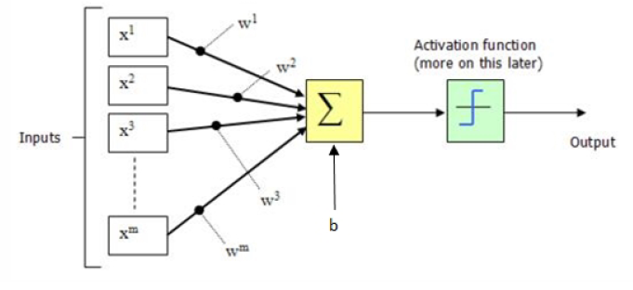
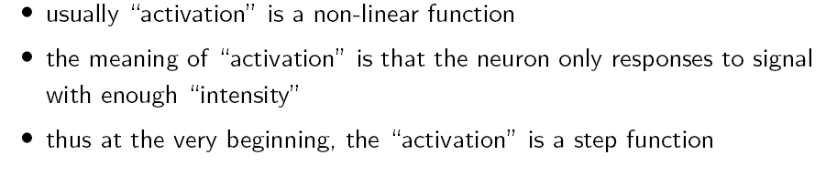
The simple mathematical model
Each neuron implements a relatively simple mathematical function (McCulloch-Pitts Model, 1943)
Processing Element
The weighted sum of several inputs with bias is fed into an activation function
<number>/42

Slide 7
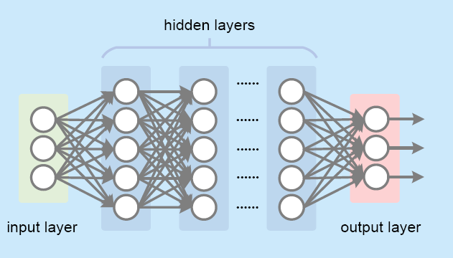
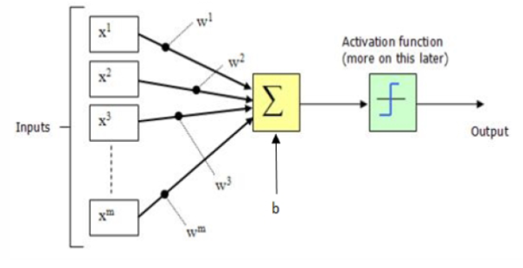
The system model of DL
A basic DL model is a fully connected feedforward neural network, where each neuron is connected to adjacent layers and non connection exists in the same layer.
<number>/42

Slide 8
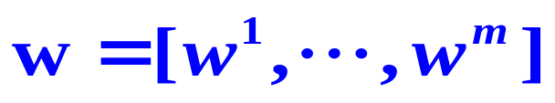

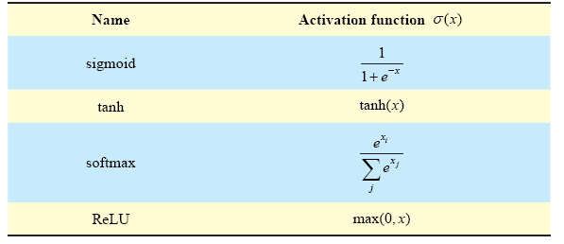
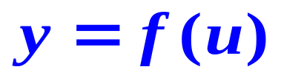
The system model of DL(The activation function)
Parameter 1: The weights
Parameter 2: The bias
Function: The activation function
<number>/42
Notes:
Exponential function

Slide 9
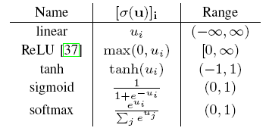
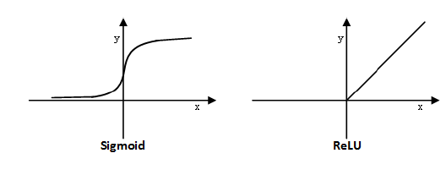
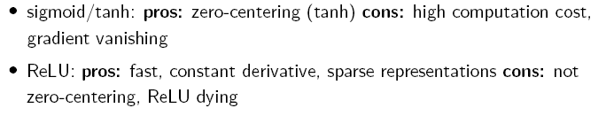
The system model of DL(The activation function)
The activation function introduces a non-linearity which important for the so-called expressive power of the NN.
Without this non-linearity, there would be not much of advantages of stacking multiple layers on top of each other.
<number>/42
Notes:
The expressive power of neural networks is important for understanding deep learning. Most existing works consider this problem from the view of the depth and width of a network.

Slide 10
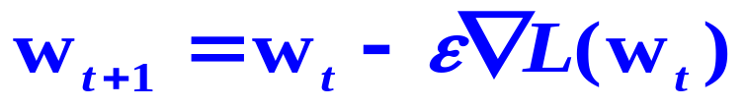
Gradient Vanishing and Gradient Exploding
Gradient Vanishing:
In DL, we use gradient-based learning methods and error backpropagation to update the weights of the neural network. The problem is that in some cases, the gradient will be vanishingly small, effectively preventing the weight from changing its value. In the worst case, this may completely stop the neural network from further training.
Gradient Exploding:
In DL, we use gradient-based learning methods and error backpropagation to update the weights of the neural network. The problem is that large error gradients accumulate and result in very large updates to neural network model weights.
<number>/42

Slide 11
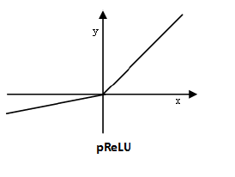
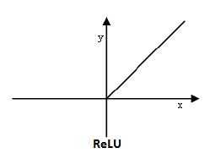

ReLU dying
ReLU neurons output zero and have zero derivatives for all negative inputs.
So, if the weights in your network always lead to negative inputs into a ReLU neuron, that neuron is effectively not contributing to the network's training.
Mathematically, the gradient contribution to the weight updates coming from that neuron is always zero (Solution: pReLU)
<number>/42

Slide 12
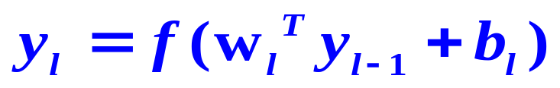
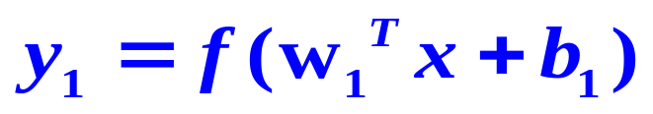
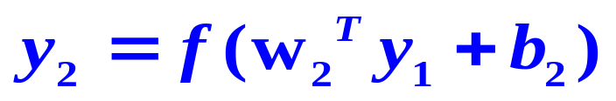
The system model of DL
Basic unit
Deep Learning NN
A Forward process for achieving the output
…
<number>/42

Slide 13
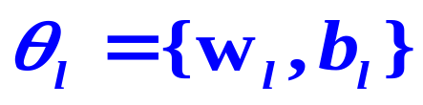
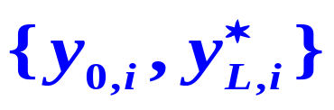

The system model of DL （The parameter optimization）
Another Problem: How to optimize the network (learn)?
Let be the parameters need to be optimized
NN are generally trained by using labeled training data, for example, a set of input-output vector pairs
input
The desired output of the NN when is used as input
<number>/42

Slide 14
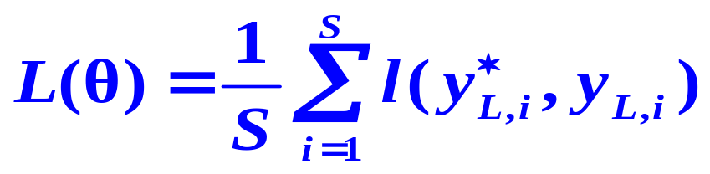

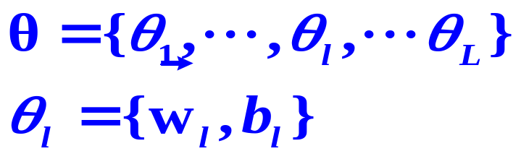
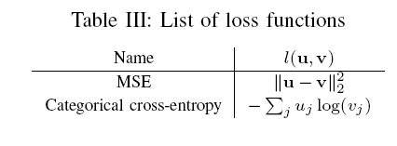
The system model of DL （Cost Function）
The goal of the training is to minimize the loss function
with respect to the parameters in
where
The output of the NN when is used as input.
Mean Squared Error function
Cross-entropy function
<number>/42

Slide 15
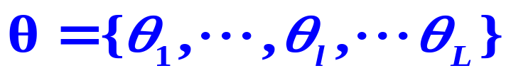
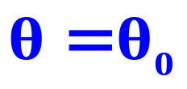

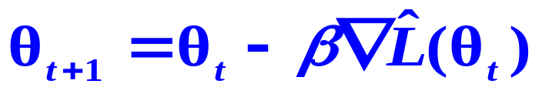
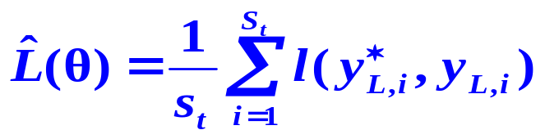
The system model of DL （Optimization Algorithm)
Pre-processing for loss function: Different norms (e.g., L1, L2) of parameters activations can be added to the loss function to favor solutions with small or sparse values.
The most popular algorithm to find good sets of parameters is stochastic gradient descent (SGD), which starts with some random initial values of and then update iteratively as
Learning rate
An approximation of the loss function which is computed for a random mini-batch
of training examples. St is small than S, which can reduce the complexity.
<number>/42

Slide 16
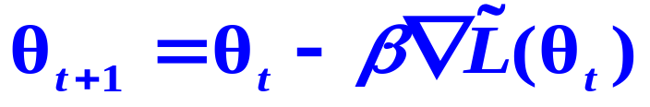
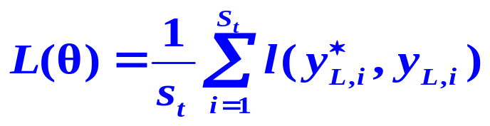

The system model of DL （Optimization Algorithm)
The calculation of the gradient
Backward method for efficiently evaluating the gradient.
the gradient for the L-th layer depends on the 1-(L-1) in front of it. (chain structure)
Backward and Forward process for DL based NN realization
<number>/42

Slide 17
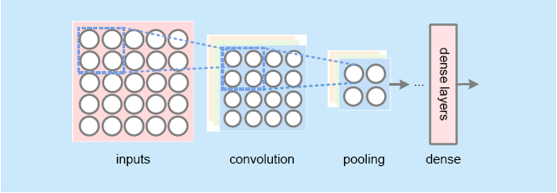
Two variants of conventional DNN
Convolutional NN (CNN): is a new DL-based NN developed from the conventional DNN to prevent a rapid growth in the parameters when applying the latter to image recognition.
(1) A CNN architecture that adds convolution layers and pooling layers before dense layers.
(2) Each output in the convolution layers is obtained by dot production between a certain filter matrix and an input matrix comprised of several neurons in the upper layer.
(3) Each output in the pooling layers is obtained by averaging or searching maximum in a group of neurons in the convolution layer .
<number>/42
Notes:
pixels

Slide 18
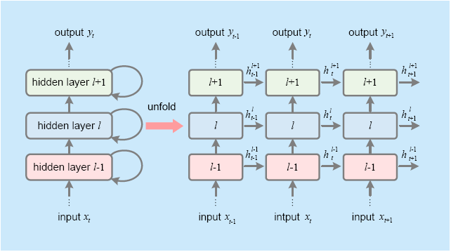
Two variants of conventional DNN
Recurrent NN(RNN) aims to provide NNs with memory because outputs depend not only on the current inputs but also on the formerly available information.
(The layer and the time are interleaved)
A RNN architecture that considers the extracted features in the former state as the one of the current input information.
The current outputs depend on current and former inputs so that the network achieves memory.
<number>/42

Slide 19
References
M. Mohri, A. Rostamizadeh, and A. Talwalkar, Foundations of Machine Learning, Cambridge, MA, USA:MIT Press, 2012.
I. Goodfellow, Y. Bengio, and A. Courville, Deep Learning. Cambridge, MA, USA: MIT Press, 2016.
T. J. OShea, J. Hoydis, “An introduction to deep learning for the physical layer,” IEEE Transactions on Cognitive Communications and Networking, vol. 3, no. 4, pp. 563-575, 2017.
C. Jiang, H. Zhang, Y. Ren, Z. Han, K. Chen, and L. Hanzo, “Machine learning paradigms for next generation wireless networks,” IEEE Wireless Commun., vol. 24, no. 2, pp. 98-105, Dec. 2016.
J. Joung, “Machine learning-based antenna selection in wireless communications,” IEEE Commun. Lett.,vol. 20, no. 11, pp. 2241-2244, Nov. 2016.
D. He, C. Liu, T. Q. S. Quek, and H. Wang, “Transmit antenna selection in MIMO wiretap channels: A machine learning approach,” IEEE Wireless Commun. Lett., vol. 7, no. 4, pp. 634-637, Aug. 2018.
<number>/42

