Slide 1

DAY 4 · FINE-TUNING · SESSION 2 · 10:45 – 12:45
Hugging Face & the Amharic Problem
Find a model, find a dataset, and prove — with evidence — that the model is bad at Amharic before you try to fix it.
Ethiopian Defense University · Day 4 of 5 · 2 hours · 4 hands-on labs

Slide 2


SESSION 2 · OBJECTIVES
What This Session Covers — and What You Walk Away With
We will cover
You will be able to
How to search the Hugging Face Hub for models and datasets
What a tokenizer is, and why Amharic costs 3x more tokens than English
How to load and inspect a real 83,000-example Amharic dataset
Why you must test the model BEFORE fine-tuning, not after
How to format raw conversations into training examples
Search the Hub and read a model card critically
Measure how many tokens Amharic uses versus English
Load addisai/FineTome Amharic and inspect its structure
Record baseline answers to five Amharic questions
Turn the dataset into text the model can learn from

Slide 3
1
Ask the Question
A single sentence becomes a matrix before it enters the Transformer.
“What is the capital city of Ethiopia?”
During both inference and training, the model first converts the sentence into tokens, then vectors.
Sentence
Token IDs
≈ 9 tokens
Embedding
9 × 12,288
Position
added
Transformer
layers
Working assumption for the example
Tokens ≈ 9
Hidden size = 12,288
Heads = 96
FFN = 49,152
Layers = 128
Input matrix values: 9 × 12,288 = 110,592 numbers
Demystifying LLMs

Slide 4
2
Inference: The Model Only Predicts
No weights are updated; the learned matrices are used to compute the next-token probability.
Inside one Transformer layer
Q, K, V projections
≈ 4.08B
Attention scores
+ value mixing
≈ 2M
Output projection
≈ 1.36B
FFN expansion
+ compression
≈ 10.87B
Approximate cost
≈ 2.09 trillion
≈ 16.31B calculations per layer
calculations to prepare the next-token prediction
16.31B × 128 layers ≈ 2.09T
The model then selects likely continuation tokens, for example: “Addis Ababa”.
Demystifying LLMs

Slide 5
3
Training: Prediction + Correction
Training is heavier because the model computes gradients and updates weights.
Forward pass
make prediction
Loss
how wrong?
Backpropagation
who caused error?
Weight update
change matrices
Next epoch
repeat
Inference asks
Training asks
“What is the answer?”
“How wrong was I,
and how should I change?”
Uses learned weights only.
Computes gradients and updates parameters.
Approximate training cost: 3 × inference ≈ 6.3 trillion calculations
Key message: inference uses weights; training changes weights.
Demystifying LLMs

Slide 6
Imagine the number of Neurons and guess how Big LLMs are.
parameters are the internal variables that the model learns during the training process.
Weights, Biases, Embedding vectors,
For GPT 4 128 layers, hidden size of 12,288 ~1.8 trillion by summing the parameters in layers.
Model | Parameters | Layers | Hidden Size | MLP Size | Neurons/Layer | Total
GPT-3 | 175B | 96 | 12,288 | 49,152 | 49,152 | 4.72m
GPT-4 | ~1.8T* | 128 | 12,288 | 49,152 | 49,152 | 6.29m
PaLM-62B | 62B | 64 | 8,192 | 32,768 | 32,768 | 2.10m
PaLM-540B | 540B | 118 | 12,288 | 49,152 | 49,152 | 5.80m

Slide 7
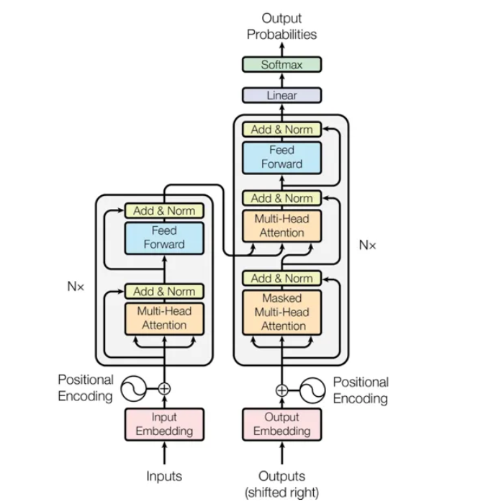
Transformer: Design Phase

Slide 8
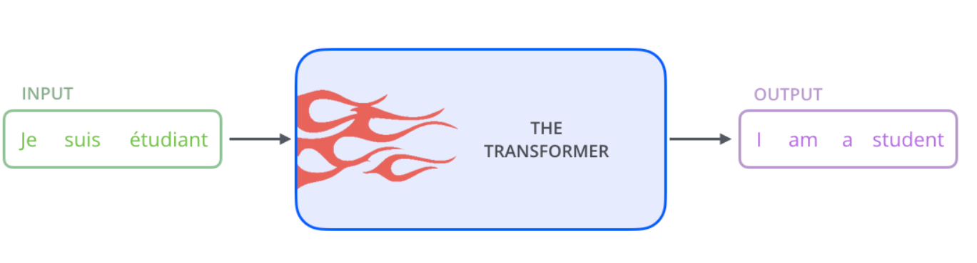
A high-level look of Transformer
እኔ ተማሪ ነኝ

Slide 9
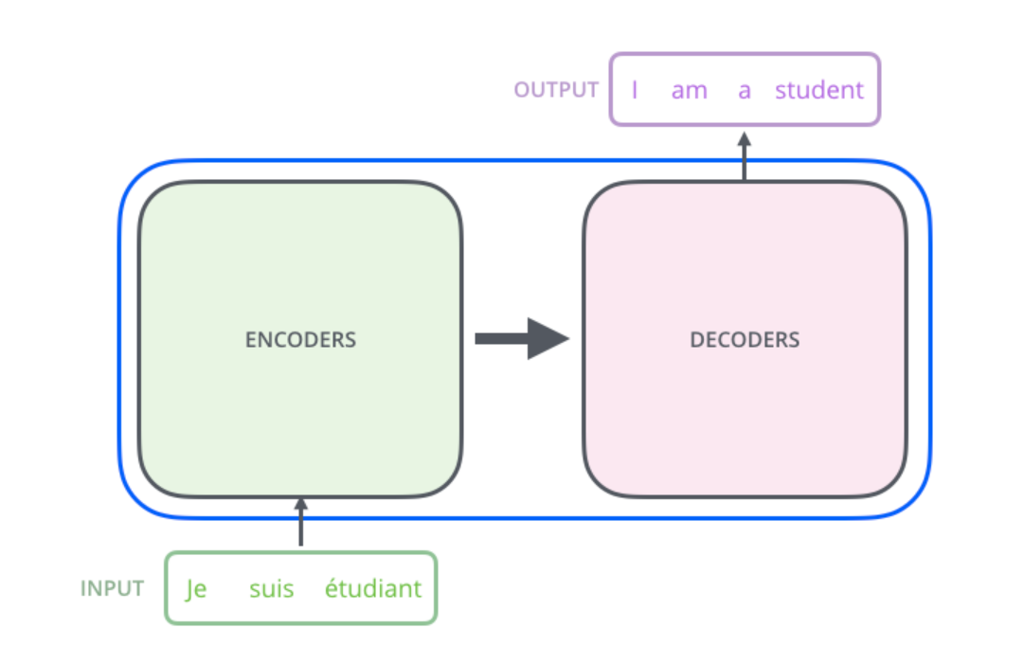
A high-level look of Transformer
እኔ ተማሪ ነኝ

Slide 10
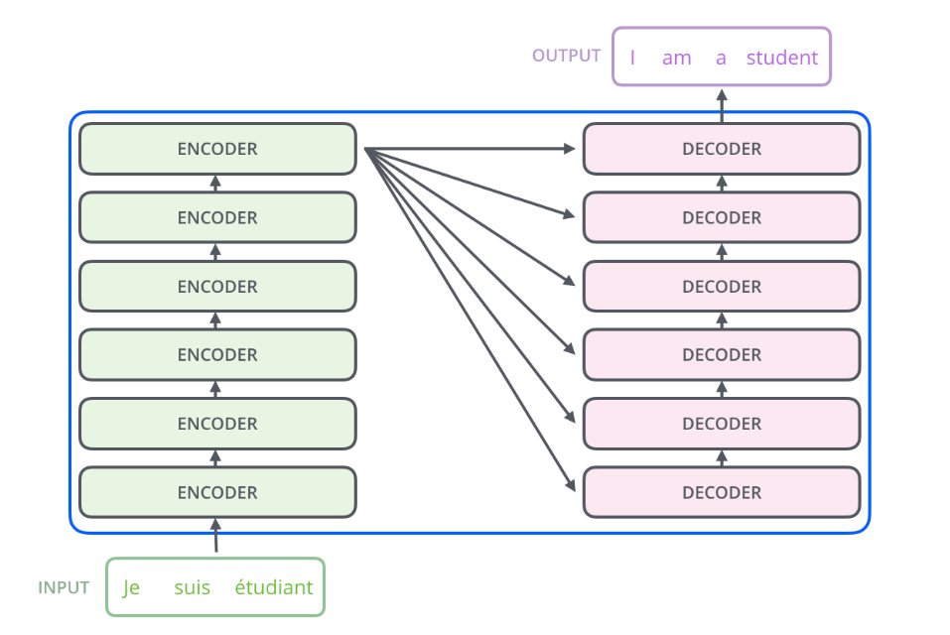
A high-level look of Transformer
እኔ ተማሪ ነኝ

Slide 11
A high-level look of Transformer
Encoder
Add & Norm
Feed Forward
Add & Norm
Self Attention

Slide 12
A high-level look of Transformer
Decoder
Add & Norm
Feed Forward
Add & Norm
Encoder/Decoder Attention
Add & Norm
Self Attention

Slide 13
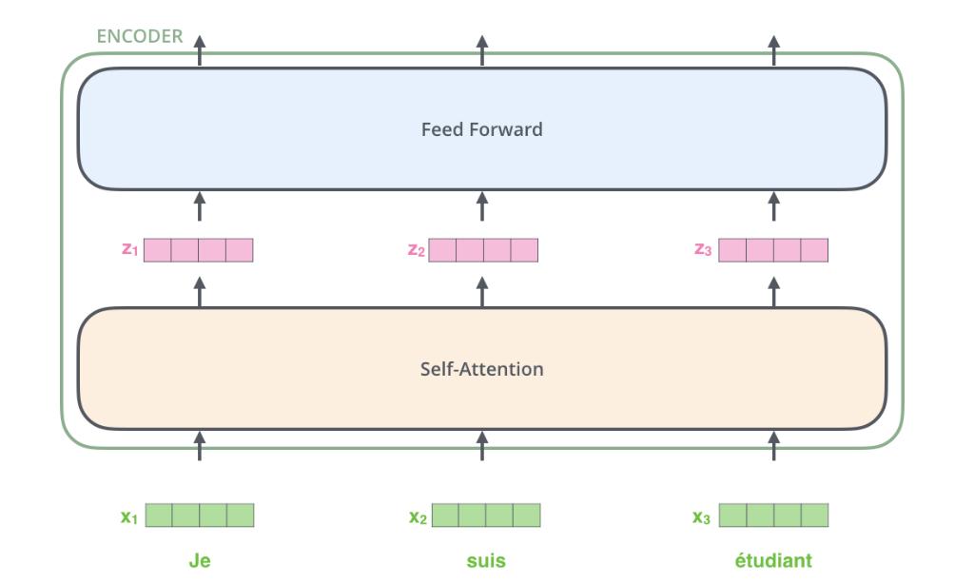
A high-level look of Transformer
እኔ
ተማሪ
ነኝ

Slide 14
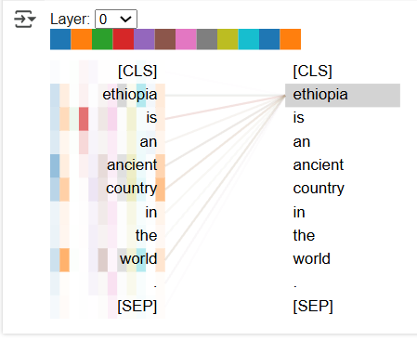
Self-Attention at a High Level
Consider the sentence” Ethiopia is an Ancient country in the world. The attention between each word looks like this using BERTViz
3

Slide 15
Self-Attention in Detail
Each token presents itself in three vectors
"The trophy wouldn't fit in the suitcase because it was too small.“
"The trophy wouldn't fit in the suitcase because it was too big." .
Transformer Component | Definition
Query (Q)(512X512) divided in 8 heads | I am looking for this.
Key (K)(512X512) divided in 8 heads | I do have this.
Value (V)(512X512) divided in 8 heads | The actual value.

Slide 16
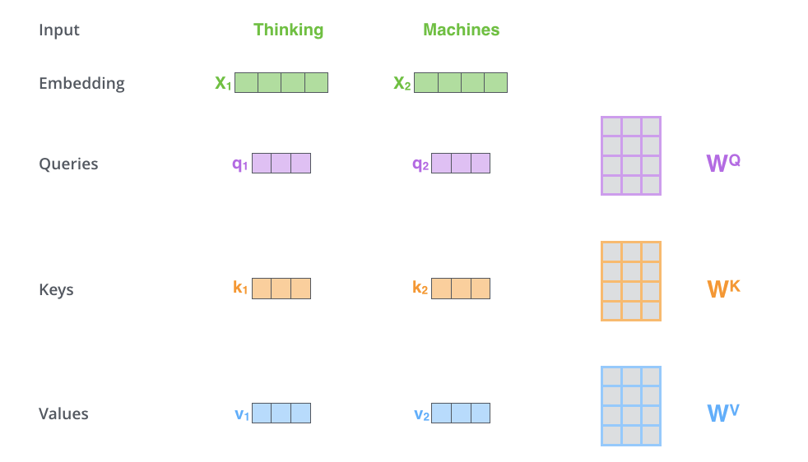
What is a Transformer??
Self-Attention in Detail
In the sentence “The capital city of Ethiopia is Addis Ababa,” each token has three vectors: The Q, The K and The V.
Capital
city
512X512
512X64
512X64

Slide 17
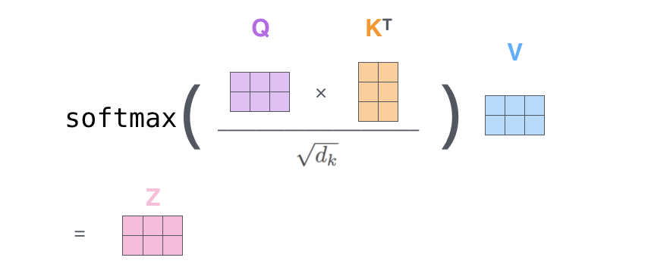
Self-Attention in Detail
Attention is calculated using this formula
Then all 8 heads are concatenated
output projections are done to combine each head contribution

Slide 18
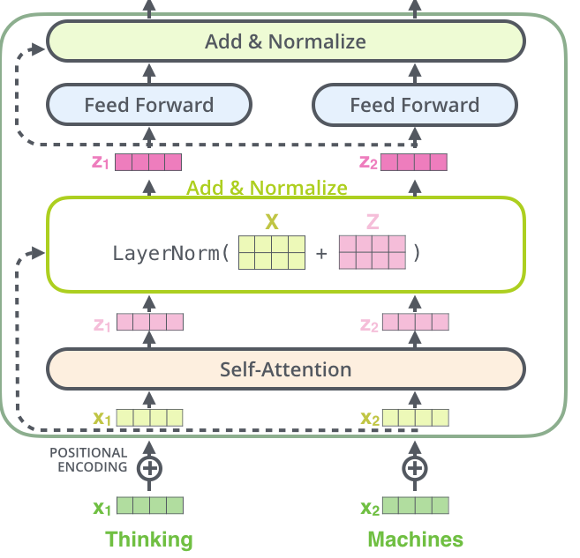
Add & Norm Layer
Capital
city

Slide 19
Feed Forward Layer
Used to find out the relationship between each property within the token
Feed Forward Layer(512X2048)
Feed Forward Layer(2048X512)
Input from Add & Norm Layer

Slide 20
Analogy: Ethiopian Market Meets Query–Key–Value Attention
Imagine a busy Saturday market in Bahir Dar. Each person in the market brings something to sell and looks for something to buy, like tokens in a sentence.
Transformer Component | Ethiopian Market Analogy
Query (Q) | A buyer walking around the market looking for specific goods (e.g., 'I want red onions').
Key (K) | A seller’s label or sign saying what they offer ('I have red onions,' 'I have teff').
Value (V) | The actual goods behind the stall (the onions, the teff, etc.).

Slide 21
What provides the power to the Transformer
deep learning weight, head and layer
The gradient of a function f(x) at point x points in the direction of the steepest increase of f(x).
Negative of f(X) points toward the steepest decrease — this is why gradient descent uses it to minimise loss.
The magnitude (or norm) of the gradient vector indicates how steep the slope is.
Large gradient → large update (fast movement).
Small gradient → small update (slow movement or stagnation).
At a local minimum, the gradient tends to zero → the update stops.(one of the problem)
The behaviour of gradient descent depends heavily on initial weights.
Gradient derivation is local: it only tells you about the function's slope at a specific point, not the global shape.
It may lead to local minima, saddle points, or plateaus unless handled with proper optimisation techniques (e.g., momentum, Adam).
Emergent Specialization through Optimization and Inductive Bias.
Earlier layers have access to the raw input structure.
Deeper layers work on already-abstracted features.

Slide 22
Why Specialization Emerges (Mathematically & Intuitively)
Gradient updates shape the entire layer/head's parameters based on what helps minimize the loss.
If Head 3 attending to syntactic structure consistently reduces the loss more than others trying the same thing, then gradient descent will push Head 3 further in that role.
Over time, functional roles emerge.
This is a kind of soft modularity via optimisation.

Slide 23
BERT show the following(BERT Topology paper)
Layer Depth | Typical Role
Shallow layers | Learn local and syntactic patterns (e.g., POS tags, phrase structure)
Middle layers | Encode semantic relationships (e.g., sentence-level meaning, paraphrasing)
Deeper layers | Align with task-specific features (e.g., QA, NLI, etc.)

Slide 24
Large Language Models
"Large language models are foundation models trained on large-scale corpora of text data using self-supervised learning and transformer architectures, capable of performing a wide range of downstream natural language processing tasks."
— Bommasani et al., “On the Opportunities and Risks of Foundation Models”

Slide 25
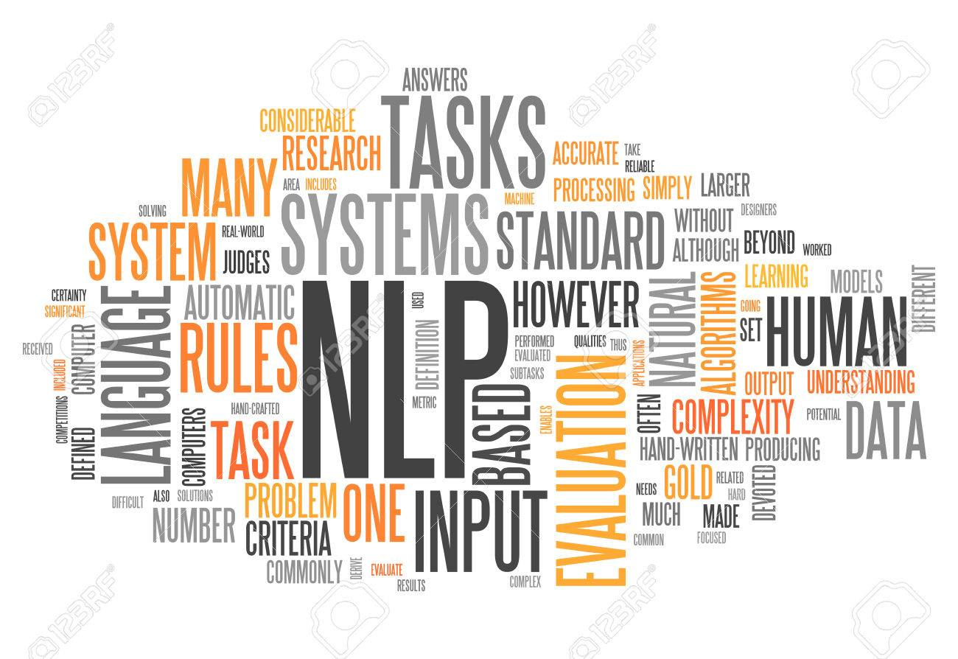
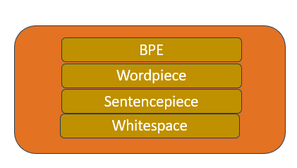
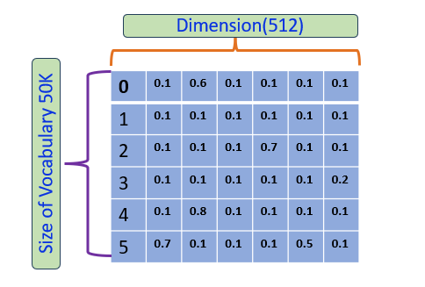
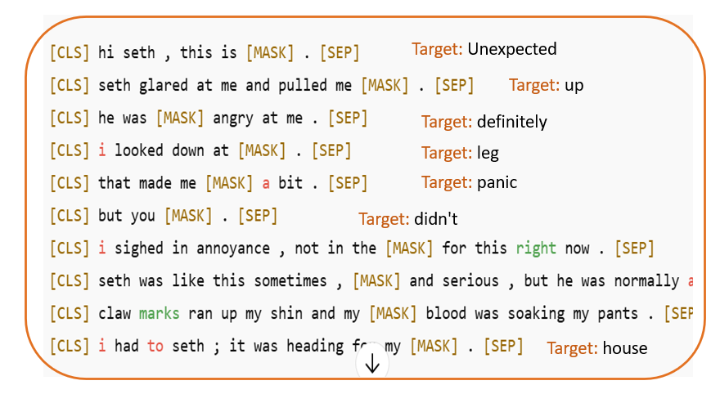
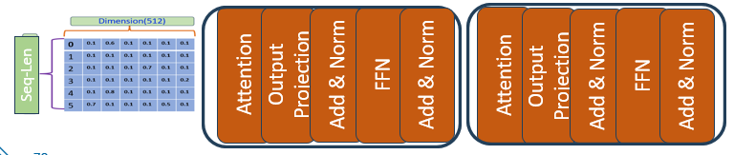
[101, 1996, 3007, 1997, 11567, 2003, 2799, 4280, 1012, 102]
["[CLS]", "the", "capital", "of", "ethiopia", "is", "add", "##is", “ababa“, “.", "[SEP]"]
Linear Transformer
Softmax

Slide 26
What has happened inside the LLMs: BERT as a showcase
Phases in the Training and Inference of Large Language Models (LLMs)
Preprocessing Phase
  Corpus Preparation
  Vocabulary Construction
  Tokenization
Training Phase
  Input Embedding
  Positional Embedding
  Self-Attention Mechanism
  Output Projection
  Add & Layer Normalization (Add & Norm)
  Feedforward Network (FFN)
  Add & Layer Normalization (Add & Norm)
  Output Layer
  Loss Computation
Optimisation (Backpropagation and Weight Update)
  Gradient Computation
  Weight Update
Inference Phase
  Tokenization
  Forward Pass
  Prediction
  Decoding

Slide 27
Human vs. LLMs: A Comparison of Reading Speed, Training Time, and Resource Demands
Dimension | PaLM Specification | Human Equivalent
Model Name | PaLM 540B | —
Training Tokens | 3 trillion tokens | Equivalent to ~2 million full-length books (e.g., Proust’s In Search of Lost Time)
Epochs | 1.56 | Each token is seen ~1.5 times
Total Tokens Processed | 4.68 trillion tokens | —
Average Reading Speed | — | ~267 tokens per minute (≈200 words per minute)
Daily Reading Capacity (24/7) | — | ~384,480 tokens per day
Time to Read Once (1 Epoch) | — | ~7.8 million days (≈21,369 years)
Time to Read Full Training Set (1.56 Epochs) | — | ~12.2 million days (≈33,331 years)
Compute vs Cognition Insight | Trained in weeks using TPU pods | Would take a human over 33,000 years to replicate reading input alone

Slide 28





SESSION 2 · VOCABULARY
Words You Need This Session
Hugging Face Hub
Tokenizer
Dataset
The GitHub of AI. Over a million models and hundreds of thousands of datasets, mostly free.
Cuts text into pieces the model understands. Each model has its own — they are not interchangeable.
The examples you train on. Today: 83,000 Amharic conversations.
Model card
Baseline
Instruction format
The documentation page. Says what data it saw, its licence, and where it fails.
How the model performs BEFORE you change anything. Skip this and you can prove nothing.
Rewriting raw data as 'question then answer' so the model learns to respond.

Slide 29
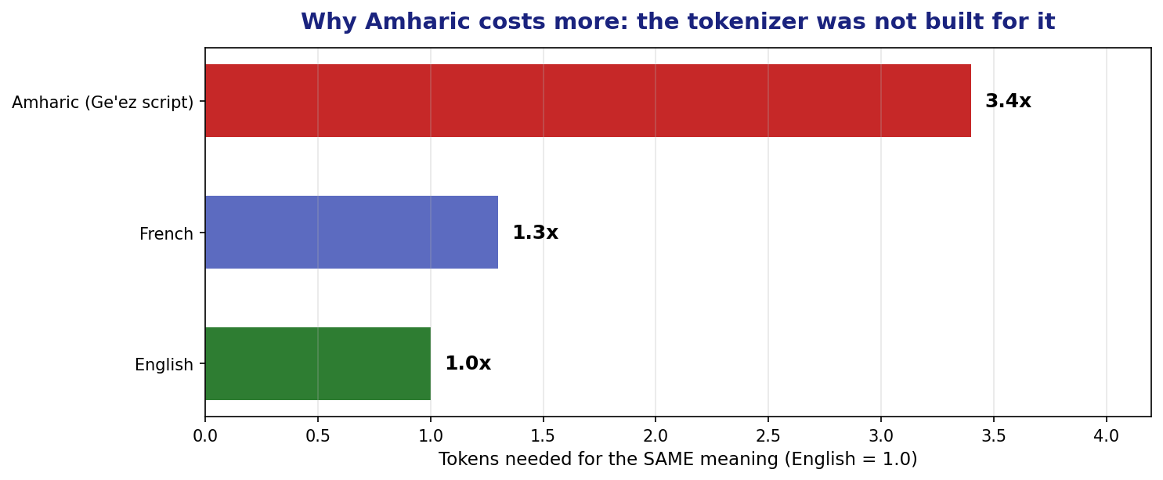
SESSION 2 · THE TOKENIZER PROBLEM
Why Amharic Costs Three Times More
Qwen's tokenizer was trained mostly on English and Chinese. Ge'ez script gets chopped into many small pieces.
What this means in practice: the same sentence costs 3x more memory, 3x more time, and hits the length limit 3x sooner.

Slide 30
SESSION 2 · HANDS-ON (25 MIN)
Lab 2A: Measure It Yourself
from transformers import AutoTokenizer
tok = AutoTokenizer.from_pretrained("Qwen/Qwen2-0.5B-Instruct")
en = "How can I track my order?"
am = "ትዕዛዜን እንዴት ልከታተለው እችላለሁ?"
print("English:", len(tok.encode(en)), "tokens")
print("Amharic:", len(tok.encode(am)), "tokens")
# Look at HOW it splits the Amharic
print(tok.tokenize(am))
What to notice
Amharic uses far more tokens for the same meaning
Many tokens are single characters or fragments
Some show as broken bytes
This is a fairness problem, not just a technical one
Discuss: if every Amharic query costs 3x an English one, who pays for that — and what does it mean for local AI?

Slide 31

SESSION 2 · HANDS-ON (30 MIN)
Lab 2B: The Baseline — Do This FIRST
If you fine-tune first and test afterwards, you have no proof anything improved. Record the baseline NOW.
QUESTIONS = [
"ስለ ምርታችሁ ዋጋ ማወቅ እፈልጋለሁ።", # pricing
"ትዕዛዜን እንዴት ልከታተለው እችላለሁ?", # order tracking
"ምርቱን መመለስ ከፈለኩ ምን ማድረግ አለብኝ?", # returns
]
before = {}
for q in QUESTIONS:
before[q] = ask(model, q) # save every answer
print(q, '->', before[q][:120])
Keep the 'before' dictionary alive all day. Session 4 compares against it. If your session restarts, you must re-run this cell.

Slide 32
SESSION 2 · HANDS-ON (35 MIN)
Lab 2C: Load a Real Amharic Dataset
from datasets import load_dataset
raw = load_dataset("addisai/FineTome-single-turn-dedup-amharic",
split="train")
print(f"{len(raw):,} examples")
print(raw.column_names)
# Always LOOK at your data before training on it
print(raw[0])
83,000 examples
Real Amharic conversations
Built by Ethiopian researchers
Free to download
We will use only 1,000 today so training finishes inside the lesson
Rule that will save you months: look at ten real examples before you train on 83,000. Bad data trains bad models, silently.
This dataset exists because people chose to build it. Amharic AI is not going to arrive by accident.

Slide 33
SESSION 2 · HANDS-ON (25 MIN)
Lab 2D: Shape the Data for Training
A model does not learn from a table. It learns from text that shows a question followed by a good answer.
def to_text(ex):
turns = ex.get("conversations_amharic") or []
if len(turns) < 2:
return {"text": ""}
question = turns[0].get("content", "")
answer = turns[1].get("content", "")
return {"text": f"### ጥያቄ:\n{question}\n\n### መልስ:\n{answer}{tok.eos_token}"}
data = raw.select(range(1000)).map(to_text, remove_columns=raw.column_names)
data = data.filter(lambda x: len(x["text"]) > 40)
print(data[0]['text'][:300])
eos_token matters. It tells the model where the answer STOPS. Leave it out and your model rambles forever.

Slide 34

SESSION 2 · CHECKPOINT
Before Lunch
I searched the Hugging Face Hub and read a model card
I measured Amharic vs English token counts
I recorded baseline answers and saved them in a variable
I loaded the 83,000-example Amharic dataset
I looked at real examples before training on them
I formatted 1,000 examples into question/answer text
The baseline answers are the most important thing you have. Do not lose them.

Slide 35
SESSION 2 — THREE IDEAS TO CARRY FORWARD
1
Tokenizers are not neutral
Amharic costs 3x English on this model. That is a design choice someone made, and it has a real cost.
2
Baseline before you build
Without a 'before', your 'after' proves nothing. This is the discipline that separates engineering from guessing.
3
Look at your data
Ten real examples read carefully will teach you more than 83,000 rows you never opened.
Next — Session 3 (13:45): LoRA. The trick that makes fine-tuning fit in 2 GB — then you actually train the model.

