Slide 1
USED CAR SALES
Presented by:
Teslari Maxim MI-211
Last Updated: 12/17/2023

Slide 2
TABLE OF CONTENTS
Purpose Statement
Work with Data
Conclusion

Slide 3
What are we talking about?

Slide 4
OBJECTIVE
Identifying if there are mileage, age, engine capacity and fuel types and more, can affect the selling price of a vehicle.

Slide 5
DATA PRESENTATION

Slide 6
Converting
Compatibility with Functions
Correct Analysis
Correct Output
Preventing Errors

Slide 7
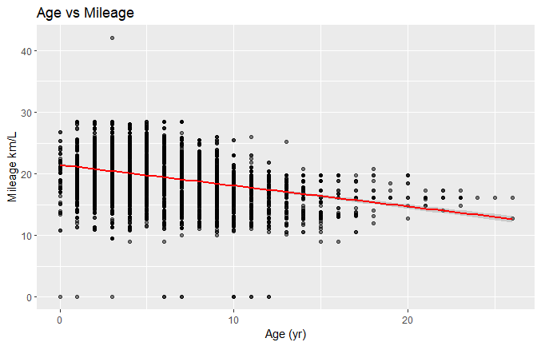
Age and Mileage: The Correlation
The older the car, the less efficient it goes
Older technology being less efficient
A negative correlation between age and mileage(fuel efficiency)
Age and mileage are key parts for when buying/selling a car

Slide 8
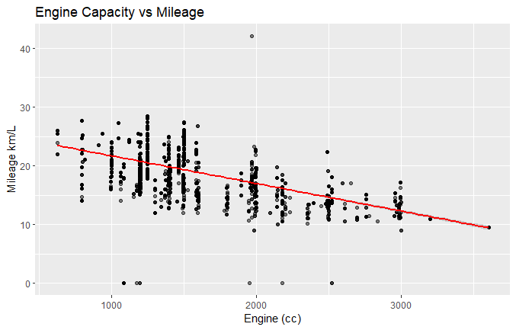
Engine Capacity and Mileage
Larger engines have lower mileage efficiency
There are consumers who prioritize fuel economy
It can inform manufacturers about consumer preferences
A negative correlation in this case

Slide 9
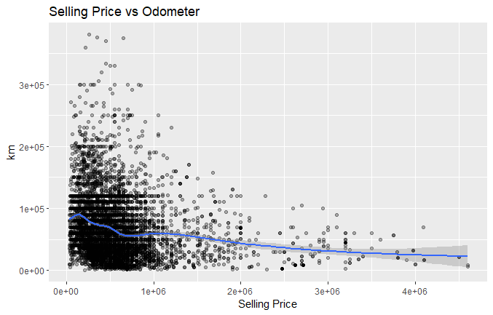
Selling Price and Odometer
Selling price does not decrease much due to odometer increase
More important points can affect the selling price
Vehicle condition can be more empathized
A slightly weak correlation than previous one

Slide 10
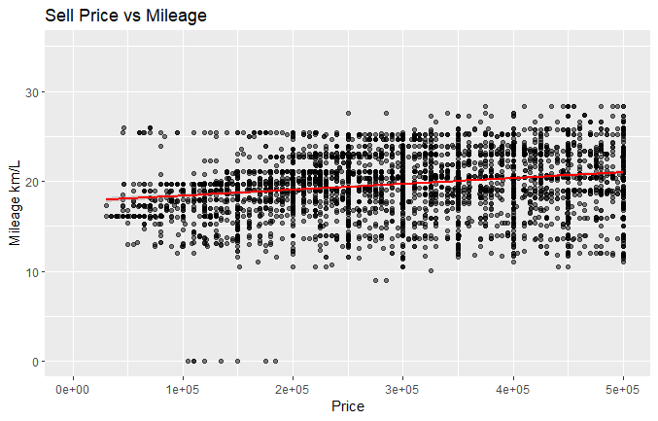
Selling Price and Mileage
Finally a slight positive correlation
Higher-priced vehicle can maintain their mileage efficiency than lower-priced
A common perception that higher mileage correlates with lower price
Can depend on brand, model, year and its condition.

Slide 11
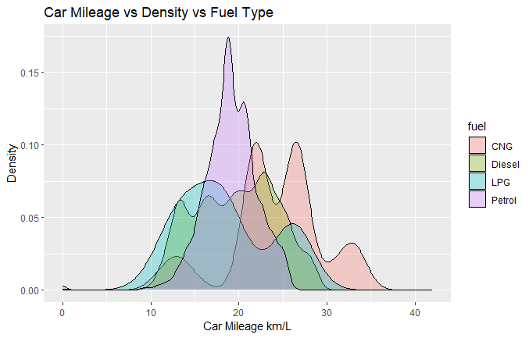
Commonly used fuel types
CNG is the cheapest and most efficient
But CNG and LPG are least used
Diesel and Petrol most commonly used
Can help consumers make informed decisions when choosing the fuel efficiency and environmental impact of their vehicle choices

Slide 12
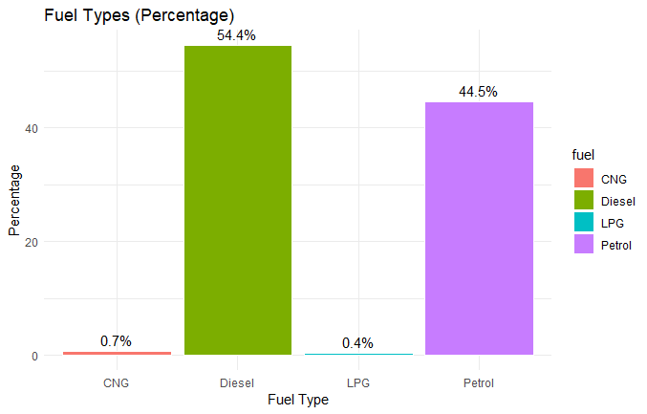
Fuel Types in Market
Diesel and Petrol the dominant ones
Potential areas for growth on CNG and LPG
But requires better infrastructure

Slide 13
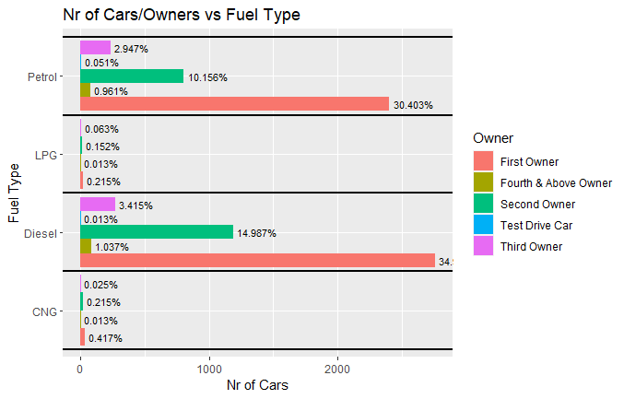
Ownership trends by Fuel Type
Diesel and Petrol still dominant due to preference or higher turnover
Can help with informing market strategies and consumer behaviour
Cars with LPG and CNG are a minority due to poor infrastructure
First and second owners dominate on the market

Slide 14
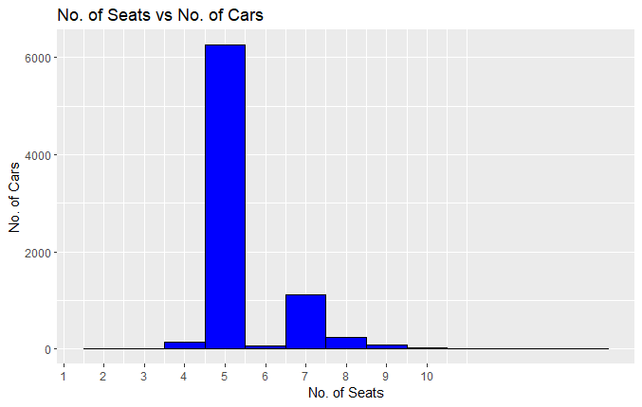
Popularity of Car Models by Seating Capacity
5-seaters are dominant on the market
7-seaters are more towards family carriers
Higher-seating and 2-seats cars might be a niche luxurious or utility cars

Slide 15
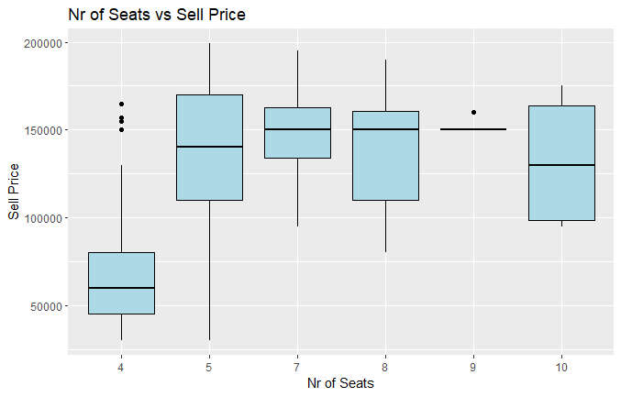
Influence of Seating Capacity on Sell Price
Prices vary on seat counts
An increase trend in more seats, due to luxury or utility vehicles
5-seats are more considered optimal option

Slide 16
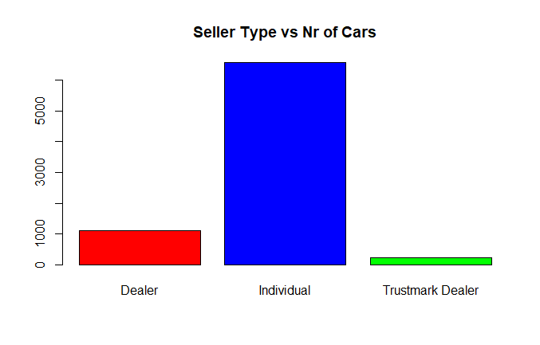
Car Distribution by Seller Type
Most cars are being sold by individuals
Might impact on price negotiation, vehicle history, transparency and warranty offerings
More towards online marketplaces

Slide 17
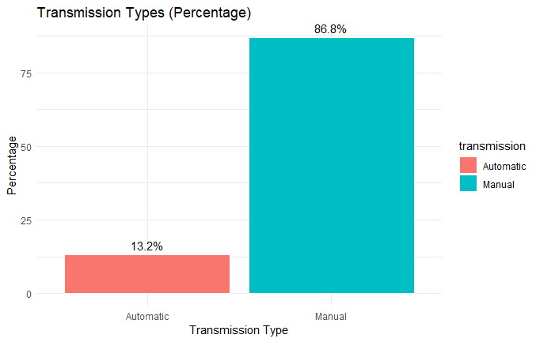
Transmission Types (Percentage)
More preferences towards manual gearbox
Cost-effective or more direct control towards the car
Can be influenced by the regional preferences, economic factors or types of vehicles being sold

Slide 18
Key importance
1
Manual transmission vehicles are significantly more prevalent in the market compared to automatic ones, suggesting a strong consumer preference potentially influenced by economic and cultural factors.
2
Individuals are the primary sellers in the used car market, overshadowing dealers and trustmark dealers, indicating a trend towards private sales facilitated by online platforms.
3
Despite a large variety of fuel types available, Diesel and Petrol maintain a dominant market share, with alternative fuels like CNG and LPG holding a small but potential growth segment.
4
Cars with a seating capacity of five dominate the market, reflecting their appeal to the average consumer likely due to a balance of space, functionality, and cost.

Slide 19
THANK YOU

