Slide 1
Multi-Robot System-
Structure, Allocation& Planning
Name: Gao Guanqiang
Class: #1
Email : stef_leon_gao@outlool.com
Notes:
Hello, everyone. My name is gao guanqiang. Before my presentation, I want to ask you a question. How many of you have seen a science fiction film? Raise your hands. (wait)
I think every one has seen the science fiction film. There are always lots of types robots in a science fiction films. Some of them can talk with people. Some of them may be used for war.
When they work together, they can be called a multi-robot system. So, here is my research that I want to introduce to you.
Multi-Robot system.

Slide 2
Roadmap
Background
1
1
Background
Structure
2
3
Task allocation
Path Planning
4
5
Conclusion
Notes:
Here is a roadmap of my presentation.
Firstly, I will talk to you the background of the MRS. Such as what is the MRS, what does MRS can do ?
Then, I will introduce to you three key issue of the MRS.
Finally, I will conclude my presentation to you.

Slide 3





cooperation
Single-robot
Single-robot
Multi-Robot
Homogeneous
Heterogeneous
Notes:
Now, let’s talk about the background of MRS.
Here we got a single robot whose name is wali wih
recovery ability.
And we got another single robot which named ewa
When they preform a task in the same environment cooperatively, we can called them multi-robot system.
The robots in the MRS may range from simple sensors, acquiring and processing data, to complex human-like machines,
able to interact with the environment in fairly complex ways.
In the taxonomy of mrs, there are two types.
When the robots in MRS are same as each other, they can be classified into the Homogeneous MRS.
When the robots in MRS have different abilities, and maybe they can perform different task.
So they can be classified into the Heterogeneous MRS.

Slide 4
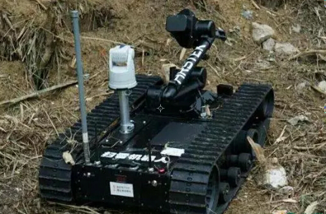
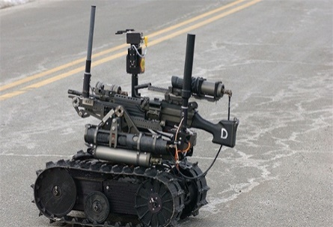

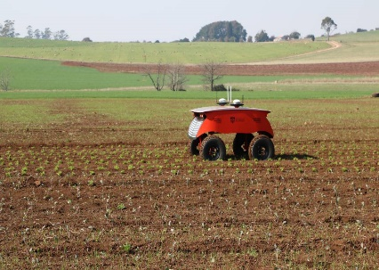


mine clearance
War
potential advantages：
spatial distribution
better overall system performance
Robustness
lower cost
better system reliability, flexibility, scalability and versatility.
Scout
Harvesting
Clean
Detecting
Notes:
The mrs can do lots of work which is hard to humanbing.
some of them can be used for the mine cleaning
Some of them is used for scouting in the air
And there lots of examples to prove the use of MRS. Such as the cleaning ,for war, harvesting , detecting .
Using a MRS can have several potential advantages over a single-robot system:
● A MRS has a better spatial distribution.
● A MRS can achieve better overall system performance. The performance metrics could be the total time required to complete a task or the energy consumption of the robots.
● A MRS introduces robustness that can benefit from data fusion and information sharing among the robots
● A MRS can have a lower cost. Using a number of simple robots can be simpler (to program), cheaper (to build) than using a single powerful robot (that is complex and expensive) to accomplish a task.
● A MRS can exhibit better system reliability, flexibility, scalability and versatility.
And they can do lots of things which single robot can’t do.
While I have mentioned several different settings of MRS, my research primarily focusses on complex mobile platforms, equipped with sophisticated sensors and actuators, able to execute complex tasks. Such as the multiple UAVs, multiple UGVs.

Slide 5
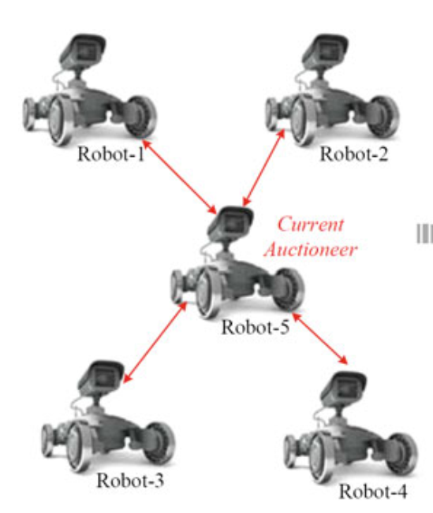
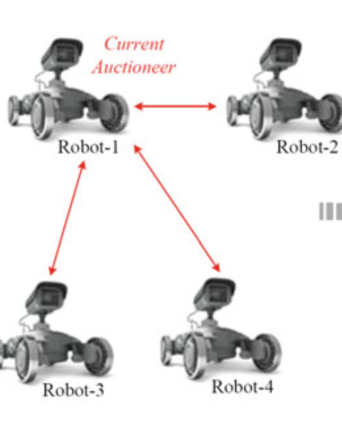
Cooperative
Aware
Strongly coordination
Weakly Coordination
Unware
Cooperation
Knowledge
Coordination
Organization
Not Coordination
Distributed
Strongly Centralized
Weakly Centralized
Notes:
Now , I will introduce to you the structure fo MRS.
Can be devided into four level.
First level is Cooperation Level: The first level is concerned with the ability of the system to cooperate in order to accomplish a specific task.
The second level is Knowledge Level: The second level of the proposed hierarchical structure is concerned with the knowledge that each robot in the team has about its team mates. Aware robots have some kind of knowledge of their team mates, while unaware robots act without any knowledge of the other robots in the system.
Coordination Level: The third level is concerned with the mechanisms used for cooperation.
we consider coordination as cooperation in which the actions performed by each robotic agent take into account the actions executed by the other robotic agents Organization Level: The fourth level of our hierarchical structure is concerned with the way the decision system is realized within the MRS. The organization level introduces a distinction in the forms of coordination, distinguishing centralized approaches from distributed ones.

Slide 6
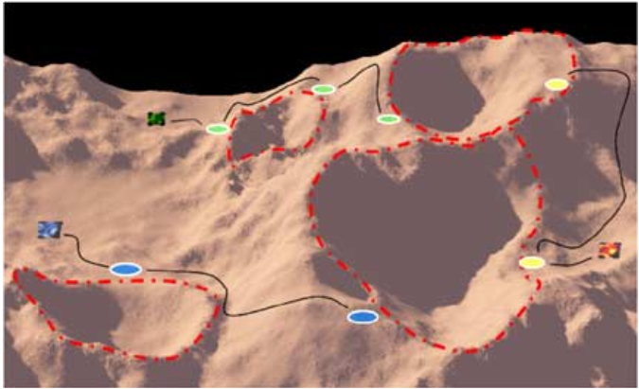
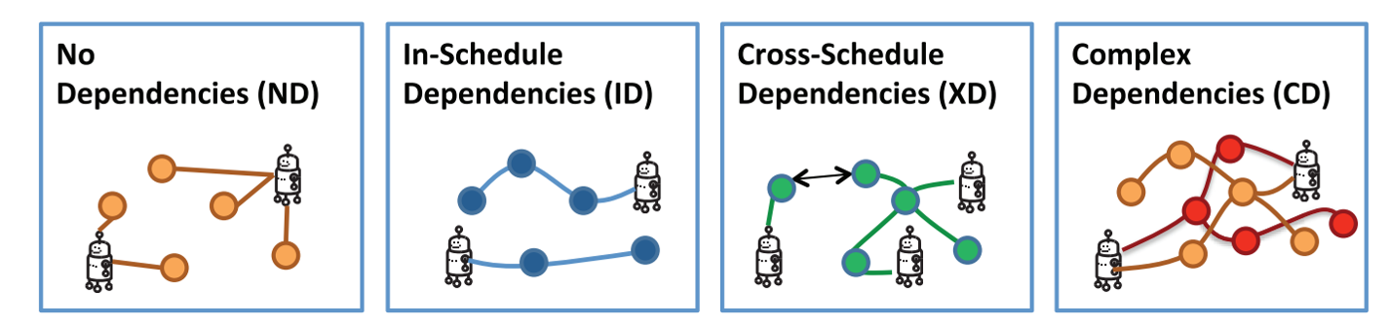
Robots
Tasks
matching
Notes:
An illustration of three robots exploring Mars. The robots’ task is to gather data around the four craters, which can be achieved by visiting the highlighted target sites.
Task allocation is the problem of feasibly assigning a set of tasks to a team in a way that optimizes a global objective function.
No Dependencies (ND). These are task allocation problems with simple or compound tasks that have independent agent–task utilities In-schedule Dependencies (ID). These are task allocation problems with simple or compound tasks for which the agent–task utilities have intra-schedule dependencies
Cross-schedule Dependencies (XD). These are task allocation problems with simple or compound tasks for which the agent–task utilities have inter-schedule dependencies (in addition to any in-schedule dependencies).
Complex Dependencies (CD). These are task allocation problems for which the agent–task utilities have interschedule dependencies for complex tasks

Slide 7
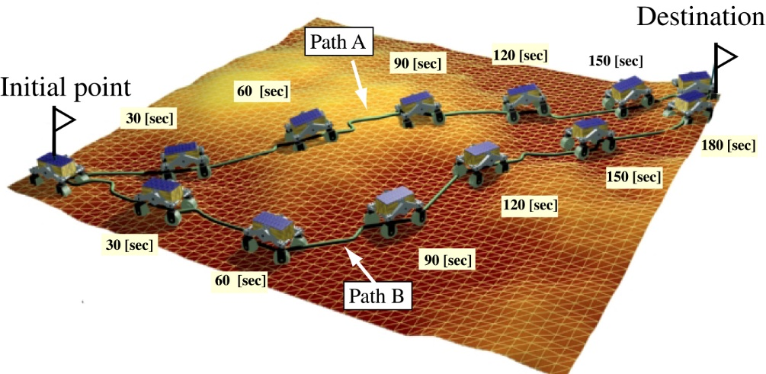
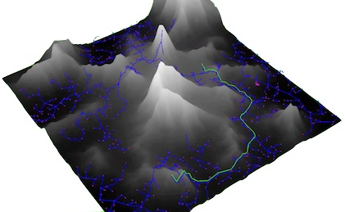
Unknown environmental
Local path planning
Global path planning
Known environmental
Notes:
The general problem of path planning for mobile robots is defined as the search for a path which a robot (with specified geometry) has to follow in a described environment, in order to reach a particular position and orientation , given an initial position and orientation.
There are two suggested techniques covering all approaches in robot path planning: (i) global path planning or off-line path planning and (ii) local path planning or on-line path planning. A global path planner usually generates a low-resolution high-level path based on a known environmental map or its current and past perceptive information of the environment. The method is valuable of producing an optimized path; however, it is inadequate reacting to unknown or dynamic obstacles. In theory, the global path planning is better than local path planning .On the other hand, local path planning algorithm does not need a priori information of the environment. It usually gives a high-resolution low-level path only over a fragment of global path based on information from on-board sensors. It works effectively in dynamic environments.

Slide 8
Environment
Perception
Localization
Cognition
Motion Control
Path
Local map
Task
Position
Notes:
There are four basic components of this process: (i) perception, the robot uses its sensors to extract meaningful information; (ii) localization, the robot determines its location in the working space; (iii) cognition and path planning, the robot decides how to steer to achieve its goal; (iv) motion control, the robot regulates its motion to accomplish the desired trajectory.

Slide 9
The potential advantages of the multi-robot system
The jobs which multi-robot can do
The structure of the multi-robot system
Task allocation of the multi-robot system
Path planning of the multi-robot system
Notes:
MRS is an interesting topic which has been well researched. But in some area of the MRS, there are some Challenge. Such as in the uncertainty and unforeseen environment.
Maybe, I will do these research. Thank you for your listening. that's all.

