Slide 1
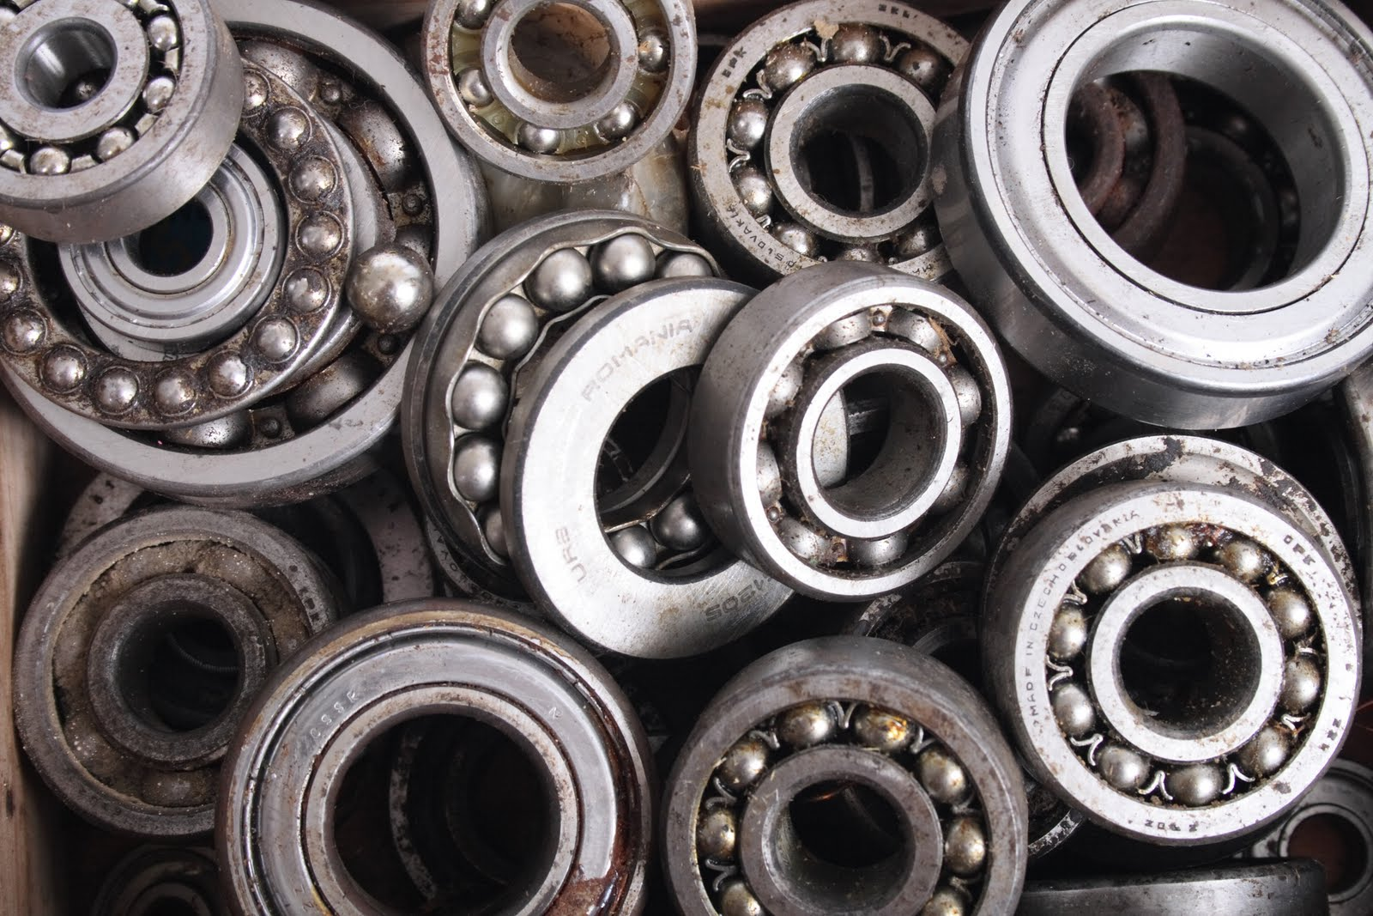
BEARING:Mechanism and types.
MAHESH CHANDRA ROUTHU
2ND YEAR Mechanical department

Slide 2
what are bearings?
A bearing is a machine element that constrains relative motion to only the desired motion and reduces friction between moving parts.
Imagine a bicycle without smooth rotating wheels or a noisy ceiling fan.Bearings are small components that make these machines work quietlyand smoothly.
Bearings reduce friction between moving parts,allowing everything from car engines fans to operate more efficiently.

Slide 3
Mechanism of Bearings
The mechanism of bearings is centered around reducing friction between two moving parts,typically a shaft and housing,by using rolling elements such as balls or rollers.
Bearings allow for smooth and efficient movement,whether rotational or linear,by transferring loads.
There are different types of components like inner and outer rings,rolling elements,cage,and lubrication.

Slide 4
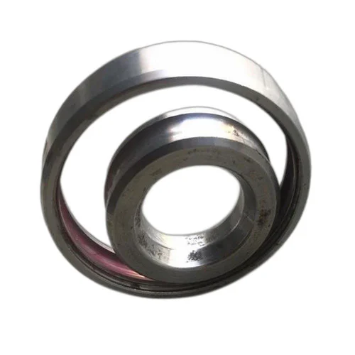
Components of bearings
Inner/Outer Ring:
The inner and outer ring are usually made from a special high-purity, chrome alloy steel. This material has the necessary hardness and purity – both important factors for a high load rating and a long service life.

Slide 5
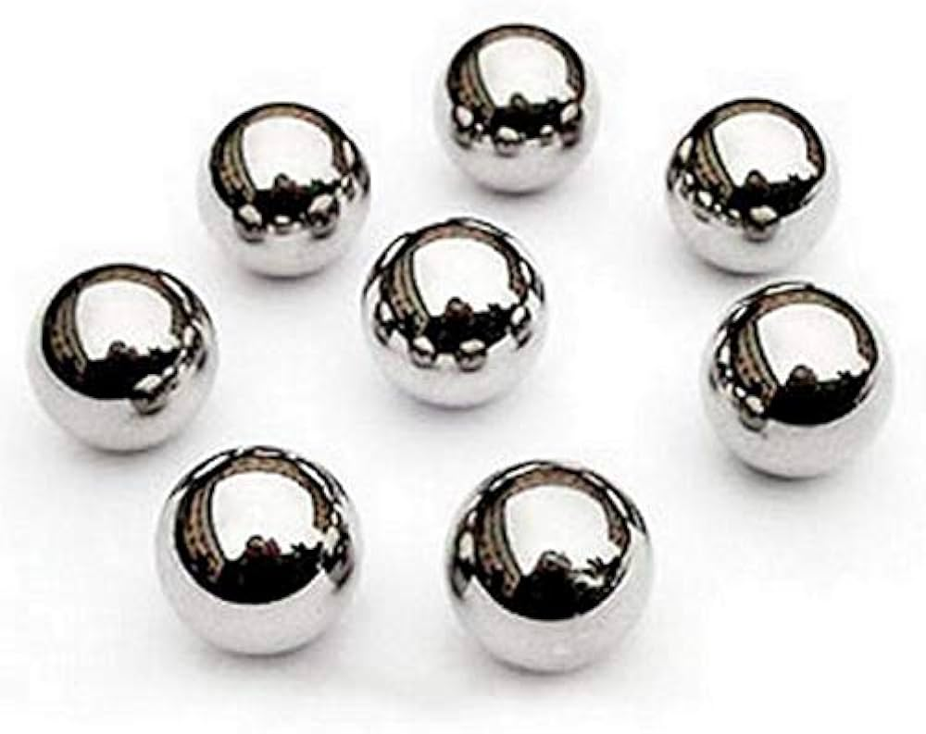
Rolling elements:
Rolling elements are either balls, rollers, cones, spheres or needles. They are usually made from a special high-purity, chrome alloy steel. Special materials such as ceramic and plastics are also used.
The rolling elements roll on the specially formed raceways of the rings or discs and are kept apart and guided by the cage.
Rolling elements carry the load without much friction as the sliding friction is replaced with rolling friction. Rolling

Slide 6
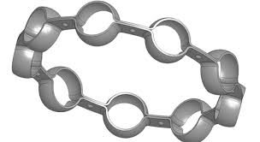
Cage:
The cage is responsible for keeping the rolling elements apart and guiding them. The materials used include steel, brass and plastic. Solid metal cages can be produced using machining techniques, while pressed cages are made from sheet metal. Similarly, plastic cages can be machined from solid plastic or injection moulded.

Slide 7
Lubrication:
Lubrication is a key part of keeping bearings running smoothly and efficiently. It helps reduce friction and wear between moving parts, which can be especially important in high-speed applications. By creating a protective film, lubrication prevents metal surfaces from grinding against each other, helping to keep things cool and extending the life of the bearing. We often use oils for fast-moving parts because they flow easily and dissipate heat well.
Greases, on the other hand, are great for slower applications where they can stay put and provide lasting protection. Regular checks on the lubricant are essential—if it gets dirty or runs low, it can lead to increased friction and overheating, ultimately causing the bearing to fail. So, taking care of lubrication is vital for keeping machinery in top shape!

Slide 8
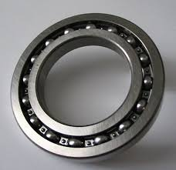
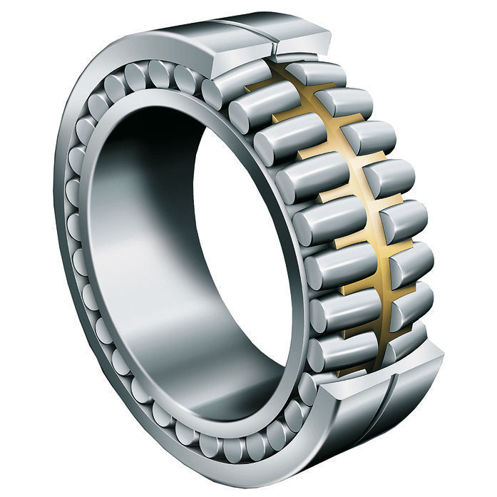
Types of bearings:
1. Ball Bearings
Ball bearings are among the most common types. They consist of a series of balls that fit between two rings, known as the inner and outer races. This design allows for smooth rotation and minimal friction, making them ideal for high-speed applications like electric motors and bicycles. They’re versatile and can handle both radial and axial loads, which makes them a popular choice in many industries.
2. Roller Bearings
Roller bearings use cylindrical rollers instead of balls, which increases their load-carrying capacity. They can handle heavier loads compared to ball bearings, making them suitable for applications like construction machinery and automotive components. The design allows for good stability and durability, especially under heavy pressure. However, they may not perform as well at very high speeds.

Slide 9
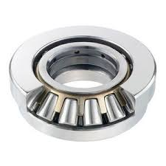
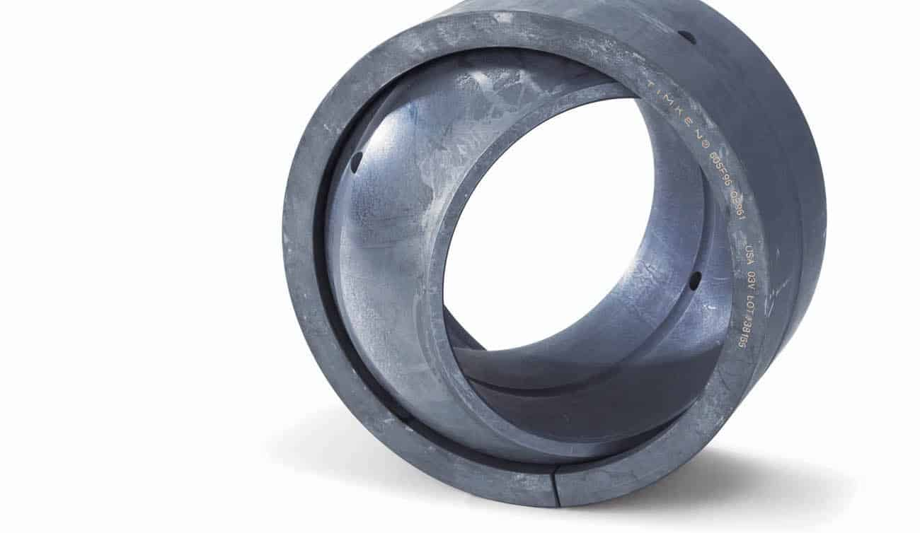
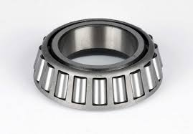
3. Thrust Bearings
Thrust bearings are designed to support axial loads, which are forces that act parallel to the shaft. They typically feature flat plates with rolling elements, such as balls or rollers, to accommodate these loads. You’ll often find them in applications like automotive clutches and turbine engines, where they help keep components aligned and functioning properly.
4. Plain Bearings
Plain bearings are the simplest type, consisting of a smooth surface that allows for sliding motion. They don't have moving parts, making them low-cost and easy to maintain. Commonly used in applications like heavy machinery and automotive engines, they excel in environments where space is limited and where simplicity is key.
5.Tapered Bearings
Tapered roller bearings handle both radial and axial loads, featuring conical rollers between tapered races. This design allows for efficient load distribution and reduced friction, making them ideal for applications like automotive wheel hubs.

Slide 10
Summary:
Bearings play a crucial role in reducing friction and supporting loads.
Understanding different types bearing mechanism is essential for machine design.
There are different types components in bearing mechanism like inner and outer ring,rolling elements,cage,lubrication.
Different types of bearings includes ball,roller,plain,tapered and thrust bearings.

