Slide 1
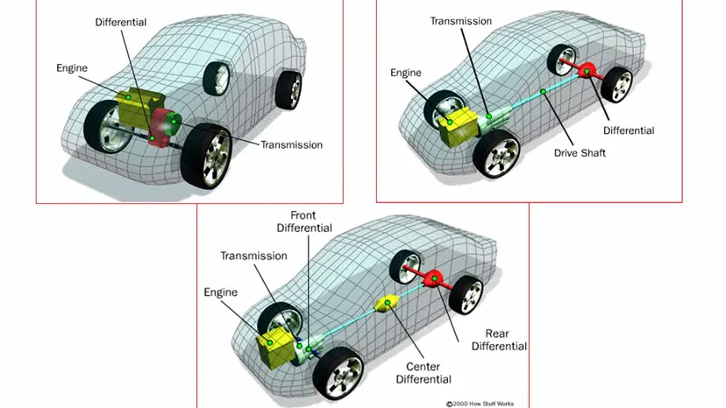
Differential
A differential is a crucial part of a vehicle's drivetrain, allowing the wheels to rotate at different speeds, especially when turning. This is important because, during a turn, the wheels on the outside of the turn travel a greater distance than the wheels on the inside, so they need to rotate at different speeds to avoid slipping or skidding.
How a Differential Works:
When driving straight, the differential ensures equal power is delivered to both wheels.
When turning, it allows the outer wheel to rotate faster than the inner wheel, preventing skidding or dragging of tires.

Slide 2
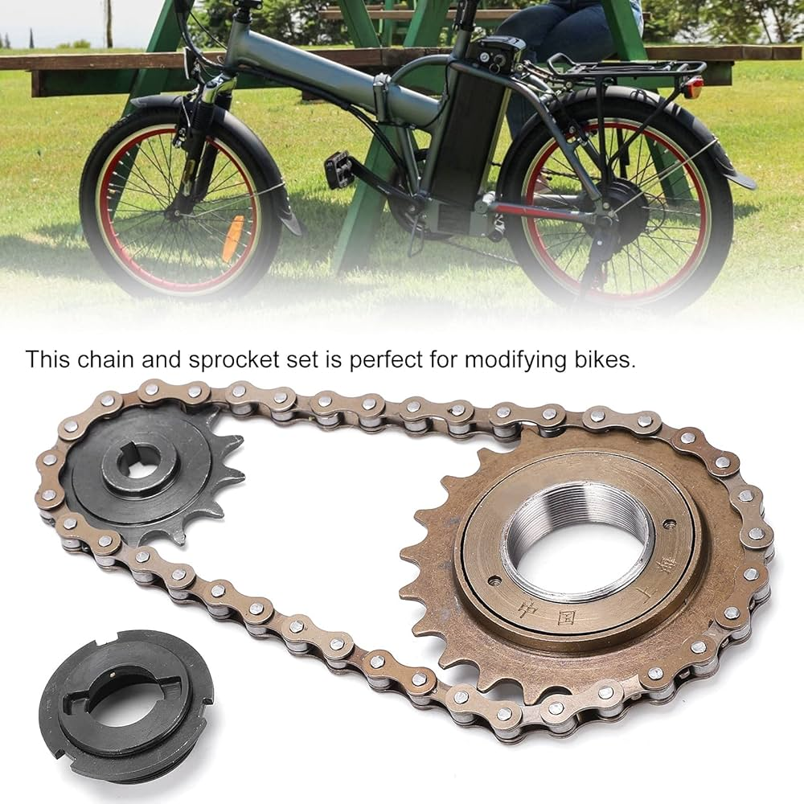
Chain and Sprocket
A chain and sprocket system is a mechanism used to transmit power and motion between rotating shafts, commonly seen in bicycles, motorcycles, and various machinery.
How a Chain and Sprocket System Works:
Power Transmission: The driving sprocket is attached to a power source, such as a motor or pedals. As this sprocket rotates, it pulls the chain, which wraps around the driven sprocket, causing it to rotate.
Speed and Torque: The gear ratio between the driving and driven sprockets determines the relationship between speed and torque. If the driving sprocket has fewer teeth than the driven sprocket, it will increase torque but reduce speed. If the driving sprocket has more teeth, it will increase speed but reduce torque.

Slide 3
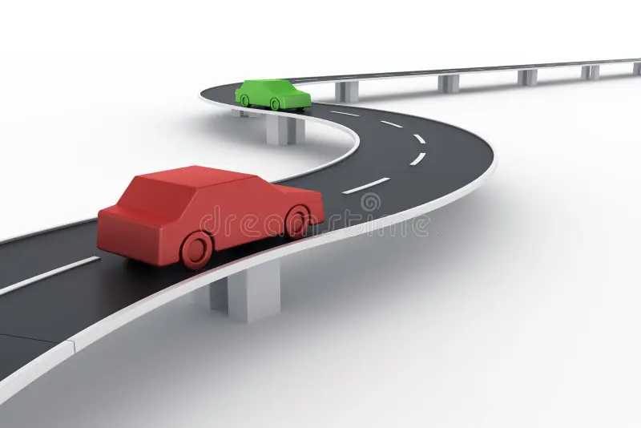
What did we use?
We used differential because although chain and sprocket allows the transmission of power from the motor to the wheels but it doesn’t has the ability of providing different torques to different wheels which may lead to sliding and skidding when in turns or curved roads.

Slide 4
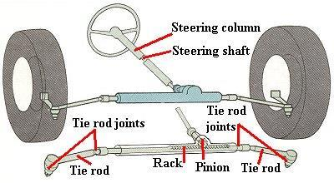
Steering
Rack and Pinion Steering
Description: This is the most common type of steering mechanism, used in most modern passenger cars and small vehicles. It consists of a pinion gear attached to the steering shaft (connected to the steering wheel) and a rack gear that moves left or right as the pinion rotates.
How It Works: When the driver turns the steering wheel, the pinion gear rotates, causing the rack to move linearly. This linear motion is transferred to the tie rods, which in turn move the wheels.
Other types of steering:
Recirculating Ball Steering (Worm and Sector)
Hydraulic Power Steering (HPS)
Electric Power Steering (EPS)
Four-Wheel Steering (4WS)

Slide 5
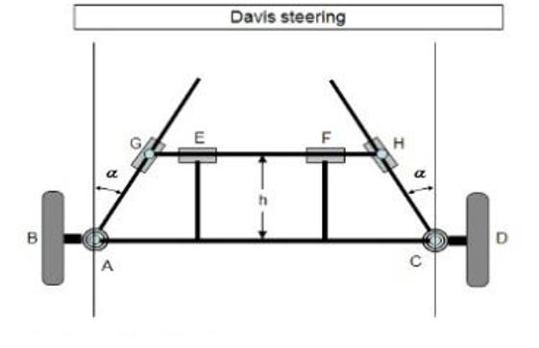
Ackermann Steering Mechanism
The Ackermann steering linkage also known as the Four bar mechanism is a type of mechanical linkage that ensures proper steering geometry, especially during turns. It is based on a simple four-bar linkage system and is widely used in most cars, trucks, and light vehicles.
How It Works:
The four-bar mechanism ensures that when a vehicle turns, the inside wheel turns at a sharper angle than the outside wheel. This is necessary because the inside wheel has to follow a smaller radius than the outside wheel during a turn. Without this adjustment, the tires would skid or scrub, causing uneven wear and making the steering less effective.

Slide 6
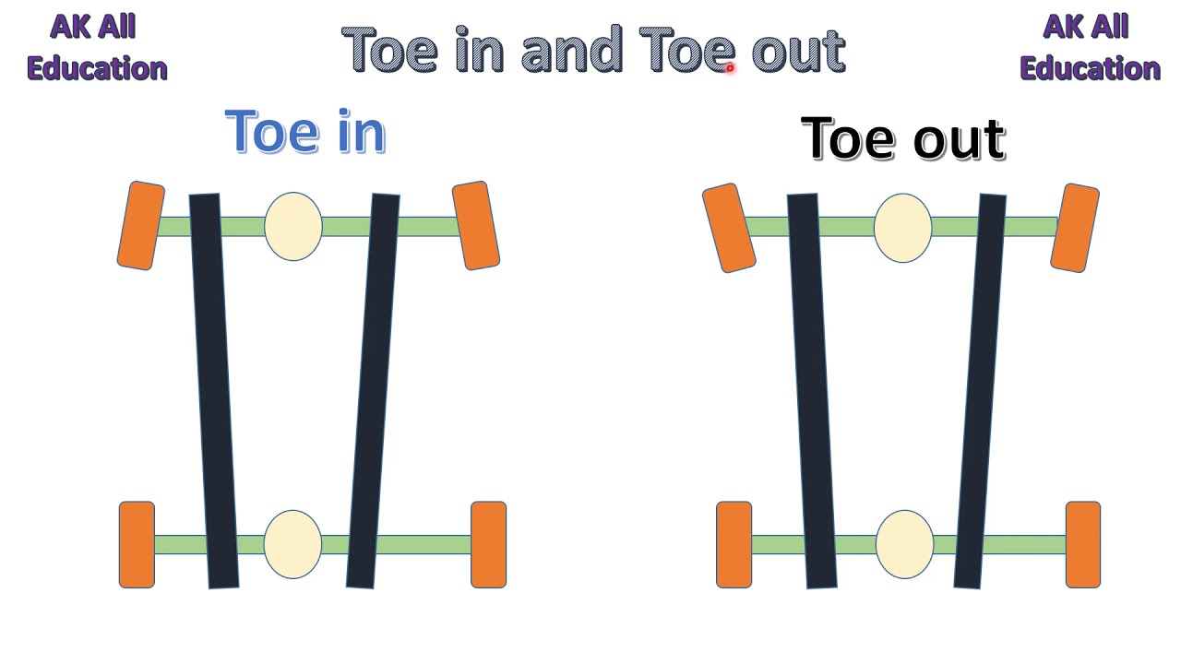
Toe IN and OUT
Toe-in and toe-out refer to the alignment of the front (or sometimes rear) wheels of a vehicle when viewed from above. They describe the angle of the wheels in relation to the centerline of the vehicle and are critical for ensuring proper handling, tire wear, and stability.
What is Toe?
Toe is the angle at which the wheels point relative to each other when looking at the vehicle from above.
If the front of the wheels point inwards towards the center of the vehicle, it's called toe-in.
If the front of the wheels point outwards away from the center of the vehicle, it's called toe-out.

Slide 7
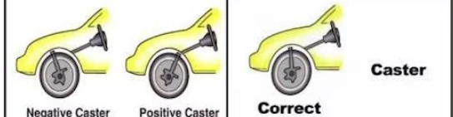
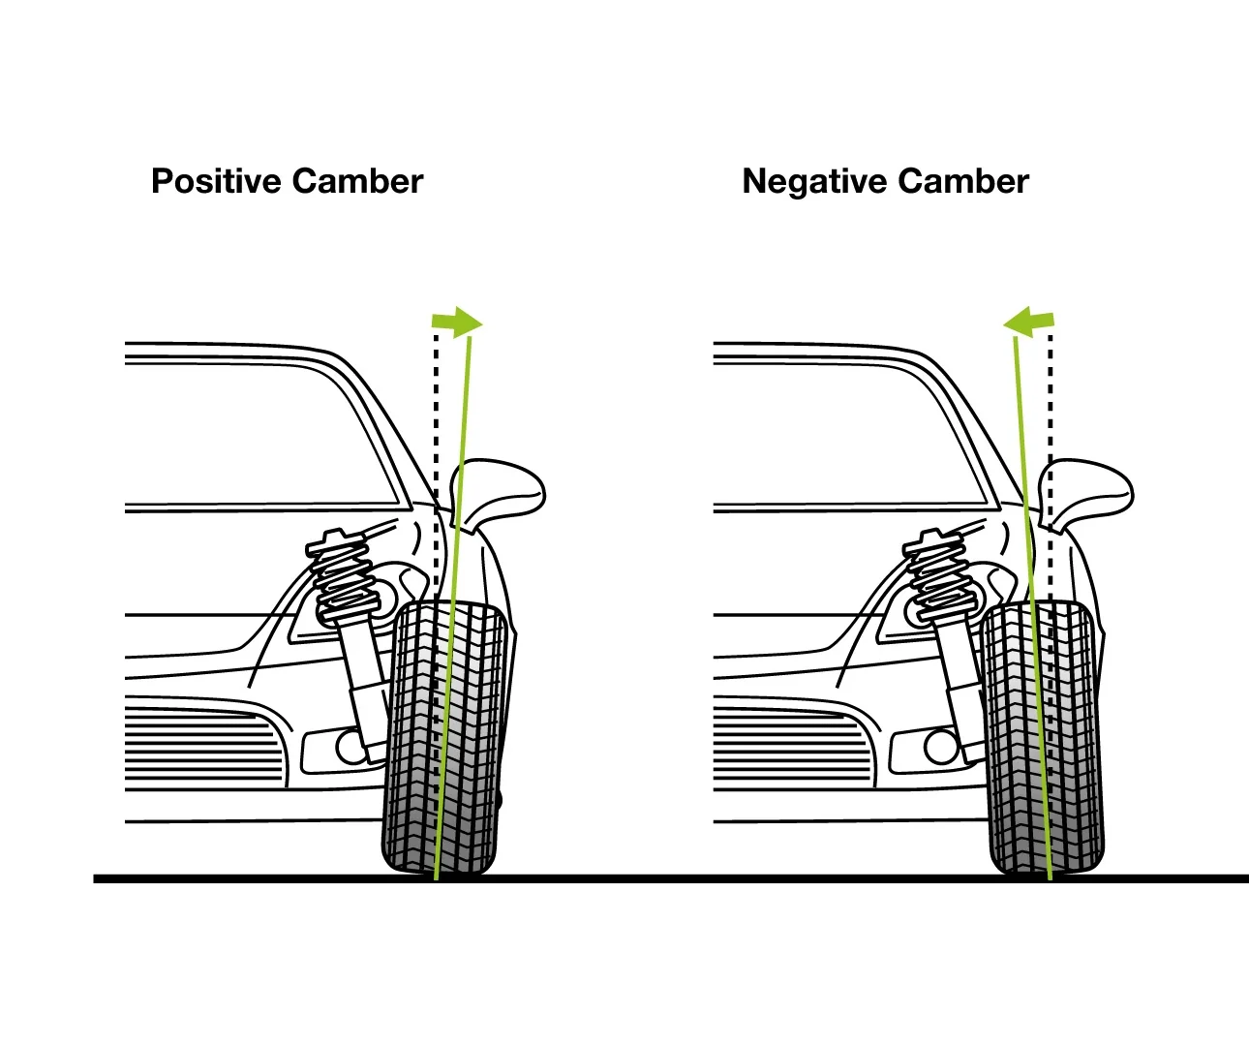
Caster and Camber
Caster is the angle of the steering axis when viewed from the side of the vehicle. It refers to the tilt of the steering pivot point (usually located at the top of the strut or spindle) either forward or backward from vertical.
Camber is the angle of the wheel when viewed from the front of the vehicle. It refers to the tilt of the wheel relative to the vertical axis.
Causes of Caster and Camber Problems:
Impact Damage
Wear and Tear
Suspension Modifications
Worn Suspension Components
Adjustments and Modifications

Slide 8
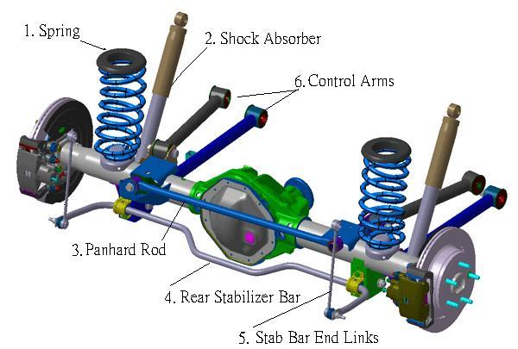
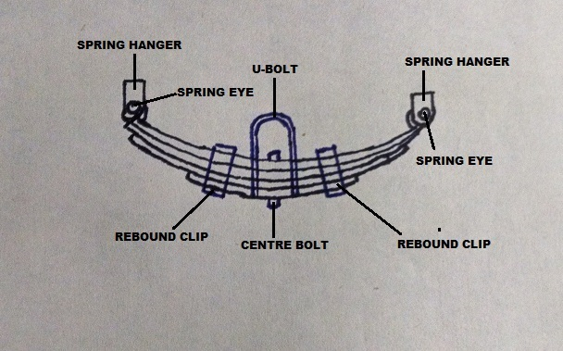
SUSPENSION
Suspension refers to the system of components (like springs, shock absorbers, and linkages) that connect a vehicle to its wheels, allowing it to absorb shocks from the road and maintain stability, handling, and comfort. It helps in smoothening out bumps and keeping the tires in contact with the ground for better control and safety.
Types of Suspension
There are two main types of suspension systems used in vehicles, each with different subtypes:
1. Dependent Suspension:-
In this type, the wheels on opposite sides of the vehicle are connected, meaning the movement of one wheel affects the other. It is commonly used in heavy-duty vehicles like trucks. e.g :- Solid Axle Suspension, Leaf Spring Suspension

Slide 9
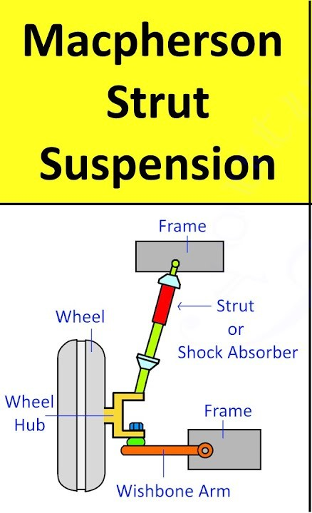
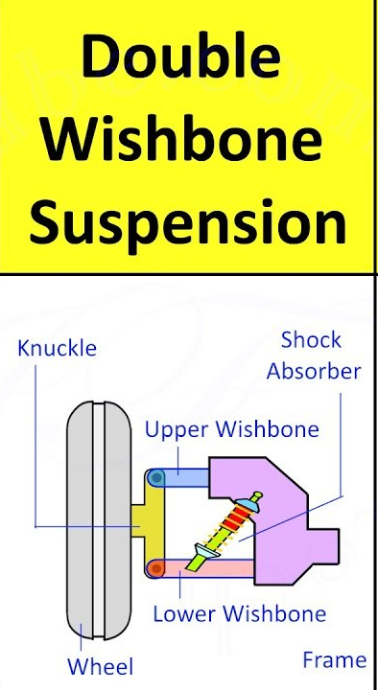
SUSPENSION
There are two main types of suspension systems used in vehicles, each with different subtypes:
2. Independent Suspension
In an independent system, the wheels on opposite sides move independently of each other, improving ride comfort and handling.
MacPherson Strut: A commonly used suspension for front wheels in many modern cars. It combines a shock absorber and a coil spring into a single unit, offering a compact design.
Double Wishbone: Uses two control arms (upper and lower) to allow each wheel to move up and down independently. It provides better control over handling and ride quality.
Other Specialized Suspension Types
Air Suspension: Uses air-filled bags instead of traditional springs, allowing for height adjustment and a smoother ride.
Hydraulic Suspension: Uses hydraulic fluid to control the suspension movement, providing a highly adjustable and smooth ride, often seen in luxury cars and low-riders.

