Slide 1

Epileptic Seizure Recognition
By Tate
Thanyaporn Techangam

Slide 2
Content
Primary goals
Vocabulary
Introduction: What my former colleague has done so far
​Summary​
Interesting topic
References

Slide 3
Primary goals
To find the best classification model with the highest possible F1- score to help predict Epileptic Seizure from brain activity recording.
Vocabulary
EEG → Electroencephalography
A scalp record of brain wave activity
Epilepsy
A neurological condition or an abnormal activity in the brain that causes unprovoked, recurrent seizures
F1- score
- A measure of a model’s accuracy on a dataset. It compares both precision
and recall. The higher value, the better.

Slide 4
Introduction
What my former colleague has done so far

Slide 5
Introduction
: What she has done so far
Up until now what my former colleague has done so far is improving the F1- score that she got from Random Forest model by using both Principal Component Analysis (PCA) and Clustering through
K-means and hierarchical clustering types.
She started her task on the data exploration part by checking all the details from raw data related to many patients and brains-scan features, such as What does each data represent? How many of them in rows and columns? What are the names of each features? and what types each feature is?. This exploration make it clear that there are too many EEG and patient features. Therefore, they are needed to be addressed!
With the diversity of the output that has up to 5 categories, the first step she took for the cleaning process was to group and convert the output of data, which represents the patients who do not have epileptic seizure into 0. Hence, the data was transformed from multiple classes to binary value [0,1]. To do PCA and Clustering, it is required to check for the missing value, the skewness of data (none to be found) and biasness of the dependent variable. However, there was an imbalanced number of 0 and 1, so my former colleague applied the Stratified Shuffle Split cross validator to help reducing biasness which tends to happen after splitting the data in to train and test datasets using the independent variable (y) with extreme unequal proportion of 0 and 1. Then, Jake normalized the data within scale 0 to 1 by scaling them as each feature has a variety of number. This helped smoothing and transforming data before training model.

Slide 6
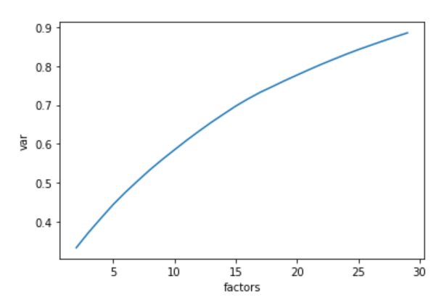
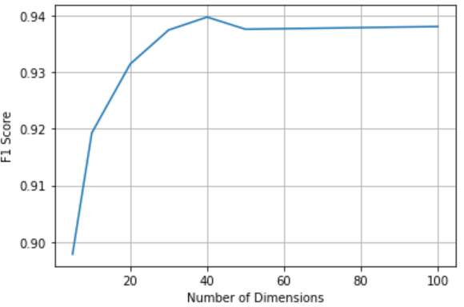
Introduction(cont.)
: What she has done so far
After cleaning and scaling all data, it was the time she fitted all data into train and test data together with calculating the scores (Precision, Recall, F1-score and Accuracy) based on 6 classifiers (Logistic Regression, Support Vector Machine (SVC), Decision Tree, Random Forest (RF), Gradient Boosting Classifier and Multi-layer Perceptron (MLP)) to find the best classifier possible. Because she chose her primary focus indicator to be F1- score as it dealt well with unbalanced data sets by comparing both precision and recall, the best classifier that provided the highest F1- score of 96.7935% was the Random Forest model.
Once she figured the best classifier, Jake improved her RF model performance using PCA and Clustering, respectively. Beginning with PCA, as it is a way to decrease multicollinearity and dimension of the data, she randomly chose a range of 2 to 30 as her number of dimensions to see how well PCA would capture the variance or variability in the dataset. She found out that the percentage of variance explained by 30 principal components was 88.54%, which could also be seen in the plot (a). Nevertheless, there was no clear elbow point using elbow method, so my former colleague decided to use pipeline to chain many transformers together and create a range of set number of dimensions to check which number
provides the highest F1- score. The results from both
numerical data and plot visualization (b) shows that only
40 component is enough to achieve the high score.
However, F1- score is only 93.98% therefore, PCA is
considered not help improving F1- score from her RF
model.
a
b

Slide 7
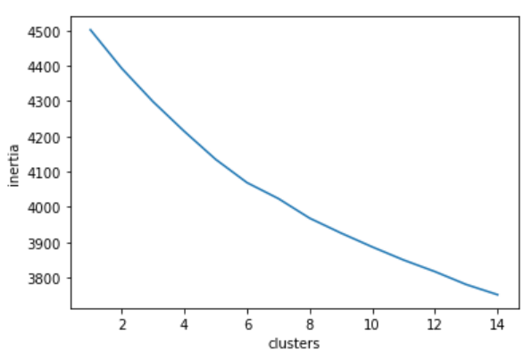
Introduction(cont.)
: What she has done so far
The next unsupervised learning that she considered was Clustering, The clustering types that she used were K-means and Hierarchical clustering to improve the performance above her basic baseline RF model.
By using K-means, Jake created a plot of number of clusters versus Inertia to measure how well
a dataset was clustered by K-Means. However, there was no elbow point (the one with
lowest inertia and number of clusters (K)) to indicate the optimal dataset from
the plot. Therefore, my former colleague solved this issue by use K= 5 as, from
the data exploration, she knew that the output has 5 classifications. She then
used this number of clusters and applied to both K-means and Hierarchical
clustering. Finally, she computed the F1- score from these 2 types of clustering.
There was a significant improving in her F1- score from 96.7935% to 99.7831%
and 100%, respectively.
Lastly, she mentioned about the extra steps that could be taken to improve more performance; choosing the hyperparameter to tune the RF model, building ensemble models to improve more performance, and combining PCA and clustering together to reduce more features further!
IMPORTANT NOTICE: Looks like Jake might forget to fix seed on the chosen classification models so; I will fix that and re-check the actual improvement in F1- score again to make sure that it actually improves.

Slide 8
Summary
Her final conclusions are that one of the unsupervised learning algorithms, ‘K-means and hierarchical clustering’ from clustering, can actually improve F1- score of her best classifier model, which is random forest from 96.7935% to 99.7831% and 100%!

Slide 9
Interesting topic
That I will guide you through!

Slide 10
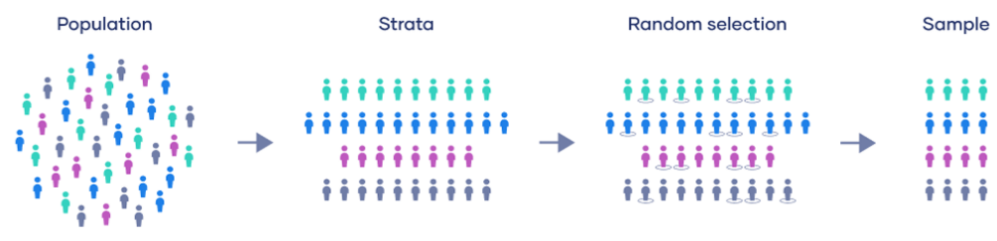
StratifiedShuffleSplit
What is it?
StratifiedShuffleSplit is one of the packages in model selection inside Sklearn. It helps reducing biasness that is likely to happen when there is an imbalance between classes in the output variable. To understand it, you need to divide it into Stratified + ShuffleSplit first and look at the meaning of each word separately.
Let’s begin with the first word ➔ ‘Stratified’ aka Stratified Sampling
Normally, when we choose a random sample from the population, which have multiple groups, to make our prediction as precise as it can be, we would like to get a sample from every groups possible to conduct our model. By using a normal random sampling, it is not guaranteed that we will get sample from every groups in the population. With this, ‘Stratified Sampling’ comes into rescue!
This statistical method will categorize all populations into an individual group named ‘Strata’. In each Strata, it will do a random selection to get the sample. This way it is certain that its sample will accurately reflect the population using in a predictive model.

Slide 11
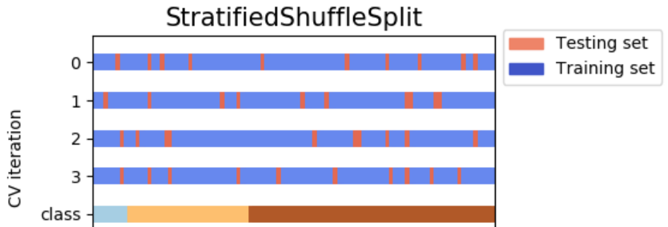
The next word that we need to look at is ‘ShuffleSplit’
It is one of the Sklearn functions which will help split the data into
multiple different train and test datasets.
When we combine these 2 words together, StratifiedShuffleSplit is a package that will shuffle the data repeatedly before splitting into actual train and test data in each class and number of splits. The way it works is that it will shuffle the data and split the data into the desired number of splits. Next, It will determine one part to be the test set and then iterate the whole process mentioned with the rest of splits over and over again until it is done with the final split.
With the way this function frequently shuffles, there are chances that the data in each test set can overlap with each other!

Slide 12
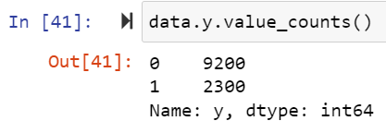
How to perform StratifiedShuffleSplit
First thing first! Before performing the StratifiedShuffleSplit, you need to make sure that there is an imbalanced size between your classes. You can check by addressing X and y and using method ‘value_counts()’ to help showing the number of classes. In this case, for example, quantity of 0 and 1 is very different from one another. The proportion of 1 is only 20% while 0 is 80%! Therefore, you will need to use StratifiedShuffleSplit function to help addressing this issue, otherwise there is a chance that a train and test datasets will acquire unequal proportion of X and y, which will lead to disrupt your prediction accuracy later.

Slide 13

How to perform StratifiedShuffleSplit (cont.)
1
To be able to use this function, you should first start by importing StratifiedShuffleSplit into your Jupyter notebook.
2
You then need to split all columns into the dependent and independent variables named ‘X’ and ‘y’
Note: You must drop your independent variable, aka ‘y’, from your features to avoid wrong prediction.
3
Before applying the function, you should set the parameter to what you want your StratifiedShuffleSplit to perform. In this case, for example,
n_splits = 1 means you want to split your data into train and test datasets only once.
test_size= 0.2 means you want your test size to be 20% and your train dataset to be 80%. The reason for setting test size to be 20% is to replicate the actual proportion of your raw y data and to make a prediction to be as accurate as it can be!
random_state= 42 means you want to fix your train and test datasets to always be the same random dataset.
Note: There are more parameters than these three that you can play with, which you can check by pressing Shift+Tab to explore!

Slide 14


How to perform StratifiedShuffleSplit (cont.)
Although you can perform StratifiedShuffleSplit without needing to match the index number with all train and test datasets, for an easier understanding, in this example, you can use next () function to return the next item in an iterator (same as for loop), extract the index number from each rows, and split them into features ‘X’ and output ‘y’ while naming them train_idx and test_idx (these names are arbitrary).
4
After splitting those indexes into ‘X’ and ‘y’, you must create the datasets by matching all index numbers with their own columns in both train and test datasets. You can name the datasets whatever you want. In this case, they are named X_train, y_train, X_test, and y_test.
5

Slide 15

How to perform StratifiedShuffleSplit (cont.)
6
FINAL STEP!! After performing all 5 steps mentioned earlier, you can check the results from using StratifiedShuffleSplit by printing out your y_train class values (again, using method ‘value_counts()’ to help showing the number of classes). In this example, you can actually see that, with StratifiedShuffleSplit, our y_train and y_test are having the same proportion of 0 and 1 as there are in the output raw data! So, right now you can claim that you already reduced the biasness of out train and test datasets and can proceed with your classification and so on!!!

Slide 16
references

Slide 17
references
- Using PCA and Clustering to Improve Classification | Kaggle
sklearn.metrics.average_precision_score() - Scikit-learn - W3cubDocs
SVM Classification with sklearn.svm.SVC: How To Plot A Decision Boundary With Margins in 2D Space | by Alex Kataev | Geek Culture | Medium
SVM-Kernels — scikit-learn 1.1.3 documentation
sklearn.svm.SVC — scikit-learn 1.1.3 documentation
python - difference between StratifiedKFold and StratifiedShuffleSplit in sklearn - Stack Overflow
Kurtosis() & Skew() Function In Pandas | by Atanu Dan | Medium
Python | Pandas dataframe.skew() – GeeksforGeeks
Python - machine learning - scikit-learn #3 - StratifiedShuffleSplit - coding for all – YouTube
Sklearn.StratifiedShuffleSplit() function in Python – GeeksforGeeks
How to Convert Pandas DataFrame to a Series – Data to Fish
Python | Pandas Series.squeeze() – GeeksforGeeks

Slide 18
References (cont.)
Scale or Standardize or Normalize | by Apipoj Piasak | Data Espresso | Medium
sklearn.model_selection.StratifiedShuffleSplit — scikit-learn 1.1.3 documentation
N-Gram คืออะไร Sentiment Classification วิเคราะห์รีวิวหนัง IMDB แบบ N-Gram (Trigram, Bigram, Unigram) ด้วย Naive Bayes, Logistic Regression - NLP ep.6 - BUA Labs
machine learning - Question about sklearn's StratifiedShuffleSplit - Data Science Stack Exchange
Principal Component Analysis (PCA) with Scikit-learn | by Rukshan Pramoditha | Towards Data Science
รู้จัก Principal Components Analysis (PCA) ในเชิง Practical | by Sasiwut Chaiyadecha | Medium
หาจำนวน Clusters ที่เหมาะสมสำหรับ KMeans clustering ด้วย Elbow method | by Sasiwut Chaiyadecha | Medium
Recall, Precision, F1 Score - Simple Metric Explanation Machine Learning (inside-machinelearning.com)
สร้าง Machine learning model ด้วย Pipeline | by Sasiwut Chaiyadecha | Medium
Clustering Analysis & PCA Visualisation — A Guide on Unsupervised Learning | by Shahbaz Hasan Raja | Codepth | Medium
Why you should use scikit-learn's Pipeline object (signal-to-noise.xyz)
Learn the Basics of Machine Learning: Clustering: K-Means Cheatsheet | Codecademy
Pros and Cons of Stratified Random Sampling (investopedia.com)

