Slide 1
SENTIMENT ANALYSIS OF CUSTOMER FEEDBACK
BRITISH AIRWAYS

Slide 2
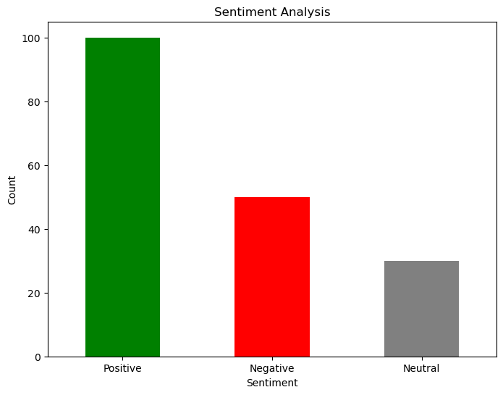
FINDINGS
As, we can see from the plot, analysis of reviews sourced from Skytrax, clearly show huge no. of positive reviews compared to negative/neutral ones, i.e for every 100 positive responses there are nearly 45 negative responses.
Key words retrieved from Topic Modelling analysis include that are likely correlated to negative reviews are : Cancelled, meal, foods.
Those are the areas the company need to improve on.

