Slide 1

Fraud Detection in Financial Transactions Project Artificial Intelligence for Business Decisions & Trans.
AUTHOR: TESSA NEJLA AYVAZOGLU DATE: July 1, 2024
This Photo by Unknown author is licensed under CC BY.

Slide 2

Agenda:
Introduction
Welcome and Objectives
Overview of Fraud Detection in Financial Services
Data Preparation and Feature Engineering
Data Information Overview
For Training Dataset
For Testing Dataset
Descriptive Statistics
Review of DataFrame Columns
Data Exploratory Analysis
Analysis of Numeric Features
Visualization:
Pearson Correlation Heatmap for Numerical Columns
Spearman Correlation Heatmap for Categorical Columns
Model Development
Introduction to Fraud Detection Modeling Techniques
Application of SMOTE (if applicable for balancing classes)
Model Building
Logistic Regression: Creating models with training data
Decision Tree: Creating models with training data
Random Forest: Creating models with training data
XGBoost: Creating models with training data
Neural Network (if applicable): Creating models with training data
Model Evaluation
Evaluation Techniques and Metrics for Fraud Detection
Discuss Model Performance
Conclusion
Summary of Findings
Future Directions and Improvements
References
Review of Cited Works and Materials Used
Q&A Session
Open Floor for Questions and Discussion

Slide 3

Overview of Fraud Detection
Objective and Motivation:
Aim: To enhance fraud detection capabilities in financial transactions using advanced AI models.
Importance: Critical for safeguarding financial integrity and customer trust in financial services.
Goal: Improve detection accuracy, reduce false positives, and mitigate financial losses due to fraudulent activities.
Problem Statement:
Challenge: Existing fraud detection methods often struggle with identifying sophisticated and evolving fraud tactics.
Solution: Develop and deploy AI-powered models to detect fraudulent transactions effectively and efficiently.
Methodology:
Models: Logistic Regression, Decision Trees, Random Forest, XGBoost, Neural Networks (if applicable).
Innovations: Utilization of techniques like feature engineering, anomaly detection, and ensemble learning. Exploration of oversampling techniques like SMOTE for imbalanced data.
Metrics: Evaluation based on precision, recall, F1-score, ROC-AUC, and detection rates.
Key Actions:
Data Preparation: Perform comprehensive data cleaning, feature selection, and transformation. Handle imbalanced data using advanced sampling techniques.
Model Development: Build and optimize fraud detection models using selected algorithms and techniques. Fine-tune parameters to enhance model performance.
Integration: Integrate models into real-time transaction monitoring systems. Implement alerts and escalation procedures for suspicious activities.
Conclusion:
Impact: The project aims to set new standards in fraud detection, ensuring robust security for financial transactions and enhancing industry-wide practices.
Techniques: Combining traditional machine learning with advanced AI methodologies to achieve higher accuracy and efficiency in fraud detection.

Slide 4
Fraud Detection:
A typical organization loses an estimated 5% of its yearly revenue to fraud. In this course, you will learn how to combat fraud using data. You will apply supervised learning algorithms to detect fraudulent behavior based on past fraud, and use unsupervised learning methods to uncover new types of fraudulent activities.
Since fraudulent transactions are rare compared to normal ones, you will learn how to properly classify imbalanced datasets.
This proje will provide both technical and theoretical insights and will demonstrate how to implement fraud detection

Slide 5
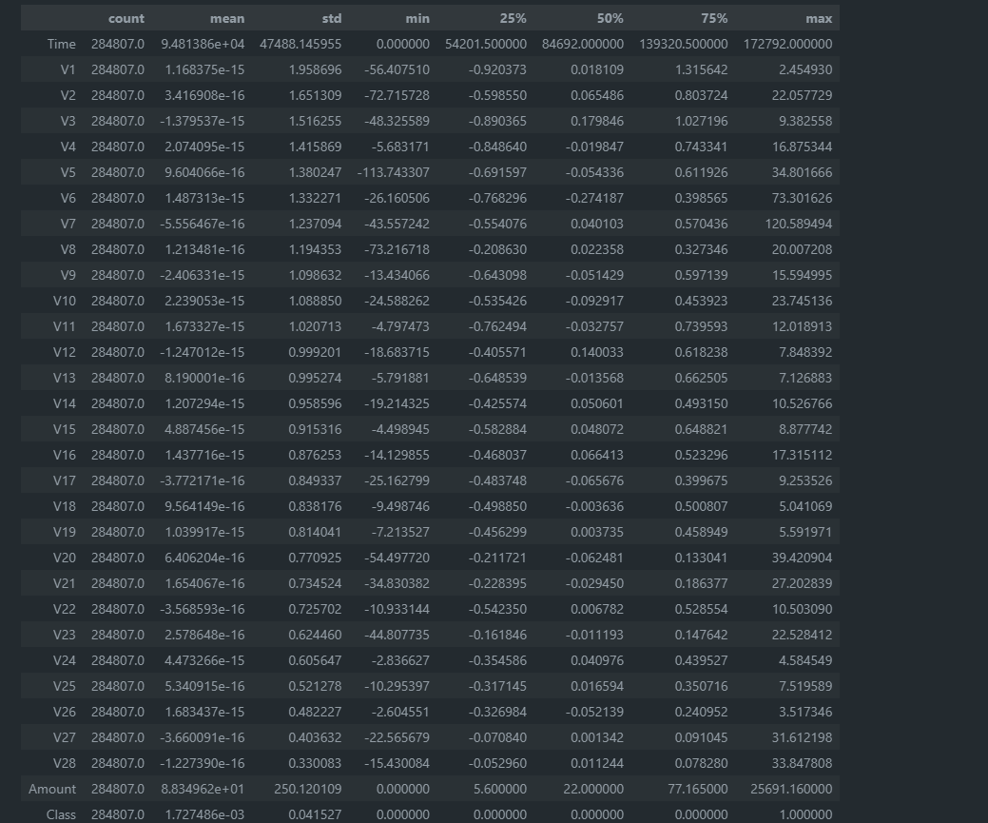
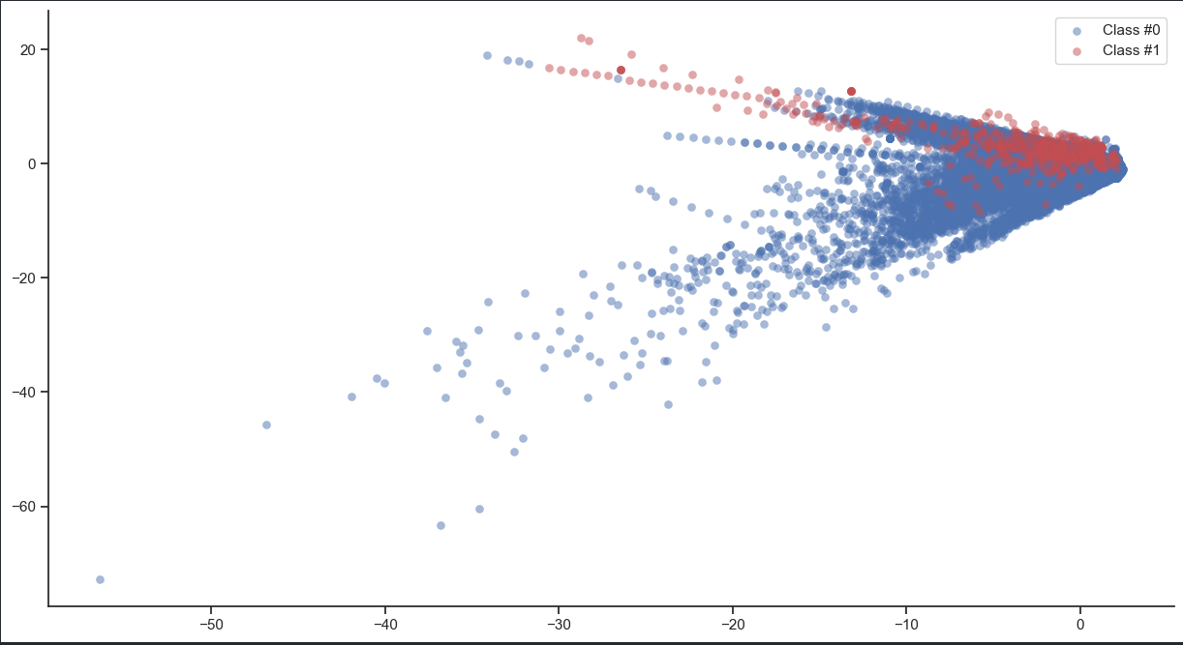
Data Preparation and Feature Engineering
By visualizing the data, you can immediately see how our fraud cases are scattered over our data, and how few cases we have. A picture often makes the imbalance problem clear. In the next graph, we’ll visually explore how to improve our fraud to non-fraud balance.

Slide 6
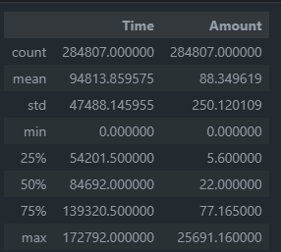
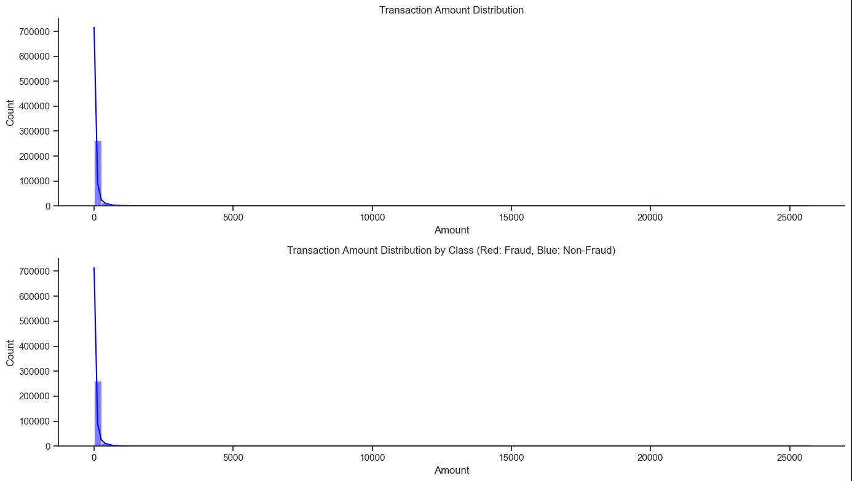
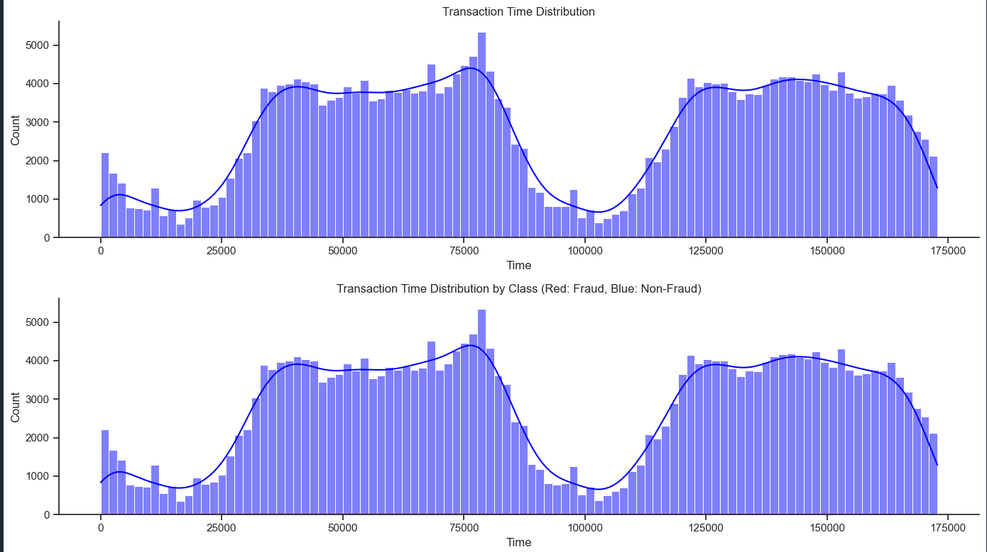
Data Preparation and Feature Engineering

Slide 7
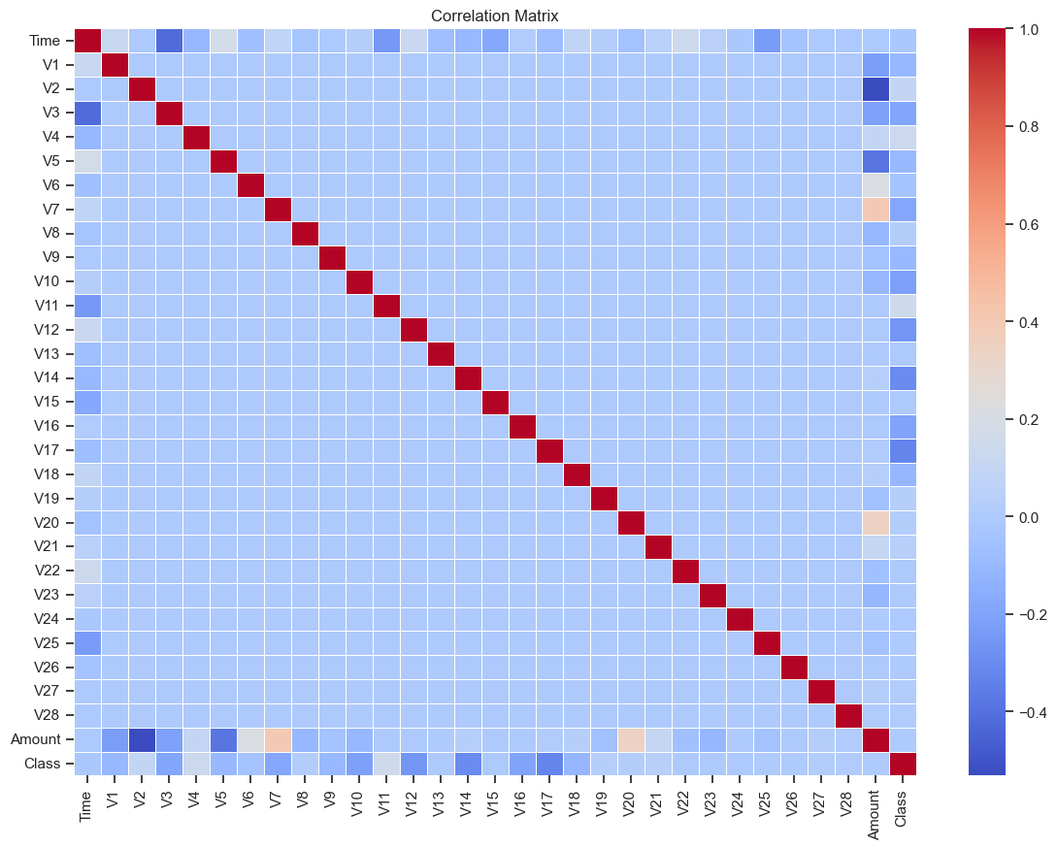
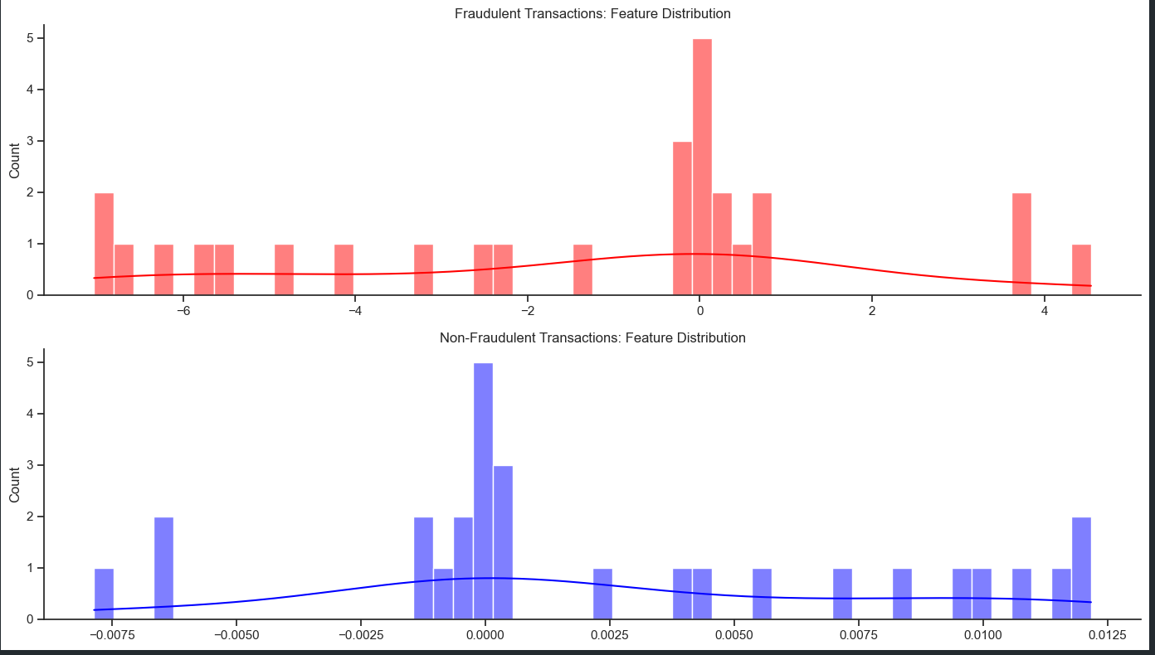
Data Preparation and Feature Engineering

Slide 8
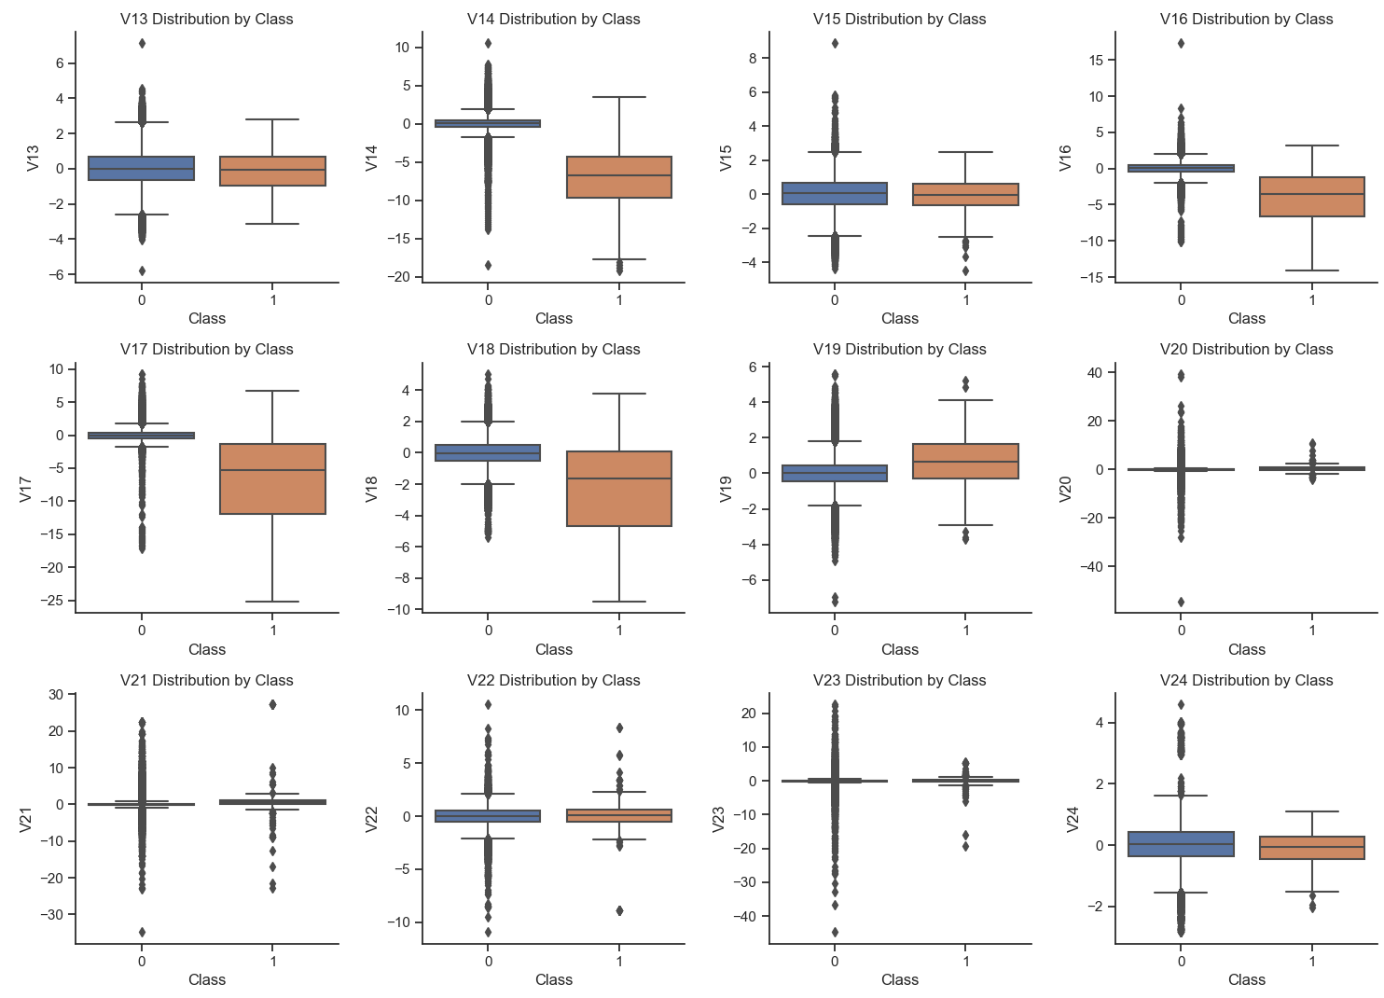
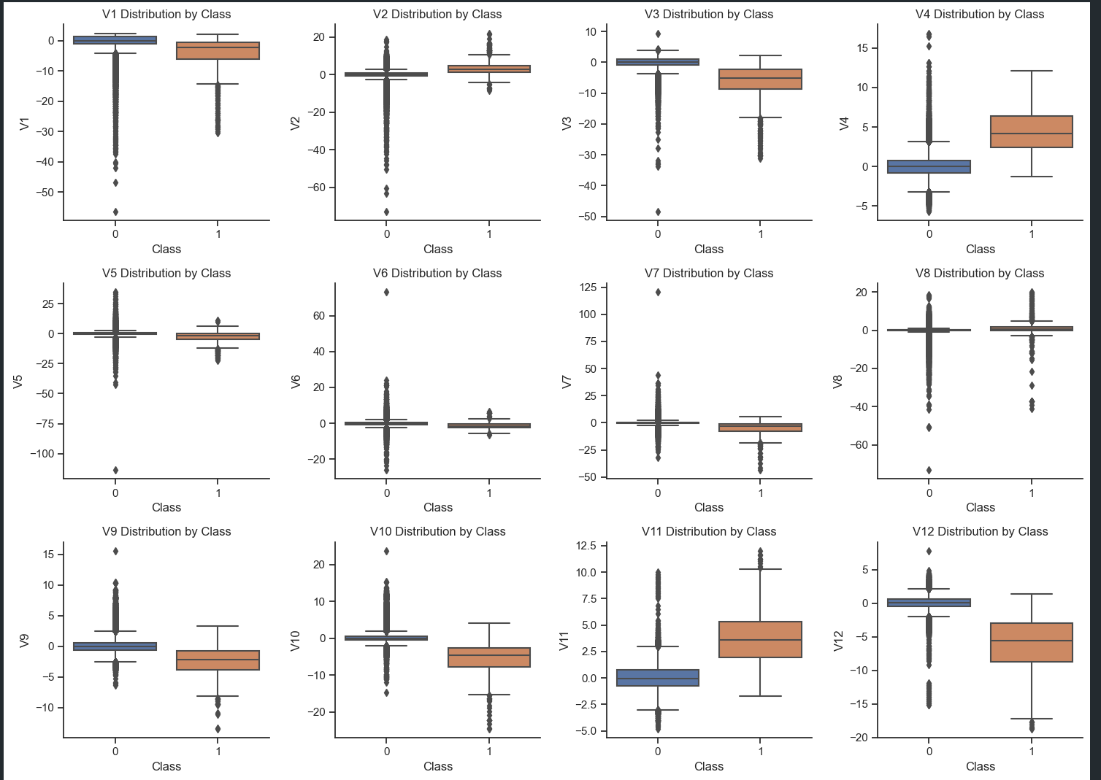
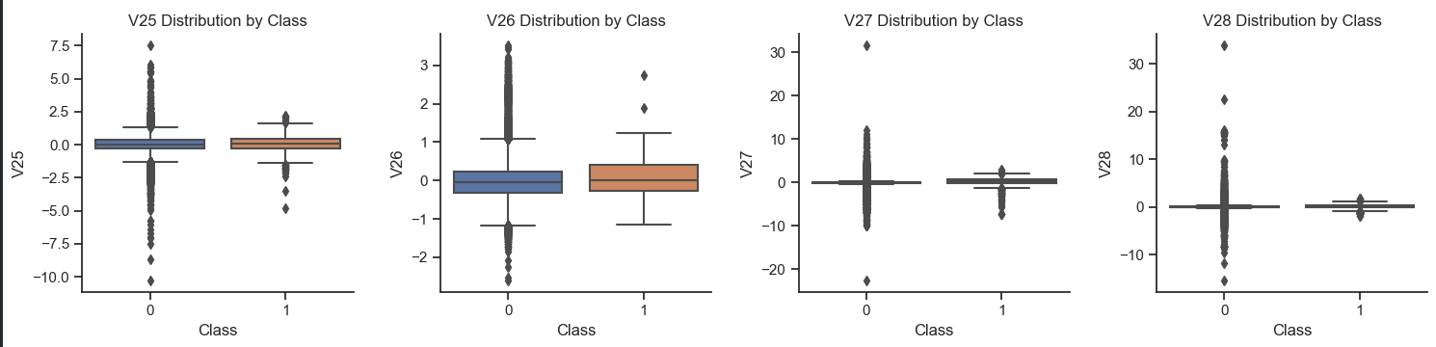
Data Preparation and Feature Engineering

Slide 9
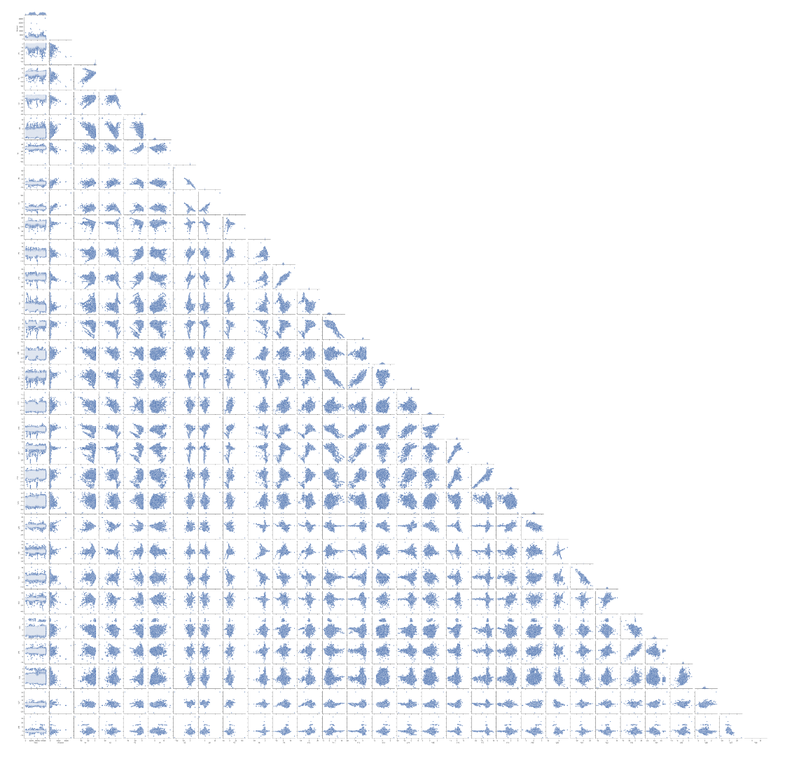
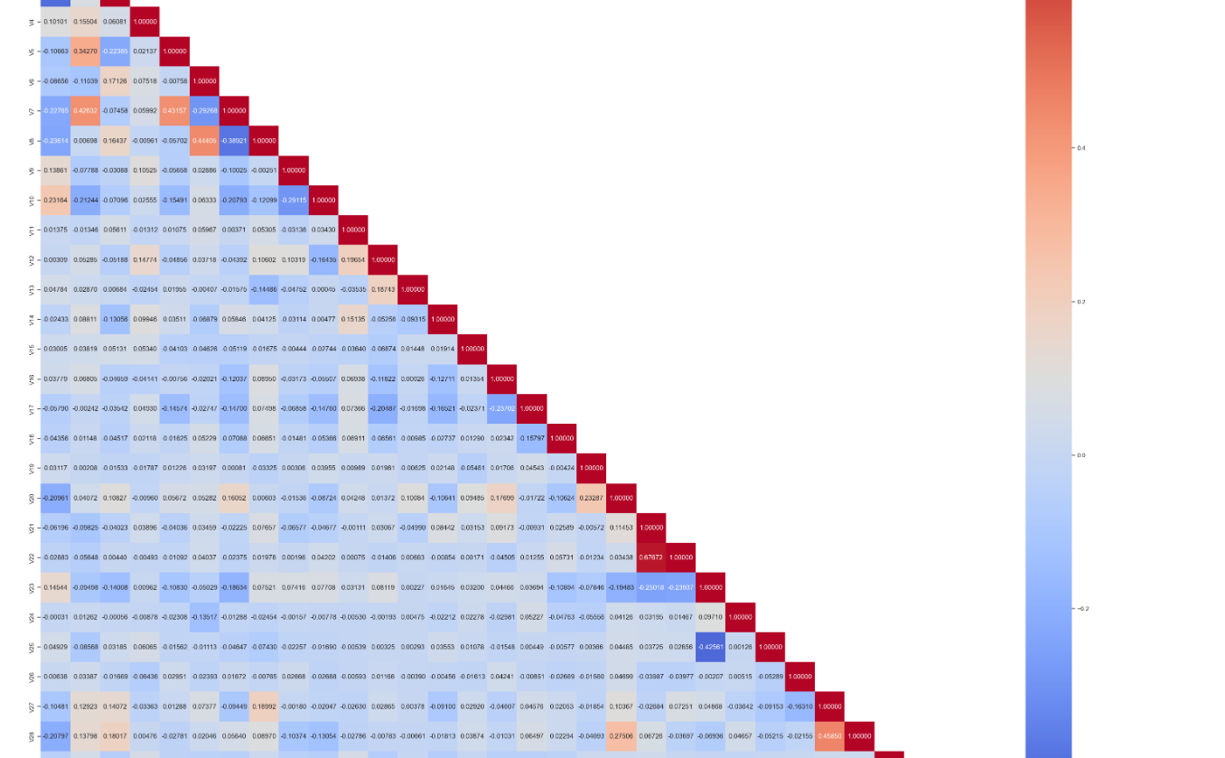
Data Preparation and Feature Engineering

Slide 10
Data Preparation and Feature Engineering

Slide 11
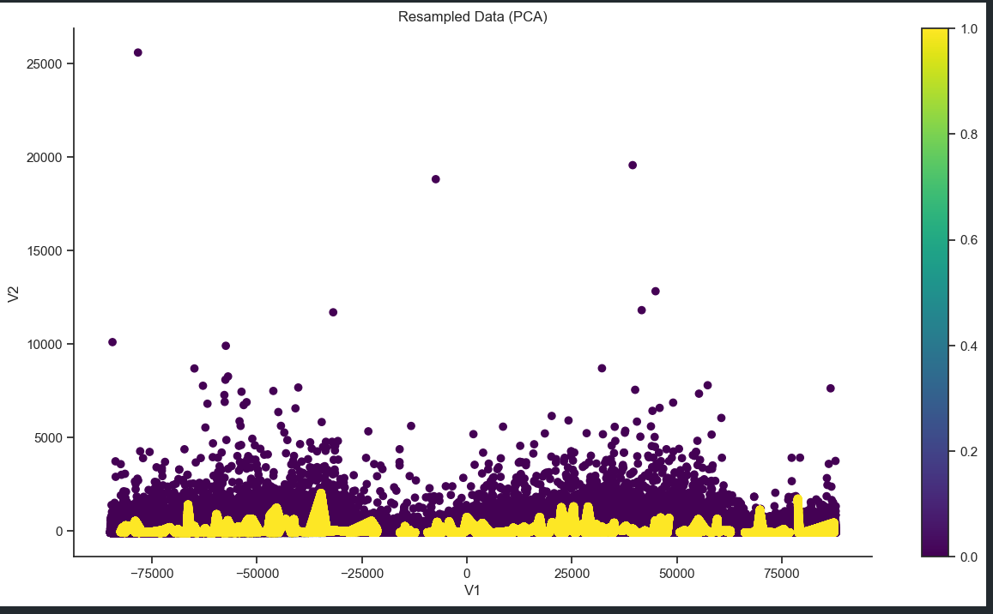
Data Preparation and Feature Engineering

Slide 12
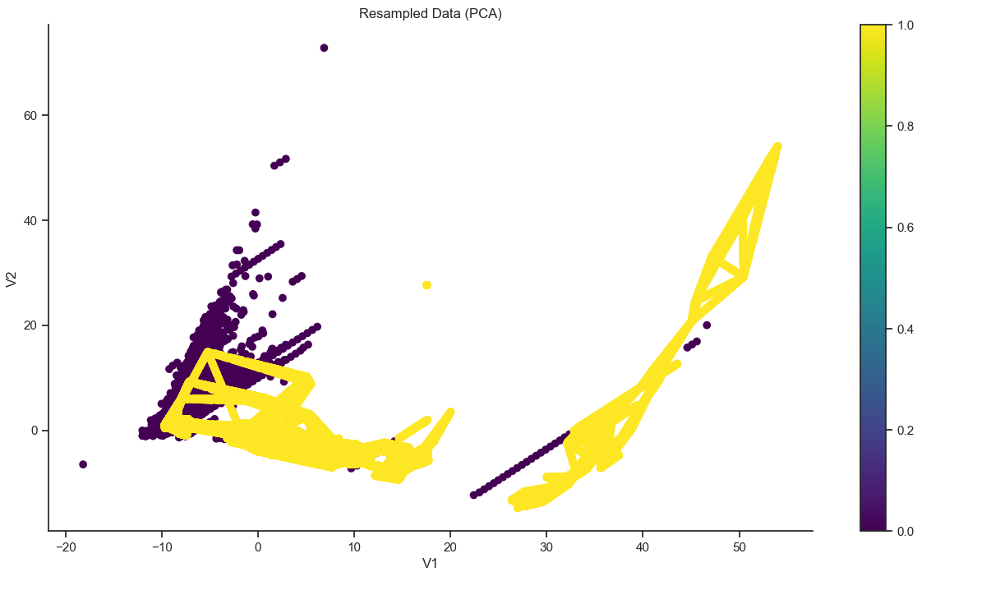
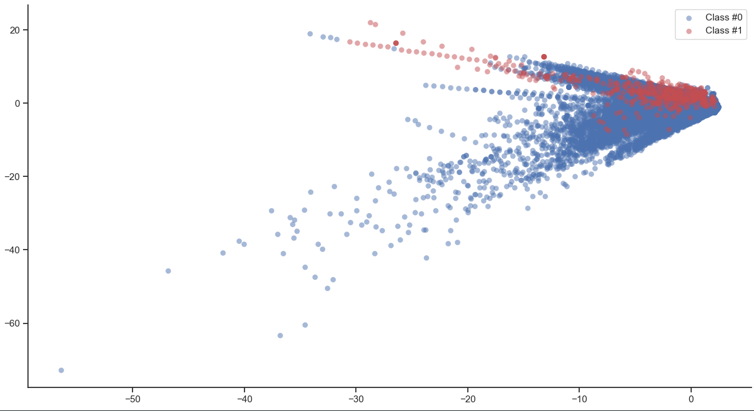
SMOTE
Original set
The minority class is now much more prominently visible in our data. To see the results of SMOTE even better, we’ll compare it to the original data in the next graph and results.

Slide 13
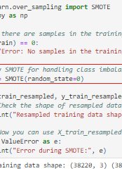
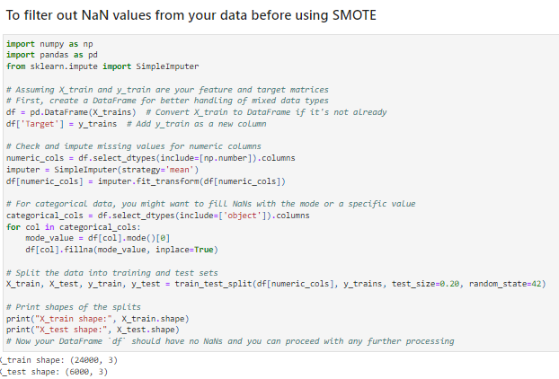
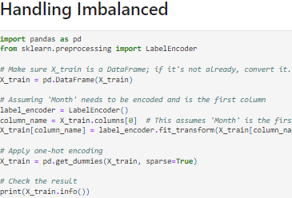
SMOTE:For those unfamiliar with the term, let me explain what SMOTE is. This method combines under-sampling of the frequent classes with over-sampling of the minority class. The aim of SMOTE is to oversample the minority class, adding more values of this type to make the data more balanced. This approach can help the model if one class is being underrepresented, as it enables the model to better identify this class through patterns.

Slide 14
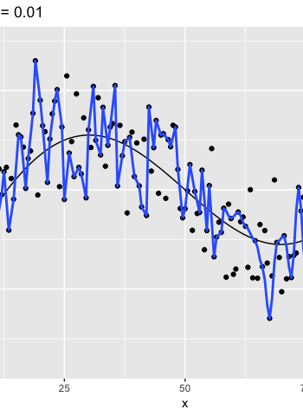
Using ML classification to catch fraud
In this exercise you’ll see what happens when you use a simple machine learning model on our credit card data instead.
Instructions
Split X and y into training and test data, keeping 20% of the data for testing.
Fit your model to your training data.
Obtain the model predicted labels by running model.predict on X_test.
Obtain a classification comparing y_test with predicted, and use the given confusion matrix to check your results.

Slide 15

Fraud Detection Using Labeled Data
Learn how to flag fraudulent transactions with supervised learning. Use classifiers, adjust and compare them to find the most efficient fraud detection model.
Review Classification Methods
Classification:
The problem of identifying to which class a new observation belongs, based on a training set of data with known class labels.
Goal: Use known fraud cases to train a model to recognize new cases.
Classes are also known as targets, labels, or categories.
Examples:
Spam detection in email services (Binary classification: spam or not spam).
Fraud detection (Binary classification: fraudulent or legitimate).
Output:
Typically categorical (e.g., yes/no, 1/0, true/false).
Variable to Predict
0: Negative class ('majority' normal cases).
1: Positive class ('minority' fraud cases).

Slide 16
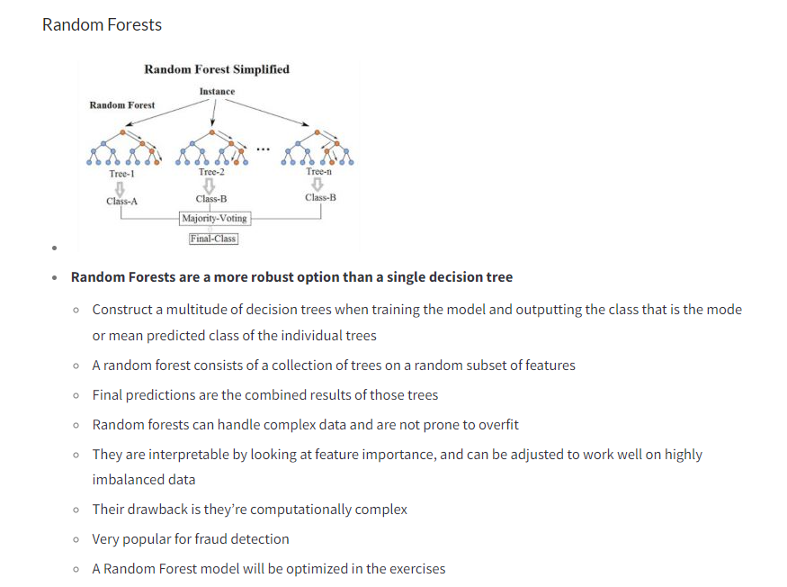
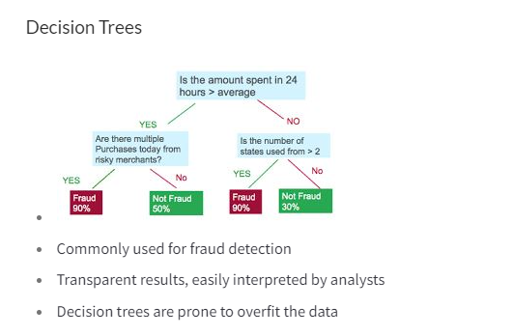
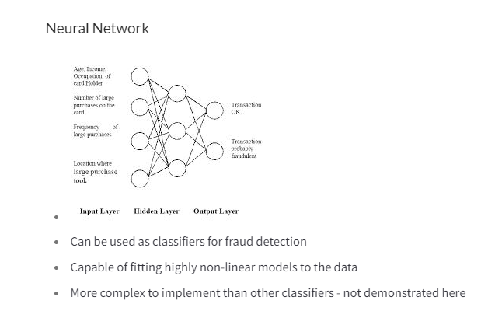
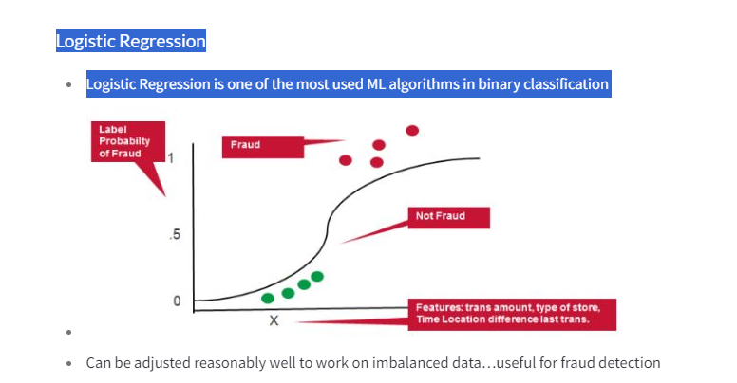
Fraud detection using labeled data

Slide 17
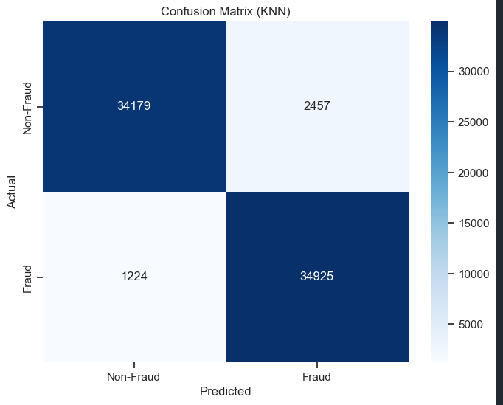
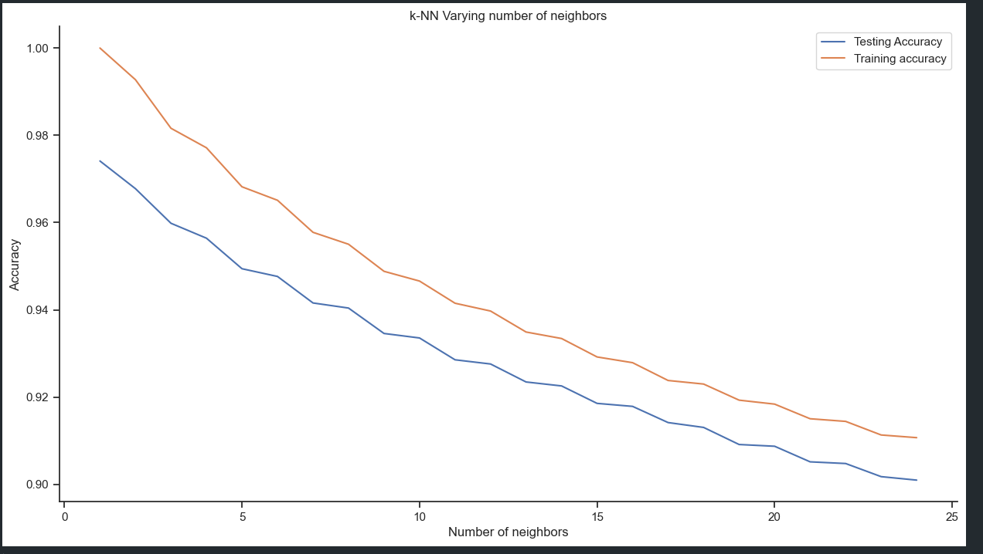
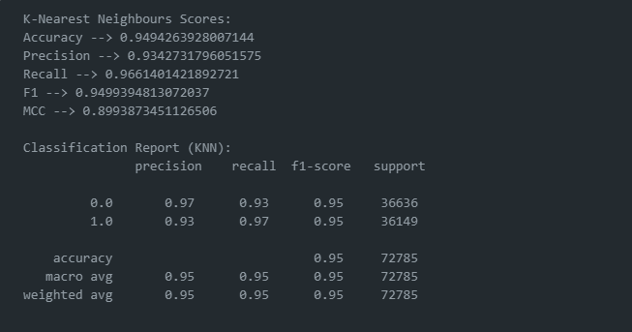
1.K-NN Creating models with data train

Slide 18
2. SVM Creating models with data train

Slide 19
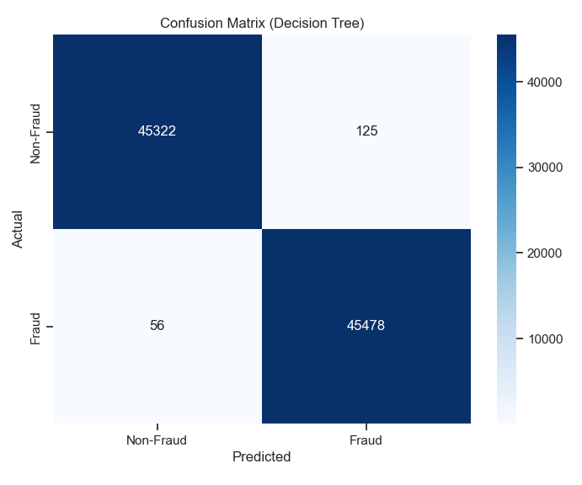
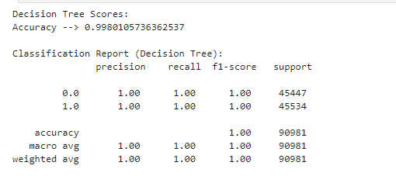
3. Decision Tree Creating models with data train

Slide 20
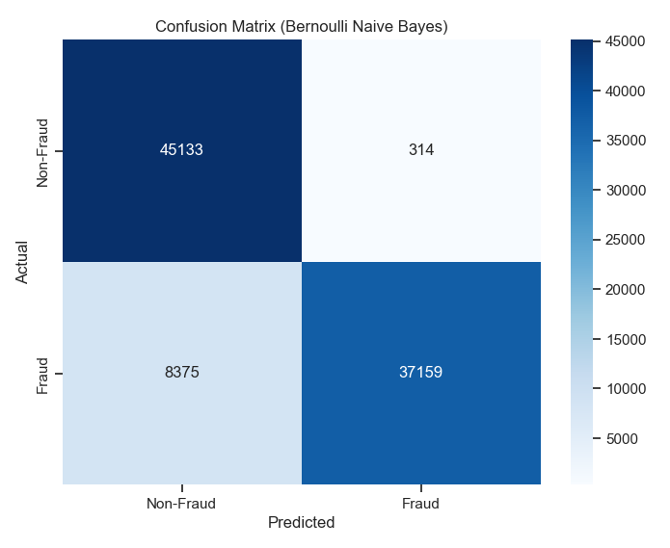
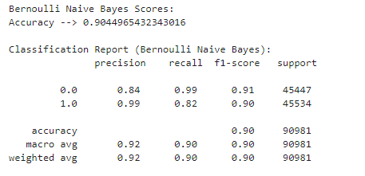
4. Multinomioal Naive Bayes Creating models with data train

Slide 21
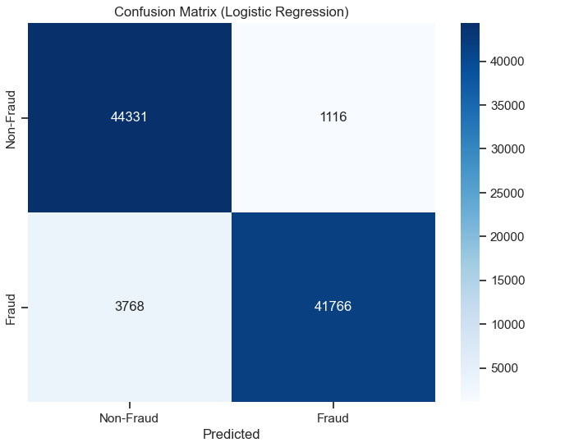
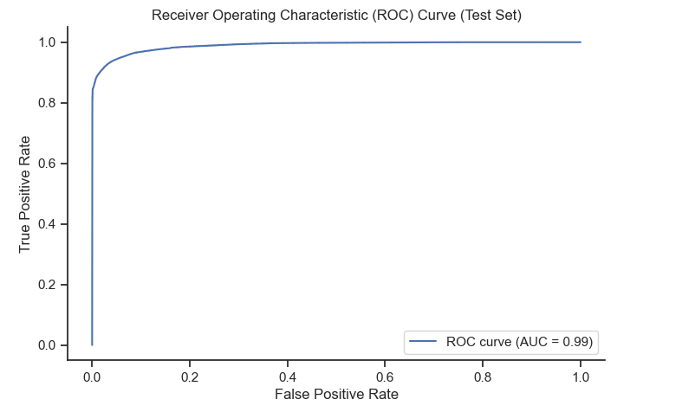
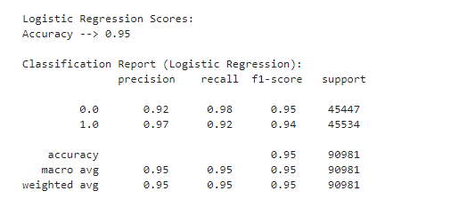
5.Logistic Regression Creating models with data train

Slide 22
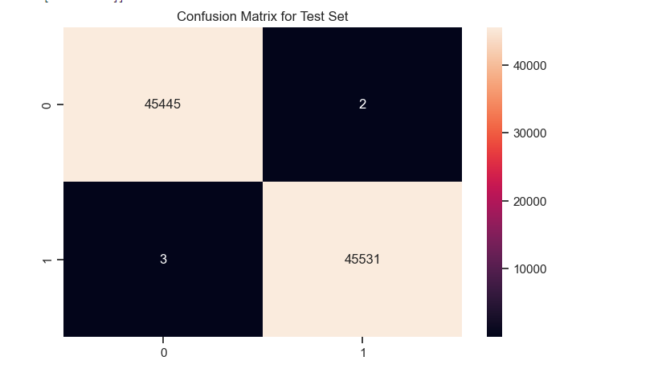
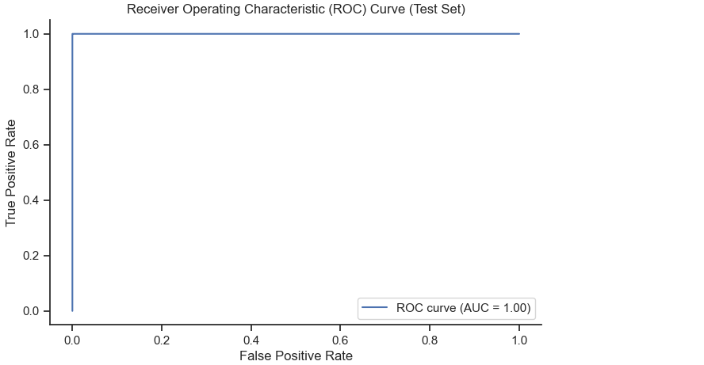
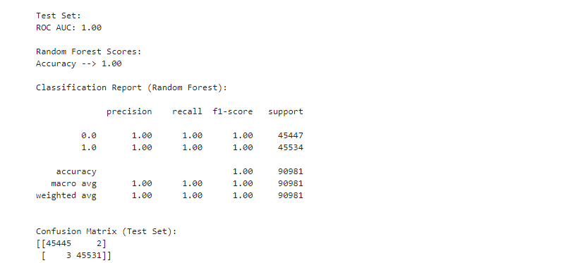
6. Random Forest Creating models with data train

Slide 23
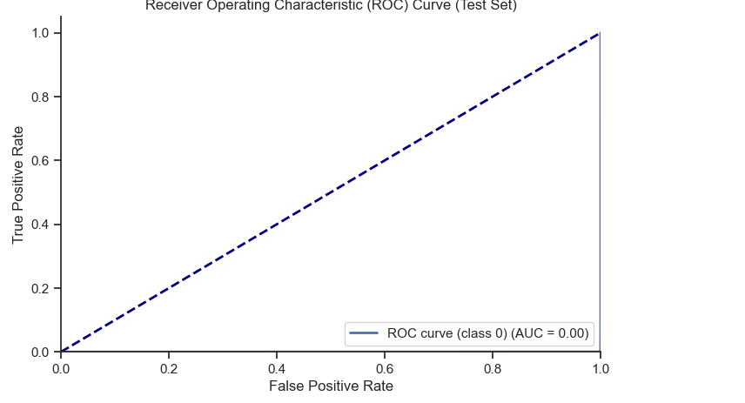
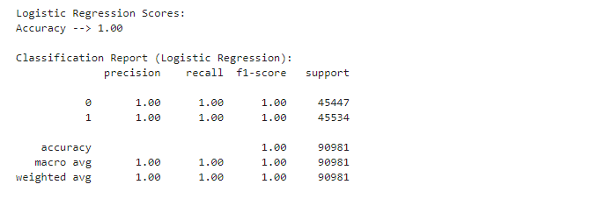
7. XGBoost Creating models with data train

Slide 24
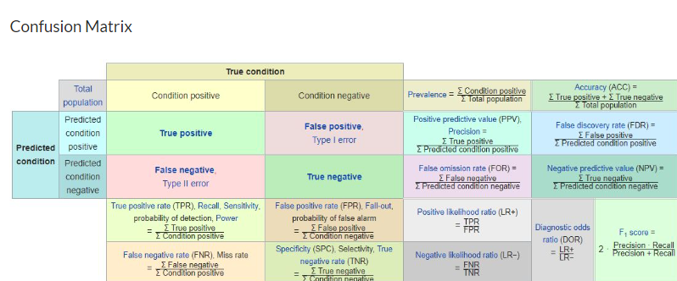
Perfomance evaluation:
Performance metrics for fraud detection models
There are other performace metrics that are more informative and reliable than accuracy

Slide 25
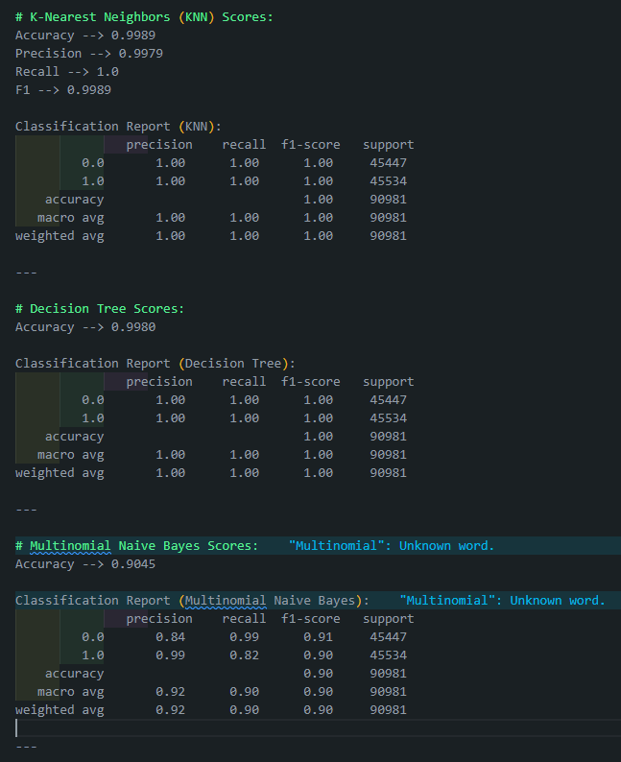
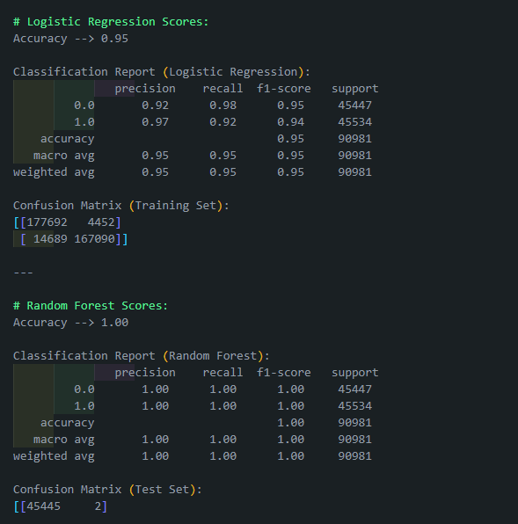

Slide 26
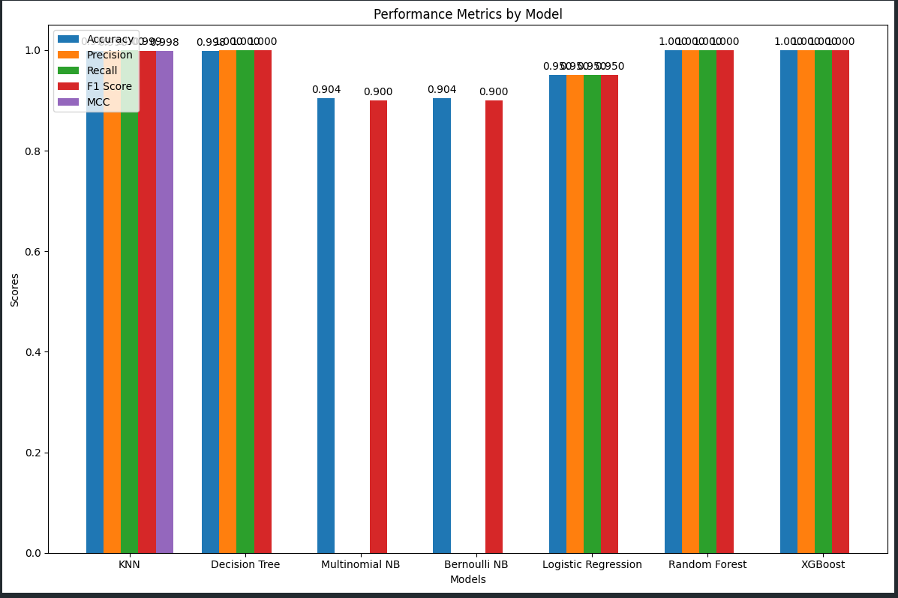
Evaluate Data
### **Insight:** This summary provides a clear comparison of different classifier models based on their performance metrics. It highlights that the Random Forest model achieves perfect accuracy on the test set, with a balanced precision and recall for both classes. This indicates that **the Random Forest** model may be the most suitable choice among the evaluated classifiers for this particular dataset, considering its robust performance across multiple metrics.

Slide 27

Web Interface- Main Page

Slide 28
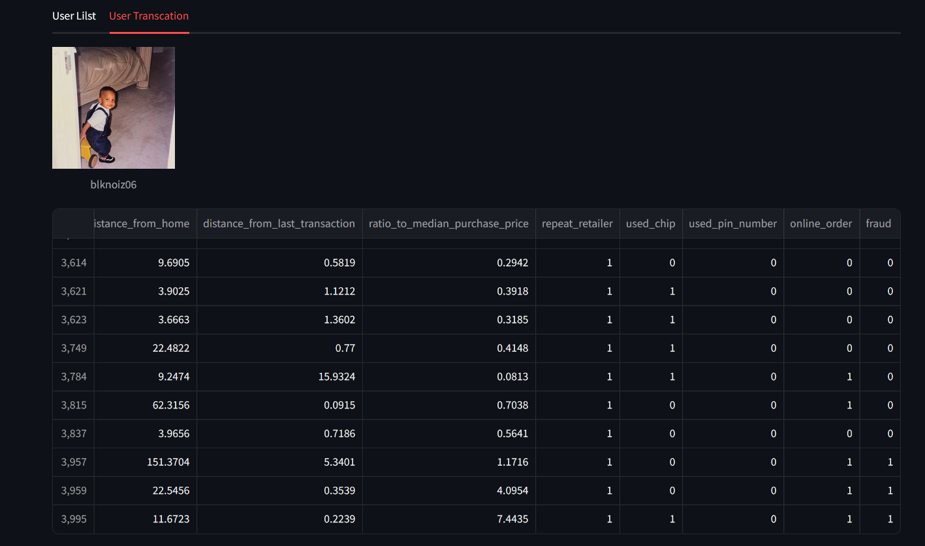
Web Interface – Transaction detection

Slide 29
REFERENCES:
https://www.kaggle.com/code/kabure/predicting-credit-risk-model-pipeline/notebook
https://www.kaggle.com/code/gpreda/credit-card-fraud-detection-predictive-models

