Slide 1
Silhouette Collective By: Payten Ivins, Kathryn Depalma, Tessa Klein

Slide 2
agenda
Overview of project
Analysis in Power BI- Sales Dashboard
Reflection

Slide 3
Who are we?
Silhouette Collective is a fashion database, that collects personal information from a client about size, brand preferences, color, etc. to create a customer profile that is assigned to a shopper within the company. The shopper can shop for specific events or just singular items per the consumer’s request.
Based in Colorado, we are looking to expand into market within its original region while slowly branching out to surrounding regions.
Currently, the company just entered the market therefore its short-term goals are to reach the east coast in sales. Long term goals would be to establish a strong presence in the market by gaining a lot of traction and customer loyalty while expanding the number of items the company sells.

Slide 4
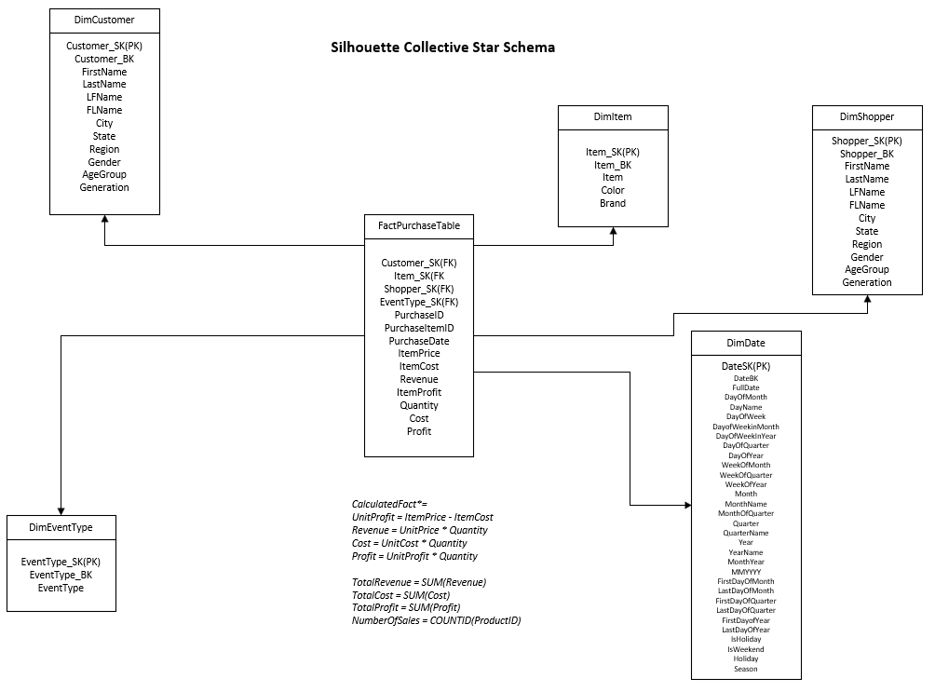
Star Schema
Notes:
This our Star Schema – we have 5 dimension tables: DimCustomer, DimItem, DimShopper, DimEventType, and DimDate and a FactPurchase table

Slide 5
Business requirement questions for analysis
What item brought in the most profit?
Which shopper generated the highest revenue?
What region generated the most revenue?
Which year generated the most profit?

Slide 6
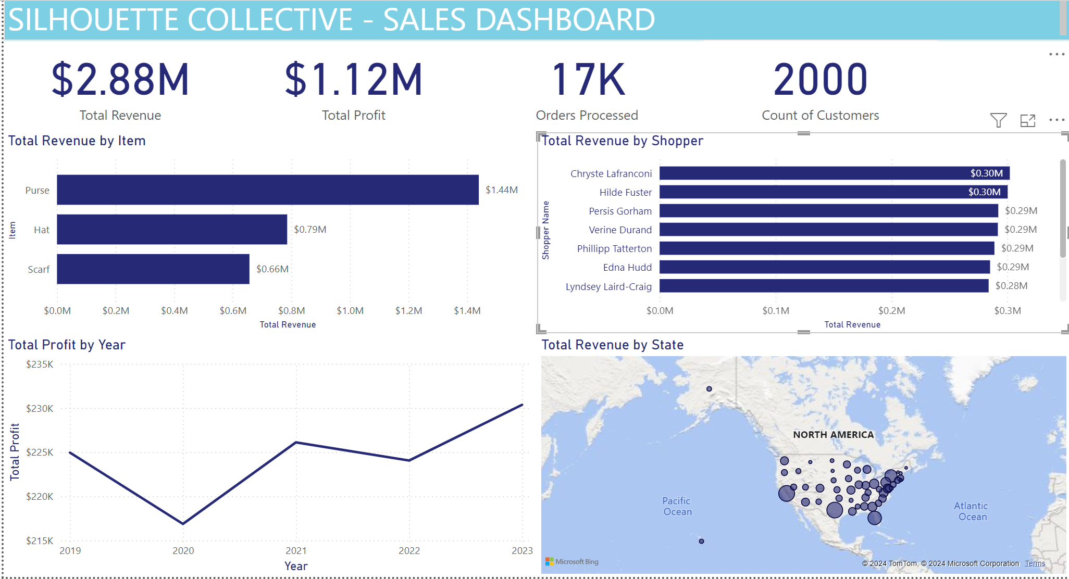
Power BI Dashboard

Slide 7
Findings
Total Revenue by Item:
We see purse being most purchased item at $1.44M
Total Revenue by State:
Achieved our short-term goal of expanding to East coast
Total Profit by Year:
Seeing growth since 2020 and the Pandemic
Recommendation
Total Revenue by Item:
Opportunity to add to our list of items offered
Total Revenue by State:
Can shift focus to expansion in Midwest and West, especially in CO
Total Profit by Year:
Opportunity to expand services and take on more customers with increasing profit

Slide 8

Reflection
Challenges transitioning from database to data mart
Database not fully normalized
Duplicate data

Slide 9
Thank you!

