Slide 1
DCD

Slide 2
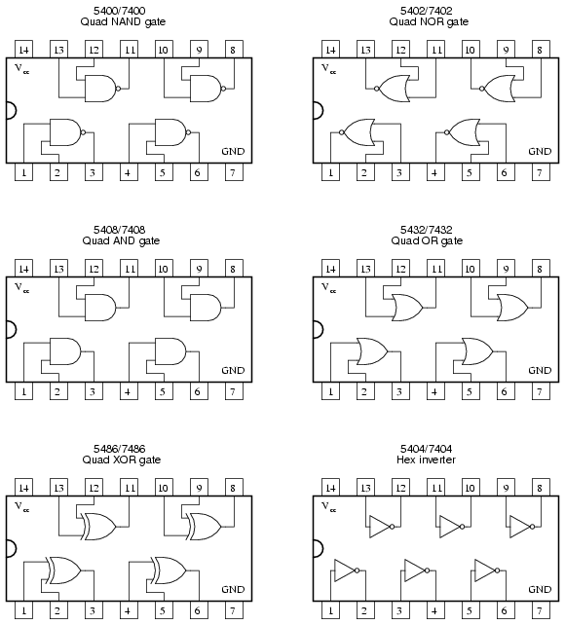
Logic Gates
7400 NAND 7400 NAND
7402 NOR
7408 AND
7432 OR
7486 XOR
7404 INVERTER

Slide 3
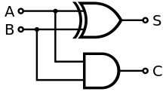
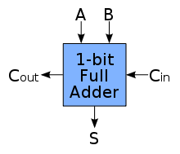

Half adder Full adder
Full adder circuit diagram

Slide 4
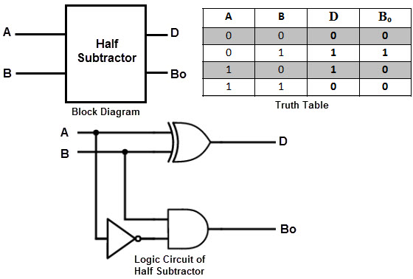
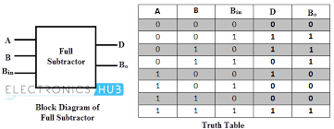
Half Subtractor

Slide 5
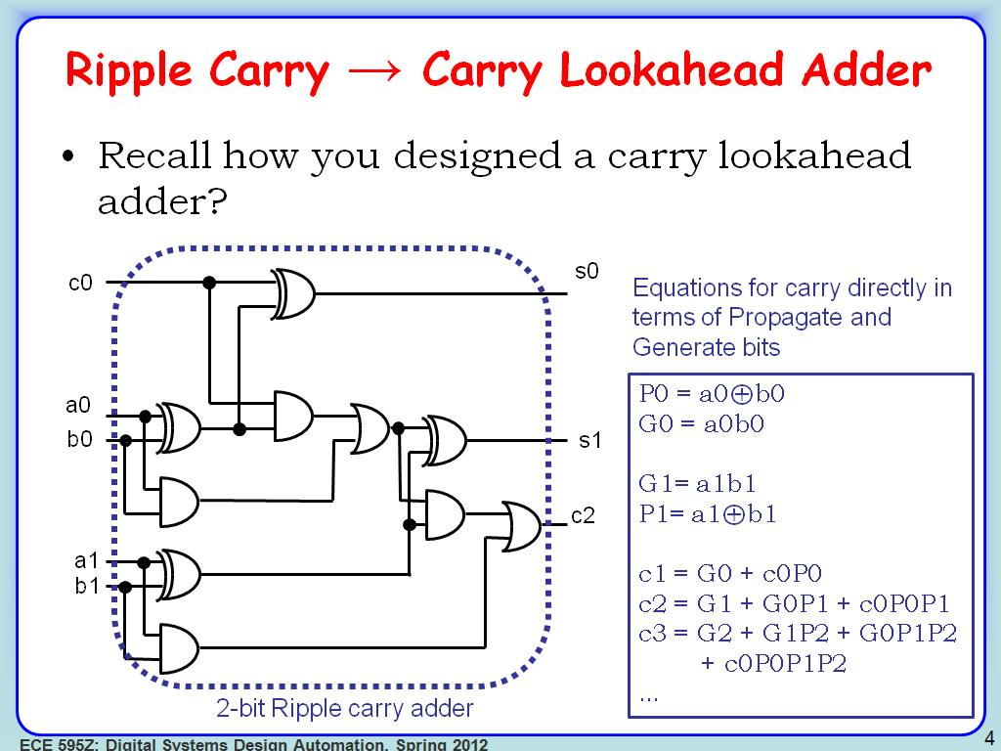

Slide 6
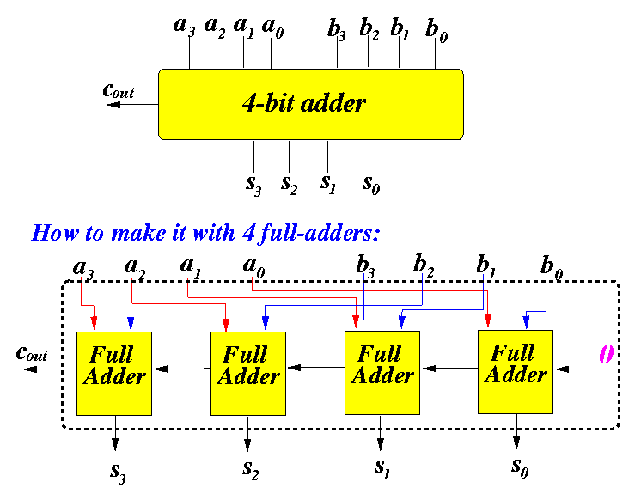

Slide 7
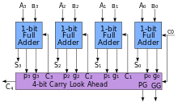

Slide 8
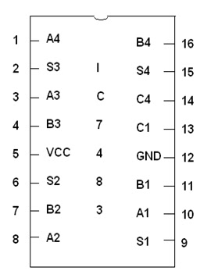
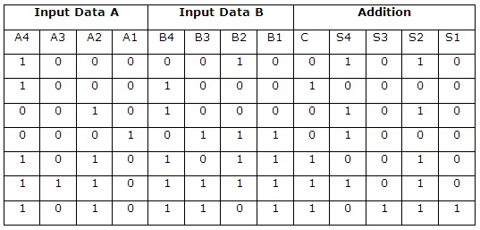
IC 7483 four bit binary adder
Pin diagram, Truth Table

Slide 9
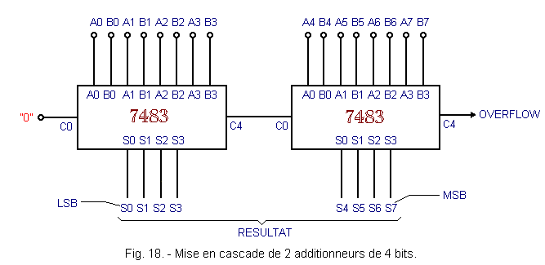

Slide 10
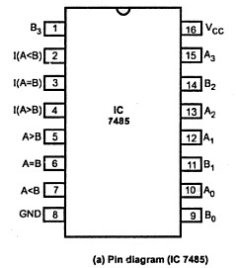
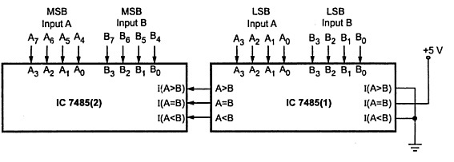
IC 7485 (4-bit magnitude comparator)
Cascading of IC 7485

Slide 11
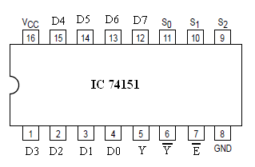
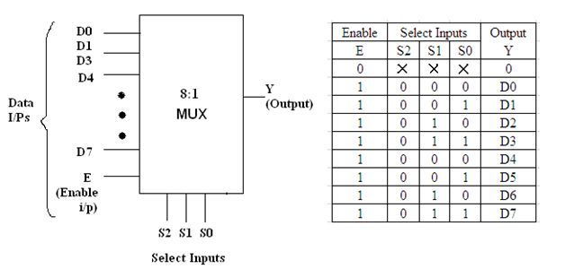
8:1 MUX (74151)
Truth Table

Slide 12
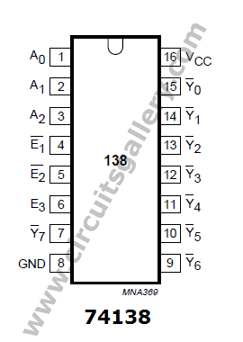
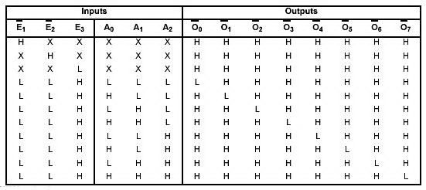
3:8 Decoder (IC 74138)

Slide 13
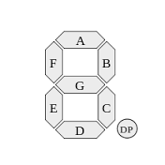
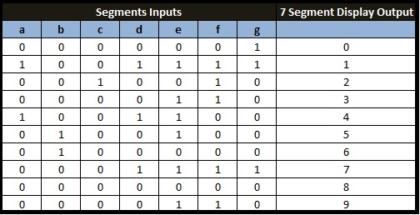
7 segment display
Truth table

Slide 14
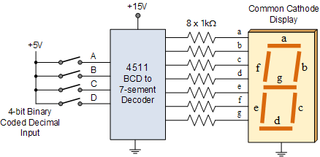
Circuit diagram of BCD to 7 segment decoder

Slide 15
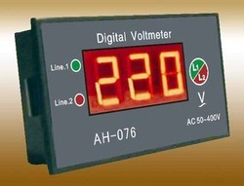
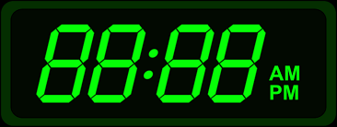
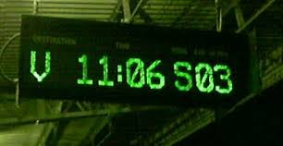
Applications
Digital clock and voltmeter
On railway stations, airports as an indicator

Slide 16
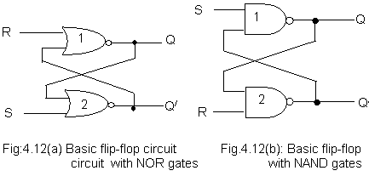
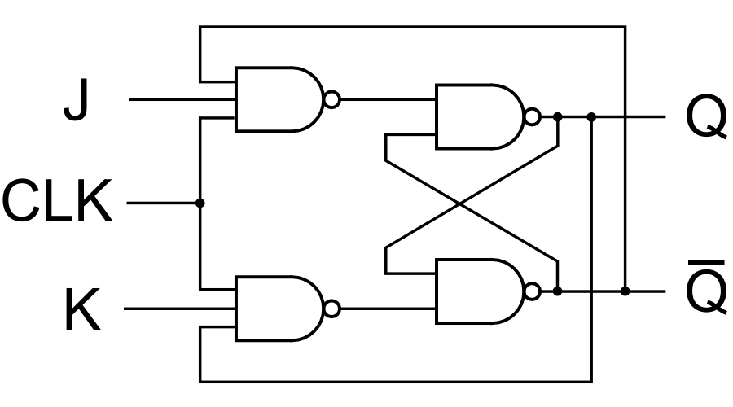
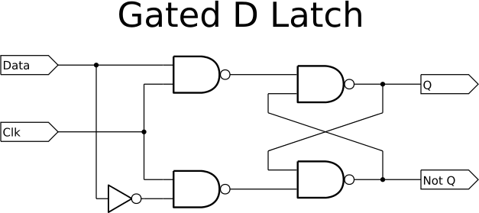
S-R Latch
Gated J-K Latch

Slide 17
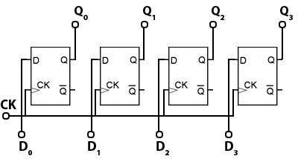
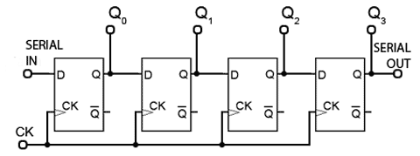
Applications of flip-flops
In various types of registers
PIPO Register SISO Register

Slide 18
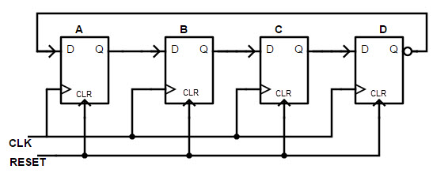
In various types of counters
4- bit ring counter

Slide 19
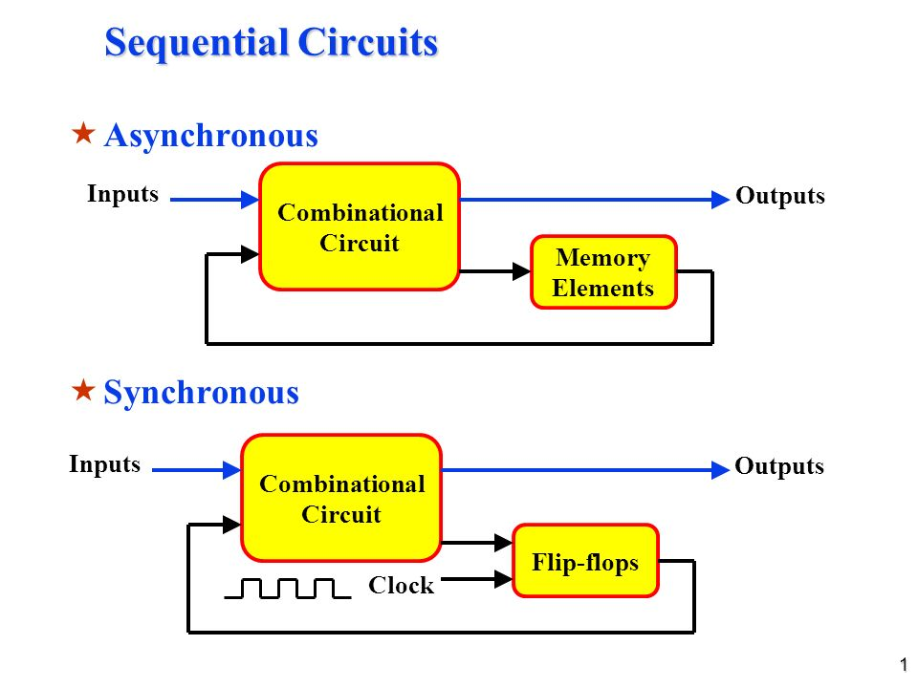

Slide 20
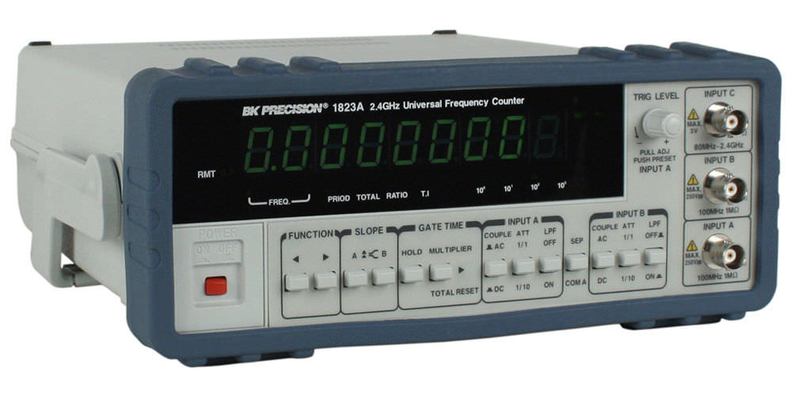
Applications of counters
1. Digital clock
3. Frequency counter
2. Digital voltmeter

Slide 21
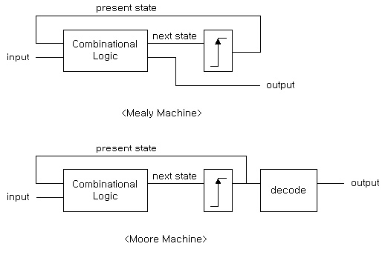
Sequential circuits

Slide 22
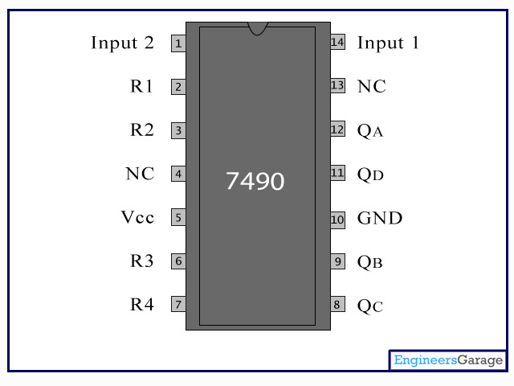
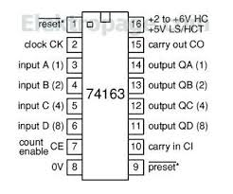
Applications of sequential circuits
IC 7490 (Decade counter)
IC 74163 Synchronous binary up counter

Slide 23
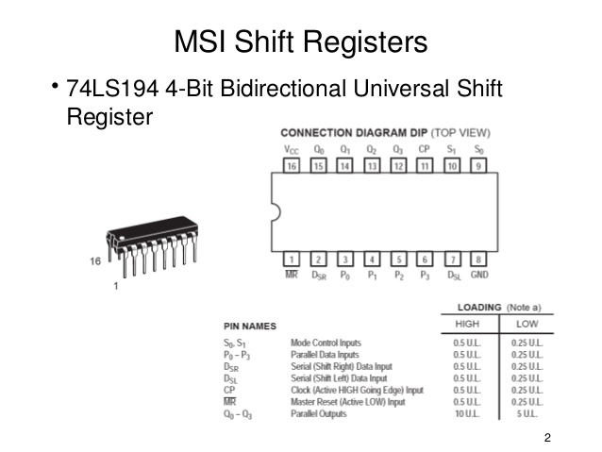

Slide 24
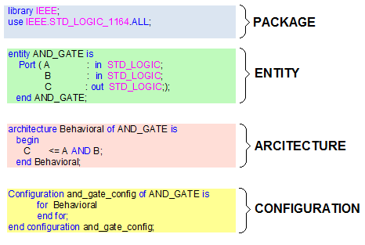
VHDL
VHDL (VHSIC Hardware Description Language) is a hardware description language used in electronic design automation to describe digital and mixed-signal systems such as field-programmable gate arrays and integrated circuits. VHDL can also be used as a general purpose parallel programming language.

