Slide 1


Dynamic Transition Analysis
with TIMES
Akari Minami
Anshuman Chaube
Prof. Katy Huff

Slide 2
Overview
I2CNER Goal:
Reduce CO2 emissions by 80% from 1990 levels by 2050
Objective:
Optimize energy supply using TIMES to meet I2CNER decarbonization goal
Evaluate potential impact of novel and existing energy technologies within Japan’s energy system
TIMES Optimization Method:
Objective function – cost
Constraints – CO2 emissions, electricity demand
Notes:
Best possible mix of energy sources / electricity system
Minimize cost w/in CO2&demand
*TIMES (The Integrated MARKAL-EFOM System)
Key Points:
Minimize carbon emissions in 2050.
Must meet energy demand by deployed generation capacity.

Slide 3
Overview
Importance for carbon-neutral energy:
Help Japan’s policymakers create timeline for R&D investment and infrastructure development
What I have done:
Collected data of investment cost and O&M cost for wind/solar/CCS power systems
Translated and organized Japanese data to English
Ran simulations
Helped eliminate early retirement bug from model
Notes:
- how to transit to other systems
- when to deploy
- how much generate power
- how much it costs
In: interest of loan, infra (road to bring in coal, LNG pipeline)
O&M: repairs, cleaning, fuel, payment for people
CCS: Carbon dioxide Capture and Storage
In: initial investment to build plants, interest of loan, payment for people, cost for infra (road to bring in coal, LNG pipeline)
O&M: cost for O&M, payment for people, repairs, cleaning, fuel
Start from data collection
Have to look up many papers, reports, and websites
Hard to find ideal data, especially for projects in experimental stage

Slide 4
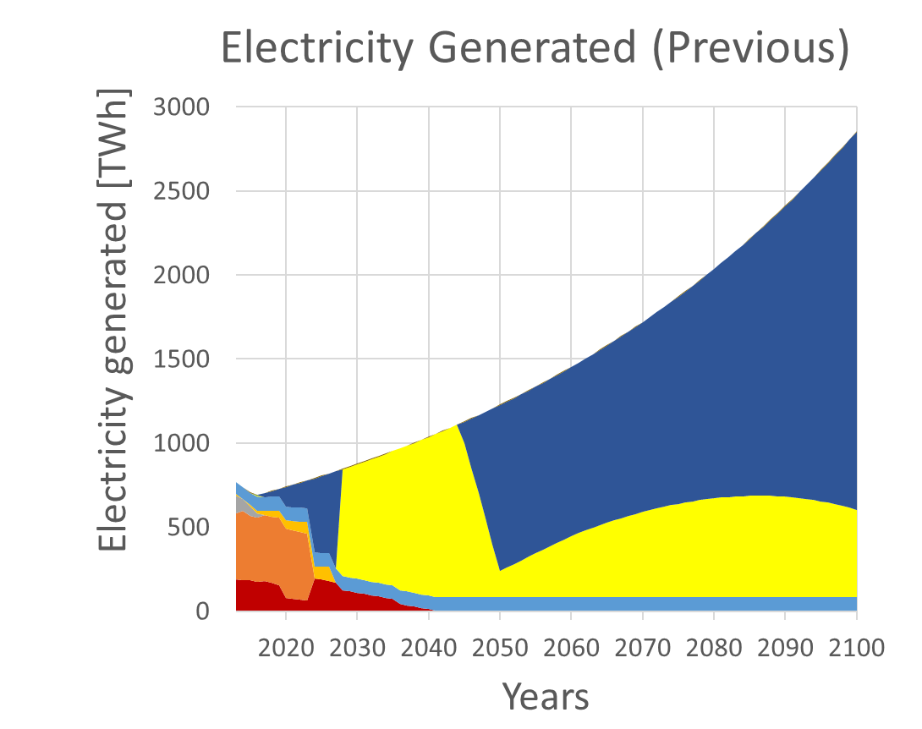
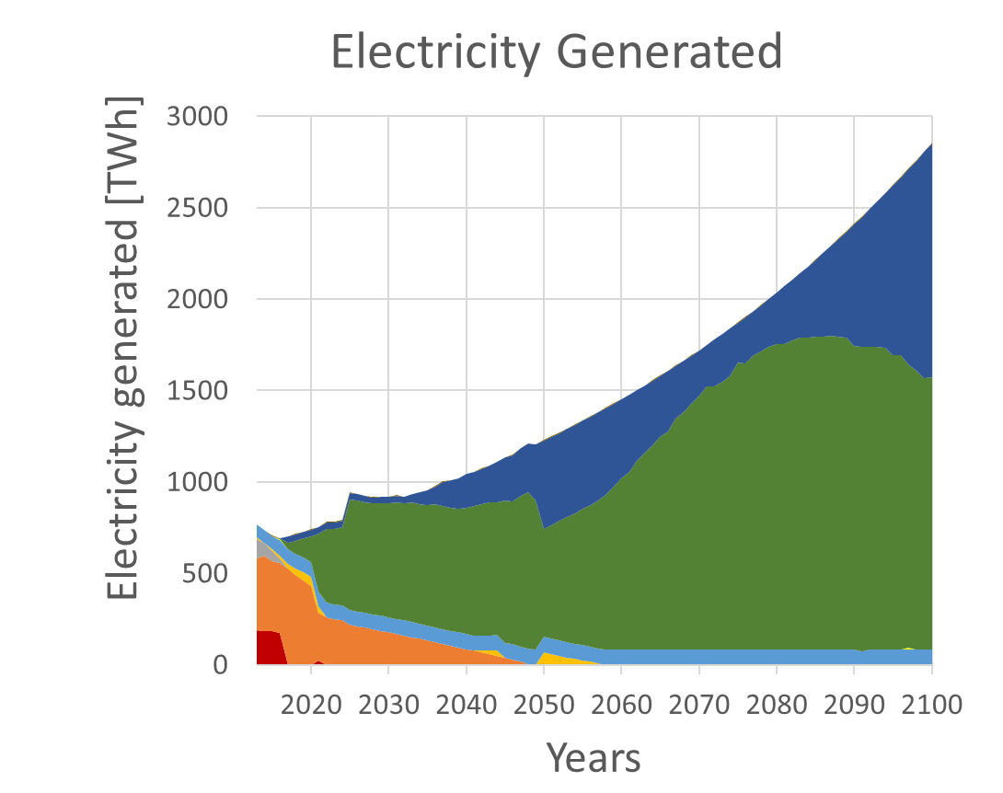
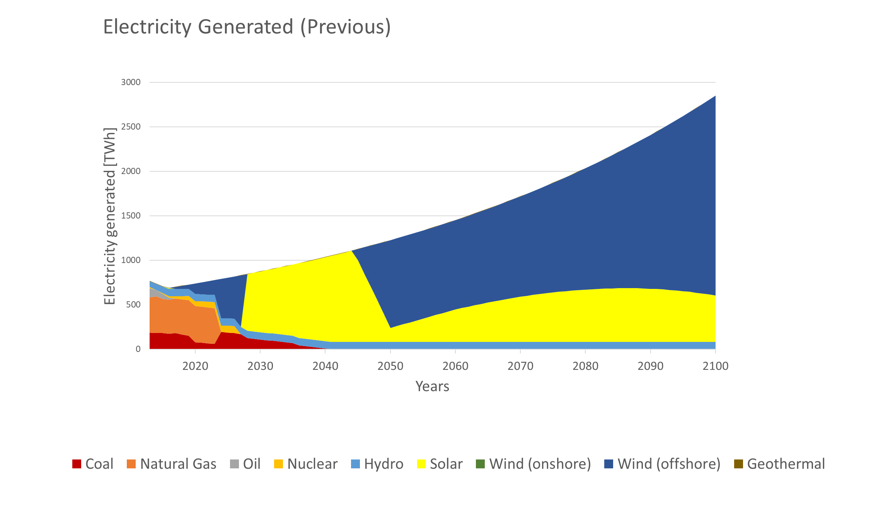
Results
Notes:
Elimination of early retirement bug
- Gradual transition
- Supposed not to be all wind
- Natural gas or novel battery (storage) needed
- Solar : wind = 1:2 for energy security
- Solar emits more CO2 during manufacturing
Start from data collection
Have to look up many papers, reports, and websites
Hard to find ideal data, especially for projects in experimental stage

Slide 5
Take Away
Research
Publish updated data in English
Need to invest in solar and wind to decarbonize
Important to do version control for reproducibility
Culture
Come early, leave early (healthy & efficient!!)
Get airplane license in the US!
Notes:
In absence of nuclear, Japan needs to invest in solar and wind to decarbonize
Important to do version control in research for reproducibility !!
Culture
- Everyone comes in the morning and leaves before evening (healthy & efficient research style!!!)
Some of them work at home
Lab meeting is not very long, efficient, and instructive
Projects are mainly driven by grad students
Cheaper to get an airplane license
Snow and ice control is well-developed
Tornado watching!!!
-

