Slide 1

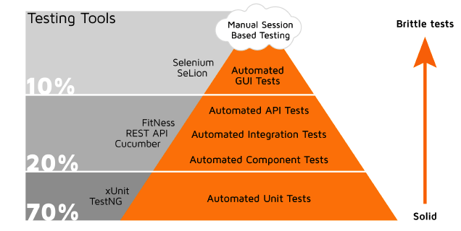
TESTING PYRAMID

Slide 2
ENCOMPASSED LAYERS OF TESTING
UNIT TESTING VALIDATION(Developer)
API TESTING (Business Layer)
USER INTERFACE TESTING

Slide 3
AUTOMATION STRATEGY
TOOL SELECTION (Selenium , Java, Rest Assured)
FRAMEWORK SETUP (Hybrid [BDD+DDT])
REPORTING (Cucumber, Allure)
TEST RUNS (Parallel Testing)

Slide 4
METHODOLOGY IMPLEMENTATION
Agile Practices
Build Tool Automation (Maven)
Version Control System
CI/CD Pipeline

Slide 5
THANK YOU

