Slide 1
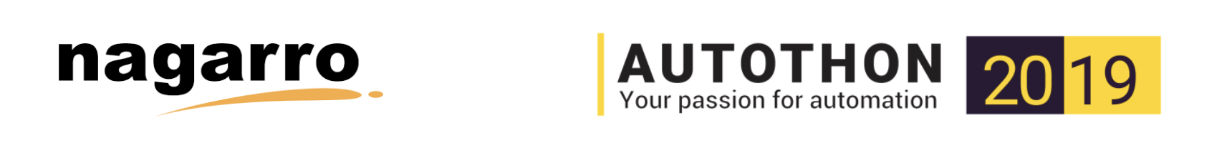
Test strategy document

Slide 2
Agenda
  Scope and overview
  Test approach
  Test Environment
  Testing tools

Slide 3
Scope and Overview
  It’s Movie Rental Portal having 2 type of accounts with different level of access right. User without login can also access the portal as view while logged in user can rent movies. Admin user has access to add new movies to make available to all visitors. The same activities we can perform using API too.
  Verify login and their access permission
  Add new movie as Admin but not as other user
  Verify user login with different user data using data driver process.
  Add and view movies using API

Slide 4
Test Approach
  We can perform multiple type of testing like Sanity Test, Build verification test, Regression test etc. using this. We can segregate these on different phase of testing.
  Interface: UI and API
  Technology Stack: For API – Karate with Gherkin, For UI: Selenium with java and cucumber. IDE, Excel to keep data, TestNG for reporting. Browser: Chrome, Firefox, Edge.

Slide 5
Testing Environment
  Environment: Test Environment, UAT Environment, Pre-prod environment.
  Test data: Identical to prod and will be in tabular form to run through the data driven framework.
  Backup/Restore: Admin would be responsible to provide pre-requisite data like configurationns, mater data etc.. before automation start.
  Platform: Azure, Third party streaming agent,

Slide 6
Streaming Content
  In Scope for testing:
  * Rent the movie
  * Download locally and upload on Azure storage.
  * Verify, turn on/off subtitle, Audio
  * Verify all actions of player
  * Verify start/left over feature
  Out of scope for testing:
  * Not ready for web

Slide 7
DWH
  Stored data is being used for analysis and reporting. It takes data from other third party tools like DQI, KPI, SQL, some ad platforms etc. Later BI would read those all data from these resources and generate complete analysis report to help user as well as Administer to see with different kind of query.
  Finally report would be generated in HTML format and also user can download these in PDF.

Slide 8
CI/CD
  We can developed declarative pipeline script to meet E2E process of CI/CD. This strategy would help developer to find out the issue in early stage of development and avoid any wonder on production. Test data would be available as file on cloud and same set of test data could be used with different set of test like sanity, regression etc..
  Tools:
  * Jenkins X with Tecton.
  * Azure , Kubenetes.

Slide 9
Distributed Team
  The distributed team is an innovative way to get things done with remote talent around the world. As a result, team structures are beginning to look a lot different. Gone are the days when you had to do your best with whomever happened to be available nearby. And gone are the days when traditional outsourcing was your only option if you couldn’t find the talent you needed.
  Nowadays lot of collaboratives tools have come that help team in communicating better. Like … Teams, Slack for communication.
  … Jenkins, Azure for build and deployment etc..

