Slide 1
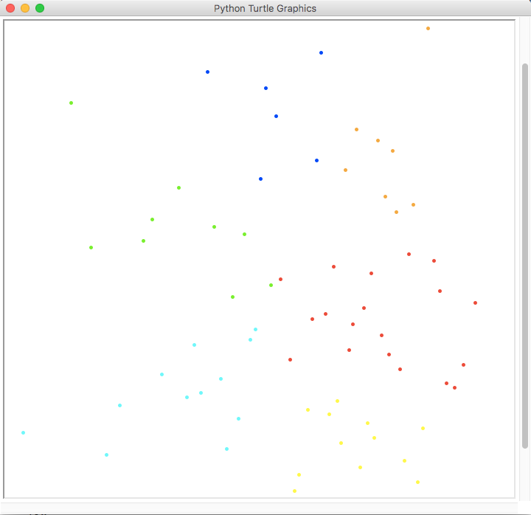
K-Means Clustering
Cluster 1
Cluster 2
Cluster 3
Cluster 4
Cluster 5

