Slide 1
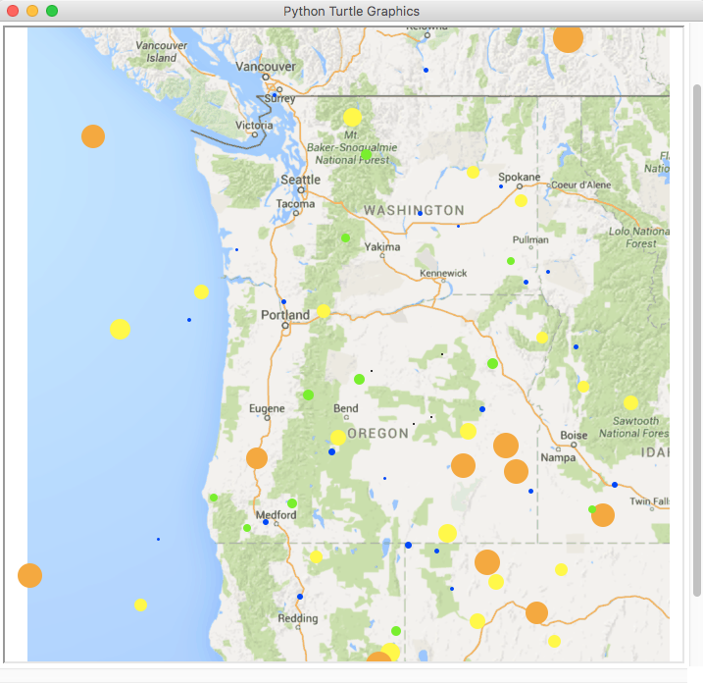
Depths (in miles)
24.0 – 30.0
18.0 – 23.9
12.0 – 17.9
6.0 – 11.9
0.0 – 5.9

