Slide 1
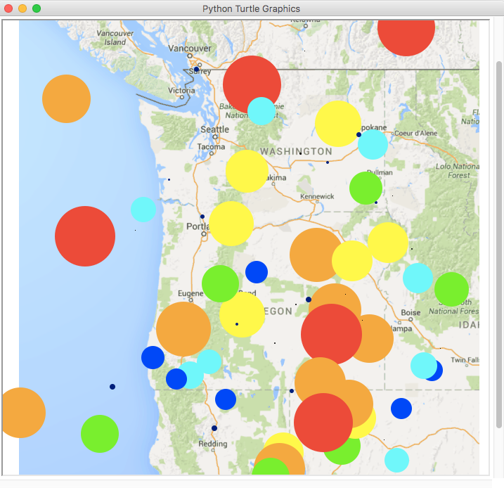
Magnitudes
(in Richter Scale measurements)
8.75 – 10.0
7.5 – 8.74
6.25 – 7.4
5.0 – 6.24
3.75 – 4.9
2.5 – 3.74
1.25 – 2.4
0.0 – 1.24

