Slide 1

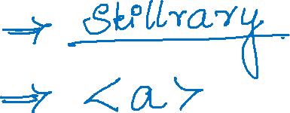

Slide 2
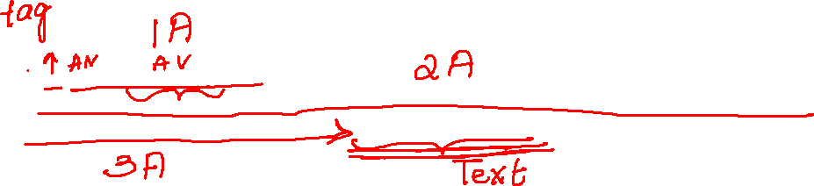
<a href="javascript: void(0)" onclick="pageController.changeState(LOGIN_PAGE_STATES[FORGET_PASSWORD_STATE])" id="toPasswordRecoveryPageLink">Forgot your password?</a>

Slide 3
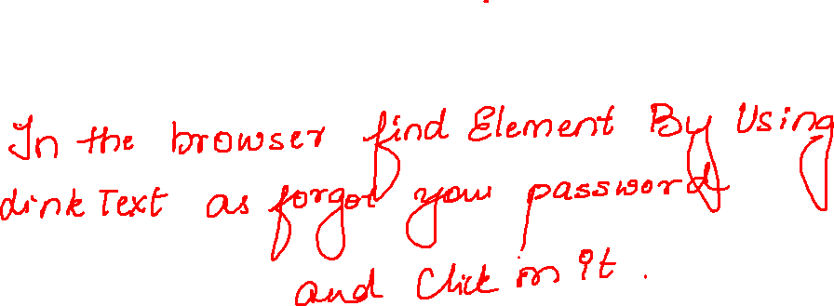
driver.findElement(By.linkText("Forgot your password?")).click();

Slide 4

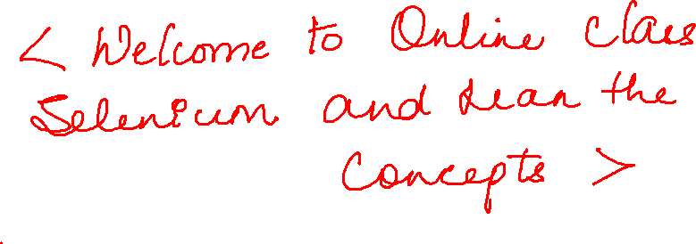

Slide 5
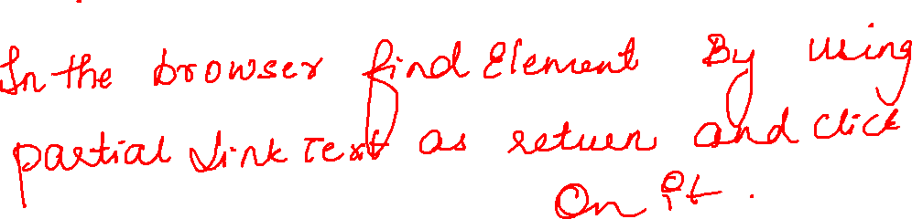
driver.findElement(By.partialLinkText("Return")).click();

Slide 6
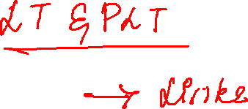

Slide 7

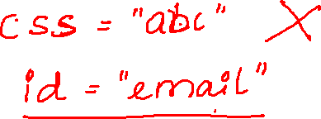

Slide 8
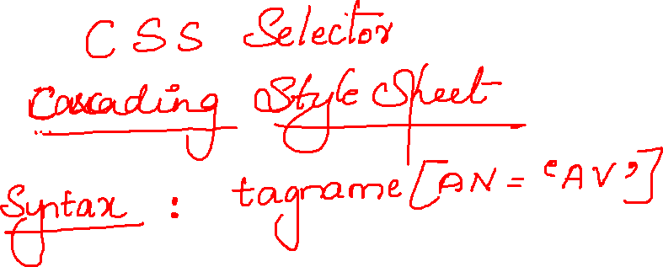
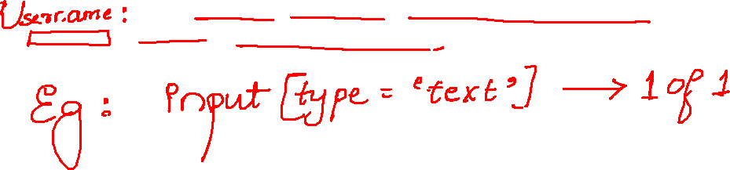
<input type="text" name="email" class="form-control controlForm" id="email" placeholder="Email" required="">

Slide 9
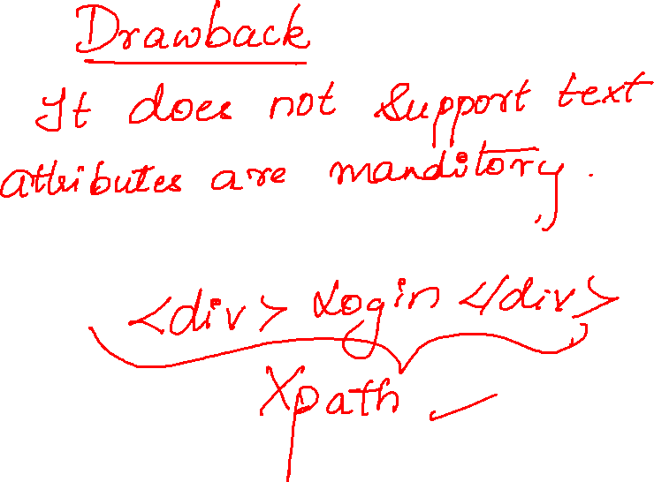

Slide 10
