Slide 1

Qt Training Labs
Hands on
11.2017. Seoul
1
19 November 2017
Presentation name / Author

Slide 2
Goals
The goals of labs are to get good practical understanding of the training material and to try out how things work.
2
11/19/17
© 2017 The Qt Company
Notes:
2

Slide 3
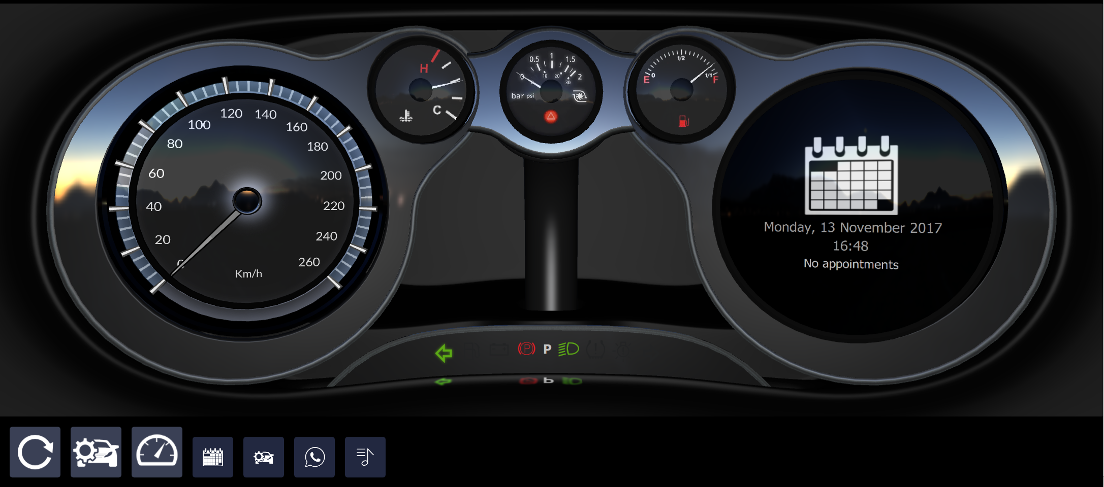
General Instructions
The exercises are built on top of each other following the course of the training
In case the task seems to be too difficult or there is not enough time, you can just check how the example works and extend it by adding new features
Remember you can use your own creativity and make it different and better!
3
11/19/17
© 2017 The Qt Company
Notes:
3

Slide 4
1. Exercise – Signals and Slots
Task: Create an engine which provides rpm and speed data for the dashboard what will be used later.
Create a qtquickcontrol2 application
Add a RpmEngine QObject derived class to the project
Create 2 signals one is providing speed and the other rpm data
Generate random data using a QTimer
Use lambda functions in the main.cpp to print the data
Example: rpmengine
4
11/19/17
© 2017 The Qt Company
Notes:
4

Slide 5
2. Exercise - Threads
Task: Use the previous code and make the RpmEngine to run in a separate thread.
There are 2 ways of doing it:
Inherit RpmEngine from QThread
Move RpmEngine to a new QThread
Example: rpmenginethreaded (moving to new thread)
5
11/19/17
© 2017 The Qt Company
Notes:
5

Slide 6
3. Exercise - QML
Task: Implement a dashboard which is showing speed and rpm gauge and gets the varying data from an engine written in QML.
You can use the graphics from the example application.
You can use the Qt Quick Designer to create the view
Example: dashboard-qml
6
11/19/17
© 2017 The Qt Company
Notes:
6

Slide 7
4. Exercise - Components
Task: Create an dashboard indicator as a separate component, which displays an icon and a text. The component can have 3 colors, normal, warning failure. Extend the previous example with it.
You can use the Qt Quick Designer to create the component
You can use the icons from the extras module
You can use Timer to change the colors of the indicator
Example: dashboard-qml-comp
7
11/19/17
© 2017 The Qt Company
Notes:
7

Slide 8
5. Exercise - Qt Quick Controls 2
Task: Implement a dashboard using gauge from Qt Quick Controls 2
You can use the Qt Quick Designer to create the dashboard
You can use the icons from the extras module
Example: dashboard-qqc2-js
8
11/19/17
© 2017 The Qt Company
Notes:
8

Slide 9
6. Exercise – QML States
Task: Add states to the dashboard, for example playing a video or displaying a map. Add animation to state changes.
You can use the Qt Quick Designer to add states
The animations can't be added in the Designer
You can use key events to trigger state changes.
The views can be behind the gauges or instead of the rpm gauge
Example: dashboard-qml-states
9
11/19/17
© 2017 The Qt Company
Notes:
9

Slide 10
7. Exercise - ListView
Task: Show a playlist on the dashboard using ListView
You can use a dummy model to store the data to display
Example: dashboard-qml-listview
10
11/19/17
© 2017 The Qt Company
Notes:
10

Slide 11
8. Exercise – QtQuick and C++
Task: Integrate the C++ rpmengine into the dashboard, so that the rmp and speed data are coming from C++
Example: dashboard-qqc2
11
11/19/17
© 2017 The Qt Company
Notes:
11

Slide 12
Thank you
Karim.pinter@qt.io
12
11/19/17
© 2017 The Qt Company

