Slide 1



Introduction to Sustainability:
Human and
Environment
What is Sustainability?
By Sraban Mondal
Roll no. - 2023a6r002
Dep. – CSE (AI&ML)

Slide 2
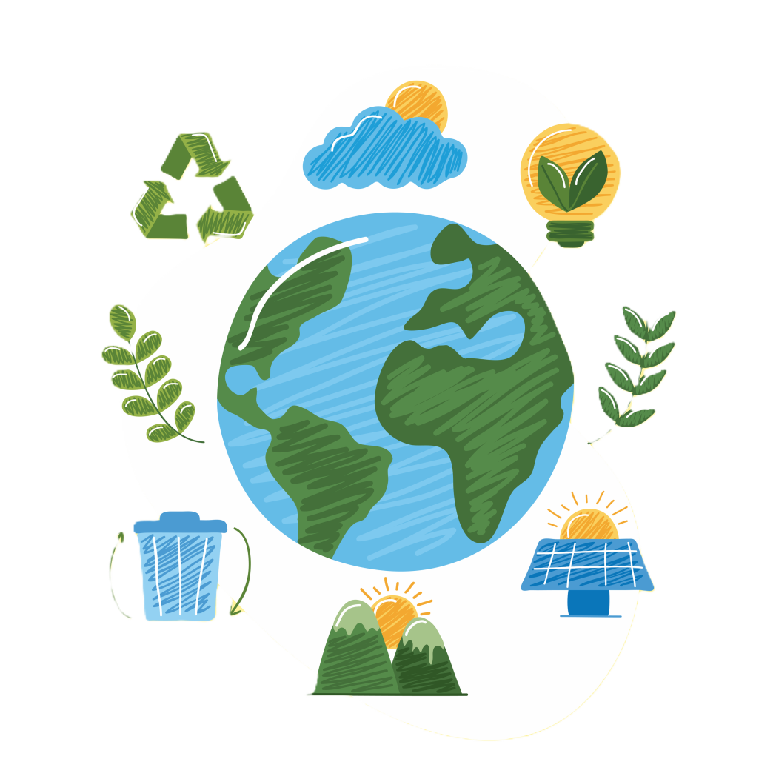
Understanding Sustainability
Sustainability is the ability to meet present needs without compromising the needs of future generations.
Sustainability is crucial for ensuring the well-being of our planet and its inhabitants.
There are three pillars of sustainability: environmental, economic, and social.

Slide 3
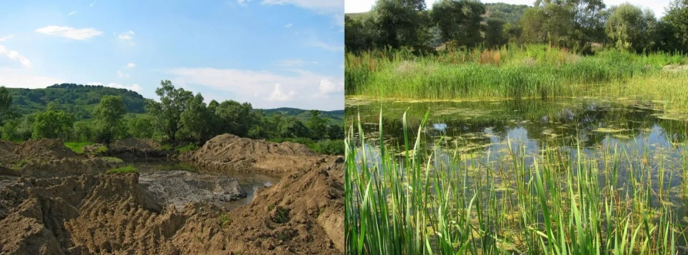
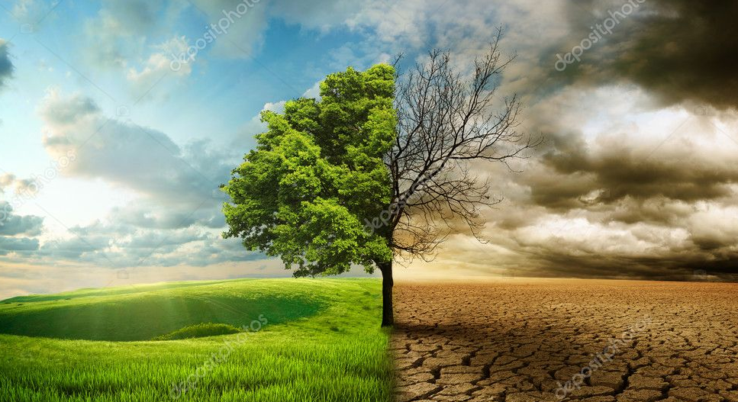
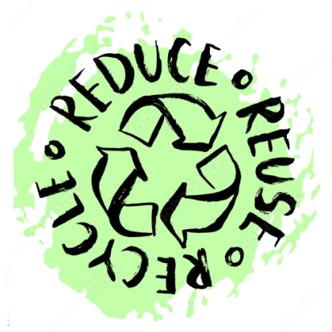
Nurturing Our Planet: Environmental Sustainability
Environmental sustainability focuses on preserving natural ecosystems, biodiversity, and the health of the planet.
It involves reducing pollution, conserving resources, and mitigating human impacts on the environment.
Preserving ecosystems and biodiversity is essential for maintaining the balance of life on Earth and ensuring the provision of ecosystem services.
Addressing environmental challenges such as climate change is crucial for safeguarding the well-being of current and future generations.

Slide 4
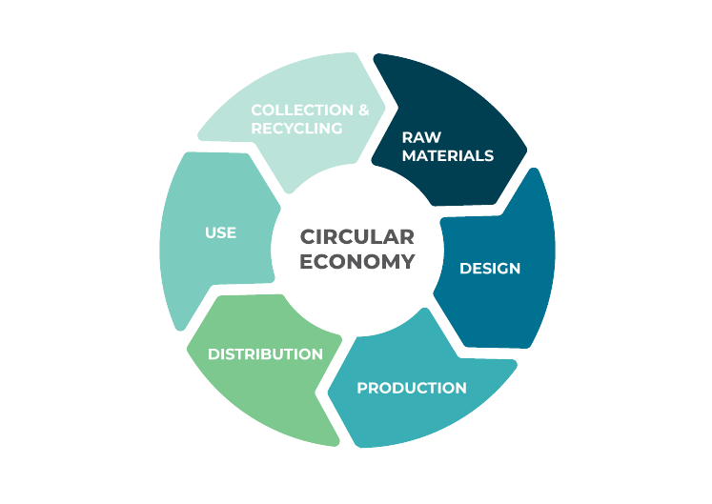

Building Prosperity for All: Economic Sustainability
Economic sustainability fosters growth while minimizing negative impacts.
Sustainable Development: Pursuing economic growth that meets the needs of the present without compromising the ability of future generations to meet their own needs.
Responsible consumption encourages informed choices and waste reduction
Essential for resilient communities and poverty reduction.

Slide 5

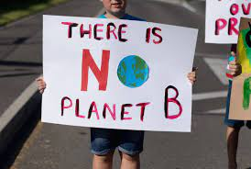
Fostering Inclusive Communities: Social Sustainability
Social sustainability focuses on ensuring equity, justice, and well-being for all members of society.
Includes access to education, healthcare, and human rights.
Social Inclusion: Creating opportunities for all individuals, regardless of background or identity, to participate fully in society.
Builds cohesive communities and reduces inequality and enhances quality of life

Slide 6

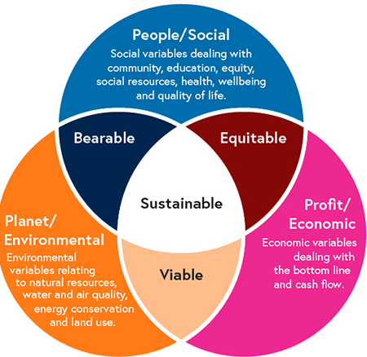
Interconnectedness of Sustainability Pillars
Actions in one pillar impact others, requiring a holistic approach.
Economic decisions affect environmental and social outcomes.
Environmental degradation undermines economic and social stability.
Social inequalities can hinder progress in environmental and economic sustainability.

Slide 7
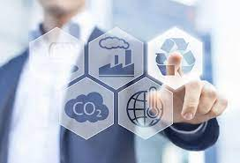
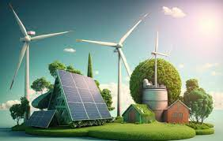
Benefits of Sustainable Practices
Preservation of ecosystems and biodiversity and reduced pollution
Cost savings through resource efficiency.
Stimulated innovation and job creation.
Improved quality of life and well-being.
Enhanced community resilience and cohesion.

Slide 8
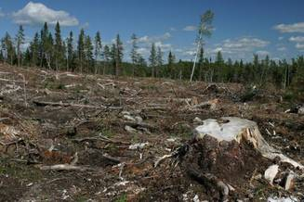
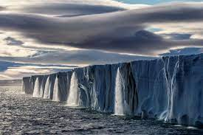
Challenges to Sustainability
Rising global temperatures and extreme weather events.
Threatens ecosystems, agriculture, and human health.
Overexploitation of natural resources such as water and forests.
Leads to ecosystem degradation and loss of biodiversity.
Disparities in access to resources and opportunities.
Hinders progress towards equitable and sustainable development.
Insufficient policies and regulations to address sustainability issues.
Need for stronger leadership and international cooperation.

