Slide 1


Understanding the Tragedy of the Commons & Environment Valuation
Exploring Economic Concepts and Environmental Sustainability
BY GROUP 1
CSE(AI&ML)
NCC-201

Slide 2

Introduction
Welcome to the presentation on the Tragedy of the Commons and Environment Valuation.
Today, we will delve into two critical concepts that intersect economics and environmental science.
These concepts are fundamental in understanding the challenges facing our planet's sustainability.
1
Economic Concepts
Understanding the intersection of economics and environmental science.
2
Environmental Sustainability
Addressing challenges and solutions for sustaining the planet's resources.
3
Interdisciplinary Study
Highlighting the need for a holistic approach to global sustainability.

Slide 3




Tragedy of the Commons Explanation
The Tragedy of the Commons refers to the depletion of shared resources due to individual self-interest.
Proposed by Garrett Hardin in 1968, this concept illustrates how common pool resources are often overexploited.
Common examples include overfishing in oceans, deforestation in communal forests, and air pollution in the atmosphere.
Depletion of Resources
Overexploitation
Global Impact
Illustrated in areas such as fishing, forestry, and pollution.
Highlighting consequences for environmental sustainability.
Due to uncontrolled individual interests.

Slide 4




Economic Implications
Economically, the Tragedy of the Commons leads to market failures.
Externalities, such as pollution, are not factored into market prices, leading to inefficient resource allocation.
Overuse and underinvestment in shared resources result in long-term economic costs and environmental degradation.
Market Failures
Environmental Degradation
Long-term Economic Costs
Resulting from unregulated resource exploitation.
Consequences of inefficient resource allocation.
Impact of overuse and underinvestment in resources.

Slide 5

Solutions and Policy Interventions
Addressing the Tragedy of the Commons requires a combination of regulatory and community-based solutions.
Government regulations, such as quotas and property rights, can help manage common resources effectively.
Community-based approaches foster cooperation and collective action among stakeholders.
Regulatory Solutions
Community-based Approaches
Effective Resource Management
Implementing quotas and property rights.
Fostering cooperation among stakeholders.
Showing the need for balanced approaches.

Slide 6

Environmental Valuation Methods
Environmental valuation seeks to assign economic value to environmental resources and ecosystem services.
Market-based methods rely on market transactions to determine value, while non-market-based methods estimate value indirectly.
Common valuation methods include contingent valuation surveys, hedonic pricing, and cost-benefit analysis.
Market-based
Non-market-based
Common Methods
Relies on market transactions.
Estimates value indirectly.
Contingent surveys, hedonic pricing, cost-benefit analysis.

Slide 7

Importance of Environmental Valuation
Valuing ecosystem services is crucial for understanding their contribution to human well-being.
Environmental conservation not only preserves biodiversity but also provides economic benefits.
Recognizing the value of nature highlights the importance of integrating environmental considerations into economic decision-making.
1
Human Well-being
2
Biodiversity Conservation
3
Economic Considerations
Understanding the link between ecosystem services and human welfare.
Preserving ecological balance and species diversity.
Highlighting the monetary and non-monetary value of nature.

Slide 8

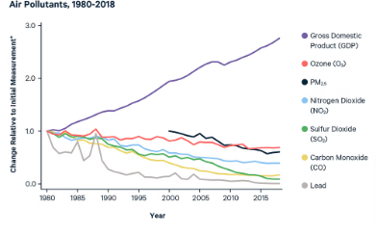
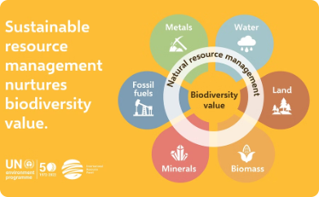
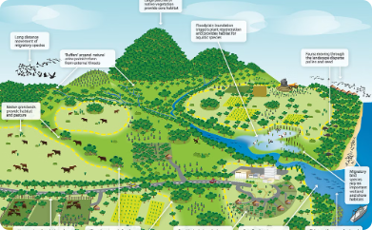
Case Studies
Case studies offer practical examples of environment valuation in action.
Valuing clean air and biodiversity conservation help prioritize conservation efforts based on societal benefits.
Assessing the economic benefits of preserving natural habitats guides land-use planning and conservation policies.
Evaluating Clean Air
Biodiversity Conservation
Natural Habitats
Understanding the economic and health benefits of air quality improvement.
Quantifying the economic significance of undisturbed ecosystems.
Assigning value to diverse ecological systems and species protection.

Slide 9

Challenges and Criticisms
Implementing environment valuation faces various challenges, including the complexity of valuing non-market goods and services.
Ethical concerns arise when assigning monetary value to nature, raising questions about commodification and equity.
Critics argue that economic valuation methods may oversimplify environmental values and fail to capture intangible benefits adequately.
Valuation Complexity
Ethical Considerations
Critiques of Valuation
Diverse challenges in assessing non-market goods and services.
Debates surrounding nature's commodification and equitable representation.
Discussion on simplification and intangible benefits oversight.

Slide 10
Conclusion
The Tragedy of the Commons and Environment Valuation are essential concepts in addressing environmental sustainability.
Balancing economic development with environmental conservation requires interdisciplinary approaches and informed decision-making.
Let us strive to implement policies and practices that promote sustainable development and protect our planet for future generations.
Economic Development
Environmental Conservation
Interdisciplinary Approaches
Informed Decision-making
Sustainable Policies
Future Generations

Slide 11


