Slide 1
Git Concepts

Slide 2

What is git?
“By far, the most widely used modern version control system in the world today.”
A staggering number of software projects rely on Git for version control, including commercial projects as well as open source.
https://www.atlassian.com/git/tutorials/what-is-git

Slide 3
Two ways to use git
Personal use: track your own local file revisions (Dropbox-style)
(Much more common): back up, collaborate on projects with others using remote repositories on Github
Both approaches require creating a git repository on your local machine

Slide 4
How to get a repository
Create, navigate to directory which will house your repository
Either:
Initialize; create local repository:
$ git init
Clone an existing remote repository:
$ git clone https://github.com/libgit2/libgit2

Slide 5
Most Basic Git Workflow
Modify or create new file
Stage the file
git add FILE
Adds a snapshot to the staging area
Commit your changes
git commit –m “Put message here”
Staging area → permanent snapshot
4. Checkout most recent version
git pull
Typically for working with remote, shared repositories
Start process over
Frequently use git status to view your status along the way!

Slide 6
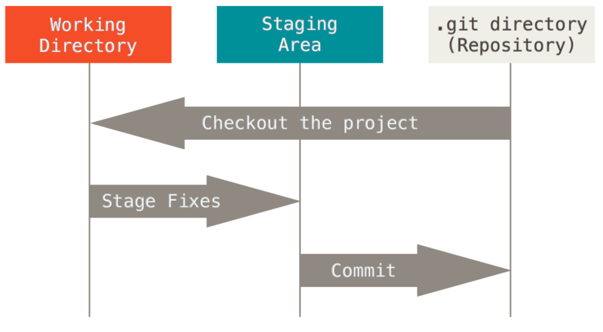
File states in Git
git pull
git add FILE
git commit -m “Put message here”
Image source: https://git-scm.com/book/en/v2/book/01-introduction/images/areas.png
Shared under Creative Commons Attribution 3.0 Unported License.

Slide 7
Options for git add
Stage specific file:
$ git add FILENAME
Stage all modifications:
$ git add -A

Slide 8
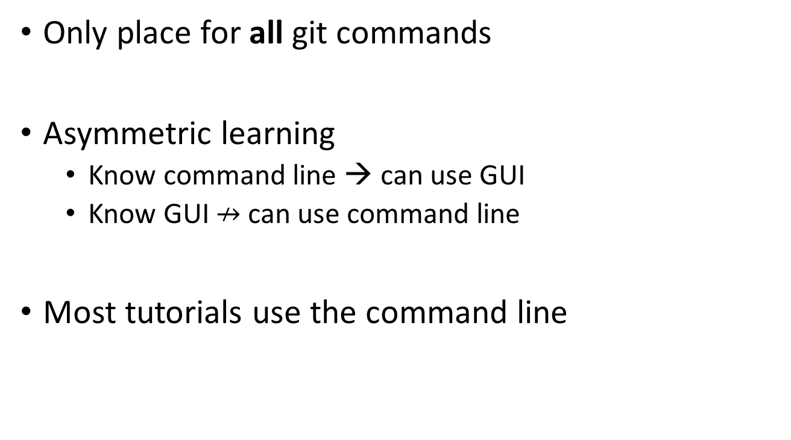
Why use the command line with Git
Only place for all git commands
Asymmetric learning
Know command line → can use GUI
Know GUI $↛$ can use command line
Most tutorials use the command line

Slide 9
Example repository
In what follows, we will:
Create new repository;
Add a README file
All repositories should have one
Describes repository
First thing people see when viewing remote repository
Stage and commit the file
Make modifications to file
Stage and commit modifications

Slide 10
TRY THIS
From a working directory of your choice….(italics text are ‘pseudo commands’)
Create example directory to house repository:
$ mkdir path/ExampleRepo
Navigate to directory, explore its (empty) contents:
$ cd path/ExampleRepo
$ ls -a (list all)
Initialize repository; explore new contents:
$ git init
$ ls -a
Create README file; note new status:
$ touch README.md
$ git status

Slide 11
Stage README file, and commit it, noting the changes along the way:
$ git add README.md
$ git status
$ git commit -m “Added README file”
$ git status

Slide 12
Let’s edit the Readme file:
$ notepad README.md
Enter the text on next slide, then save and close file…

Slide 13
### ReadMe File
This is the readme file for my repository. It is a Markdown text file which can be interpreted by a browser. For example, the text:
# Header 1
## Header 2
### Header 3
...turns into header levels. I can add <em> emphasis </em> using the &lt;em&gt; tag, and <b> bold </b> using the &lt;b&gt; tag.
We can create <em> unordered </em> lists like this:
<ul>
<li> List Item 1 </li>
<li> List Item 2 </li>
</ul>
...and ordered lists like this:
<ol>
<li> Ordered item 1 </li>
<li> Ordered item 2 </li>
</ol>

Slide 14
To see what this looks like when eventually rendered on github, enter the text here:
http://tmpvar.com/markdown.html

Slide 15
Note this modification to the README is ‘untracked’:
$ git status
…so we will need to stage and commit the modification:
$ git add -A
$ git commit -m “added content to README file”

Slide 16
You have successfully created a git repository!
Next, we will discuss pushing this repository to a remote (github).

