Slide 1
Link to WINSTATS GitHub
http://bit.ly/2roJRua

Slide 2
The File System and Command Line Interaction
Lecture adapted from notes at
http://www.cgl.ucsf.edu/Outreach/bmi219/slides/shell.html,
and from Todd Iverson

Slide 3
The Command Line
Text interactions with OS:
Type commands
Execute commands
Run another program
Displaying the output
Interpreted with BASH
Bourne-Again SHell
Pun based on Stephen Bourne, author of Unix ancestor sh

Slide 4
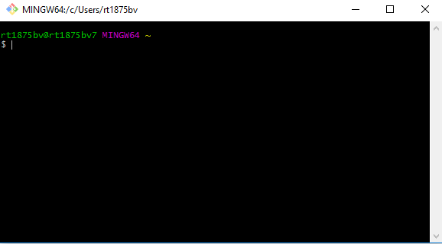
Git Bash
Command-line interaction; plus
Version control with git

Slide 5
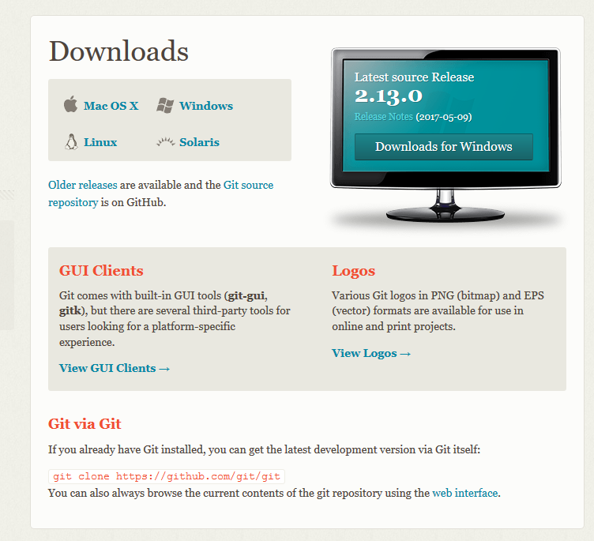
Download from:
https://git-scm.com/downloads

Slide 6
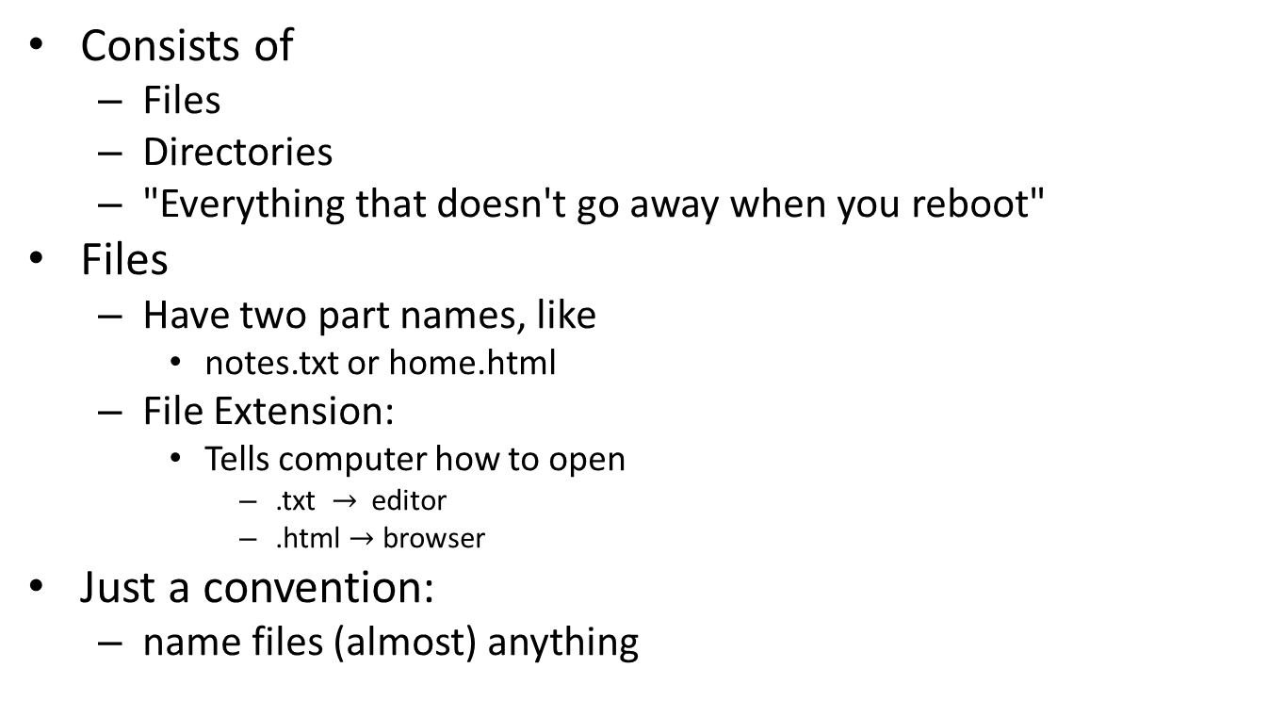
The File System
Consists of
Files
Directories
"Everything that doesn't go away when you reboot"
Files
Have two part names, like
notes.txt or home.html
File Extension:
Tells computer how to open
.txt $→$ editor
.html $→$ browser
Just a convention:
name files (almost) anything
file extension
notes.txt
name

Slide 7
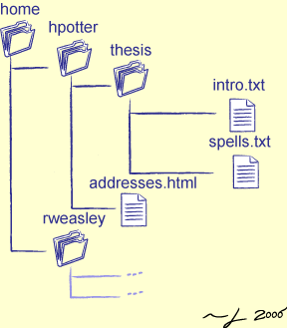
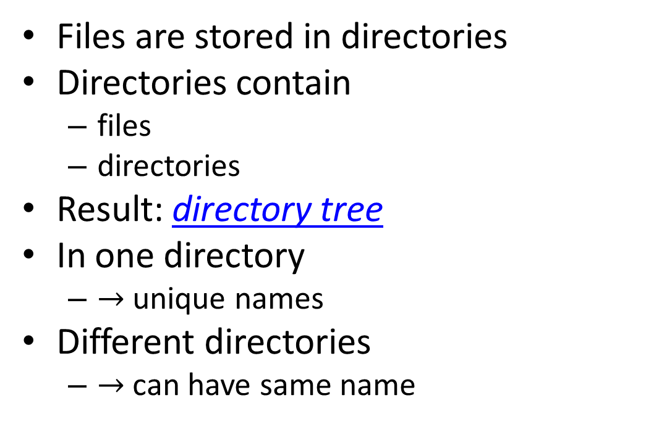
The File System
Files are stored in directories
Directories contain
files
directories
Result: directory tree
In one directory
$→$unique names
Different directories
$→$ can have same name
Image from http://www.cgl.ucsf.edu/Outreach/bmi219/slides/swc/lec/img/shell01/directory_tree.png

Slide 8
Navigating the File System
Important commands
Important commands
pwd
Print working directory
cd
change directory
cd <name> to go to child directory
cd .. to go to parent directory
cd ~ to switch to home directory
different for each user
mkdir <name>
make a new directory
ls
List files in current directory
Use ls –al for more info
ls address
List files in a subdirectory
more
List the contents of a file

Slide 9
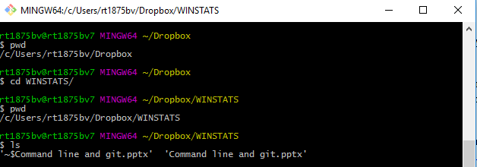
From my machine…

Slide 10
Paths
A path describes a files location
absolute path : Full address
Like street address
Starts with drive, e.g. c:/
/home/nbuser/home/hpotter
Harry Potter's directory
/home/nbuser/home/hpotter/addresses.html
The addresses html file

Slide 11
Paths Continued
A relative path location relative to current location
"Four blocks north, and seven east"
Every program has a current working directory (CWD)
linux short-cut: pwd
"Where am I?"
Relative paths are deciphered relative to this location
It can change while a program is running

Slide 12
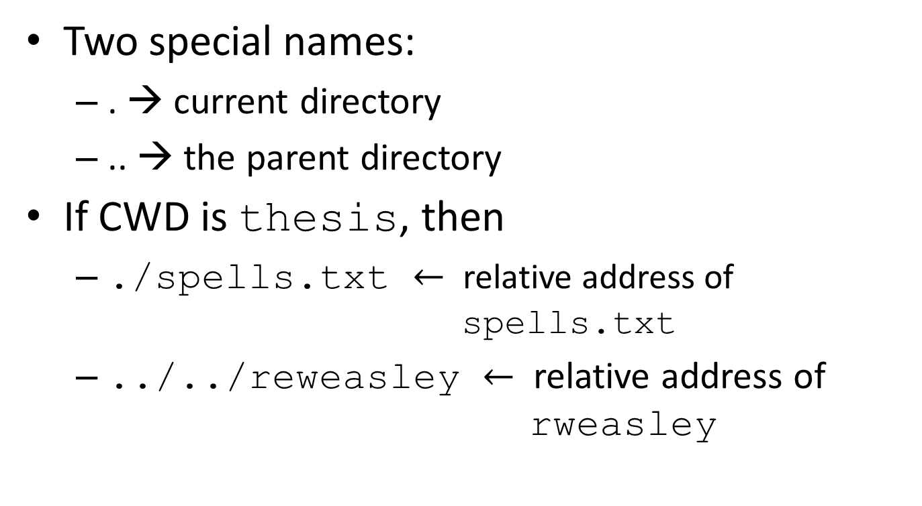
Relative Path Shortcuts
Two special names:
. → current directory
.. → the parent directory
If CWD is thesis, then
./spells.txt $←$ relative address of spells.txt
../../reweasley $←$ relative address of rweasley

Slide 13
Text Files
File Extension: .txt
Can also be .html, .py, etc.
Contents: text and symbols
Create an empty text file with touch
Edited with a text editor
Try:
$ touch HelloWorld.txt
$ notepad HelloWorld.txt

Slide 14
The copy and move commands
cp command
Move command
cp will
make a copy of a file
leave original unchanged
Example
The CWD is thesis
cp spells.txt spells.bak
The CWD is home
mv will
move the file
remove the original
Can use it to change a files name
Example
The CWD is thesis
mv spells.text spells.txt
The CWD is home
cp ./hpotter/addresses.html ./rweasley/addresses.html
mv ./hpotter/addresses.html ./rweasley/addresses.html

Slide 15
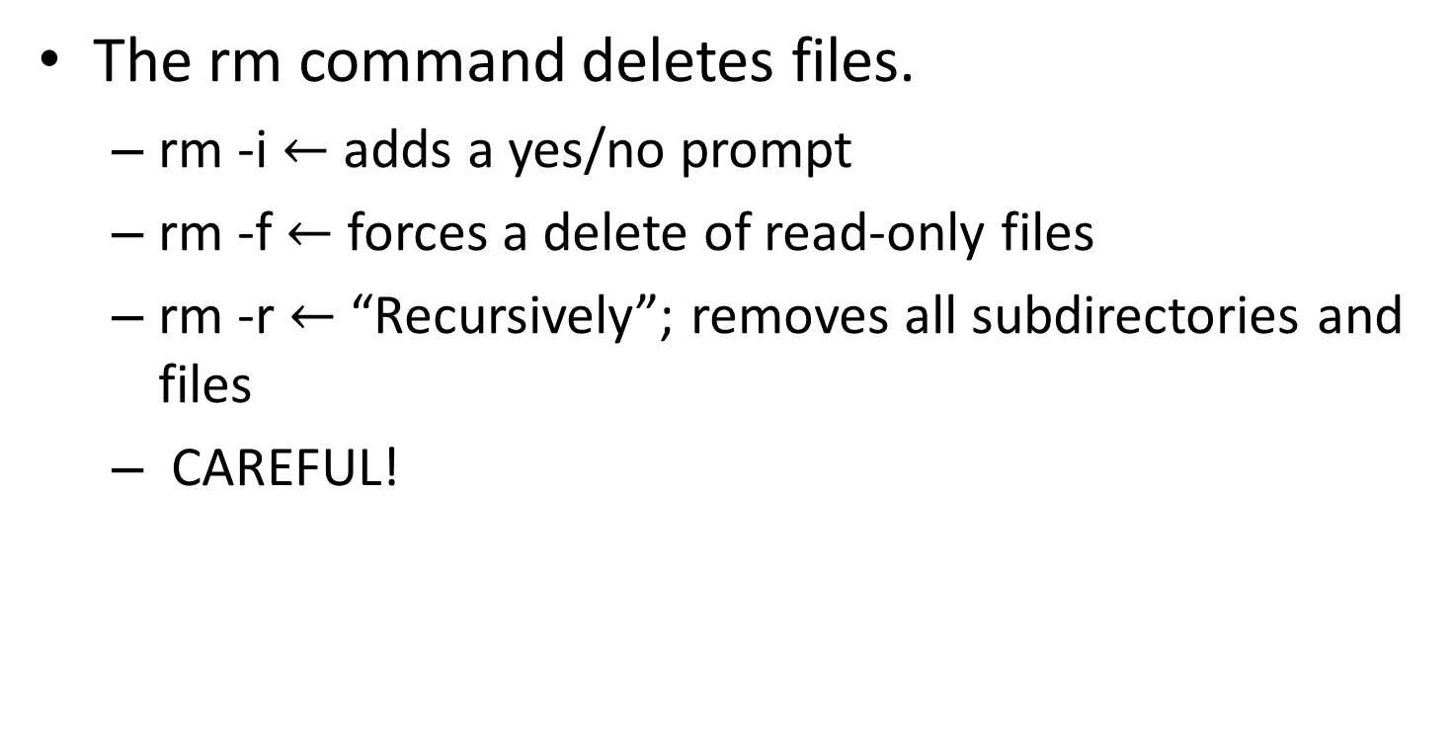
Deleting Files and Folders
The rm command deletes files.
rm -i $←$ adds a yes/no prompt
rm -f $←$ forces a delete of read-only files
rm -r $←$ “Recursively”; removes all subdirectories and files
CAREFUL!

