Slide 1
Stress Testing LLMs with Prompt Perturbations
Advait Singh, Ishan Kotwani, Prachi Garg
Course: CS F429 - Natural Language Processing
December 17 , 2025

Slide 2
Motivation
As Large Language Models (LLMs) become staples in real-world technology, a significant challenge has emerged: their sensitivity to how a user phrases a request. Because users rarely provide perfectly structured or uniform prompts, even minor variations—such as a simple typo, the choice of a synonym, or a slight change in the order of instructions can cause the model to produce wildly inconsistent results.
This lack of stability raises critical concerns regarding the reliability, fairness, and overall trustworthiness of systems built on these models.

Slide 3
Problem Statement
Despite their widespread use, LLMs exhibit high sensitivity to prompt phrasing, often yielding inconsistent results from minor changes like typos or synonyms. While current evaluations focus on fixed benchmarks and structured templates, they fail to account for the informal, varied nature of real-world human input.
This research aims to systematically evaluate how realistic prompt perturbations affect LLM responses to ensure the reliability, fairness, and trustworthiness of these systems in production.

Slide 4
Key Contributions
Robustness Framework: Introduces a systematic approach to evaluate LLM performance under realistic, human-like prompt variations.
Red-Team/Blue-Team Paradigm: Utilizes a dual-testing strategy where a "Red Team" generates naturalistic perturbations while a "Blue Team" measures response stability.
Standardized Comparative Study: Evaluates five prominent open-source LLMs under identical experimental conditions to ensure a fair and rigorous comparison.
Quantitative Stability Metrics: Employs BERTScore-F1 to conduct semantic-level analysis, comparing perturbed responses against original, baseline outputs.

Slide 5
Background and Related Work
Prior studies show that LLM outputs are highly sensitive to prompt structure, including instruction order, formatting, and context placement. Parallel work on adversarial robustness, such as PromptRobust and ADV-LLM, demonstrates how small input changes can severely disrupt model behavior. However, existing research largely focuses on adversarial or template-based prompts, whereas our work examines benign, human-like prompt perturbations that better reflect real-world usage.

Slide 6
Methodology
We curate a diverse prompt corpus sourced from publicly available datasets on HuggingFace and GitHub to represent realistic user inputs. Our evaluation framework consists of two complementary variants:
Severity-based analysis that studies the effect of increasing perturbation intensity, and
Perturbation-type analysis that isolates the impact of individual perturbation strategies.
All prompt variants are evaluated using identical inputs across models to ensure controlled and fair comparison.

Slide 7
Evaluated Models and Scale
Our evaluation includes five widely used open-source Large Language Models—Llama 3.2, Qwen 2, Gemma, Mistral, and Phi 3—covering a range of architectures and training strategies. Each model is evaluated on 4,420 prompt–response pairs generated under identical conditions, resulting in a total of 22,100 evaluations across all models, enabling a comprehensive and fair robustness comparison.

Slide 8
Prompt Corpus Structure

Slide 9
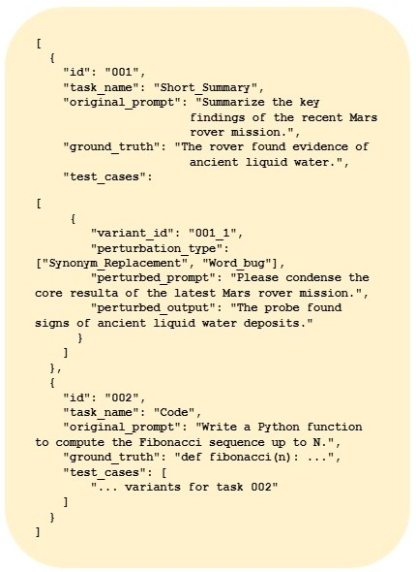
Each entry in the prompt corpus is structured to support systematic analysis, consisting of a base prompt, the corresponding unperturbed model response, a perturbed version of the prompt, and the resulting perturbed response. Additional perturbation metadata is recorded to capture the type and severity of each modification. This standardized structure enables reproducible experiments and consistent robustness evaluation across models.

Slide 10
Perturbation Categories
Character-level perturbations introduce typographical errors
Word-level perturbations replace terms with semantically similar alternatives
Structural-level perturbations modify sentence or phrase ordering
Lexical and formatting-level perturbations alter casing, spacing, or punctuation.
Together, these perturbations are designed to closely mimic natural, non-malicious variations in human-authored prompts.

Slide 11
WordBug
WordBug introduces character-level perturbations by performing random character deletions, insertions, replacements, and swaps within words, effectively simulating common typographical errors made by users. The intensity of perturbation is controlled through a configurable ratio that determines the proportion of modified words. This approach evaluates a model’s tolerance to spelling noise and its ability to preserve semantic intent under low-level input corruption.

Slide 12
TextFooler
TextFooler applies word-level perturbations by replacing selected terms with their synonyms sourced from WordNet, while preserving the overall semantic meaning of the prompt. The number of substitutions is carefully controlled to avoid excessive distortion of intent. This perturbation tests whether LLMs rely on true semantic understanding or are overly sensitive to specific word choices and phrasing.

Slide 13
Structural and Formatting Perturbations
Structural and formatting perturbations modify the organization and visual presentation of prompts without substantially altering their meaning. These include random phrase or sentence shuffling, stopword removal or insertion, and random casing changes. Such transformations evaluate a model’s sensitivity to syntactic structure and visual formatting cues rather than semantic content.

Slide 14
Evaluation Pipeline
Collect unperturbed & perturbed responses
Aggregate scores by type and severity
Generate perturbed prompts
Query LLMs
Compare outputs using BERTScore-F1

Slide 15
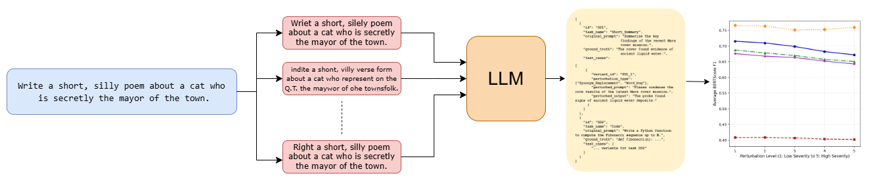
Pipeline

Slide 16
Evaluation Metric
BERTScore-F1 measures the semantic similarity between two text sequences using contextual embeddings from pretrained BERT models, providing a more robust assessment than traditional n-gram metrics like BLEU or ROUGE. In our evaluation, the reference is the model’s response to the unperturbed prompt, and the candidate is the response to the perturbed prompt. Lower BERTScore-F1 values indicate greater sensitivity to prompt variations, reflecting reduced robustness.

Slide 17
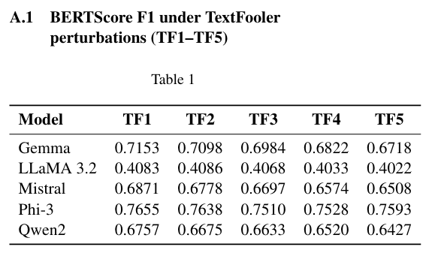
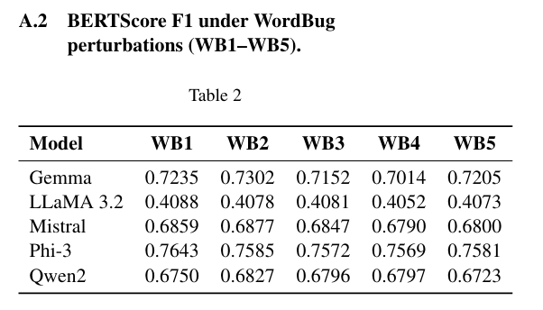
Results and Key Insights

Slide 18
Results and Key Insights
Across all testing scenarios, Phi-3 consistently demonstrated the highest level of resilience, maintaining semantic stability (BERTScore-F1 > 0.75) even as noise levels increased. In contrast, LLaMA 3.2 showed significant sensitivity to even minor changes, with its stability scores dropping to near 0.40. Models like Gemma, Mistral, and Qwen 2 occupied a middle tier, showing a steady but moderate decline in performance.
Character vs. Word-Level Impact
Results indicate that WordBug is generally less disruptive than word-level changes TextFooler. While models can often "see through" typographical errors, the use of synonym substitutions frequently alters the semantic surface of the prompt enough to shift the model's response. This suggests that lexical choice is a greater factor in output stability than simple spelling accuracy.

Slide 19
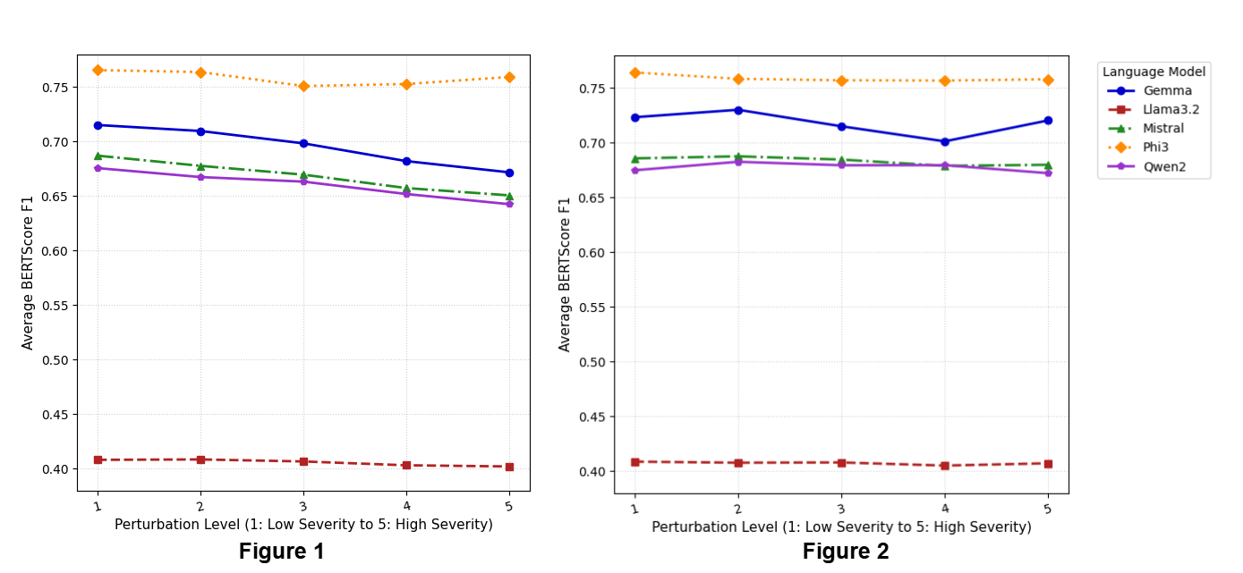
Figure 1: Model responses to elevating severity of TextFooler (Word level Perturbation)
Figure 2: Model responses to WordBug (Character Level Perturbation)

Slide 20
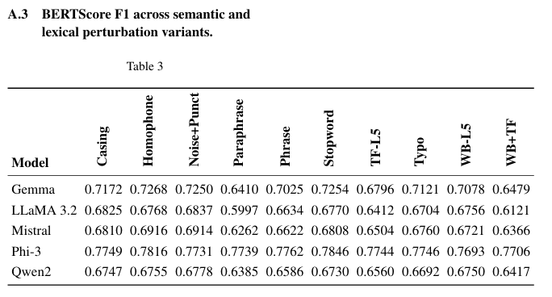
Results and Key Insights

Slide 21
Results and Key Insights
Major Disruptors to Output Stability
The evaluation revealed that simulated paraphrasing and compound attacks (Combining WordBug and TextFooler) are the most disruptive to model performance. These high-coverage semantic changes cause the lowest stability scores across the board. This indicates that while LLMs can tolerate isolated errors, they struggle significantly when multiple layers of linguistic variation are introduced simultaneously.
Resiliency to Surface-Level Noise
All evaluated models showed strong robustness against surface-level transformations such as casing variations, punctuation injection, and homophones. These findings suggest that modern tokenization and training allow models to effectively ignore phonetic and formatting noise.

Slide 22
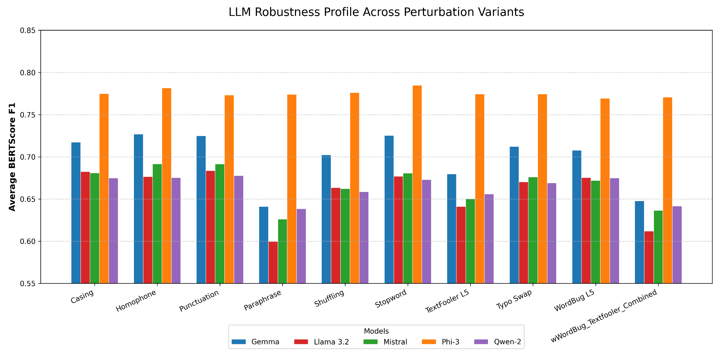

Slide 23
Conclusion and Key Findings
The Robustness Hierarchy
Our systematic evaluation reveals a clear divide in how Large Language Models handle prompt noise. Phi-3 stands out as the most resilient model, maintaining high semantic consistency across both character and word-level changes. While Gemma, Mistral, and Qwen 2 showed moderate, predictable degradation, LLaMA 3.2 was identified as highly sensitive, showing the lowest stability across nearly all testing environments.
Patterns of Failure and Stability
The study confirms that LLMs are generally robust against surface-level noise, such as casing and punctuation. However, they are significantly more vulnerable to semantic-level changes. Simulated paraphrasing and combined attacks consistently triggered the largest drops in performance, suggesting that high-coverage lexical transformations pose the greatest threat to output reliability in real-world usage.

Slide 24
Future Works
Proposed Defense Framework
To mitigate these vulnerabilities, we propose a layered defense pipeline focusing on two primary stages. First, a Self-Denoised Smoothing phase would allow models to normalize noisy inputs before generation, filtering out character and lexical errors. Second, a Consensus-based Aggregation mechanism would utilize majority voting across multiple prompt variants to ensure the final output remains consistent with user intent.
Strategic Research Directions
Future research will focus on optimizing the balance between denoising strength and the fidelity of the final response. We aim to explore how different architectural choices respond to these defenses and investigate adaptive aggregation strategies that can weight outputs based on reliability. Ultimately, this work provides a foundation for building more trustworthy LLMs that can withstand the variability of natural human communication.

Slide 25
Thank You

