Slide 1

CS 250: Agile Presentation
Tomas Estanislao

Slide 2
Agenda
Agile Roles
Agile Phases
Waterfall Model
Which to Choose?

Slide 3
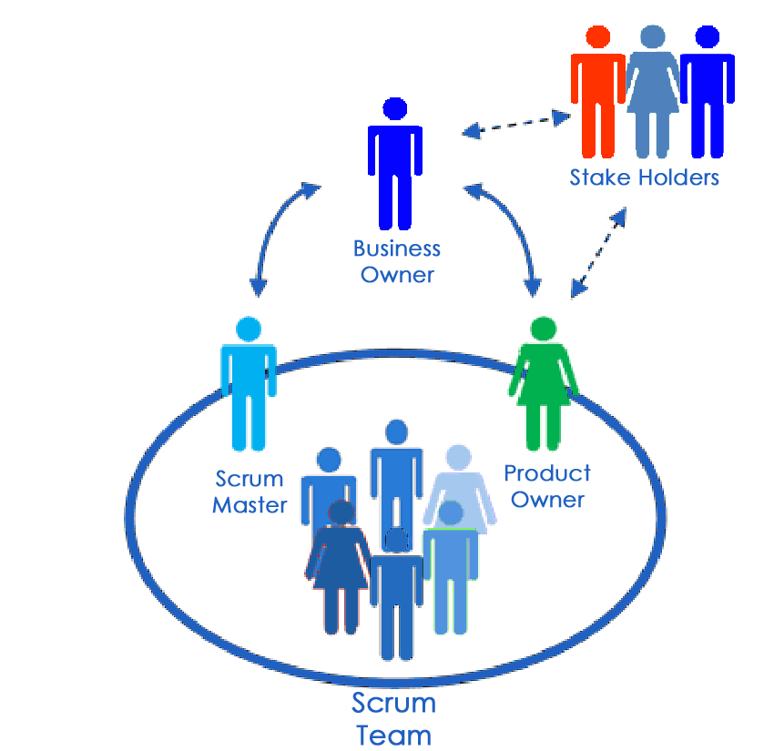
Agile Roles
Scrum Master:
Created Agile Charter document to guide the projects’ goals and scope.
Product Owner:
Conducted target user interviews and curated the Product Backlog— of end-user stories.
Tester:
Constructed initial User Tests, and revised Tests, with acceptance criteria.
Developer:
Produced initial list-view prototype and revised slideshow prototype.
Source: (Milindageorge, 2013)

Slide 4
Agile Phases Agile is divided into repeating mini-SDLC’s called sprints. Each iteration of the project is: 1. Planned (Agile Charter/Product Backlog), 2. Analyzed (User Stories/Sprint Backlog), 3. Designed (User Tests), 4. Implemented (Iteration/Coding), 5. Tested (Functional Testing/End-User Training), 6. Deployed (Final Sprint Deliverable), 7. Maintained (Sprint Review/Retrospective) Source: (Wrike, 2024)
Planning: Defining the purpose and scope.
Analysis: Constructing the requirements.
Design: Creating the system design blueprint.
Implementation: Coding each system component.
Testing: Unit testing ensuring software meets customer requirements.
Deployment: Fully released versions to users.
Maintenance: Rectifying new errors and introducing new features.
Source: (Ferreira, 2023)

Slide 5
Waterfall Model The Waterfall approach consists of clearly defined phases that cannot advance until each is approved. The methodology is designed to be for one linear SDLC process, including clearly defined goals, scope, and planning. In the SNHU Travlr project, a speedy deadline would not be feasible due to the following disadvantages: lack of collaboration, specialized teams, delays from changing requirements, and limited stakeholder feedback.
Sources: (Department Of Information Technology, 2024)
(Radigan, 2024)
Requirements: Gathering requirements from stakeholders to determine the project purpose and scope.
Design: Creating detailed design document.
Development: Coding software to meet requirements and unit testing individual components.
Testing: Integrating components into a single system and performing acceptance testing.
Deployment: Fully released versions to users.
Maintenance: Rectifying new errors and introducing new features.
Sources: (Sayan Kumar Pal, 2024) (Tutorialspoint, 2024)

Slide 6
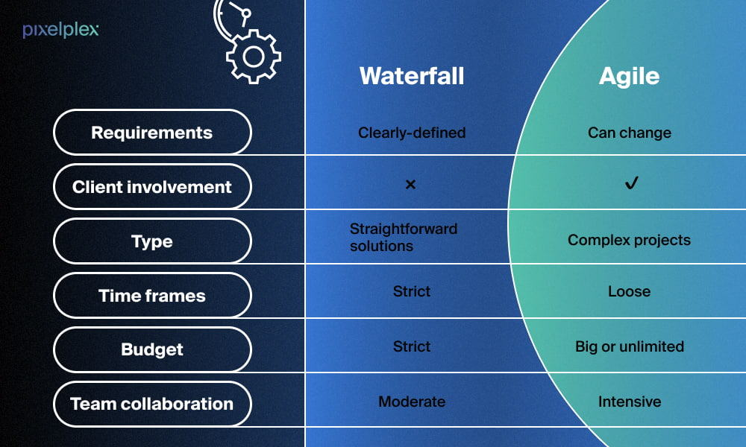
Choosing Waterfall or Agile Generally, Agile should be chosen for projects with flexible requirements, frequent stakeholder involvement, and cross-functional team skillsets. Whereas Waterfall might be preferred for projects with fixed requirements, clear end goals, and a lack of agile experience. Source: (Lucidchart, 2018)
Source: (Serebryantseva, 2022)

Slide 7
References
Department Of Information Technology. (2024). SDLC Waterfall Phases. Maryland.gov. https://doit.maryland.gov/SDLC/Pages/waterfall_phases.aspx
Ferreira, A. (2023, October 31). Deep Dive: The software development life cycle (SDLC) in Agile Environments. Medium. https://medium.com/@argferreira1/deep-dive-the-software-development-life-cycle-sdlc-in-agile-environments-6b245bbea5ab
Lucidchart. (2018, August 10). The Pros and cons of waterfall methodology. https://www.lucidchart.com/blog/pros-and-cons-of-waterfall-methodology
Milindageorge. (2013, March 26). An agile team, Scrum team – roles & responsibilities. https://milindageorge.wordpress.com/2013/03/26/an-agile-team-scrum-team-roles-responsibilities/
Radigan, D. (2024). Agile vs. Waterfall Project Management. Atlassian. https://www.atlassian.com/agile/project-management/project-management-intro
Sayan Kumar Pal. (2024, May 21). Waterfall Model - Software Engineering. GeeksforGeeks. https://www.geeksforgeeks.org/waterfall-model/
Serebryantseva, V. (2022, June 29). Agile vs waterfall: Which development approach is better?. PixelPlex. https://pixelplex.io/blog/agile-waterfall-software-development/
Tutorialspoint. (2024). SDLC - Waterfall Model. https://www.tutorialspoint.com/sdlc/sdlc_waterfall_model.htm
Wrike, Inc. (2024). The Agile Software Development Life Cycle: Wrike Agile Guide. https://www.wrike.com/agile-guide/agile-development-life-cycle/

