Slide 1
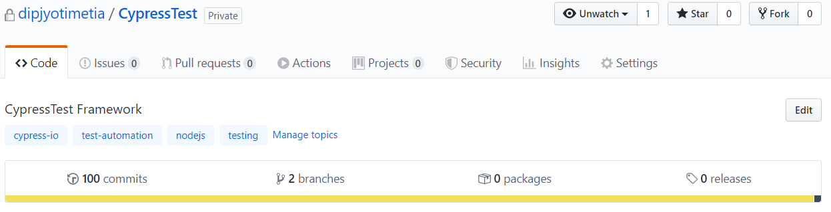
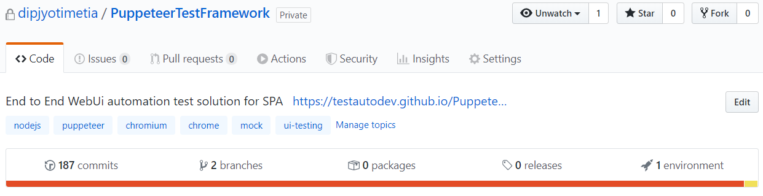
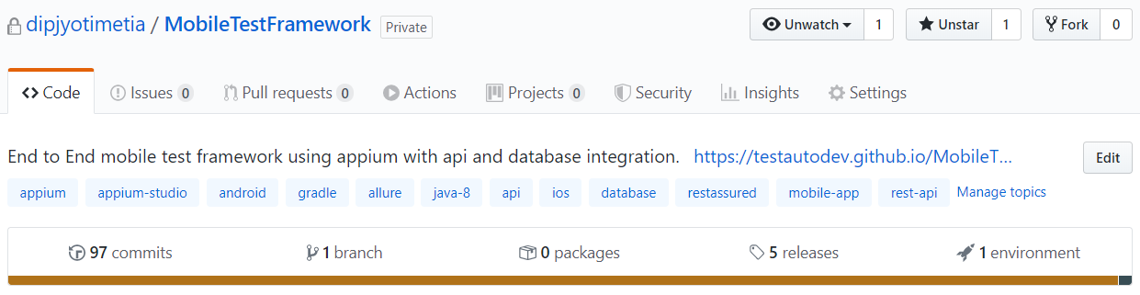

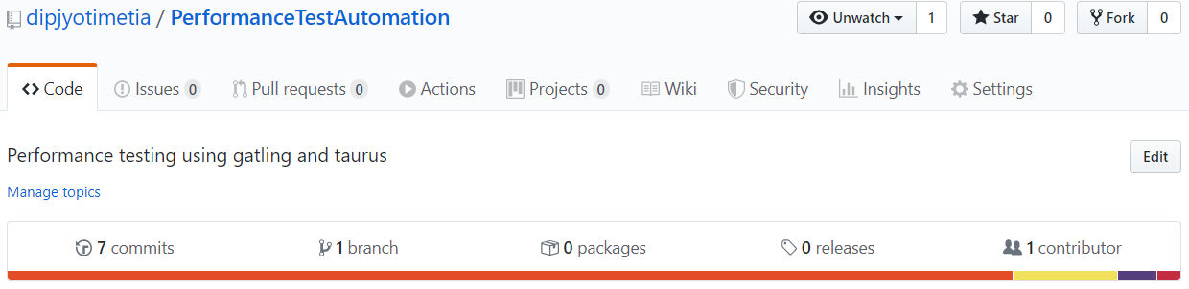
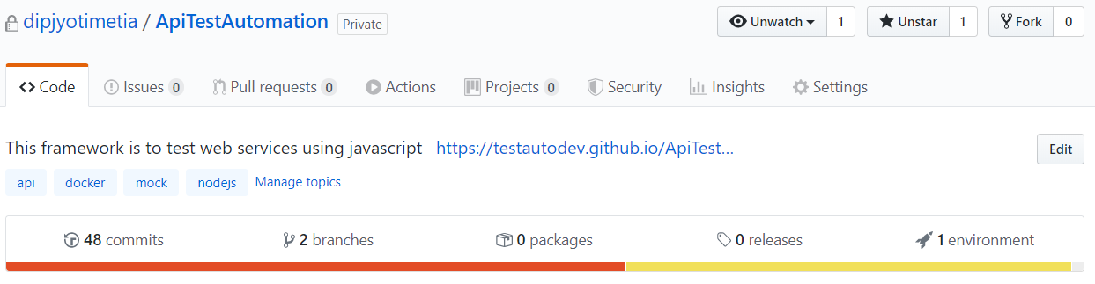
UI
Mobile
Performance
API

Slide 2
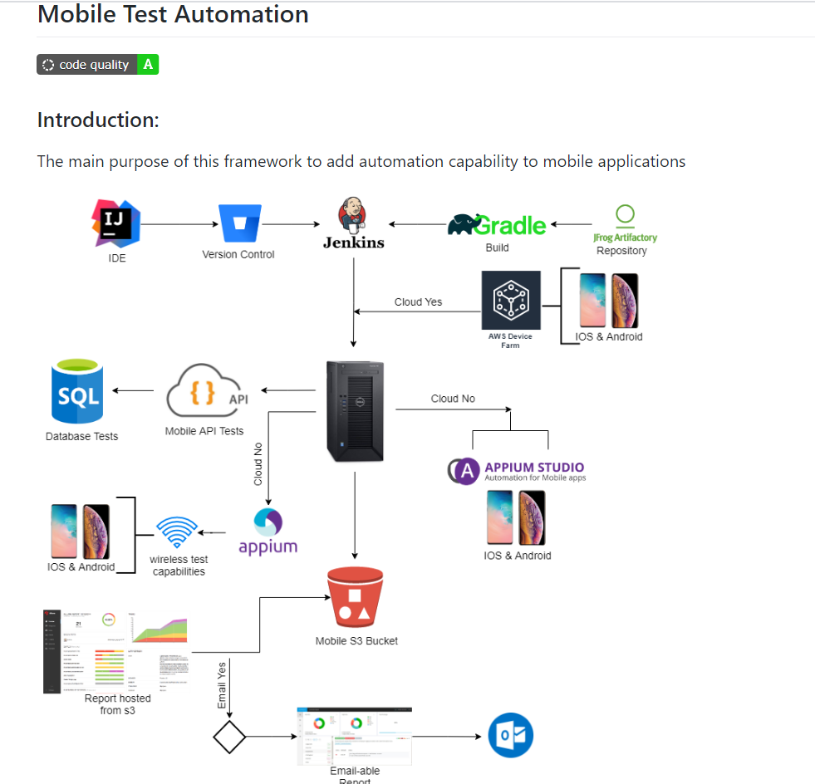
Mobile iOS & Android
Api
Database

Slide 3
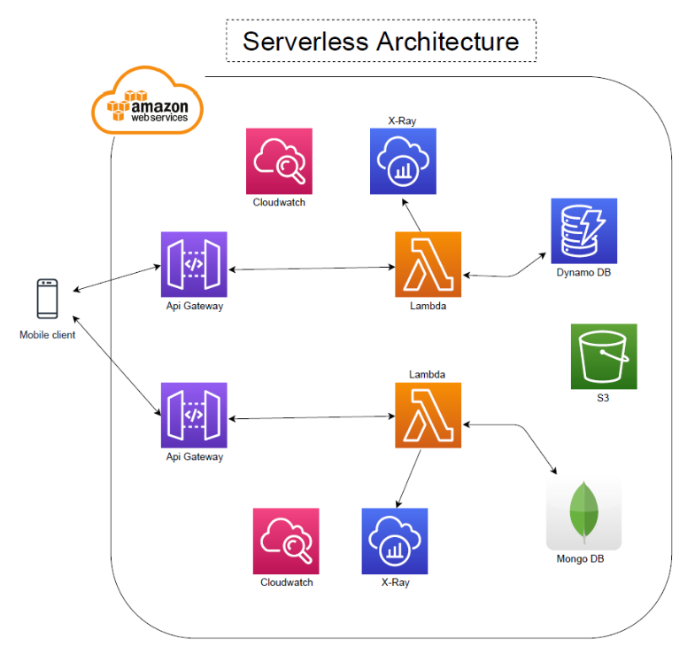
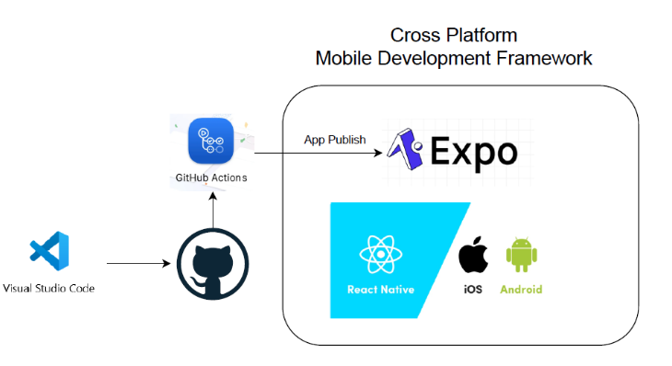

Slide 4
Thank You

Slide 5
Seetest Cloud
Jenkins
Artifactory
Stub server
Localstack
Sonarqube
Docker & ECS & Docker published images Slack mobilebot
Kibana dashboard, new relic, sumologic, run scope. Salesforce. Leading team of 5 for Cloud migration of around 35 legacy applications, setup pipeline, setup health dashboard. Meetup presentations

