Slide 1
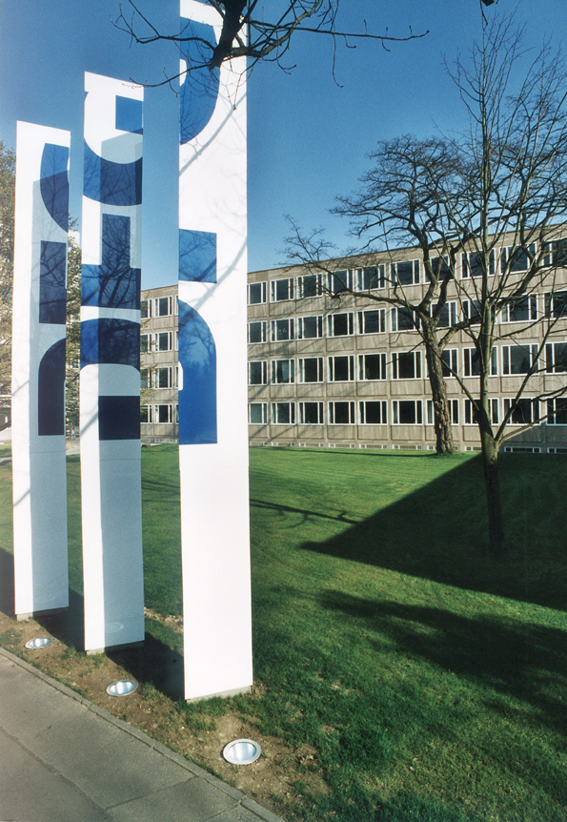
The DFG Study of Author Experience of Open Access
Dr. Johannes Fournier (Bonn)
The Deutsche Forschungsgemeinschft
(German Research Society)

Slide 2
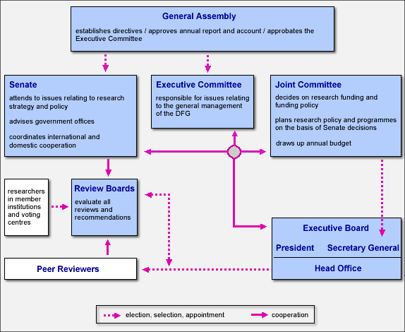
DFG‘s Organisational Structure

Slide 3
I. Survey Design
II. Preliminary Results
    1. Trends and Tendencies
    2. Discipline-Specific Differences
    3. Awareness, Knowledge, and Usage
    4. Costs, Fees, and Royalties
    5. Views and Opinions
III. Possible Roads to Take

Slide 4
Survey Design: Structure of Our Questionnaire
(1.023 respondents from 48 research areas)
I. Publication and Reading
II. Open Access: Awareness, Declarations, Journals, Self-Archiving
III. Publication and License Fees
IV. On Spending the DFG‘s publication grants
V. Person, Profession, Institution, Age, Gender

Slide 5
4 Scientific Disciplines and 48 Research Areas
HSS = Humanities and Social Sciences
  Ancient Cultures, History, Fine Arts Studies, Linguistics, Literature, Theatre and Media Studies, Ethnology, Non-European Cultures, Religious Studies, Theology, Philosophy, Education Sciences, Psychology, Social Sciences, Economics, Jurisprudence
LS = Life Sciences
  Foundations of Biology and Medicine, Plant Science, Zoology, Microbiology, Virology and Immunology, Medicine, Neurosciences, Agriculture, Forestry, Horticulture and Veterinary Medicine
NS = Natural Sciences
  Molecular Chemistry, Chemical Solid State Research, Physical Chemistry of Molecules, Liquids and Interfaces, General, Theoretical Chemistry, Analytical Chemistry, Method Development, Chemistry of Biological Systems, Polymer Research, Condensed Matter Physics, Optics, Quantum Optics and Physics of Atoms, Molecules and Plasmas, Particles, Nuclei and Fields, Statistical Physics and Nonlinear Dynamics, Astrophysics and Astronomy, Mathematics, Atmospheric Science and Oceanography, Geology and Paleontology, Geophysics and Geodesy, Geochemistry, Mineralogy and Crystallography, Geography, Water Research
ENG = Engineering
  Production Technology, Mechanics and Constructive Mechanical Engineering, Process Engineering, Technical Chemistry, Heat Energy Technology, Thermal Machines and Drives, Materials Engineering, Materials Science, Raw Materials, System Engineering, Electrical Engineering, Computer Science, Construction Engineering and Architecture

Slide 6
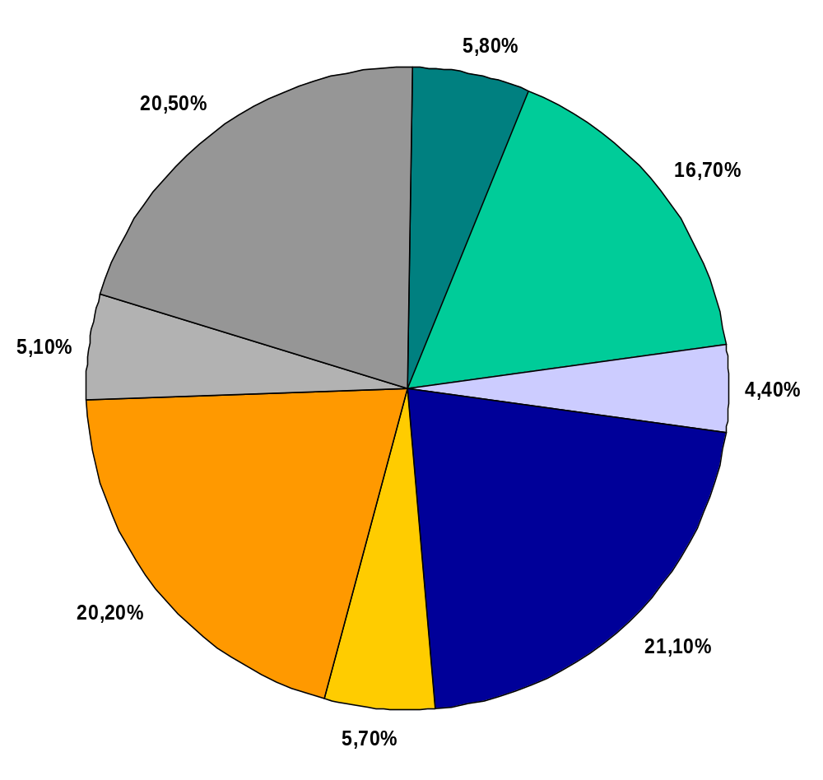
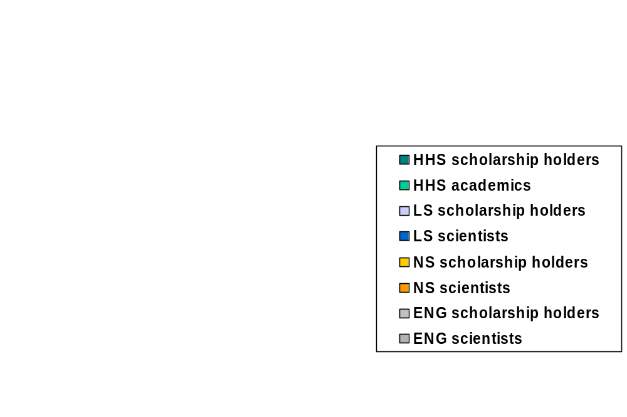
Respondent‘s Distribution

Slide 7
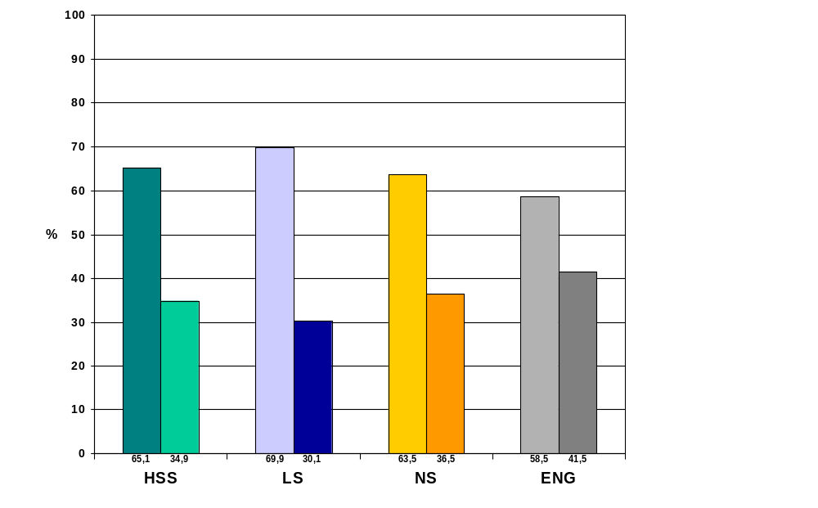
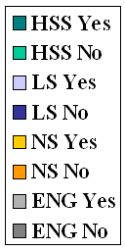
Should the DFG rather be Encouraged in Promoting Open Access?

Slide 8
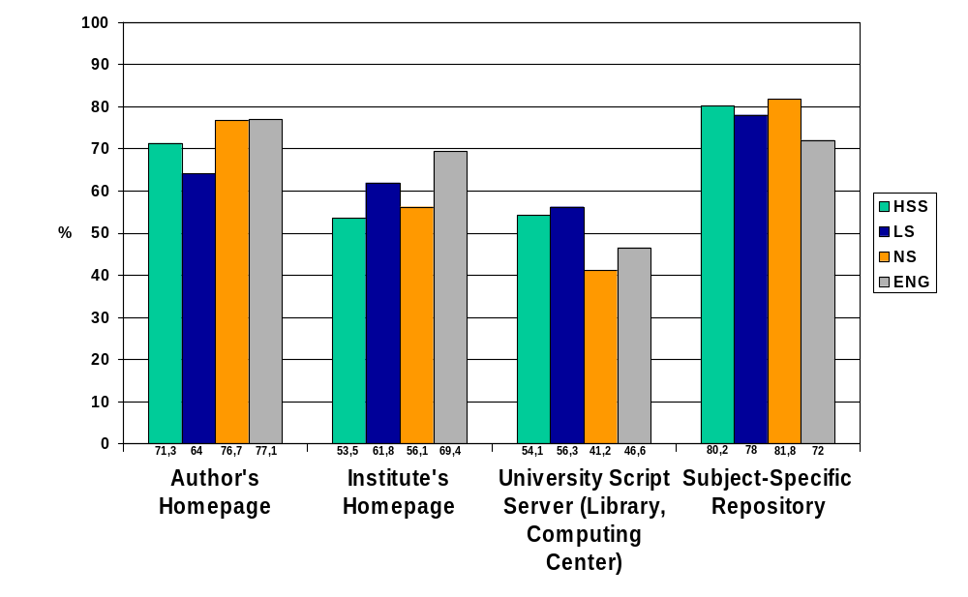
Most Reasonable Places for Depositing Self-Archived Articles

Slide 9
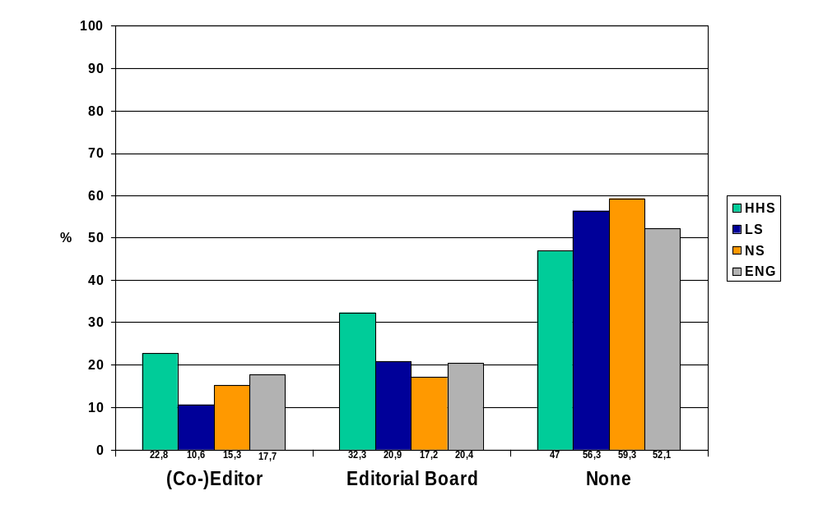
Editorial Experience

Slide 10
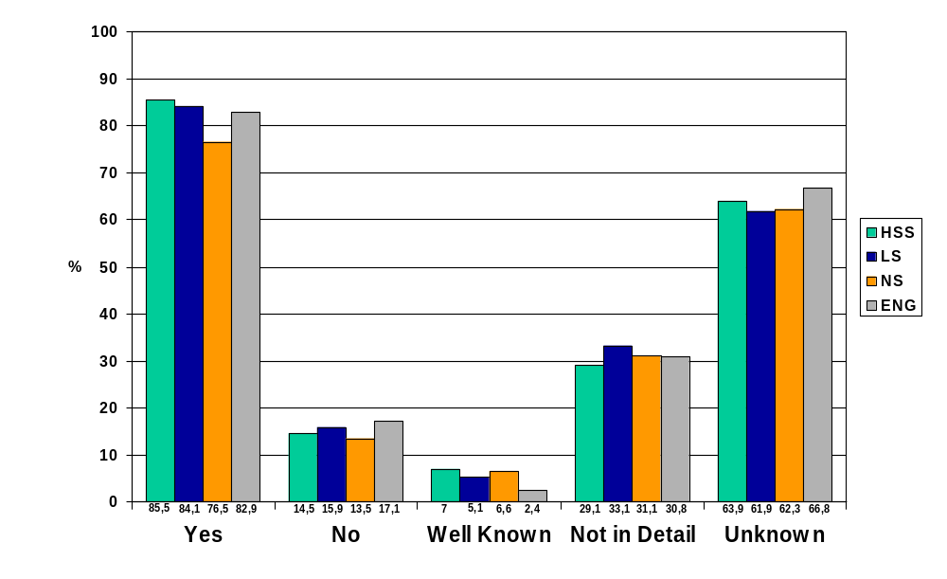
Open Access Awareness
Is open access still unknown as means of publication?
How familiar are you with the Berlin declaration?

Slide 11
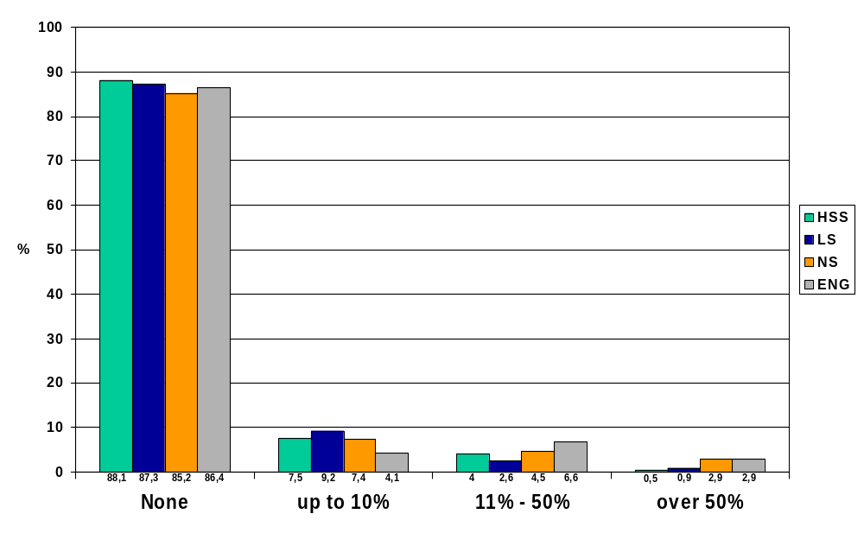
How many articles did you publish in an open access journal within the last 5 years?

Slide 12
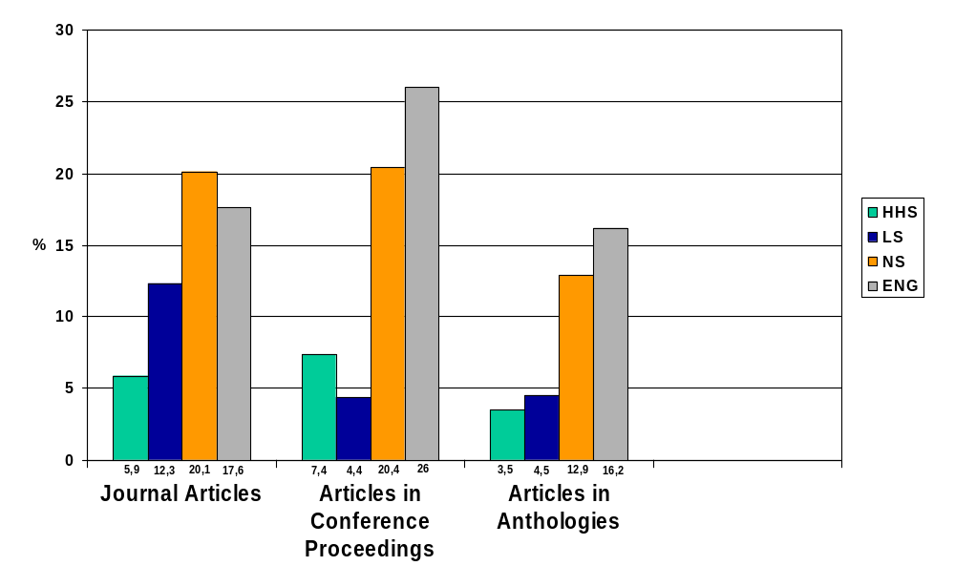
Proportion of Self-Archived Articles (Postprints) within the last 5 years

Slide 13
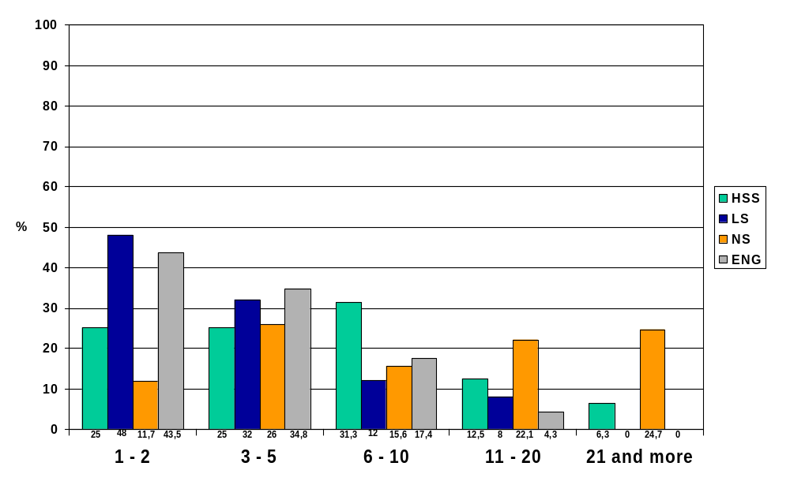
Self-Archived Articles (Preprints) within the last 5 years

Slide 14
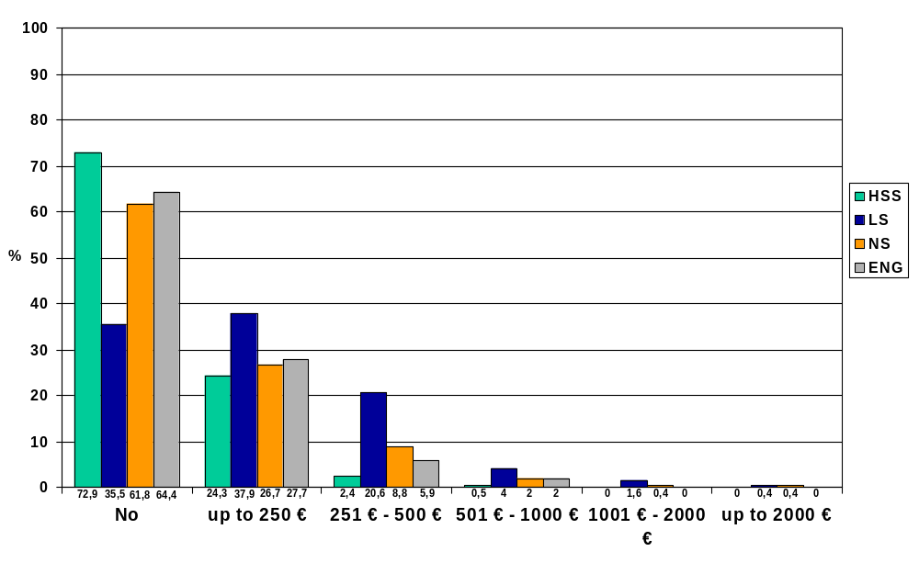
Would you be willing to pay for the publication of a research article in an open access journal?

Slide 15
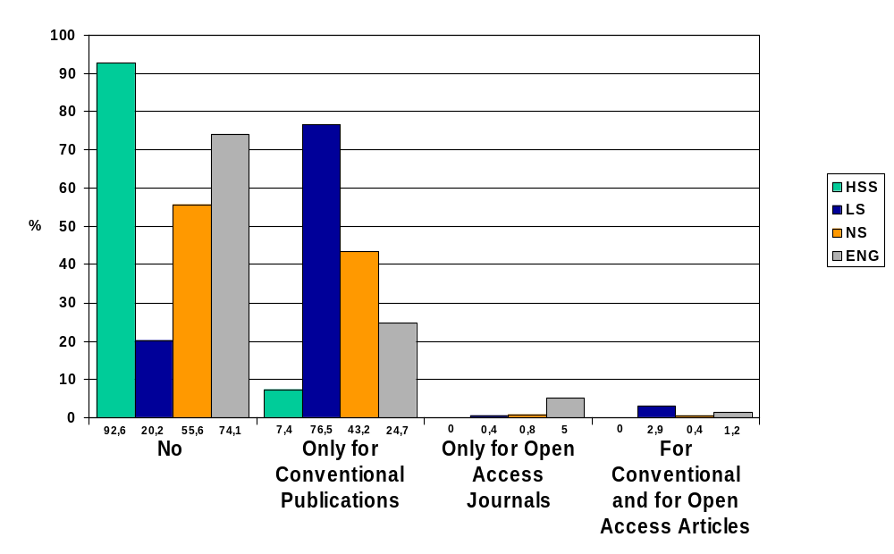
Did you ever pay fees for the publication of a research article?

Slide 16
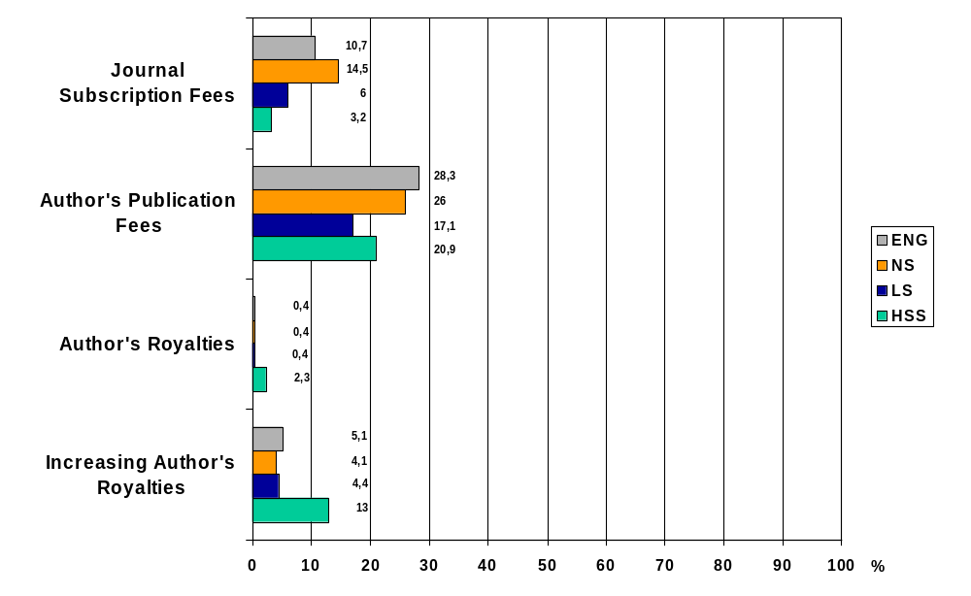
Some Criteria in Choosing a Journal for a Publication and Improvement of International Visibility of German Journals

Slide 17
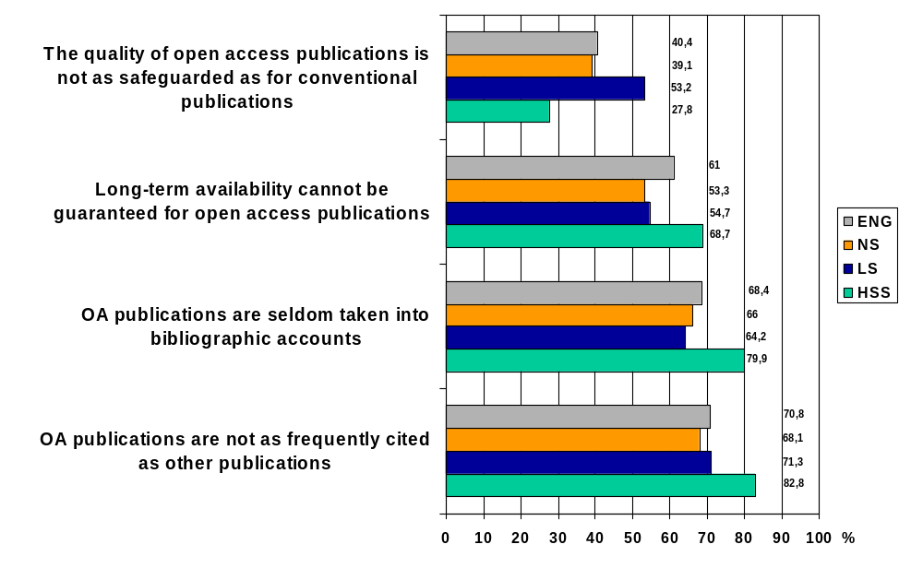
Some Views on Open Access

Slide 18

Thank you very much for your attention!
Dr. Johannes Fournier
johannes.fournier@dfg.de
Further Information at: www.dfg.de

