Slide 1
Chemical Engineering
Introduction to Engineering
Notes from Dr. Christine Kelly

Slide 2
Chemical Engineering
Chemical engineers create, modify, trouble shoot, and analyze processes based upon physical and chemical change.
Basic sciences: chemistry, biology, physics, and mathematics.
Consider: economics, environmental impact, and safety.

Slide 3
Historical Top 10 Important Achievements
Synthetic rubber
Antibiotics
Polymers
Synthetic fibers
Cryogenic separation of air
Separation of nuclear isotopes
Catalytic cracking of oil
Pollution control
Fertilizers
Biomedical engineering

Slide 4
Chemical Engineering Applications
Chemicals
Environmental
Food/consumer
Materials
Pharmaceuticals
Electronics
Pulp and paper
Biotechnology

Slide 5
Integrated Circuit Manufacturing
Integrated circuit manufacturing (Pentium CPU’s, memory chips, …)
Chemical engineers design the circuit manufacturing processes: photoresist, silicon purification and fabrication, and plasma etching.
Computer engineers design the pattern of “wires” on the chip.

Slide 6
SU Graduates
Pharmaceuticals
Computer Chips (IBM)
Sales of high tech medical equipment
Chemical engineering software development
Environmental Engineering
Film (Kodak)
General Electric (designing compressors)
Batteries
Fuel Cells
Weapons development

Slide 7
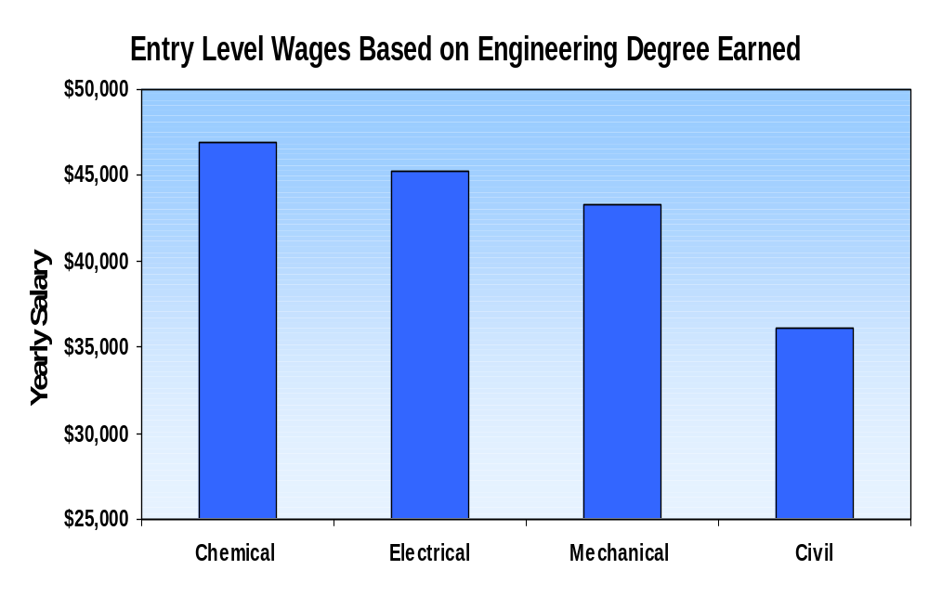
Source: "National Association of Colleges and Employers, 1999 Survey"

Slide 8
Two Examples of Chemical Engineering Problems
Fuel cells
Corn-wet milling

Slide 9
Fuel Cell Outline
How is power generated conventionally?
How do fuel cells work?
How can we provide fuel for the fuel cell?

Slide 10
How is power generated conventionally? Fuel Burning.
1. Chemical
fuel+O₂ CO₂+H₂O+N₂+O₂+CO
+ash+No_{x}+So_{x}+heat
2. Mechanical
heat+H₂O high pressure steam (HPS)
HPS + turbine rotation + LPS
3. Electrical
rotation electrical power

Slide 11
How do fuel cells work?
Fuel cells convert H₂ and O₂ directly to electrical power through a chemical reaction without the intermediate mechanical step.

Slide 12
Fuel Cell Operation
2H₂
2CO₂
2H₂O
2H₂+2CO₃²⁻ → 2CO₂+2H₂O+4e⁻
4e⁻
anode
power
distribution
K₂CO₃
cathode
4e⁻
2H₂O
2CO₂+2O₂+4e⁻ → 2CO₃²⁻
O₂
2CO₂
2H₂O
O₂

Slide 13
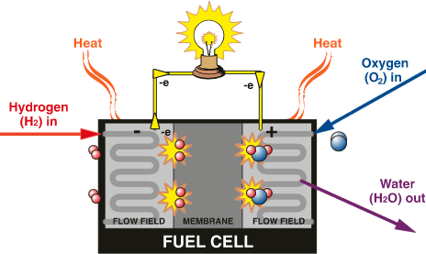
Fuel Cell Operation

Slide 14
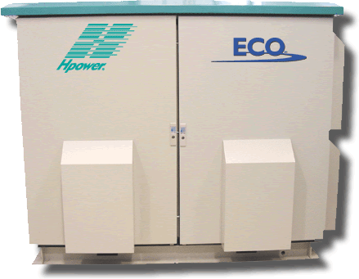

Stationary and Portable Fuel Cells

Slide 15
How can we provide fuel?
Pure H₂ and O₂ are expensive, explosive, flammable, and difficult to transport.
We can produce pure O₂ from air (inexpensive) by cooling the air until O₂ liquefies and N₂ remains a gas.
Then the liquid and gas can easily be separated.

Slide 16
Production of Pure O₂
N₂ (79%)
O₂ (21%)
condenser
-190ºC
N₂ (gas)
O₂ (liquid)

Slide 17
Production of Pure H₂
Oxidize methane to provide the energy to ‘break’ water.
Use two reactions to complete the oxidation. CH₄ CO CO₂.
Three catalysts help the reactions proceed: NiO particles on aluminum oxide, iron oxide, and copper-zinc oxide.

Slide 18
Flowsheet for H₂ Production
CH₄
H₂O
CH₄ + H₂O 3H₂ + CO
syngas
CO, H₂,
H₂O, CH₄
CO (0.3%)
CO₂ (18%)
H₂ (77%)
CH₄ (4.7%)
H₂O
CO + H₂O H₂ + CO₂
water-gas shift reaction

Slide 19
Chemical Engineering and Fuels Cells
Chemical engineers play integral roles in both traditional power generation and the increasingly important power generation by fuel cells.
Fuel cells have the potential to produce power more efficiently with significantly less environmentally harmful emissions.

Slide 20
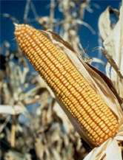
Products from Corn?

Slide 21
Products from Corn Outline
Corn wet-milling process
Syrup refining
Ion exchange process

Slide 22
Corn
Wet-Milling
CORN
Steeping
CORN OIL
Germ Separation
Oil Refining
Screening
Feed Processing
Starch-gluten Separation
FEED
Starch Processing
STARCH
Syrup Conversion
Fermentation
SWEETENER
Syrup Refining
ALCOHOL

Slide 23
Syrup Conversion and Refining
Enzymatic Syrup Conversion
starch dextrose
STARCH
Enzymatic Conversion
dextrose fructose
Syrup Refining
cleaning the syrup and concentrating the fructose
HIGH FRUCTOSE CORN SYRUP

Slide 24
Cleaning the Syrup: Ion Exchange
Ion exchange is a unit operation that will selectively remove specific ions from a liquid stream.
Calcium ions are removed from the syrup with the ion exchange process.
The syrup is pumped through a column containing ion exchange resin beads and the calcium is taken up by the resin beads and removed from the syrup.

Slide 25
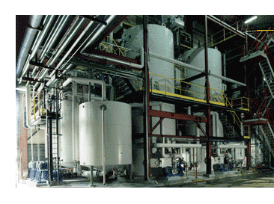
Ion Exchange Columns

Slide 26
FLOW
RESIN

Slide 27
FLOW
RESIN

Slide 28
Chemical Engineering
Chemical engineers play integral roles in the production of food, pharmaceuticals, fuels, and materials; they are influential in understanding and developing medical treatments; and they develop processes to clean our environment.

