Slide 1
AWS

Slide 2

What is AWS…
AWS is a cloud provider
They Provide you with
Servers –which enables you to host applications
Variety of Services

Slide 3
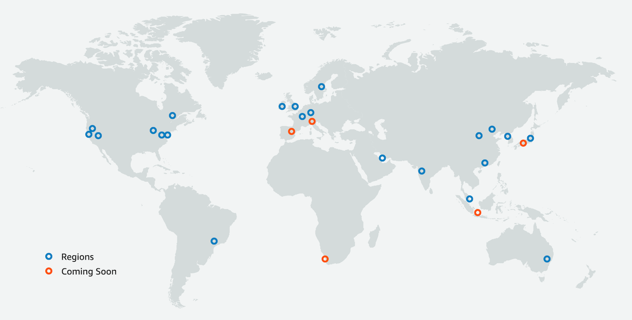
AWS Availability Regions
US
Africa
Asia Pacific
Canada
China
Europe
Middle East
South America

Slide 4
What can be expected in this Session
talking about few AWS services
Live demo of the services we talked about
Its just an attempt to make every one to get an idea of AWS services,

Slide 5
Services that will seen in this session
AWS EC2
AWS S3
AWS Elastic Bean Stalk
AWS Code Commit
AWS Code Pipeline

Slide 6

AWS EC2 (Elastic Compute Cloud)
It provides you virtual servers, with a variety of configurations
Enables to host applications
In the Hands on
We will see the way of hosting Jenkins

Slide 7
EC2 Hands On…

Slide 8
Q1: Applications hosted on EC2 can be accessed using…?
Public IP
Private IP
Instance Id

Slide 9

AWS S3 (Simple Storage Service)
It’s a Storage Service
Apart from storing of files, it can also be used to store static webpages/ sites
In the hands on,
We will host a static webpage
We will also talk about encryption in S3

Slide 10
S3 Hands On…

Slide 11
Q2:Which of the following is not an encryption strategy in S3
AES-256
AES-128
AWS-KMS

Slide 12

AWS Elastic Beanstalk
AWS Elastic Beanstalk is a service used to deploy web application developed using
Node Js
.NET
PHP
Java, Phython, Ruby, Go….
In the Hand on, we shall deploy a sample Node Js application

Slide 13
Elastic BeanStalk Hands On…

Slide 14
Q3:Elastic BeanStalk creates its own instance of Ec2 Intance
True
False

Slide 15

AWS Code Commit
Its AWS version of DVCS
Very Similar to GitHub
In the Hand on…we will the way of committing our sample source code in AWS code commit, by
UI
Command Line

Slide 16
AWS CodeCommit Hands On…

Slide 17

AWS Code Pipeline
AWS CodePipeline is a AWS version of CICD
In the hands on….we will implement a sample CICD pipeline

Slide 18
AWS Code pipeline Hands On…

Slide 19
Q4: Using Code pipeline, can we integrage code from GITHUB?
Yes
No

Slide 20
Thank you!

