Slide 1
DEPARTMENT OF COMPUTER SCIENCE & ENGINEERING
DNS Poisoning
Attack · Detection · Mitigation
Student Name:
Tethi Das
Enrollment No:
241370107080
Branch:
BE – Computer Engineering
Semester:
4th Semester
Guide:
Prof. Deepak Upadhyay
University:
Gujarat Technological University
Subject:
Operating Systems (OS)
🔴 Live Lab Demo | Kali Linux (Attacker) + Ubuntu 24.04 LTS (Victim) | MacBook M4 | April 2026
Live Lab Demo · Kali Linux (Attacker) + Ubuntu 24.04 LTS (Victim) · MacBook M4 · April 2026

Slide 2
01 Introduction to DNS & DNS Poisoning
What is DNS and why is it vulnerable?
DNS (Domain Name System) — designed by Paul Mockapetris in 1983 — is the internet's phonebook, converting domain names like www.google.com into IP addresses like 142.251.155.119.
DNS was designed for a trusted academic network — it has NO built-in authentication. Any server can forge a DNS response.
DNS Poisoning (DNS Spoofing) tricks the victim's device into connecting to the attacker's server instead of the real one.
The attack is completely invisible — no browser warning, no certificate error, no visual indication to the victim.
User types www.google.com
Browser checks cache / /etc/hosts
OS queries /etc/resolv.conf DNS
🔴 Rogue DNS intercepts query!
Returns 192.168.1.13 (Kali IP)
⚠️ Why DNS is Vulnerable:
UDP — connectionless, no handshake, easily spoofed
No authentication — any host can send a fake response
16-bit transaction ID — only 65,536 possibilities
Caching — poisoned entries persist until TTL expires
Browser connects to FAKE page
Normal DNS Resolution Flow (Poisoned)
DNS Poisoning · OS Project · Tethi Das · 241370107080

Slide 3
02 Lab Environment Setup
MacBook M4 · VMware Fusion + UTM · Bridged Network (192.168.1.x)
🔴 ATTACKER — Kali Linux
🟡 VICTIM — Ubuntu 24.04
OS:
Kali Linux 2024 Rolling
OS:
Ubuntu 24.04 LTS Noble
IP:
192.168.1.13 (eth0)
IP:
192.168.1.10 (enp0s1)
MAC:
00:0c:29:07:7b:f0
MAC:
6e:1e:0b:eb:6b:2e
VM:
VMware Fusion 13.x
VM:
UTM 4.x (QEMU-based)
RAM/Storage:
4 GB / 40 GB
RAM/Storage:
2 GB / 20 GB
Shell:
zsh (Kali default)
DNS (default):
systemd-resolved stub
Username:
tethi
Username:
codebind
Tools: fakeDNS.py · Apache2 · dsniff · kali_attack.sh
Tools: tshark · dig · nslookup · arpwatch · curl
⟵ Same Subnet: 192.168.1.x | Gateway: 192.168.1.1 | Bridged Network ⟶
DNS Poisoning · OS Project · Tethi Das · 241370107080

Slide 4
03 Tools & Technologies
Attack tools on Kali · Detection tools on Ubuntu
ATTACK
DETECT
fakeDNS.py
tshark
Custom 40-line Python rogue DNS server using dnslib. Intercepts ALL queries → returns 192.168.1.13
CLI Wireshark: captures UDP port 53 traffic, proves DNS responses come FROM 192.168.1.13
ATTACK
DETECT
Apache2
dig / nslookup
Open-source web server serving fake 'DNS POISONED' HTML page on port 80 as visual proof
DNS lookup tools: compare poisoned resolver vs @8.8.8.8. Shows IP, TTL, query time discrepancies
ATTACK
DETECT
dsniff / arpspoof
arpwatch
Suite for DNS spoofing and ARP cache poisoning. Used as alternative attack vector
Daemon monitoring MAC-to-IP changes. Alerts on 'changed ethernet address' or ARP flip-flop
ATTACK
DETECT
kali_attack.sh
ubuntu_victim.sh
Bash automation script: 9 steps — install, IP forwarding, hosts file, Apache, fakeDNS launch
15-step automation: baseline → attack proof → detection → mitigation → final summary
DNS Poisoning · OS Project · Tethi Das · 241370107080

Slide 5
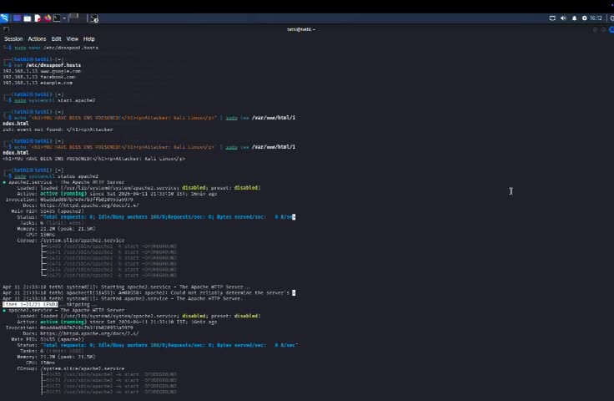
04 Attack Phase — Kali Linux Setup
Preparing the rogue DNS server and fake web page
1
Network Reconnaissance
ip a → eth0: 192.168.1.13 | ping -c3 192.168.1.10 → 0% loss
2
Install Tools
apt install dsniff apache2 python3-dnslib (all already newest version)
3
Enable IP Forwarding
echo 1 | tee /proc/sys/net/ipv4/ip_forward → keeps victim's internet working (stealth)
4
Create Fake DNS Hosts File
📹 Kali Video — Apache + dnsspoof.hosts
/etc/dnsspoof.hosts: 192.168.1.13 → *.google.com, facebook.com, example.com
5
Deploy Apache Fake Page
systemctl start apache2 → 'YOU HAVE BEEN DNS POISONED!' served on port 80
DNS Poisoning · OS Project · Tethi Das · 241370107080

Slide 6
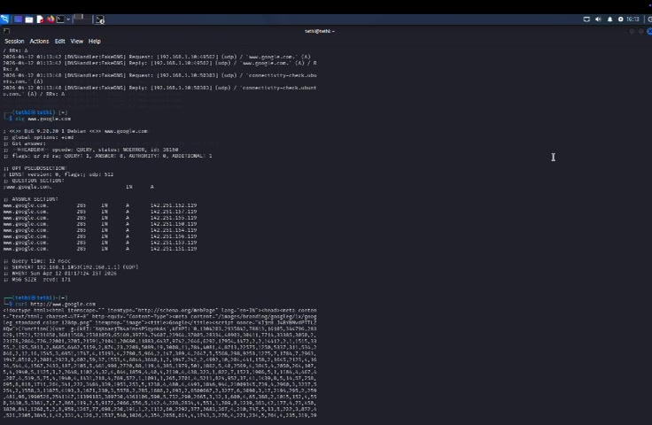
05 fakeDNS.py — Rogue DNS Server Live
Python script intercepts all DNS queries and replies with attacker IP
FAKE_IP = "192.168.1.13"
class FakeDNS(BaseResolver):
def resolve(self, request, handler):
reply = request.reply()
reply.add_answer(RR(
request.q.qname,
QTYPE.A,
rdata=A(FAKE_IP),
ttl=60
))
print(f"[SPOOF] {request.q.qname}")
return reply
server = DNSServer(FakeDNS(), port=53)
server.start_thread()
How fakeDNS.py Works:
Binds to UDP port 53 on ALL interfaces (0.0.0.0)
Every DNS query → replied with 192.168.1.13 (Kali)
TTL = 60s (low → frequent re-queries, attack stays active)
Logs every interception: [SPOOF] www.google.com --> 192.168.1.13
kali_attack.sh: KALI ATTACK SCRIPT COMPLETE! ✓
📹 Kali Video — fakeDNS.py live interception log
DNS Poisoning · OS Project · Tethi Das · 241370107080

Slide 7
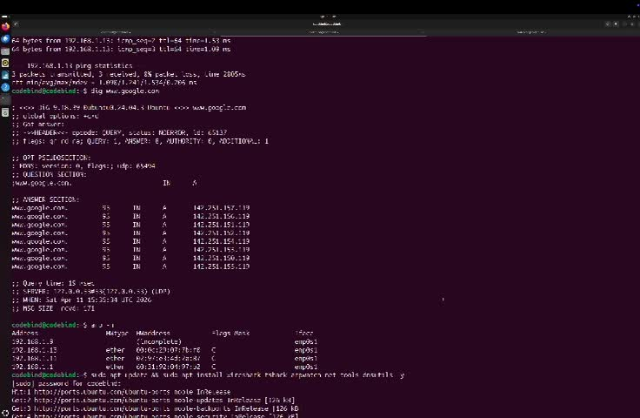
06 Victim Side — Attack Proof
Ubuntu 24.04 · DNS pointing to Kali (192.168.1.13)
Metric
BEFORE Attack
AFTER Poisoning
IP Address
142.251.155.119 (Google)
192.168.1.13 (Kali!)
DNS Server
127.0.0.53 (systemd)
192.168.1.13 (rogue)
TTL
300+ seconds
60 seconds ⚠️
Query Time
~20 ms (internet)
~2 ms (local) ⚠️
📹 Ubuntu Video — Baseline dig: real IPs (142.251.x.x) BEFORE attack
Answer Count
8 A records
1 A record ⚠️
curl Result
Real Google HTML
DNS POISONED! page
Before vs After Comparison
DNS Poisoning · OS Project · Tethi Das · 241370107080

Slide 8
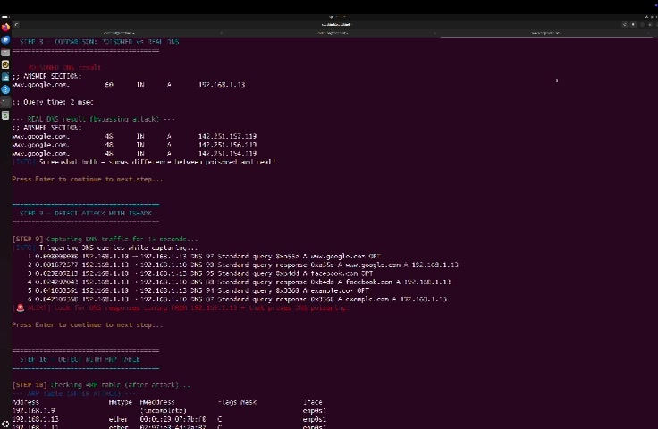
07 Detection Phase
5 Methods to Identify the Attack from Ubuntu
1
dig Comparison
Poisoned returns 192.168.1.13, real returns 142.251.155.119
HIGH
HIGH
dig www.google.com @8.8.8.8
2
nslookup
Server: 192.168.1.13 — private LAN IP, not a public DNS
HIGH
HIGH
nslookup www.google.com
3
tshark Capture
Packets 2,4,6: responses FROM 192.168.1.13 — incontrovertible proof
VERY HIGH
VERY
HIGH
tshark -i enp0s1 -f 'udp port 53'
4
ARP Table Analysis
Gateway MAC unchanged → no ARP spoof; only rogue DNS method used
HIGH
HIGH
arp -n (before vs after)
📹 Ubuntu Video — tshark packet capture + ARP table after attack
5
arpwatch Daemon
Monitors MAC changes; alerts on 'changed ethernet address' / flip-flop
MEDIUM
MEDIUM
journalctl -u arpwatch -f
DNS Poisoning · OS Project · Tethi Das · 241370107080

Slide 9
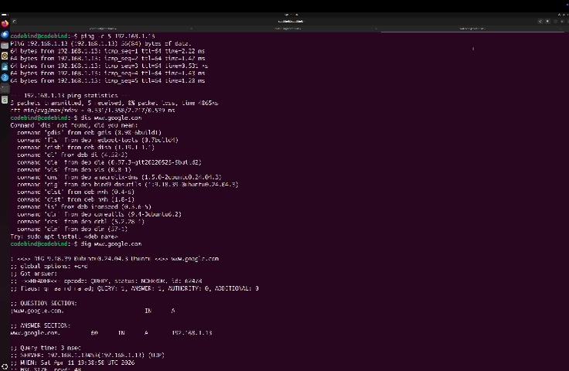
08 Mitigation & Defense
4 Defenses Applied and Verified on Ubuntu
1
Flush DNS Cache
CMD: sudo resolvectl flush-caches
→ Cache: 0/0/0 — all poisoned entries immediately removed
2
Restore Real DNS
CMD: nameserver 8.8.8.8 → /etc/resolv.conf
→ dig returns 142.251.x.x · TTL=235s · 19ms · DEFENSE SUCCESSFUL!
3
Enable DNSSEC
CMD: DNSSEC=yes in /etc/systemd/resolved.conf
→ Cryptographic signature verification — forged responses rejected
4
Static ARP Entry
CMD: sudo arp -s 192.168.1.1 60:31:92:04:97:b2
📹 Ubuntu Video — Defense steps: DNS restore + dig verification
→ CM flag set → gateway MAC permanently locked, ARP spoof blocked
5
Automation Verified
CMD: ubuntu_victim.sh — 15 steps complete
→ ATTACK ✓ DETECTION ✓ DEFENSE ✓ — All 3 phases confirmed
🛡️ Best Practice: DNSSEC + DoH/DoT + arpwatch + HSTS = Comprehensive DNS Security
DNS Poisoning · OS Project · Tethi Das · 241370107080

Slide 10
Conclusion & Thank You
Thank You!
✅ 40-line Python (fakeDNS.py) poisoned ALL DNS queries silently
✅ Ubuntu redirected to Kali fake page — 100% transparent to victim
✅ 5 detection methods: dig, nslookup, tshark, ARP table, arpwatch
✅ 4 defenses verified: cache flush, real DNS, DNSSEC, static ARP
✅ Automated: kali_attack.sh (9 steps) + ubuntu_victim.sh (15 steps)
⚠️ DNS needs layered defense: DNSSEC + DoH/DoT + monitoring
Student:
Tethi Das
Enrollment:
241370107080
Branch:
BE – CE, 4th Sem
Guide:
Prof. Deepak Upadhyay
University:
GTU
Subject:
Operating Systems
Demo Date:
April 13–15, 2026
40
5
4
15
Lines of
Python
Detection
Methods
Defenses
Applied
Script
Steps
For Educational Use Only · Gujarat Technological University · Academic Year 2025–2026

