Slide 1
High Strength Concrete Density of Fresh Concrete Flexural Strength
Ece KARAKUŞ

Slide 2
Definitions
High strength concrete is concrete with higher compressive strength than 55 Mpa (8000psi) according to the American Concrete Institute .
Fresh concrete is concrete which setting process is not yet started.
Flexural strength is the stress in material just before yielding.

Slide 3
Relationships
Compressive strength of HSC is higher than NSC.
Flexural strength of HSC is higher than NSC due to flexural strength increases as compressive strength increases.
As density of concrete increases, flexural strength increases as well.
Density of fresh concrete is higher than hardened concrete because density of concrete decreases over time and through 28 days of curing. Therefore flexural strength of fresh concrete is higher than hardened concrete.

Slide 4

Relationship Between Compressive Strength and Flexural Strength

Slide 5
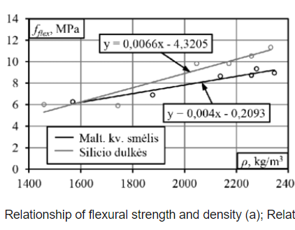
Relationship Between Density and Flexural Strength

Slide 6
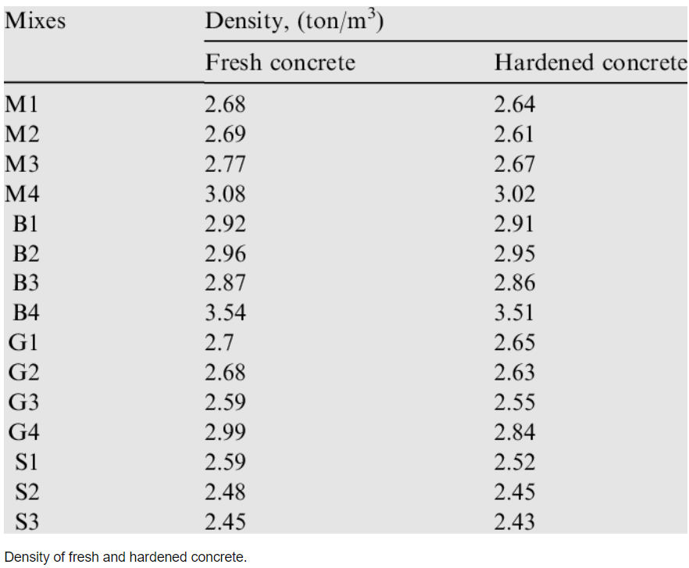
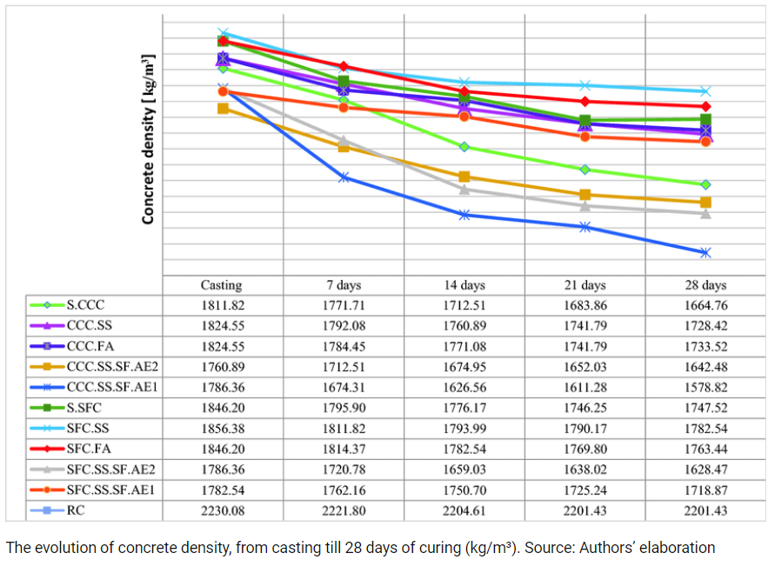
Density of Concrete Over Time

Slide 7
References
When Agricultural Waste Transforms into an Environmentally Friendly Material: The Case of Green Concrete as Alternative to Natural Resources Depletion - Scientific Figure on ResearchGate. Available from: https://www.researchgate.net/figure/The-evolution-of-concrete-density-from-casting-till-28days-of-curing-kg-m-Source_fig2_331358138 [accessed 3 Nov, 2021]
Elasticity and Shrinkage of Cement:Sand Mortar Produced in Riyadh - Scientific Figure on ResearchGate. Available from: https://www.researchgate.net/figure/Relationship-between-flexural-strength-and-compressive-strength-for-mortar-specimens-all_fig1_234169321 [accessed 3 Nov, 2021]
Mechanical Properties of Lightweight Concrete Produced with Expanded Glass Aggregate - Scientific Figure on ResearchGate. Available from: https://www.researchgate.net/figure/Relationship-of-flexural-strength-and-density-a-Relationship-of-compressive-strength_fig2_322343894 [accessed 3 Nov, 2021]

