Slide 1
Select Location for Traffic Lights and Signs
Ece Karakuş
201819042
Crash Data

Slide 2
Aim
Selecting the Best Location for Traffic Lights and Signs

Slide 3
Parameters
LANE CLOSED
TURNPIKE
WET ROADSNOW SLUSH ROAD
ICY ROAD
WORK ZONE
INTERSECTIONSCHOOL ZONE
CURVED ROADTRAIN
CROSS MEDIAN
STREET NAME
.
HIT FIXED OBJECT
HEAVY TRUCK RELATED
SPEEDING RELATED
DEER RELATED
MOTORCYCLE DEATH COUNT
BICYCLE DEATH COUNT
PEDESTRIAN DEATH COUNT
PEDESTRIAN MAJOR INJURY COUNT
BICYCLE MAJOR INJURY COUNT
MOTORCYCLE MAJOR INJURY COUNT
INJURY OR FATAL
.
MOTORCYCLE COUNT
SMALL TRUCK COUNT
HEAVY TRUCK COUNT
BICYCLE COUNT
PEDESTRIAN COUNT
SCHOOL BUS COUNT
VEHICLE TOWED
.

Slide 4
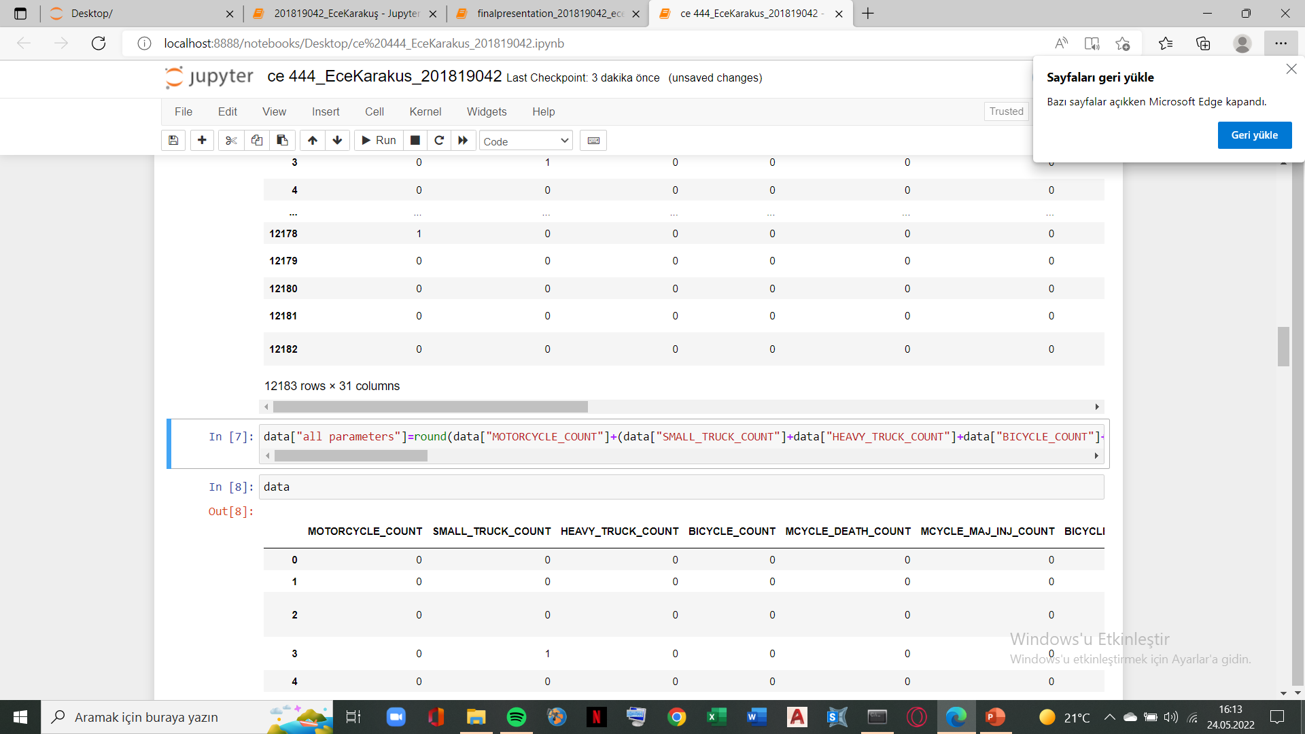
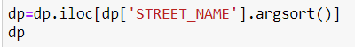
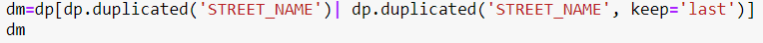
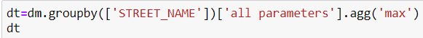
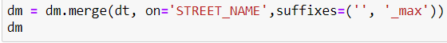
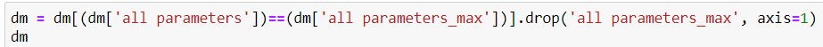
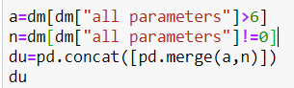
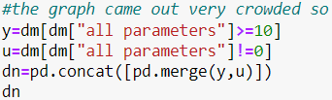
Process
Drop unrelated data
Create a column named ‘all parameters’ containing all parameters
Group by Street name and keep only one data for each street name
Mask the ‘all parameters’ column
First try: Second try:

Slide 5
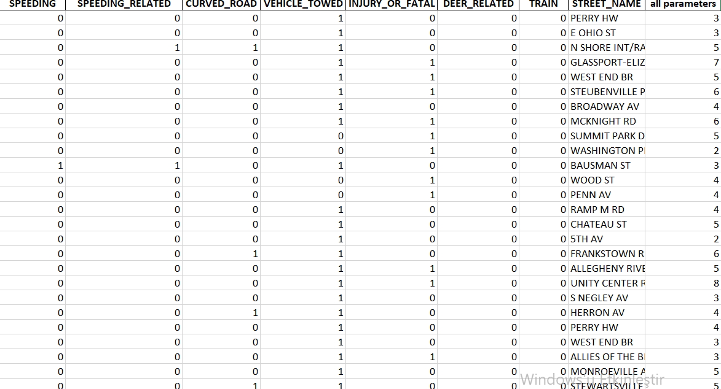
Graphs and Tables

Slide 6
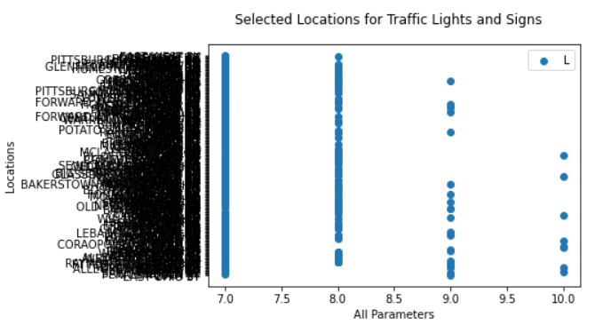
Graphs and Tables

Slide 7
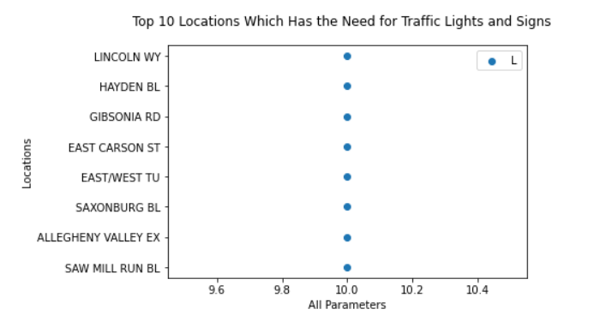
Conclusion

