Slide 1
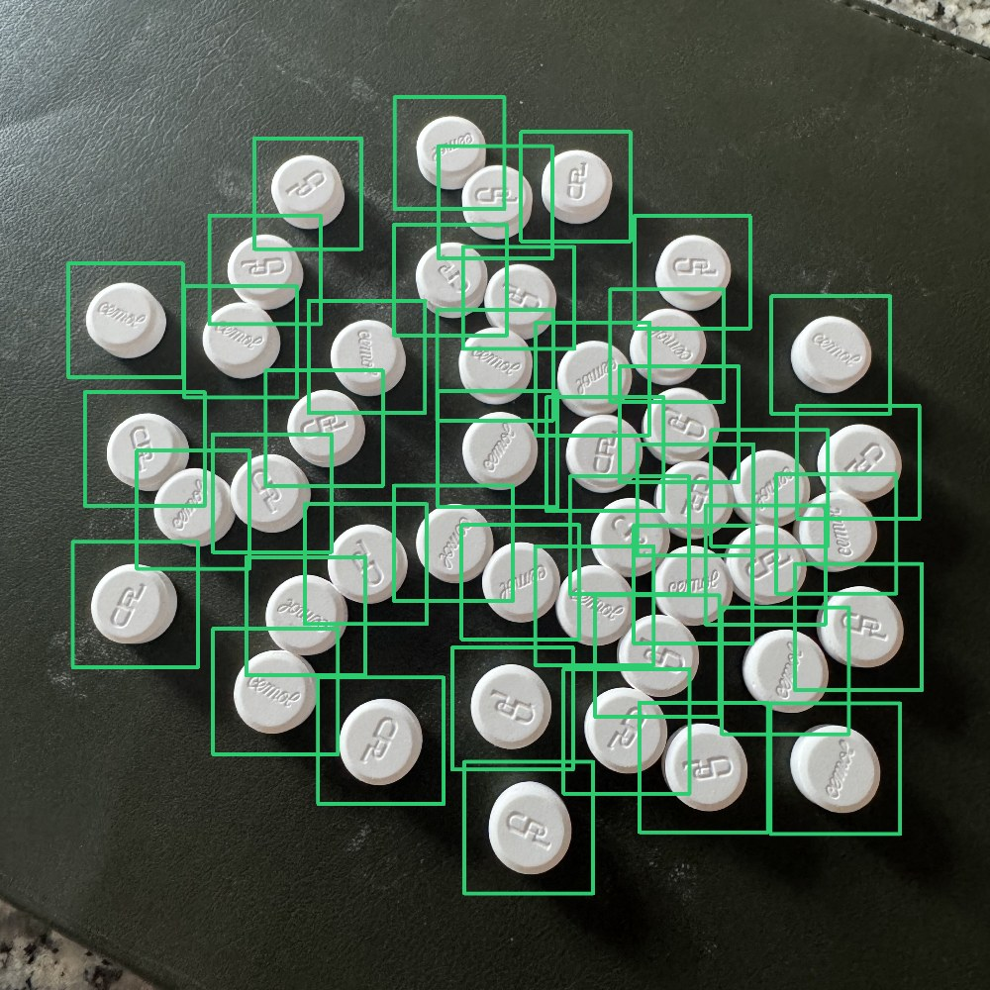
PillTally
Counting pills from one phone photo
Applied AI · computer vision · live demo
Peeranat Patarakittisopol
45 pills found · 45 on the tray
Notes:
Hi, I'm Peeranat. My project is PillTally: you spread pills on a tray, take one photo with a phone, and it gives the count with a box around every pill, so the pharmacist can check the result at a glance. The photo on the right is one of my own test photos: 45 pills, and the model found all 45. I'll show you the problem briefly, then the live demo, then how the data, model and evaluation work underneath.

Slide 2
The next 11 minutes
A short setup, the live demo, then what is under the hood
1
2
3
4
5
6
Problem
Live demo
Data
Model
Evaluation
Limits
Why counting is hard
Phone photo in, count out
Public + own photos, labels
Counter + form classifier, how they learn
Baselines, shortcuts, mixed tray
What works, what doesn't yet
1 min
3 min
1 min
3 min
2.5 min
1 min
Notes:
Here is the plan. About a minute on the problem, then the live demo early so you can try it yourself. After that I'll go under the hood: the data, the model and how I trained it, how I evaluated it against five baselines, and finally what works and what doesn't yet. Please interrupt any time to try your own photo.

Slide 3




Counting by hand is slow and risky
Pharmacies count 30, 60 or 90 tablets per prescription, five at a time, on a tray
Why it isn't trivial
A wrong count means
Pills touch
the patient gets too few pills, or
the pharmacy loses stock
and the pharmacist spends time on a repetitive task instead of checking prescriptions
Edges blend, so two pills look like one blob
Pills are identical
Small, round, all the same: no unique features
Background and light
Speckled counters, shadows, glare
Alternative today: a dedicated counting machine, which is expensive and takes counter space
Phones and distance
Different cameras, angles, pill sizes in pixels
Notes:
In a pharmacy, staff count 30, 60 or 90 tablets for long-term prescriptions, sliding them five at a time on a tray. It's slow and a miscount either shortchanges the patient or loses stock. The alternative is a counting machine, which is expensive. Counting ten separated pills is easy for any method. It gets hard when pills touch, when they're identical, when the background is busy like a granite counter, and when photos come from different phones and distances. Those four conditions are what my evaluation focuses on.

Slide 4
50× faster per pill than hand counting
Same piles timed by hand (five at a time) and with PillTally: the app counted all three exactly
0.46 → 0.009 s
per pill: hand vs PillTally, all 160 pills
48.8 s → 0.6 s
one pile of 100 pills
3 / 3
piles counted exactly by the app: 10, 50, 100
PillTally time = processing after the photo is taken; taking the photo adds a few seconds.
Notes:
So does it actually save time? I timed the same piles both ways. By hand, counting five at a time like a pharmacy, 10 pills took 3.6 seconds, 50 took 22 and 100 took 49. Per pill that's 0.46 seconds, and it gets slower as the pile grows, because you have to keep track. PillTally's processing took 0.4 to 0.6 seconds per photo, almost the same for 10 or 100 pills: 9 milliseconds per pill, about 50 times faster. And it counted all three piles exactly.
To be fair: the PillTally time is processing after the photo; picking up the phone and taking the photo adds a few seconds. Even with 10 seconds added, 100 pills take about a fifth of the hand time, which beats my proposal's target of 50 percent less time. These are single timings on my own piles, so a pilot should measure it properly.

Slide 5
A fraction of a counting machine's cost
Pharmacy counting machines vs phones the staff already carry, plus a small server
Counting machines (list prices, about)
PillTally
$7,500+
$4,700+
$0 extra hardware
GSE Eyecon (camera)
Kirby Lester KL1
self-hosted: staff phones + a PC the pharmacy already has
$2,499
฿49k–126k
≈ $15 / month
RxCount Rx-4
counters sold in Thailand
cloud: small server in AWS Thailand, 8 h a day, 26 days
Machines are certified products with support and need no network. PillTally is an assistant, not a certified device, and its speed on a small cloud server is not measured yet.
Notes:
The alternative to hand counting today is a counting machine. List prices: a camera-based GSE Eyecon from about 7,500 dollars, a Kirby Lester KL1 from about 4,700, a budget RxCount Rx-4 at 2,499, and counters sold in Thailand from 49,000 to 126,000 baht, though those are mostly bottling counters for factories. That's per counter, and it takes counter space.
PillTally runs on the phones the staff already carry. The model server can run on a PC the pharmacy already has, so no extra hardware, or on a small cloud server: about 7 cents an hour in AWS's Thailand region, roughly 15 dollars a month for opening hours. One server serves every counter.
To be fair to the machines: they're certified, supported and don't need a network. PillTally is an assistant the pharmacist checks, not a certified device, and I haven't measured its speed on a small cloud CPU yet.
Sources: rxcount.com/2019/03/12/how-much-do-pill-counters-cost (Eyecon, KL1, Rx-4; 2019 prices); ebay.com/p/25044062330 (KL1 Plus); dotmed.com (used Eyecon 9400); panyachemipan.com (DXS-2A 125,900 baht; SPN400 49,000 baht); compute.doit.com (AWS c7g.large, ap-southeast-7 Thailand, $0.0708 per hour on demand).

Slide 6




The count is the number of boxes
Object detection counts; a second model checks each pill's form; the pharmacist sees everything
Photo
Counter
Form check
Pharmacist checks
One type of pill, one layer, on a tray or table
YOLO11s draws a box on every pill: count = boxes
A classifier labels each pill: tablet, caplet or mini
Orange = unsure box, red = not the expected form
Why detection, not "predict a number"?
A regression or density model outputs only a number. Boxes let the pharmacist verify every pill and spot a miss, which matters for trust and safety. The tool assists the check; it never replaces it.
Notes:
I framed counting as object detection: the model draws a box around each pill, and the count is simply the number of boxes. I could have used a regression or density-map model that outputs only a number, but then the pharmacist can't see what was counted. With boxes, every pill is visible and the uncertain ones are flagged in orange, so the pharmacist always confirms. Then a second, small model looks at each pill on its own and says its form: tablet, caplet or mini tablet. If the pharmacist picks the expected form, any pill that doesn't match gets a red box. That safety point was in my proposal: the tool assists the check, it doesn't replace it.

Slide 7


Live demo
Phone browser → Next.js page → Python model server, all on one Mac
Phone browser
Next.js page :3000
FastAPI :8000
Takes the photo, sends it at full resolution, draws the boxes
Serves the page, forwards /api/count to Python
Counter: thai_mix_s1024
Forms: pill_type.pt
Old way: classical.py
Things to try
Mix tablets + caplets
Pick a pill form
Pills touching
Close up vs far
Type a hand count
Notes:
Now the demo. [Open http://<Mac IP>:3000 on the phone.] The page runs in the phone's browser. When I take a photo, the browser sends it at full resolution to Next.js, which forwards it to a FastAPI server running the two models: the counter and the form classifier, which needs the detail. [Take a photo.] The same photo is counted by two methods at once. The AI tab: green boxes are confident, orange ones are worth a second look. The Old way tab is a classical image-processing method with no machine learning, which I'll explain in the evaluation. If I type the hand count, each tab shows how far off it is. [Pick a pill form, e.g. caplet, then add one tablet: it gets a red box.] [Invite the reviewer to try: a mixed tray, touching pills, distance.] The server takes about half a second; the rest is upload time. Every photo is also saved locally, so failures can become training data.

Slide 8
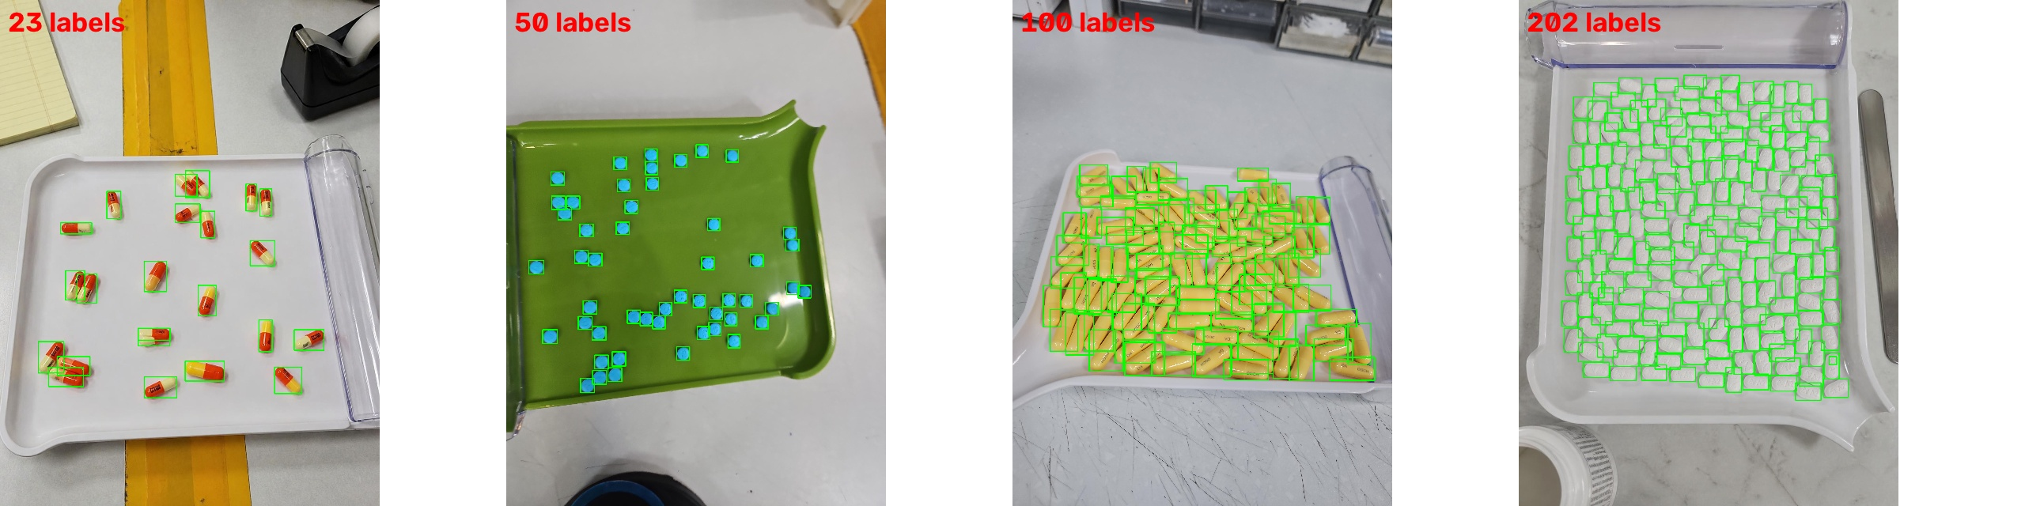
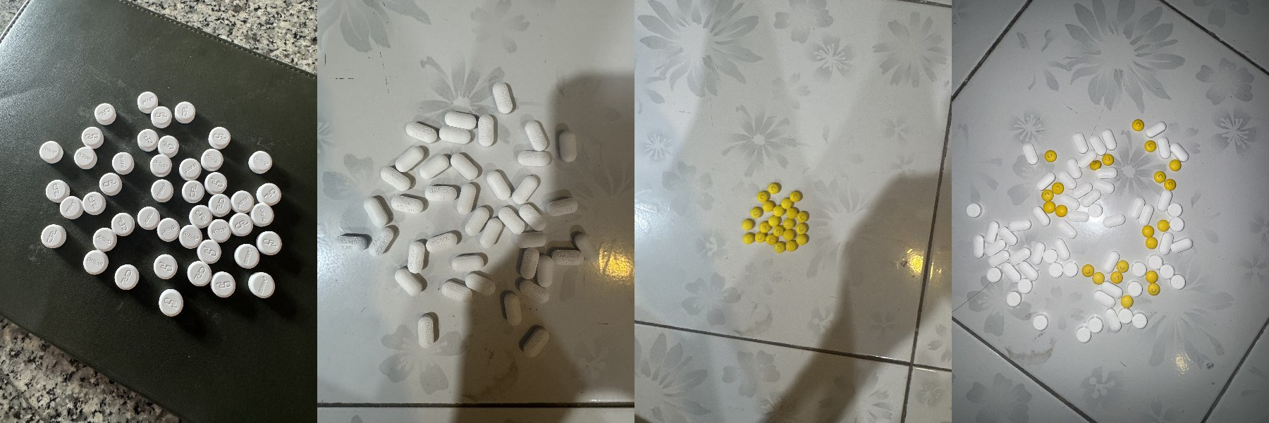
Two data sources
A public dataset teaches "what a pill is"; my own photos teach my pills, surfaces and phone
Public
Pill Counting v4 (Roboflow, CC BY 4.0)
Own
My photos, hand-counted
1,236 photos, 71,269 labeled pills
Pharmacy counting trays, median 50, up to 202 pills per photo
+ Pill-Counter v2: 1,255 photos of 110 other drugs, added so the counter generalizes
256 photos in 26 hand-counted sessions
Tablet 80, caplet 36, mini 43, crowded mixed 97
+ mixed tray s20 (82 pills), testing only
Notes:
I used public data and my own photos. First, Pill Counting v4 from Roboflow Universe: 1,236 photos of pharmacy counting trays with 71 thousand labeled pills. Later I added a second public set, Pill-Counter v2: 1,255 photos of 110 different drugs, because a counter trained only on my three medicines counted other medicines badly. Second, my own photos: 22 single-form sessions plus 4 crowded mixed trays of 90 to 97 pills, 256 photos, every pile counted by hand, plus one mixed tray, s20, used only for testing.

Slide 9
Labels checked, split by session
Every photo's box count equals its hand count, and no pile appears in two splits
15,636
pills labeled, one class: "pill"
Split by session: no same-session leakage
Train
15 sessions · 151 photos
68 / 80
new photos already exact from pre-labeling
all 3 forms + 3 crowded mixed trays
Val
5 sessions · 60 photos
each form + 1 crowded tray: tunes, picks models
−6
false boxes found by checks, removed
Test
6 sessions · 45 photos
blue tablets, brown cloth (unseen) + each form
276 = 276
photos whose box count = hand count
Mixed
1 tray · 20 photos
82 mixed pills, floor tile: evaluation only
Notes:
Labeling 1,880 pills by hand would be slow, so I pre-labeled: the v4 model suggested 1,937 boxes, and I corrected them in Roboflow. (Roboflow is a web platform for computer-vision datasets: I used its annotation editor to fix boxes and its export to get YOLO-format labels. I did not train on Roboflow; training ran in Colab and on my Mac.) After my corrections 47 of 50 photos matched the hand count. A script then flagged unusually small boxes; I looked at each one and removed 4 boxes sitting on granite specks. Final result: every one of the 50 photos has exactly as many boxes as its hand count. For the later caplet, mini-tablet and floor-tile tablet sessions, the current model pre-labeled them and was already exact on 68 of 80 photos; after corrections all 159 photos match their hand counts. The four crowded mixed trays were recounted by hand and checked the same way: with the mixed tray s20, all 276 labeled photos match. For the split, the important thing is leakage: each pile was photographed 5 times, so if photos of the same pile were in train and test, the test would be too easy. So I split by session: 15 piles for training, including three crowded mixed trays, 5 for validation, including one crowded tray, 6 for test, and the same split for both models. Two test piles are blue tablets on brown cloth in warm light, a condition never seen in training. The mixed tray is only for evaluation.

Slide 10
Transfer learning in two steps
Course rule of thumb: less data → freeze more. Start frozen, then full fine-tuning at a low learning rate
L3
yolo11s.pt
L4
v4_pill_model.pt
L5
thai_mix_s1024
Pretrained on COCO (everyday objects). Knows edges and shapes, not pills.
Fine-tuned on Pill Counting v4. Colab T4, 60 epochs, 1024 px.
Fine-tuned on my 151 photos (×6) + 110-drug public photos. A100.
1024 px input
Freeze, then unfreeze
Pills are small objects in a 12 MP photo
Stage 1 frozen backbone, lr 0.005 (like feature extraction); stage 2 full fine-tuning, lr 0.001, early stopping
Rotation 180° + flips
max_det = 500
Pills look the same at any angle
The default 300 would cap the count on big piles
Notes:
The counter is YOLO11s, trained with supervised transfer learning in steps. I start from yolo11s.pt, pretrained on COCO: Level 3. Then I fine-tune on the public v4 pill dataset: Level 4, a general pill model. Then Level 5, the app's counter: fine-tuned on my own photos together with public photos of 110 other drugs. My photos are repeated six times so they're about a third of every epoch, and the public ones keep it general. Key choices: 1024-pixel input because pills are small; freeze the backbone first, then unfreeze at a low learning rate; rotation and flips; max_det 500 so big piles aren't capped.

Slide 11
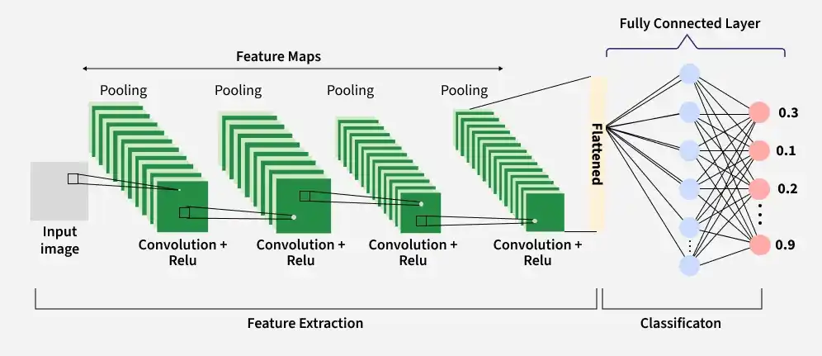
What is a CNN?
A convolutional neural network: a neural network built for images, using small learned filters
1
Slide a filter
Multiply 9 weights with a 3×3 patch, add up, slide on: high where the pattern is
2
Stack layers
Edges → shapes → objects. Each layer sees a wider area (receptive field)
3
Shrink as you go
Stride 2 or max pooling halves the map, keeping the strongest signals
Why not a normal (fully connected) network?
4
Learn the filters
A 224×224 color image is 150,528 inputs: one dense layer of 1,000 neurons needs 150 M weights. A filter reuses the same 9 weights everywhere.
Backpropagation adjusts every weight to reduce the loss. Nobody writes them by hand
Notes:
Before going into my model, what is a CNN? To a computer, an image is just a grid of numbers. A normal fully connected network would connect every pixel to every neuron: for a 224 by 224 color image that's 150 thousand inputs, so one layer of 1,000 neurons already needs 150 million weights. That's too much memory and it overfits. A CNN fixes this with small filters, for example 3 by 3, so only 9 weights, that slide across the image and are reused everywhere.
READING THE PICTURE, left to right: Input image: the pixels. Convolution + ReLU: many filters slide over the image; each produces a feature map that is high where its pattern appears, and ReLU keeps only the positive responses. Pooling: shrinks each feature map, keeping the strongest signal in each small region. Repeated several times: this is the feature extraction part. Early layers find edges, later layers combine them into shapes and then whole objects, and each layer sees a wider area of the image. Flatten + fully connected layer: in a classification CNN, the final features are flattened into one long list and a small fully connected layer turns them into class probabilities, like the 0.3, 0.1, 0.2, 0.9 on the right.
THE 4 STEPS on the right: 1 slide a filter (multiply and add, move one step). 2 stack layers (edges, then shapes, then objects). 3 shrink as you go (stride 2 or max pooling). 4 learn the filters (backpropagation sets the weights, nobody writes them by hand).
SAY THIS: this picture is a classification CNN, it outputs one label for the whole image. YOLO uses the same feature extraction part, but it does not flatten. It keeps the spatial grid and predicts a box and a score at every grid cell. That's what I show in Inside YOLO11s.
IF ASKED "Your picture has a fully connected layer, but you said CNNs avoid them?": The fully connected layer is only at the very end, on a small set of features, so it's cheap. The expensive part, connecting every pixel, is what the convolutions replace. And YOLO has no fully connected layer at all.
Next, I'll show what these filters actually learned inside my own model.

Slide 12
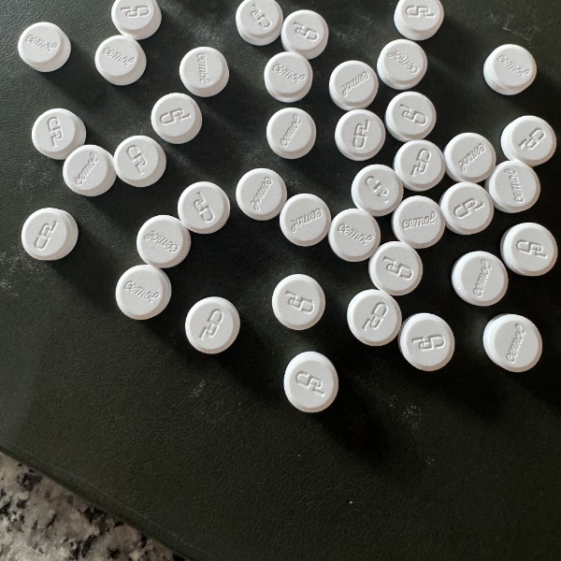
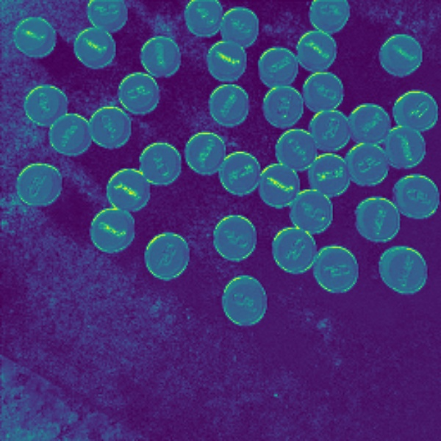
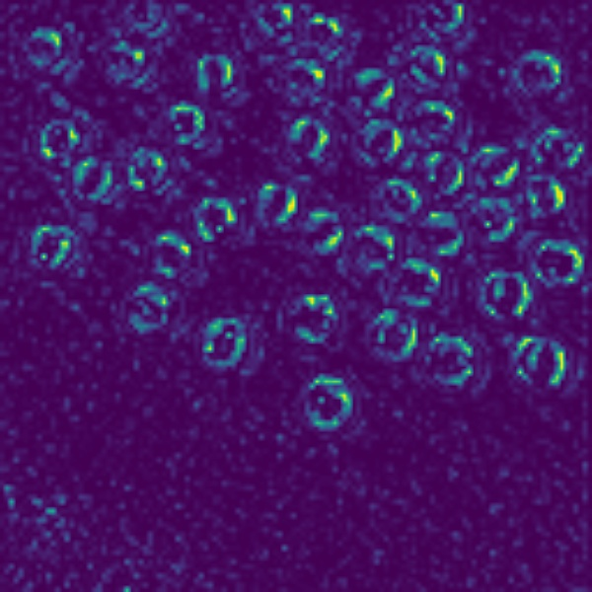
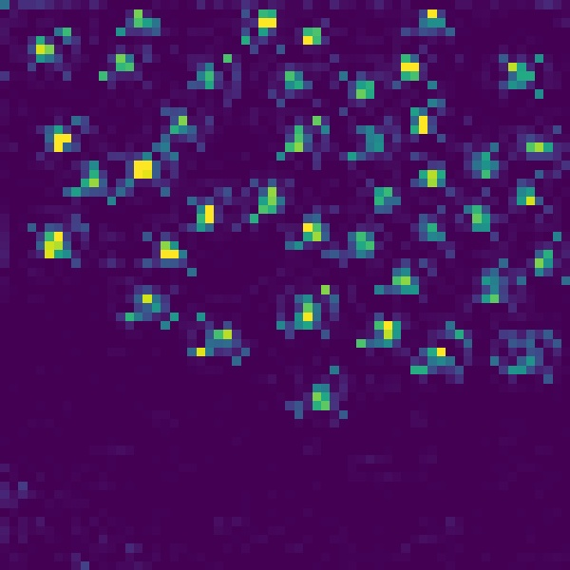
YOLO11 is a CNN
Inside my trained model: real feature maps from thai.pt on one of my photos
Input photo
Layer 1 · 256×256
Layer 4 · 128×128
Layer 6 · 64×64
1024 × 1024 pixels
brightness, stamp texture
curved pill outlines
one spot per pill
Edges to objects
Weight sharing
Learned, not written
Early layers react to texture, later ones to outlines, then whole pills
Same filter everywhere: 9.5 M weights vs 3.1 B for one dense layer
Backpropagation learned these filters; Level 2's rules were hand-written
Notes:
YOLO11 is exactly this kind of network, so here is what its filters learned. These are real feature maps from my trained model on one of my photos. Layer 1, still at 256 by 256, reacts to simple things: the pills' brightness and the stamp texture. By layer 4, at 128 by 128, a channel responds to curved pill outlines. By layer 6, at 64 by 64, a channel gives one spot per pill: the network has learned the concept 'pill here'. This is the edges-to-objects idea from the previous slide, inside my own model. Weight sharing is why the whole of YOLO11s has 9.5 million weights, while one fully connected layer of 1,000 neurons on a 1024 by 1024 color image would need 3.1 billion. And the contrast with my Level 2 baseline: there I wrote the rule 'bright and round is a pill' by hand, and it broke on shadows and granite. Here, backpropagation learned the filters from labeled examples. How I chose these channels: each layer has 64 to 256 channels; for each I picked the one that best matches a target, edges, pill discs or pill centres. So they're real channels, chosen to illustrate.

Slide 13
Inside YOLO11
One pass of a CNN: extract features, mix scales, predict a box and score at every grid cell
Input
Backbone
Neck
Head
Output
1024 × 1024
RGB photo
(letterboxed)
5 stride-2 convs
C3k2 residual blocks
SPPF max pooling
C2PSA attention
FPN top-down +
PAN bottom-up:
mixes fine detail
with context
Anchor-free,
3 scales:
P3 128×128 (8 px)
P4 64×64 · P5 32×32
21,504 boxes
+ pill scores
→ conf + NMS
→ count
Why 1024 px matters here
What freeze=10 froze
My pills are ~54 px wide at 1024 input, about 7 cells of the finest (stride-8) grid. At the default 640 they'd be 34 px, about 4 cells, and touching pills blur together.
Layers 0–9: the backbone up to SPPF (general shape features). Attention, neck and head still trained on my photos, then everything was unfrozen.
Notes:
Here's what happens inside YOLO11 in one forward pass. The s and m sizes have exactly these layers; m is just wider and deeper. The photo is resized to 1024 by 1024. The backbone is a convolutional network: five convolutions with stride 2 shrink the image by 32 while building richer features; C3k2 blocks are its main feature extractors, C3k2 blocks use residual connections, the ResNet idea from class. SPPF is repeated 5 by 5 max pooling, which captures context at several sizes, and C2PSA adds a small attention block. The neck is a feature pyramid: it combines the fine, high-resolution features with the coarse, context-rich ones, top-down and bottom-up. The head is anchor-free and predicts at three scales. The finest grid is 128 by 128 with 8-pixel cells, which is the one that matters for small pills. Every cell predicts a box and a pill score: that's 21,504 candidates, which the confidence threshold and NMS reduce to the final boxes. This is why I use 1024 input: my pills are about 54 pixels wide, roughly 7 cells on the finest grid. At the default 640 they'd only cover 4 cells. And when I froze 10 layers during fine-tuning, that's layers 0 to 9, the backbone up to SPPF.

Slide 14
How YOLO11 learns
Supervised: compare predicted boxes with my labeled boxes, and adjust weights to reduce the loss
1 Match predictions to labeled pills
3 Update and repeat
Task-Aligned Assigner: for each labeled pill, the 10 grid cells with the best mix of class score and box overlap become its "positives". Everything else learns "no pill here".
v4 step: AdamW 0.002 (auto); my photos: SGD, momentum 0.937
lr 0.005 frozen stage, 0.001 unfrozen; decays over epochs
Augmentation each batch: mosaic (4 photos tiled), rotation ±180°, flips, scale ±30%, brightness/saturation
Keep the epoch with the best validation fitness; stop early after 25 epochs without improvement
2 Score the mistakes (loss)
7.5 ×
CIoU
box overlap, centre distance and shape vs the label
1.5 ×
DFL
each box side predicted as a 16-bin distribution, sharpens edges
0.5 ×
BCE
is there a pill in this cell? (one class)
Notes:
Training is supervised. First, the model has to decide which of its 21 thousand predictions should be responsible for each labeled pill. YOLO11 uses the Task-Aligned Assigner: for each labeled pill it picks the 10 cells whose predictions have the best combination of class score and overlap with the label. Those are trained to predict that pill; all other cells are trained to say 'no pill'. Second, the loss has three parts. CIoU loss, weighted 7.5, scores how well the predicted box overlaps the label, including centre distance and shape. Distribution Focal Loss, weighted 1.5: each side of the box is predicted as a 16-bin distribution rather than one number, which gives sharper edges. And binary cross-entropy, weighted 0.5, for the pill-or-not score, since I have one class. Third, SGD updates the weights; my learning rates were 0.005 while frozen and 0.001 unfrozen. Augmentation creates variety each batch: mosaic tiles four photos, plus rotation, flips, scale and brightness. The best epoch on validation is kept, and training stops after 25 epochs without improvement.

Slide 15
Why a YOLO-style detector
Alternatives I considered, and why they fit this problem less well
Approach
Strength
Why not here
Classical rules (L2)
No training, fast
Breaks on shadows and touching pills (MAE 16.4)
Density-map regression
Good for huge crowds
Gives a number, not boxes: pharmacist can't verify
Two-stage (Faster R-CNN)
Strong accuracy
Slower and heavier; harder to serve on a laptop
Transformer (RT-DETR)
No NMS needed
Fixed 300 queries caps the count; needs more data
Segmentation (YOLO-seg)
Pill outlines
Needs polygon labels: much slower labeling
YOLO11 detection ✓
Fast, boxes, small data OK
Needs NMS tuning for touching pills
Notes:
Why this kind of model? I compared it with the alternatives. Classical rules need no training, but my Level 2 results show they break. Density-map regression is good for counting huge crowds, but it only gives a number, so the pharmacist can't check it. Two-stage detectors like Faster R-CNN are accurate but slower and heavier to serve. Transformer detectors like RT-DETR remove NMS, but they use a fixed set of about 300 queries, which caps the count right where my target piles are, and they need more data. Segmentation would give pill outlines but needs polygon labels, which is far slower to label. A one-stage YOLO detector is fast, gives boxes, and fine-tunes well from little data. Its weakness is NMS with touching objects, which is exactly why I tune the IoU threshold.

Slide 16
Why the small (s) size, after trying m
The YOLO11 family scales width and depth; with the right data, s beat every m
Data size
m on my photos only: good on my trays, bad on other medicines (17% exact)
Speed
s: 0.2 s per photo vs 0.4 s for m (21.7 vs 68.5 GFLOPs)
Accuracy
mixed-data s: 93% val vs 87% for m; crowded tray 93% vs 87%
Next
a mixed-data m is the next experiment
Notes:
YOLO11 comes in five sizes. I tried both small and medium. The medium model trained on my photos only looked best on my own crowded trays, but it counted other people's medicines exactly on only 17 percent of photos. The small model trained on my photos plus public photos of 110 drugs beat every medium model: 93 percent on validation, 93 on the crowded tray, and it's twice as fast, 0.2 seconds per photo. So data mattered more than model size here. A medium model on the same mixed data is the obvious next experiment.

Slide 17
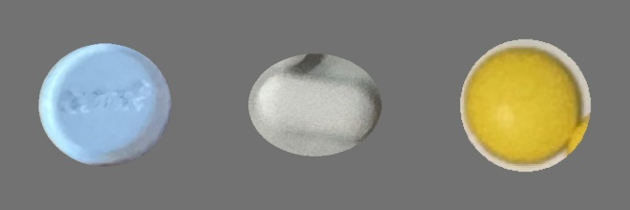
Two models: count, then classify
The counter finds every pill; a small classifier then names each pill's form
1
Counter
thai_mix_s1024 · YOLO11s detector
1 class "pill": a box on every pill
2
Crop + mask
full-resolution photo
each box cut out, everything but the pill gray
tablet
caplet
mini tablet
3
Classifier
pill_type.pt · YOLO11n-cls
Why not one 3-class detector?
ImageNet base → tablet / caplet / mini tablet
Counting learns from every pill as one class
The classifier sees each pill at full resolution
Forms come from session names: no extra labels
Notes:
To check pill forms I added a second model instead of giving the detector three classes. Step one, the counter draws a box on every pill, with one class, pill, so it learns from every pill I have. Step two, each box is cut out of the full-resolution photo, and everything outside the pill is grayed out, so the classifier only sees the pill itself. These are real crops from my test set. Step three, a small classifier, YOLO11n-cls pretrained on ImageNet, says tablet, caplet or mini tablet. This needs no extra labels: each session holds one form, so every crop gets its form from the session name. And adding a new form only means retraining the small classifier.

Slide 18
Two thresholds decide the count
The detector proposes many boxes; these two settings decide which ones count
Tuning alone, v4 model on v4 validation
Confidence cut-off (conf)
34.6%
76.4%
Keep boxes scoring above it. Too low: shadows and specks count. Too high: real but unclear pills are dropped.
exact count rate, no retraining (MAE 1.90 → 0.38)
Overlap limit (NMS IoU)
Tuned on validation, never on test
If two boxes overlap more than this, keep only the stronger one. Too low: touching pills merge. Too high: one pill gets two boxes.
v4 model: conf 0.50, IoU 0.40
thai_mix_s1024: conf 0.55, IoU 0.60
Lowest MAE on 5 val sessions, one photo at a time
Notes:
A detector outputs many candidate boxes, each with a confidence score. Two settings decide which boxes become the count. The confidence cut-off: too low and shadows count, too high and real pills are dropped. The NMS overlap limit: when two boxes overlap more than this, only the stronger one is kept. Too low and touching pills merge; too high and one pill gets two boxes. This matters a lot for crowded scenes: on the v4 validation set, just tuning these two numbers took exact counts from 34.6% to 76.4% without retraining. I tune them on validation only, never on test. I choose by lowest average error, which is steadier than the exact rate on a few photos.

Slide 19
Five levels, five questions
Each level adds one thing, so the gaps show what each part is worth
Guess the average train count
Is there anything to learn at all?
L1
Classical image processing, no ML
Could simple, cheap rules already do it?
L2
Pretrained YOLO, no pill training
Can we just download a model?
L3
Trained on public pill data (v4)
Is public data enough for my conditions?
L4
v4 + fine-tuned on my photos
Does a little local data make it work?
L5
Lecture 5 baseline types: predict the mean (L1), simple heuristic (L2), previous versions (L3, L4)
Notes:
I evaluate five levels, each adding one ingredient. Level 1 guesses the average count: the floor. Level 2 is classical image processing with no machine learning: threshold the colors, split touching pills with the watershed method, count regions. I tuned its settings on the training photos only, same rule as the model. Level 3 is the pretrained YOLO with no pill training. Level 4 is the public-data pill model. Level 5 is my fine-tuned model. The main metric is exact count rate, because a pharmacy needs the exact number; I also report average error in pills. Confidence intervals resample whole sessions, not single photos, because five photos of the same pile aren't independent.

Slide 20
First comparison: one granite pile
Session s06, 39 tablets, 5 photos: only the fine-tuned model was exact
5 / 5
exact, all 39
L5
1 / 5
38, 39, 41, 40, 38
L4
0 / 5
40, 23, 21, 12, 19
L2
Optimistic: one pile, and thresholds were tuned on it. The test set is held out and run once.
Notes:
These are the validation results, on one pile of 39 pills on granite, the hardest surface. The fine-tuned model counted all five photos exactly. The public-data model got one of five, off by one or two pills. The classical method got none and missed 16 pills per photo on average. The pretrained model with no pill training missed almost 3. Notice Level 1, guessing the average, misses only 1 pill: that's because all my piles are 25 to 50 pills, so the average is close by luck. With piles of 10 to 300 that would fail badly. I want to be clear that this is optimistic: it's one pile and the thresholds were tuned on it. The test set, three held-out piles, is the real number.

Slide 21
Mixed-data counter: 77% → 93% exact
Validation, 5 held-out sessions, each photo scored one at a time as in the app
0.30 → 0.10
average miss per photo (pills)
+ 1,900
public photos of 110 drugs, mixed into training
63% → 93%
on the crowded tray s26 (90 pills)
Notes:
This is the validation comparison, with every photo scored one at a time, exactly as the app runs. thai_v2 was trained on my photos; the new counter, thai_mix_s1024, also learned from public photos of 110 other drugs. It counts 93 percent of validation photos exactly against 77, and the crowded 90-pill tray goes from 63 to 93 percent. An honest note: for a while my tuning script scored photos differently from the app, because mixed photo sizes made the library pad every photo to a square. Fixing that changed the best overlap setting from 0.4 to 0.6, and that's one reason the crowded caplets are now counted. I come back to that on the lessons slide.

Slide 22
Other medicines: 23% → 58% exact
187 held-out photos of drugs I never photographed, counted with each model's app settings
0.7 vs 1.9
average miss: app counter vs thai_v2
IoU 0.4 → 0.6
scoring photos like the app fixed heaped caplets
Lesson
evaluate the way you deploy
Unseen photos, but from the same public source as part of the app counter's training data.
Notes:
Would it work on someone else's medicines? I counted 187 public photos of drugs I never photographed, which no model trained on. The medium model trained only on my three medicines got 17 percent exact, thai_v2 23. Adding public pill data helps: the medium model through the v4 trays gets 37, and the app's counter, trained with public photos of 110 drugs, gets 58 percent, with an average miss of 0.7 pills. Caveat: these photos are unseen, but come from the same public source as part of its training data.
Two lessons. First, data variety mattered more than model size. Second, evaluate the way you deploy: my tuning script fed validation photos as one batch, and because some photos had a different size, the library padded all of them to a square, unlike the app. That picked an overlap setting of 0.4, which merged heaped caplets. Scoring photos one at a time, like the app, picked 0.6 and fixed it.

Slide 23


Minimum viable evaluation
The Lecture 5 checklist, applied to PillTally
A clearly justified metric
Exact count rate: a pharmacy needs the exact number ("the metric is a product decision"). MAE and relative error show how far off.
A baseline comparison
Predict the mean (L1), simple heuristic (L2), previous versions (L3, L4) vs my model (L5).
Proper evaluation, no leakage
Split by session; thresholds and models chosen on val only; test guarded in code, run once at the end.
Confidence in the results
Bootstrap CIs over whole sessions. With 5 val and 6 test sessions they're wide: more sessions or leave-one-session-out CV next.
Notes:
Lecture 5 ended with a minimum viable evaluation checklist, so here's where I stand on each point. Metric: exact count rate, because, as the lecture said, the metric is a product decision, and a pharmacy needs the exact number. MAE tells me how far off I am when I'm wrong. Baselines: I have the types from the lecture: predict the mean, a simple heuristic, and previous versions of my own model. Proper evaluation: split by session to avoid the same-session leakage pitfall, thresholds tuned only on validation, and the test set is guarded in code so it can only run once. Confidence: I compute bootstrap confidence intervals over whole sessions, but with one validation pile and three test piles they're wide. The lecture also says to be suspicious of perfect results: my 100% on validation is exactly that, which is why I treat the test set as the real number. The fix is more sessions, or leave-one-session-out cross-validation, which the lecture recommends for small datasets.

Slide 24
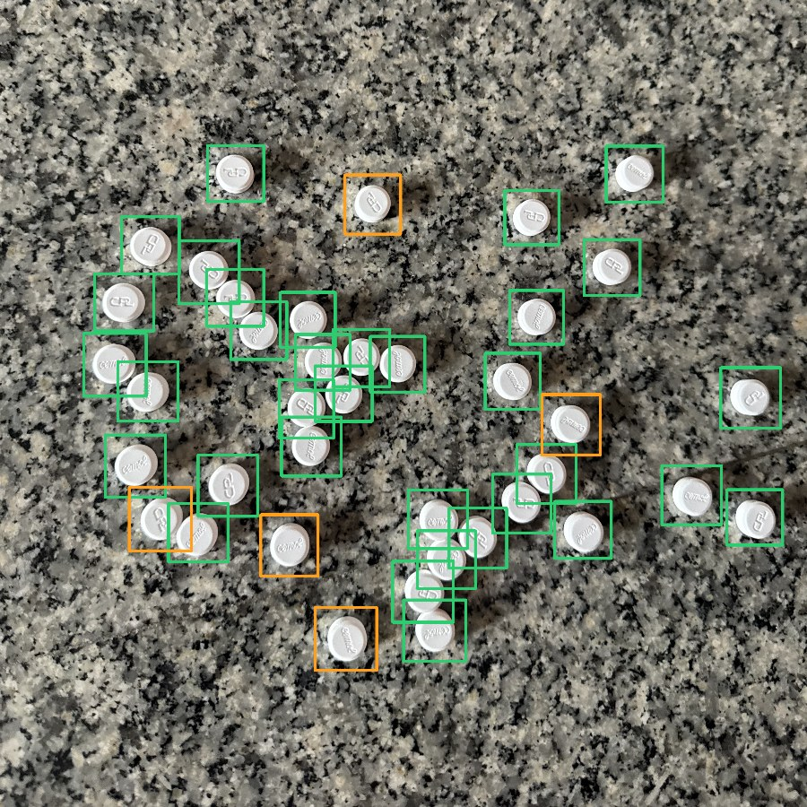
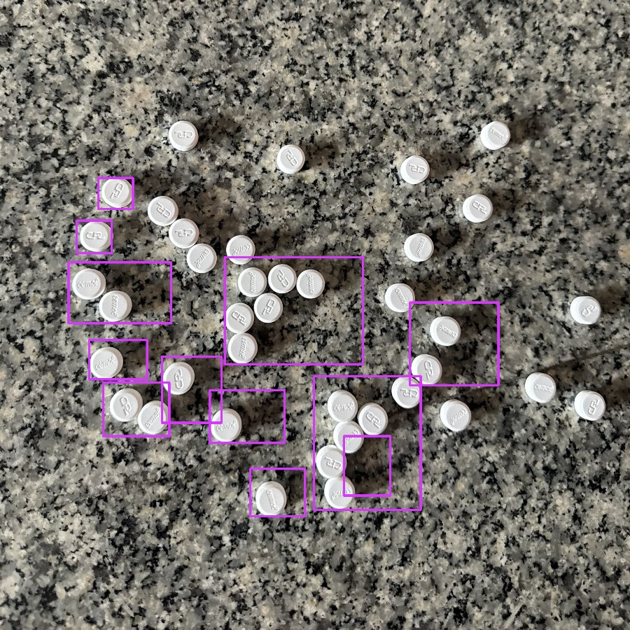
Rules break, a learned model adapts
Same photo, 39 pills: AI counts 39, the classical method counts 12
Why the rules fail
Shadows join each pill into one long blob
Touching pills merge into one region
Farther away, pills are smaller than the tuned size, so most are ignored
Orange boxes: the AI is unsure and asks the pharmacist to check those
AI (L5): 39 / 39
Classical (L2): 12 / 39
Notes:
Here's why the classical method fails, on the same validation photo. Left is my model: 39 out of 39, with a few orange boxes where it's less sure. Right is the classical method: 12. Its rules say a pill is a bright round region of a certain size. Shadows attach to pills and make long blobs, touching pills merge, and this photo was taken a bit farther away so the pills are smaller than the size it was tuned for, and most are ignored. The learned model handles all three because it learned what a pill looks like at any size. This is the core claim of my proposal: a learned detector beats classical image processing.

Slide 25
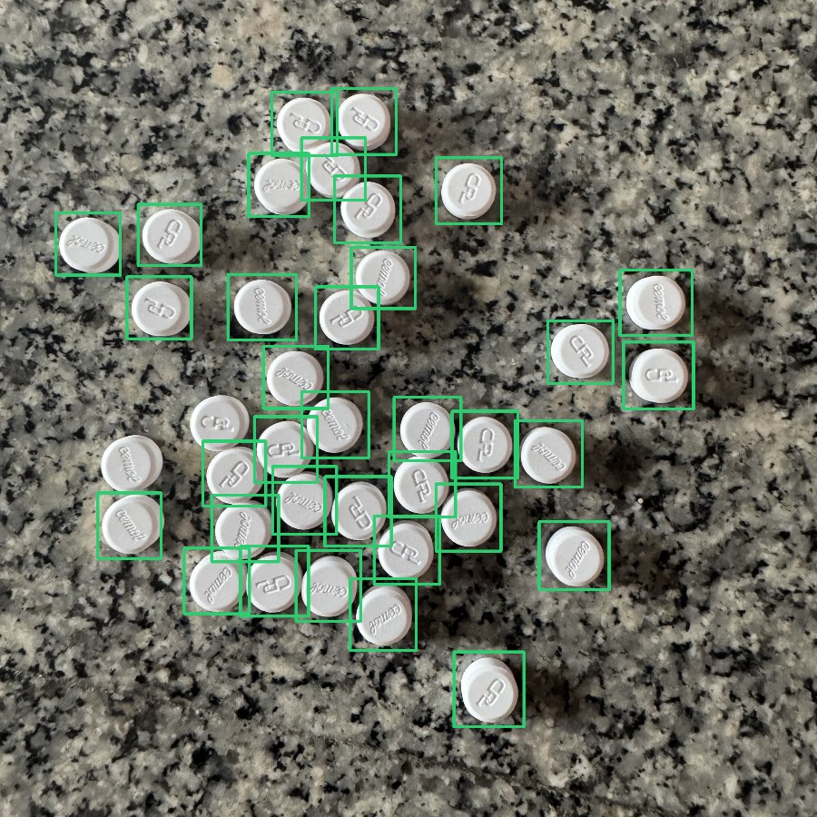
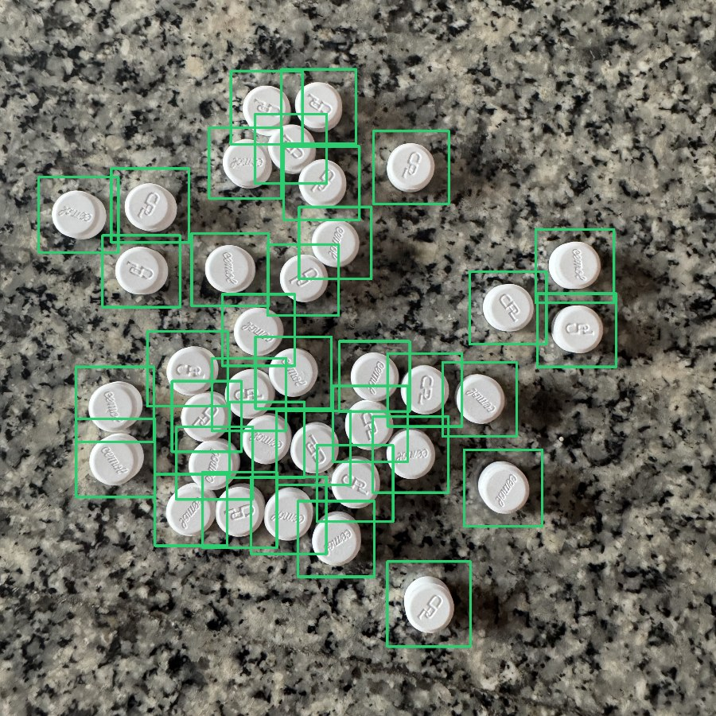
Local data fixed the granite problem
Session s05, 37 pills on granite: v4 alone counts 35, after fine-tuning 37
v4 on all 50 of my photos, no Thai training
68%
exact. Plain surfaces 24 / 25 exact; every error on granite: specks counted, real pills scored too low
s05 is a training session: shown to explain, not as a score
v4 only (L4): 35 / 37
Fine-tuned (L5): 37 / 37
Notes:
Why fine-tune at all, if v4 already knows pills? Before any training on my data, the v4 model got 68% exact on my 50 photos. On plain surfaces it was almost perfect, 24 of 25, but every error was on granite: it counted bright specks as pills and gave real pills low scores, in the same score range, so no single threshold could fix both. After fine-tuning on my photos, that problem disappears. To be honest about this slide: s05 is a training session, so I'm showing it to explain the mechanism, not as an evaluation score.

Slide 26


Three shortcuts, three fixes
Each time the form classifier scored near 100%, a harder test showed it was cheating
Background
Lighting
Box size
A blue pill among white ones was called white 89% of the time
All caplets were shot on one floor, no tablets were: tablets on it became "caplet"
Trained on hand-drawn boxes, confused by the counter's slightly different boxes
Found by: pasting a pill onto another background
Found by: the real mixed tray (pasted test missed it)
Found by: validation with the counter's own boxes
Fix: mask everything but the pill
Fix: photograph tablets on that floor
Fix: train on resized / shifted boxes
11% → 100%
0 → 18 of 20 photos
84% → 99.7% tablets
Notes:
The most important lesson of this project. Three times the form classifier looked perfect, and three times a harder test showed it was using a shortcut. First, background: with the whole crop visible, a blue pill surrounded by white pills was called white 89 percent of the time. I found it by pasting pills onto the other class's background, and fixed it by masking everything except the pill: 100 percent. Second, lighting: all my caplets and mini tablets were photographed on one floor tile, and no tablets were, so it learned that this floor's light means caplet. The pasted test missed it, because a pasted pill keeps its own lighting. Only the real mixed tray showed it: zero of 20 photos had the right tablet count. I photographed tablets on the same floor, and it went to 18 of 20. Third, box size: it was trained on my hand-checked boxes, and the new counter draws slightly different boxes, so tablets dropped to 84 percent. Training on randomly resized and shifted boxes fixed it: 99.7 percent. This is Lecture 5's warning in practice: be suspicious of near-perfect results.

Slide 27
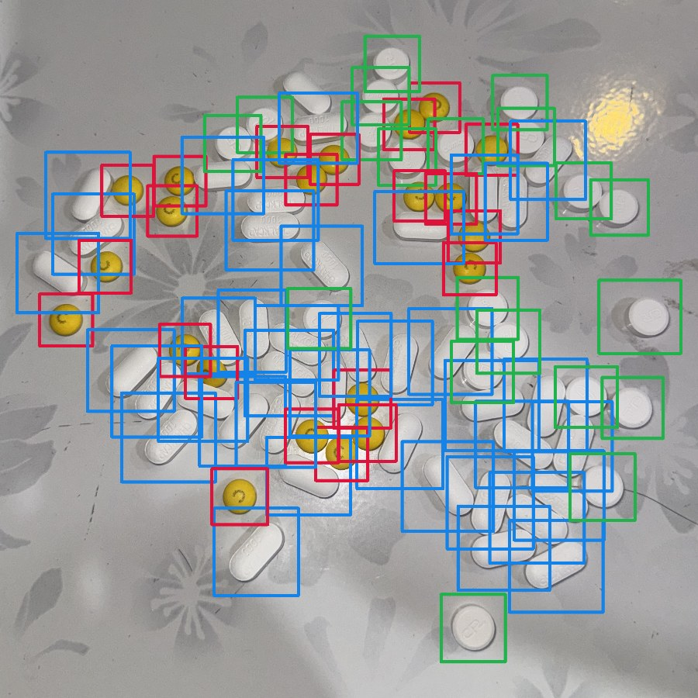
Real mixed tray: 0% → 90%
82 pills (20 tablets, 40 caplets, 22 minis), 20 photos: all three form counts exact
100%
95%
90%
95%
Minis exact
Tablets exact
Caplets exact
Total exact
81/82 · green tablet · blue caplet · red mini
Notes:
The honest end-to-end test is a real mixed tray: 20 tablets, 40 caplets and 22 mini tablets, photographed 20 times, never used for training or choosing. The bars show how often all three form counts were exactly right: zero with the first classifier, 55 percent with thai_v2, and 90 percent now. The total count is exact on 19 of 20 photos. The earlier misses were caplets in a heap: the model saw them, but the overlap filter removed them. With the overlap setting chosen correctly on validation, they're counted. Caveat: it's one tray, so 20 photos.

Slide 28
Test set (2 runs): learned counters win
45 held-out photos, 6 piles of 10–46 pills, incl. blue tablets on brown cloth never seen in training
89% vs 93%
app counter vs thai_v2: 5 vs 3 misses, all ±1–2
58% vs 23%
other medicines (187 unseen photos): app vs thai_v2
Run twice
run 1 on earlier models, run 2 on the final one
App counter chosen on validation and other medicines, not on this test; CIs of all L5 rows overlap.
Notes:
Everything was chosen on validation, then scored on the held-out test set: 45 photos of 6 piles, including blue tablets on brown cloth never seen in training. To be transparent: I used the test set twice. Run 1 scored my earlier models; after I added public multi-drug data and fixed how validation photos were scored, run 2 scored the final model. Both runs are logged and reported.
The baselines fail: guessing the average and the pretrained YOLO get nothing exact, the classical method 4 percent. The learned counters get 82 to 93 percent. The app's counter gets 89, slightly below thai_v2's 93; its 5 misses are 1 or 2 pills, and the confidence intervals overlap. I kept the app counter because it was chosen on validation, and because it counts other people's medicines far better: 58 against 23 percent exact on 187 photos no model trained on.

Slide 29

What works, what doesn't yet
Honest scope of the prototype
Works
Not yet
Counting: 93% val, 89% test exact
Forms: 99.9% per pill; mixed tray all 3 exact 90%
Phone in, count + forms out in about a second
Orange = unsure box, red = wrong form
Tested to 100 pills; 150–300 not yet
Other medicines: 58% exact so far
Few test sessions; test used twice
Crops lose real pill size; runs on a Mac
Notes:
What works: the counter is exact on 93 percent of validation photos and 89 percent of test photos, the mixed tray is fully right on 90 percent of photos, the form classifier is right on 99.9 percent of pills, and a photo goes in and the count comes out in about a second. What doesn't yet: I tested up to 100 pills; 150 to 300 is untested. On other people's medicines it's 58 percent exact: much better than before, not yet good enough. The test set has only 6 sessions, so confidence intervals are wide, and I used it twice, which I've disclosed. The classifier can't see real pill size, and the server runs on my Mac.

Slide 30
Next steps
From prototype to a pilot at one dispensing counter
1
More data
App photos and mistakes become training sessions; crowded trays on more surfaces
2
More medicines
Capsules, colored and scored tablets: only the small classifier retrains
3
Size + barcode
A reference card gives real pill size; scan the stock bottle for identical drugs
4
On the phone
Export to ONNX / Core ML so it runs offline, no server needed
5
Pharmacy pilot
One dispensing counter: time and miscounts vs today's hand count
Notes:
Next steps. First, more data: the app already saves every photo, so real mistakes become new labeled sessions, and the crowded trays need more surfaces, since they're all on one beige tray now. Second, more medicines: capsules, colored and scored tablets. Because counting and form are separate models, a new form only means retraining the small classifier. Third, the look-alike problem: a reference card in the photo gives real pill size, and for truly identical drugs the answer isn't vision, it's scanning the stock bottle's barcode. Fourth, export the model to run on the phone itself, offline. And finally a pilot at one dispensing counter, measuring time and miscounts against today's hand counting. Thank you. I'm happy to take questions or walk through any of the code.

Slide 31
Appendix: code map
Where each part of the pipeline lives, in the order data flows
notebooks/*_colab.ipynb
src/classical.py
v4 model, counters v2 + v3, form classifier
Level 2: LAB threshold → distances → watershed
src/prelabel.py · split.py
src/evaluate.py · eval_mixed.py
Pre-label with the counter; split by session
Thresholds, Levels 1–5; mixed-tray score
src/finetune.py
src/api.py
Counter: two-stage fine-tune, frozen → unfrozen
FastAPI: count + forms + classical; upload log
src/crops.py · train_classifier.py
web/app/page.tsx · dev.sh
Masked crops + box jitter; form classifier
Phone page; one-command start, auto-reload
Notes:
Backup slide for the technical Q&A: use it to jump to the right file when the reviewer asks how a part works.

Slide 32
Appendix: course concepts used
Where each Applied AI lecture shows up in PillTally
L2 Fundamentals
Loss functions, gradient descent (SGD), overfitting, early stopping, bias-variance (model size choice)
L3 Computer vision
CNNs: local connectivity, weight sharing, stride, max pooling (SPPF), residual blocks; object detection (YOLO family)
L3 Transfer learning
COCO → v4 → my photos (counter); ImageNet → crops (classifier); less data → freeze more
L3 Data
Augmentation; small data; same-session leakage; the lighting shortcut = distribution shift
L5 Evaluation
Product metric (exact count) + MAE; train/val/test (test runs logged, disclosed); baselines; ablations (planned); session bootstrap CIs
L5 Experiments
A/B pilot design for the next step; runs, thresholds and test runs logged in results/
Notes:
Backup slide: maps each lecture to where it appears in the project, to show the techniques come from the course. Lecture 4 (time series, recommender systems) doesn't apply to this project.

Slide 33
Appendix: likely questions
Short answers to have ready
Why YOLO11s, not a bigger model?
Why not a density/regression model?
The mixed-data s beat every m model on val, the mixed tray and other medicines, at half the time.
Boxes are verifiable by the pharmacist; a number alone is not.
How did you avoid leakage?
Can a 100% score be trusted?
Split by session; thresholds tuned on val only; test runs logged and both reported.
Three times it hid a shortcut (background, light, box size); real mixed trays caught them.
Why two models, not one?
How would it scale?
Counting learns from every pill; forms get full-resolution crops; a new form only retrains the classifier.
Model server on a GPU/cloud; or export to ONNX to run on the phone.
Notes:
Backup slide: answers to questions the reviewer is likely to ask. Be ready to open the matching file from the code map.

