Slide 1
COSC 6386 Project Lazy Clone Detector A simple but effective clone detection process
Orion Lowy David Daniels
Sammy Tawakkol Glenn Turner

Slide 2
Motivation
We wanted to catch the simplest but most common types of clones (types I and II) at lightning speed.
We streamlined the detection model to be sensitive to cloned functions, which are common in our experience.
Our “lazy”/non-exhaustive approach might miss some clones, but it works efficiently and quickly to catch most clones in our intended category.
Our work focuses on Python language exclusively, but it would be easy to adapt to other languages.

Slide 3
The Flow of our process
Start
Preprocess files and place each block of code in a folder
Hash all of the code blocks
Compare hash code for each block with every other one
>90%
Hash similarity?
<50%
Report clone:
Not clone; discard
50~90%
Tokenized yet?
Tokenized yet?
Yes
No
Yes
No
Type I
Type II
Code: tokenize, write to new files

Slide 4
Details of the preprocessing
The preprocessor first breaks each source file into the functions.
The functions are places in a directory named for the parent file
If there are no functions a file named “__main__.py” is created
Code outside of functions is in a file called “front_matter.py”
If there is a class in the file, the functions in that class is all that is processed
Each file then has:
Comments and blank lines removed
Extra blanks are removed; i.e. white spaces (not including indents) are limited to a single one at a time.

Slide 5
Hashing
Comparing all the functions with each other is at least O(n²).
We used Locality-Sensitive Hashing (LSH) to speed up each compare.
The py-tlsh library has convenient functions for this.
A hash function on a large string of text (like a source code listing of a function) converts it to a hash code of a small fixed size.
A function might be several KB if it contains 1000’s of characters.
The hash code (in our version) is always 70 bytes.

Slide 6
What is Locality-Sensitive Hash (LSH)?
The trick is that LSH hash codes are locality sensitive:
If two input strings are almost alike, the corresponding hash codes will be almost alike.
Hashing all of the code blocks in our base only adds O(n) complexity.

Slide 7
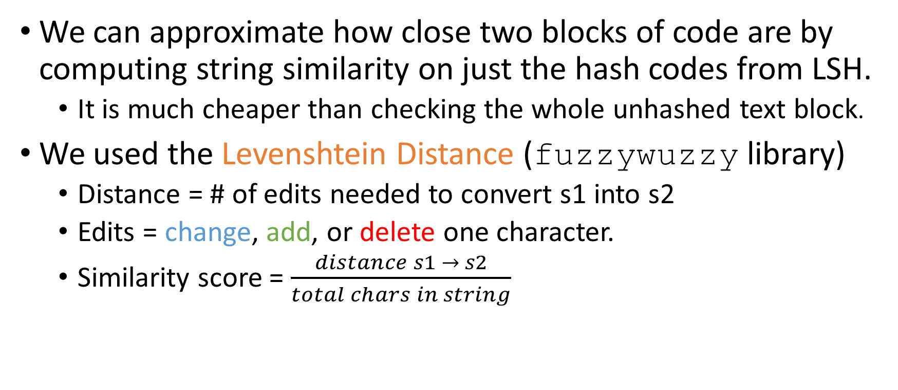
String similarity
We can approximate how close two blocks of code are by computing string similarity on just the hash codes from LSH.
It is much cheaper than checking the whole unhashed text block.
We used the Levenshtein Distance (fuzzywuzzy library)
Distance = # of edits needed to convert s1 into s2
Edits = change, add, or delete one character.
Similarity score = $\frac{distance s1 → s2}{total chars in string}$

Slide 8
Tokenizer
The tokenizer is very basic, all it does is remove inconsistencies in variable/function names
It does this utilizing pythons tokenize library and replaces the names of variables with a consistent naming scheme
This will even include things like print or type statements.
As of right now it only supports python, but it can be easily expanded in the future to include other languages
Such as C, for which there is a similar library

Slide 9
Test Data
Our method was tested with a dataset extracted rom the competitive programming site https://atcoder.jp/.
All the data is on our github page under dataset
The dataset primarily consists of python code submitted to competitions and is organized by event

