Slide 1
Motion Parsing with HMM and HPYLM
M2 Komota Tetsuya

Slide 2
Background
It is expected to realize a general-purpose robot which are able to do task in the human living environment.
General-purpose robots need the ability to learn the behavior from the interaction with humans.
→It is NOT just “imitation”.
The ability to learn the human intentions from the human motions is necessary.
It enables robots to predict the task goal.
Notes:
近年のロボット技術の進展から，人間の生活環境で活動する汎用ロボットの実現が期待されています.
汎用ロボットが持つべき能力として，人の動作を見ただけで意図するところを把握し，模倣する能力が考えられます．

Slide 3











Background
Ex) The task “Take the cup.”
Reproduction with human intention.
The human
position
is important.
Take
the cup.
Teaching the task.
Notes:
その問題を解決するために～
卒業研究では～ガウス～

Slide 4

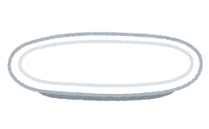
Problem of previous work

Slide 5

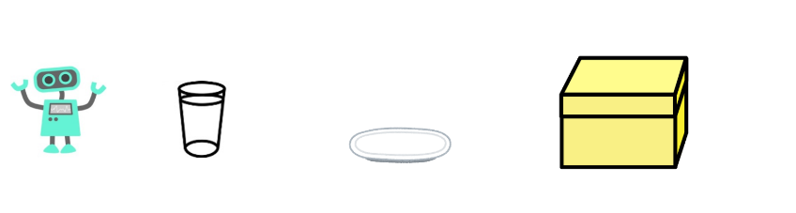
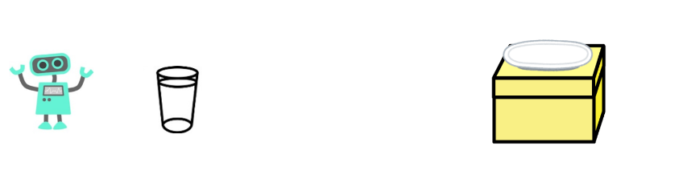

Problem of previous work
Getting the “intermediate state” of motion sequence.
・HMM(Encoding) + Ngram(Parsing)
・with DP (HMM → HDP-HMM, Ngram → NPYLM)

Slide 6
Finding the important intermediate states
The important states means the boundary of motion primitives, and to find them, the motion has to be encoded to the sequence of motion primitives.
HMM can encode various time sequential data.
But when using HMM to encode motion, there are some difficulties.
the number of hidden states(i.e. kind of motion primitives) is not known in advance.
Encoding with HMM is not enough to get the motion primitives.
(Each states of HMM is too primitive to explain the motion.)
Notes:
経由するべき重要な途中状態とは動作の意味的な境界であると考えられるため，途中状態を抽出するために動作情報を符号化してプリミティブ列に変換することが有効であると考えられます．
連続的な動作を符号化する手法として，隠れマルコフモデルが存在しますが，隠れマルコフモデルを動作情報の符号化に適用する場合，いくつか困難があります．

Slide 7
Finding the important intermediate states
Tadahiro Taniguchi et al [1] solved that problem by using sticky-Hierarchical Dirichlet Process Hidden Markov Model (sHDP-HMM [2]) and Nested Pitman-Yor Language Model(NPYLM [3]).
sHDP-HMM realizes encoding without to decide the number of hidden states in advance.
NPYLM realizes parsing the sequence of character to sequence of words without to input dictionary in advance.
The intervals of words made by NPYLM mean the boundary of motion primitives, the important interval states.

Slide 8
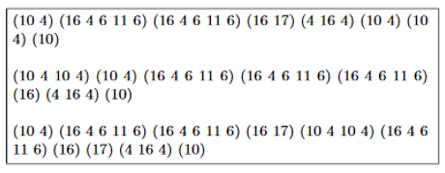
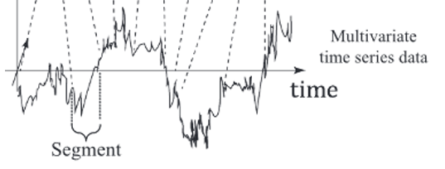
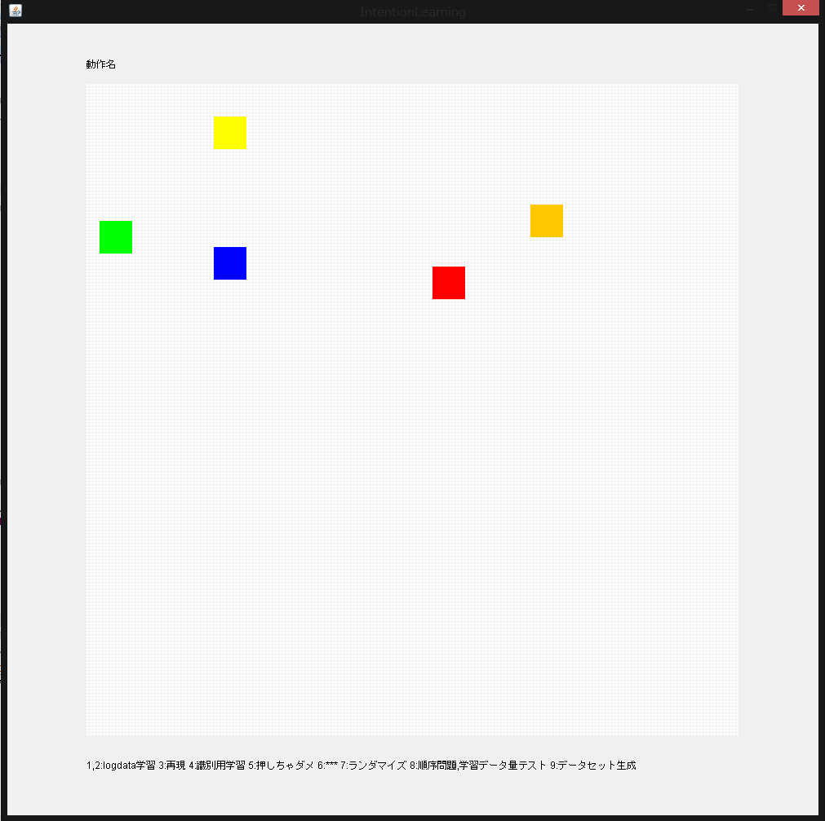
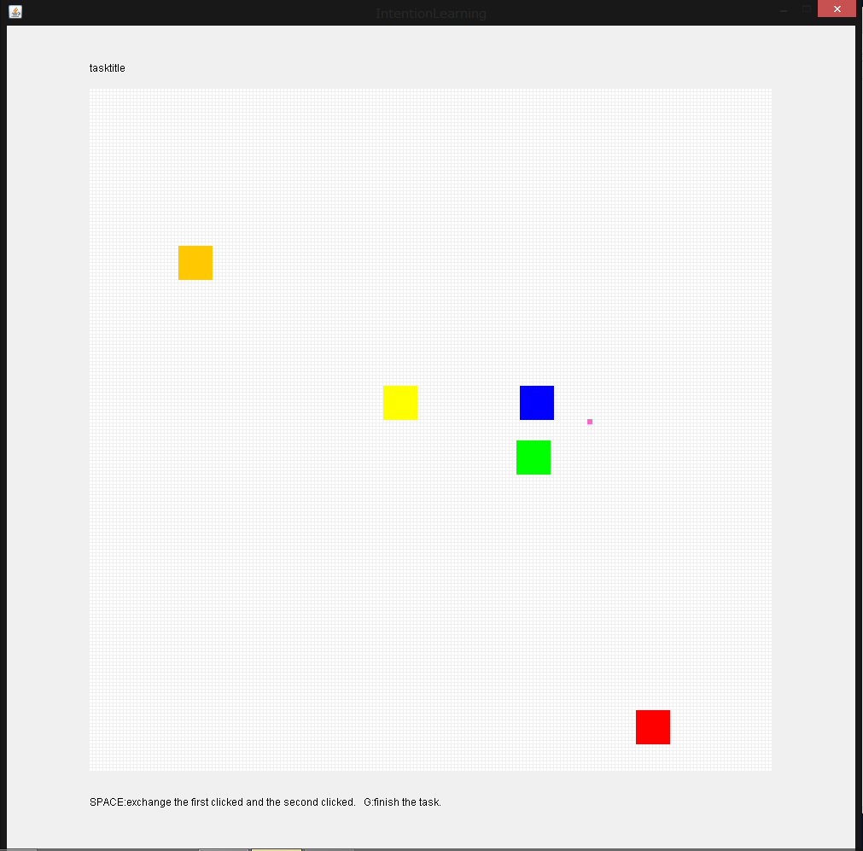
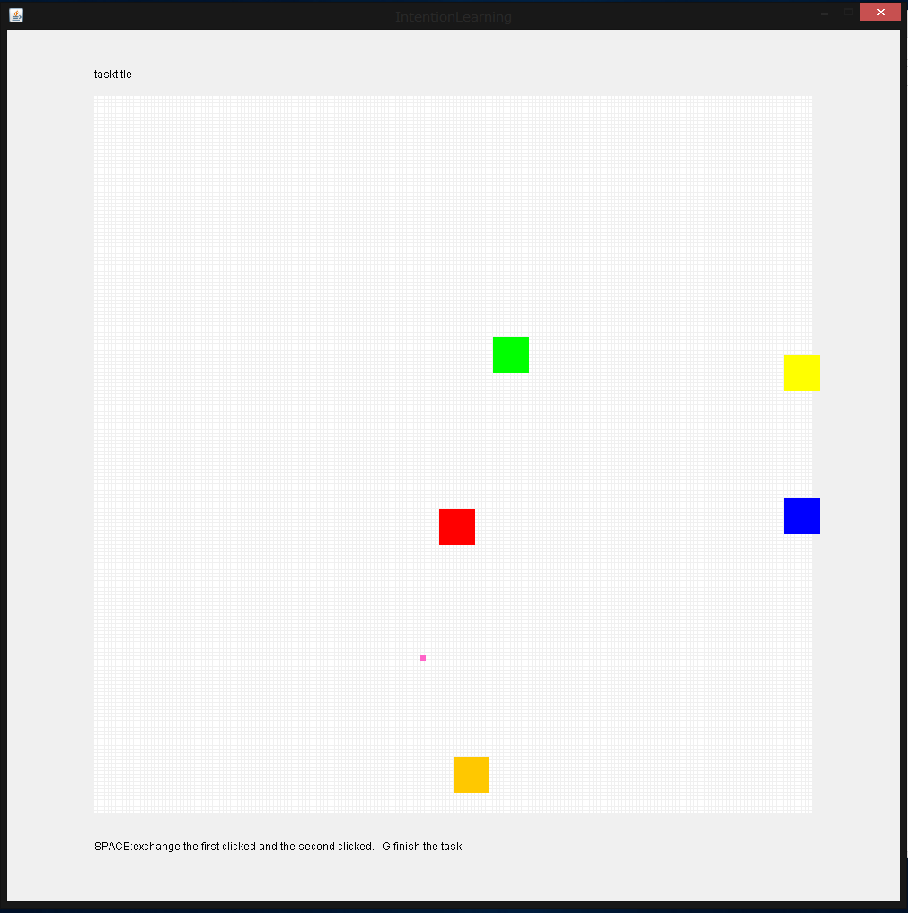
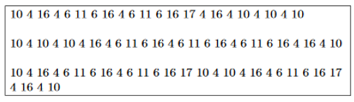
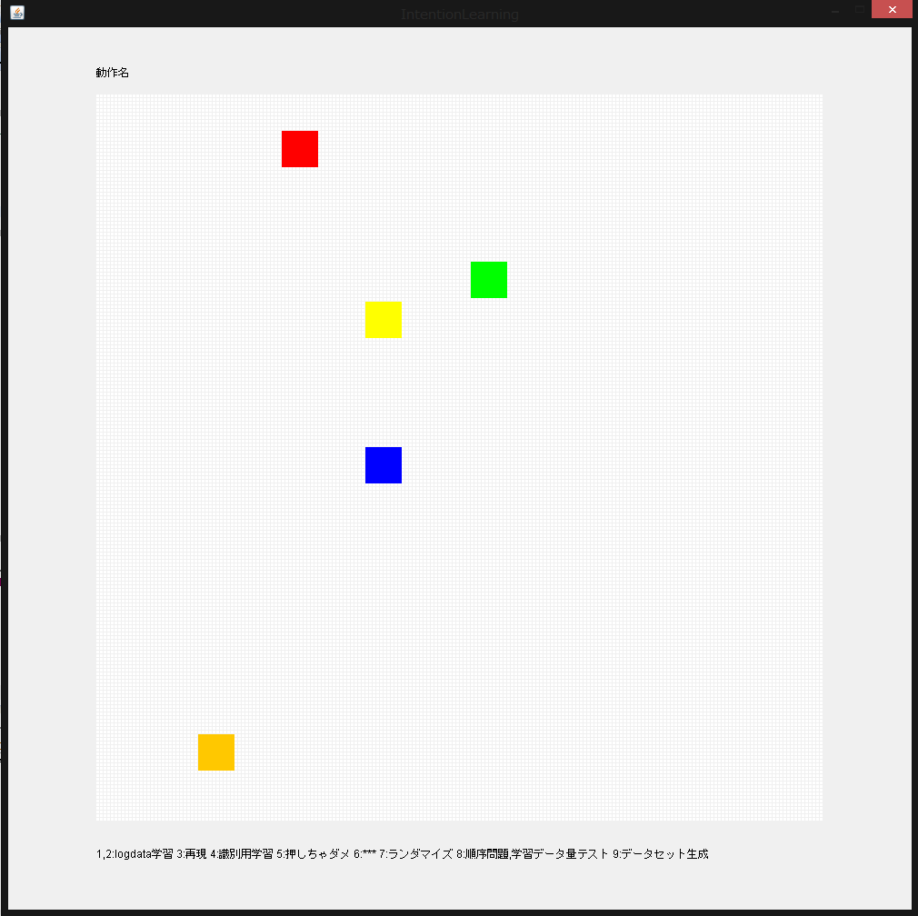
Outline
Smoothing (TMA)
sHDP-HMM
NPYLM
Start
interval
interval
・・・
Goal

Slide 9
Current works
Smoothing (TMA)
Normal HMM
HPYLM
Start
interval
interval
・・・
Goal

Slide 10
Current works
Smoothing the motion data by TMA
Encoding motion with normal HMM
Consideration of influence by the number of states
Parsing sentences with HPYLM
Consideration of necessity of NPYLM
Parsing motion with combination HMM and HPYLM

Slide 11
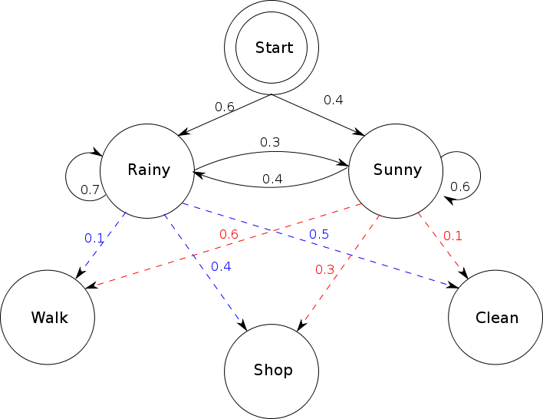
About HMM
HMM :
Markov model with unsupervised learning
It can recognize or/and encode the time sequential data.
It is frequently used for speech recognition.

Slide 12
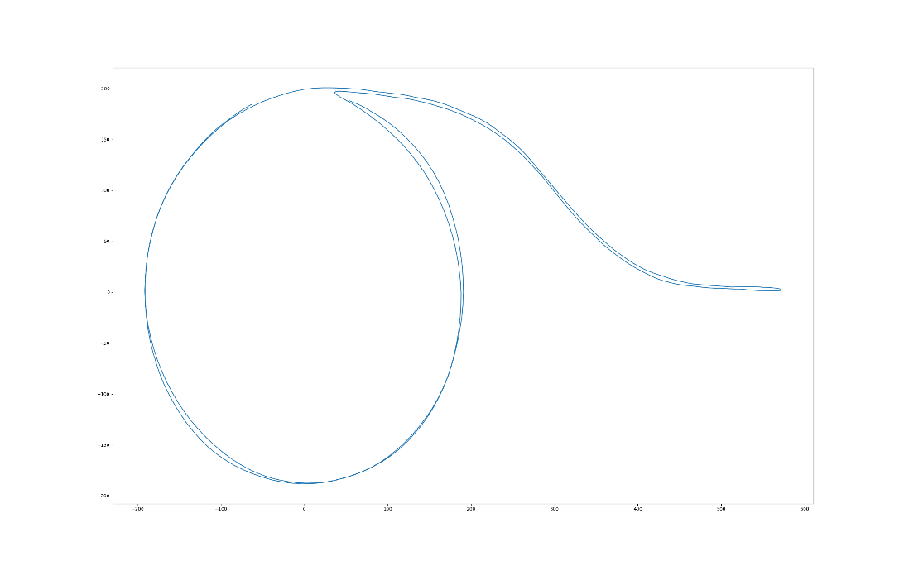
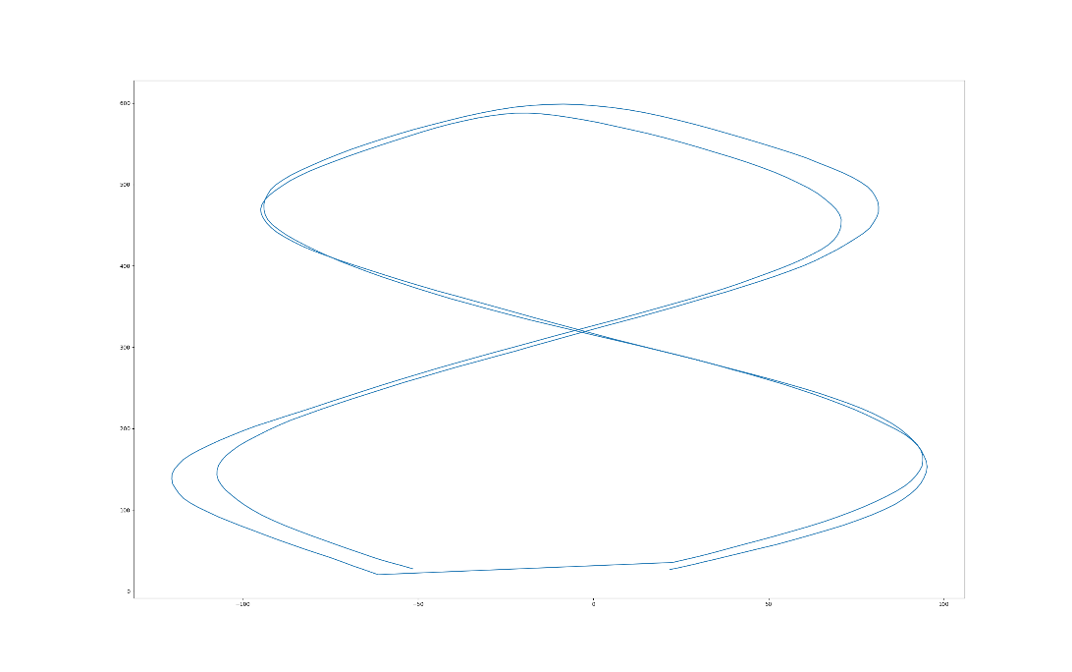
Experiments - HMM
Experiment about Learning of HMM and estimation based on simple time series data
I verified the influence of the number of states.
I used two kinds of two dimensional trajectories for learning.
circle and sigmoid
eight curve

Slide 13
Experiments - HMM
# of state | Length |  | state occuerred only once
 | cir+sig | eight
5 | 14 | 6 | 0
10 | 27 | 12 | 0
15 | 35.4 | 16 | 0
20 | 37.1 | 19.2 | 0.1
25 | 47.1 | 19.1 | 0.04
30 | 51.1 | 25 | 0.066666667
35 | 51.5 | 23.7 | 0.057142857
40 | 62.6 | 27 | 0.125
45 | 63.8 | 27.8 | 0.066666667
50 | 77.1 | 27.6 | 0.1
# of state | examples
 | cir+sig | eight
5 | [1. 2. 0. 3. 4. 1. 0. 3. 0. 1. 2. 0. 3. 4] | [4. 3. 4. 1. 2. 1]
10 | [6. 8. 5. 0. 9. 4. 2. 3. 7. 1. 6. 1. 6. 8. 4. 2. 4. 8. 6. 8. 5. 0. 9. 4. 2. 3. 7] | [7. 3. 2. 3. 7. 1. 6. 8. 5. 0. 5. 8]
40 | [11. 24. 2. 36. 34. 12. 10. 31. 32. 16. 39. 6. 19. 37. 4. 33. 13. 23. 8. 20. 7. 21. 3. 27. 22. 18. 22. 27. 3. 21. 25. 29. 28. 5. 35. 5. 28. 5. 28. 29. 11. 24. 22. 2. 36. 34. 12. 10. 31. 32. 16. 39. 6. 19. 37. 4. 33. 13. 23. 8. 20. 7. 17] | [25. 38. 15. 1. 13. 26. 33. 13. 1. 15. 38. 17. 21. 24. 2. 34. 12. 9. 14. 30. 0. 30. 14. 9. 34. 11]

Slide 14
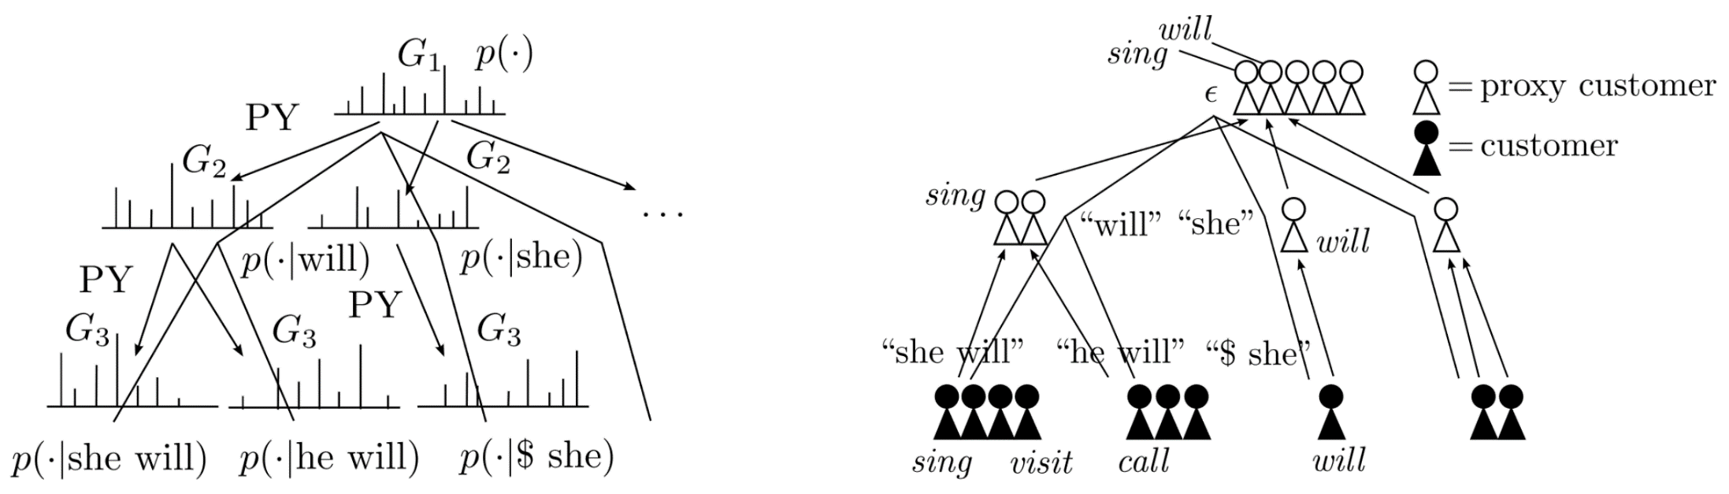
About HPYLM
HPYLM :
Hierarchical Ngram model with Pitman-Yor Process
Thanks of introducing the Dirichlet process, it can deal with unknown words.
Base measure(the prior distribution of words) is unknown.
NPYLM deals with another HPYLM as base measure.
持橋[3]

Slide 15
Experiments - HPYLM
(For simplicity of coding, ) I used the Gauss distribution as base measure.
I entered the following five strings for learning.
(It is just concatenation of five words)
applegrapeorangebananapeach
peachorangebananaapplegrape
grapebananaorangeapplepeach
bananaappleorangepeachgrape
orangepeachbananaapplegrape

Slide 16
Experiments - HPYLM
[Resautrant]executeParsing:iteration:5000
['apple', 'gra', 'pe', 'orange', 'ban', 'ana', 'peach’]
['peach', 'orange', 'bananaapplegrape’]
['gra', 'pe', 'ban', 'ana', 'orange', 'apple', 'peach’]
['ban', 'ana', 'apple', 'orangepeac', 'h', 'gra', 'pe’]
['orangepeac', 'h', 'bananaapplegrape’]
[Resautrant]executeParsing:iteration:25000
['apple', 'grape', 'orange', 'ban', 'ana', 'peach’]
['peach', 'orange', 'bananaapplegrape’]
['grape', 'ban', 'ana', 'orange', 'apple', 'peach’]
['ban', 'ana', 'apple', 'orangepeac', 'h', 'grape’]
['orangepeac', 'h', 'bananaapplegrape']
[Resautrant]executeParsing:iteration:80000
['apple', 'grape', 'orange', 'banana', 'peach’]
['peach', 'orange', 'bananaapplegrape’]
['grape', 'banana', 'orange', 'apple', 'peach’]
['banana', 'apple', 'orange', 'peach', 'grape’]
['orange', 'peach', 'bananaapplegrape']

Slide 17
HMM + HPYLM
時系列データを HMM で符号化して得られた文字列を HPYLM で形態素解析
（現在計算中）

Slide 18
Summary and future works
In the case of a normal HMM, the number of states must be manually set according to the number of kinds of input data.
For parsing of less complicated strings, the nested structure of NPYLM is not essential.
Future works
Introduction of HDP-HMM
Consider about dealing with parsing results
prediction of the idioms
removing noizes
Application using real (high-dimensional) data

Slide 19
References
[1] Taniguchi, Tadahiro, and Shogo Nagasaka. "Double articulation analyzer for unsegmented human motion using pitman-yor language model and infinite hidden markov model." System Integration (SII), 2011 IEEE/SICE International Symposium on. IEEE, 2011.
[2] Teh, Yee Whye, and Michael I. Jordan. "Hierarchical Bayesian nonparametric models with applications." Bayesian nonparametrics 1 (2010).
[3]持橋大地, 山田武士, and 上田修功. "ベイズ階層言語モデルによる教師なし形態素解析." 情報処理学会研究報告 2009-NL (2009): 190.
[4]平博順. "石井健一郎, 上田修功, 続・わかりやすいパターン認識 (教師なし学習入門), pp. 326, オーム社, 2014." 人工知能: 人工知能学会誌 30.3 (2015): 404.
[5] Takenaka, Kazuhito, et al. "Contextual scene segmentation of driving behavior based on double articulation analyzer." 2012 IEEE/RSJ International Conference on Intelligent Robots and Systems. IEEE, 2012.
[6] Fox, Emily B., et al. "An HDP-HMM for systems with state persistence." Proceedings of the 25th international conference on Machine learning. ACM, 2008.
[7] Skeletal Joint Smoothing White Paper , https://msdn.microsoft.com/ja-jp/library/jj131429.aspx

Slide 20
Appendix

Slide 21
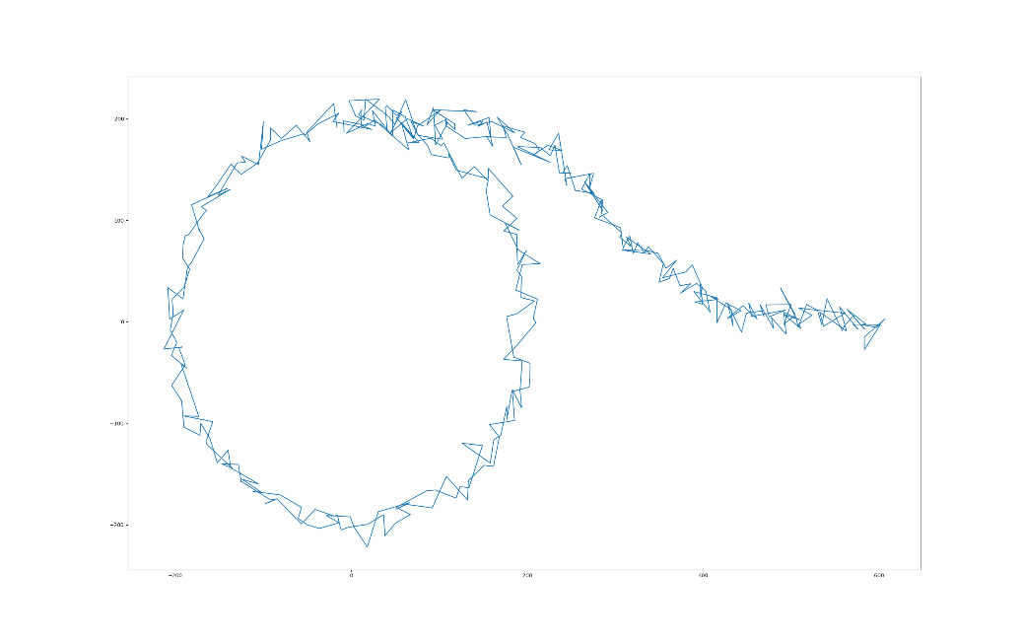
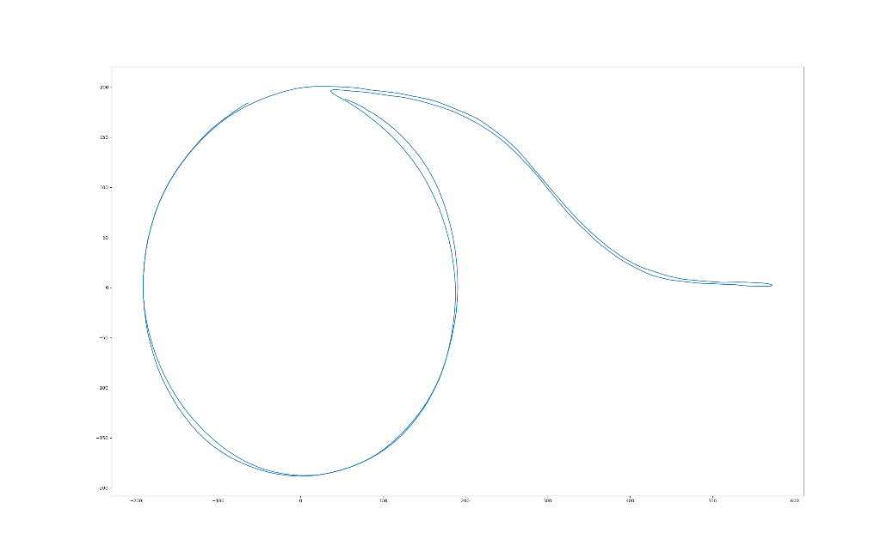

三角移動平均について
TMA : 平滑化処理の一つ
Kineect の公式ドキュメンテーションに記載
$${\tilde{x}}_{t}=\frac{1}{2L}\sum_{l=−L}^{L}{\left|\frac{L−l}{L}\right|{\tilde{x}}_{t+l}}$$
before TMA smoothing
(added Gauss error)
after smoothing

Slide 22
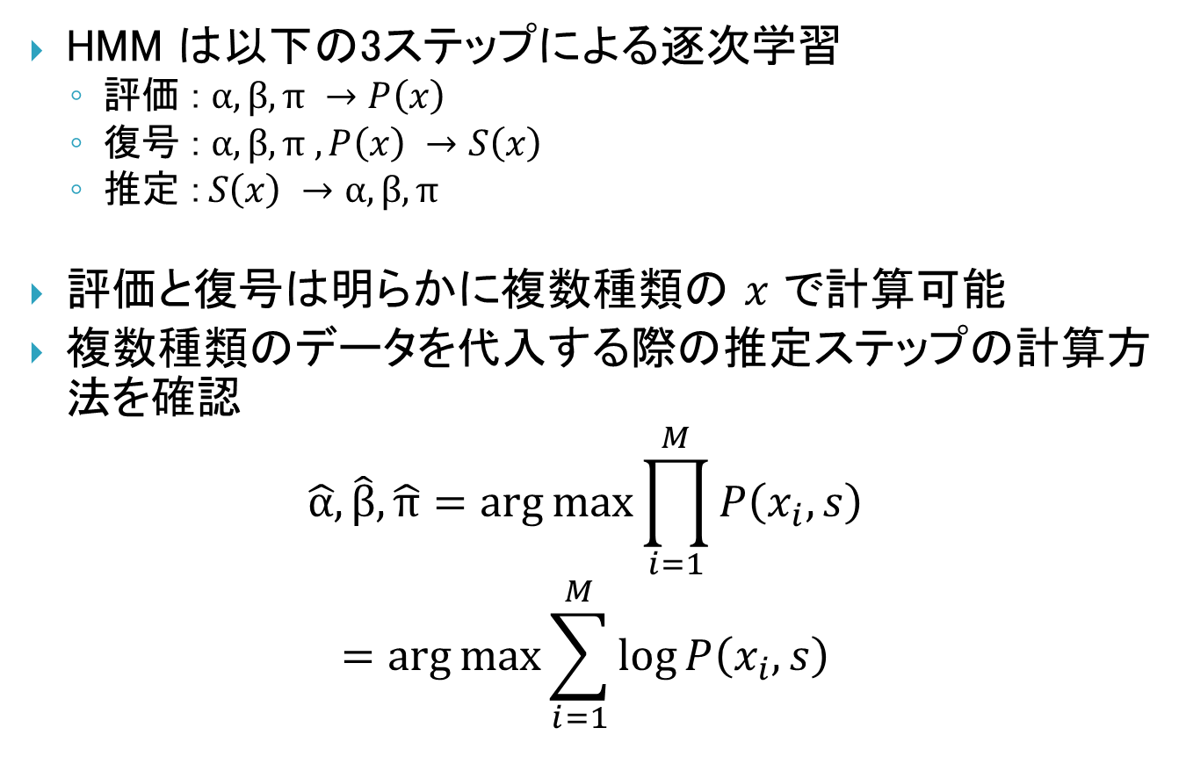
HMM に複数種類の時系列データ
HMM は以下の3ステップによる逐次学習
評価 : $α, β, π →P\left(x\right)$
復号 : $α, β, π , P\left(x\right) →S\left(x\right)$
推定 :$S\left(x\right) →α, β, π$
評価と復号は明らかに複数種類の $x$ で計算可能
複数種類のデータを代入する際の推定ステップの計算方法を確認
$$\hat{α},\hat{β}, \hat{π}=\arg{\max{\prod_{i=1}^{M}{P\left(x_{i}, s\right)}}}$$
$$=\arg{\max{\sum_{i=1}^{M}{\log{P\left(x_{i}, s\right)}}}}$$

Slide 23

HMM に複数種類の時系列データ
$$\log{P\left(x, s\right)}=\log{P\left(s\right)}+\log{P\left(x|s\right)}$$
$$=\sum{}\sum{}$$
$$\hat{α},\hat{β}, \hat{π}=\arg{\max{P\left(x, s\right)}}$$

Slide 25


Problem of previous work
Previous method learn only the relationship between initial states and goal states.
So, it could not take account for intermediate states.
確か前作ったやつに差し替え
Notes:
卒業研究の課題として，動作を最初と最後の環境の変化と仮定している点が挙げられます．
実際の多様な動作を学習するには，これでは十分ではないと考えられます．
例えば～

Slide 26

Problem of previous work
If the sequences of states can be used for learning, the method can learn this task as the sequence of relationship.
But, it has to be considered which (i.e. when) states are need for learn.
確か前作ったやつに差し替え
Notes:
これを解決するためには，教示動作の中から重要な「途中状態」を抽出し，これを用いて状態変化のシーケンスとして動作を学習する方法が考えられます．
しかし，そのためには～

