Slide 1
Encoding for human motions by sticky-Hierarchical Dirichlet Process Hidden Markov Model
M1 komota tetsuya
Notes:
スティッキー階層ディリクレ過程隠れマルコフモデルを用いた動作情報の符号化と模倣学習への応用というタイトルで M1 の菰田が発表いたします．

Slide 2
Background
It is expected to realize a general-purpose robot which are able to do task in the human living environment.
General-purpose robots need the ability to learn the behavior from the interaction with humans.
→It is NOT just “imitation”.
The ability to learn the human intentions from the human motions is necessary.
It enables robots to predict the task goal.
Notes:
近年のロボット技術の進展から，人間の生活環境で活動する汎用ロボットの実現が期待されています.
汎用ロボットが持つべき能力として，人の動作を見ただけで意図するところを把握し，模倣する能力が考えられます．

Slide 3





Background
Ex) The task “Take the cup.”
Teaching the task
Just imitation
Take the cup.
Take the cup.
Notes:
卒業研究では，物体を移動させる動作から，その動作による移動物体の目標位置を周りの環境から推定する手法についてあつかいました．
例えば～

Slide 4







Background
Ex) The task “Take the cup.”
Reproduction with human intention.
The human
position
is important.
Take
the cup.
Teaching the task.
Notes:
その問題を解決するために～
卒業研究では～ガウス～

Slide 5
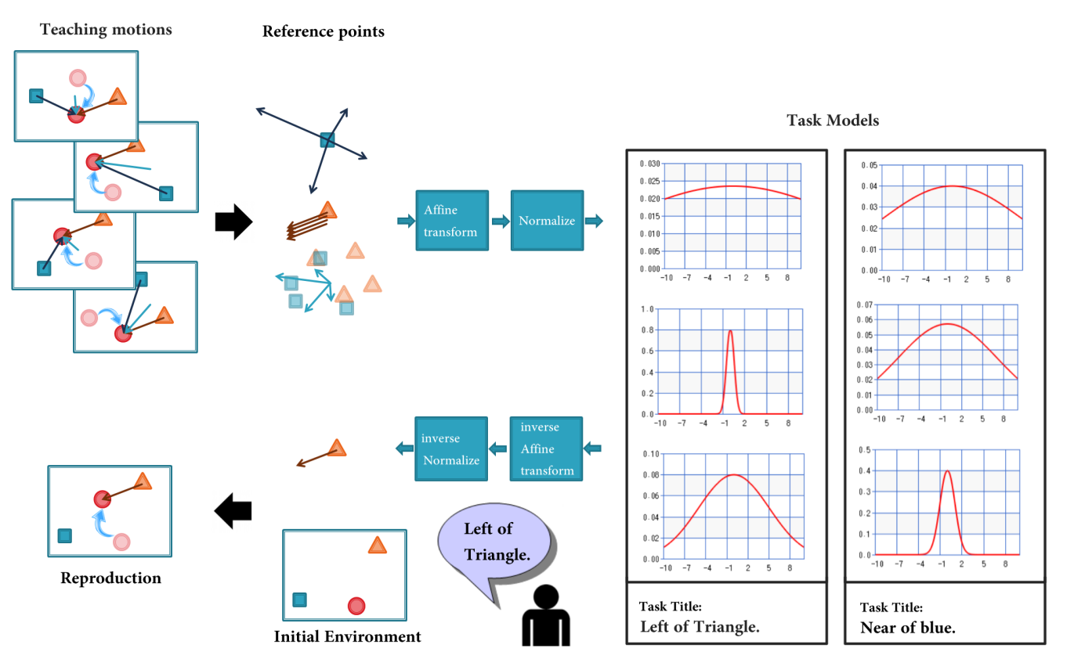
Model

Slide 6

Problem of previous work
Previous method learn only the relationship between initial states and goal states.
So, it could not take account for intermediate states.
Notes:
卒業研究の課題として，動作を最初と最後の環境の変化と仮定している点が挙げられます．
実際の多様な動作を学習するには，これでは十分ではないと考えられます．
例えば～

Slide 7

Problem of previous work
If the sequences of states can be used for learning, the method can learn this task as the sequence of relationship.
But, it has to be considered which (i.e. when) states are need for learn.
Notes:
これを解決するためには，教示動作の中から重要な「途中状態」を抽出し，これを用いて状態変化のシーケンスとして動作を学習する方法が考えられます．
しかし，そのためには～

Slide 8
Finding the important intermediate states
The important states means the boundary of motion primitives, and to find them, the motion has to be encoded to the sequence of motion primitives.
HMM can encode various time sequential data.
But when using HMM to encode motion, there are some difficulties.
the number of hidden states(i.e. kind of motion primitives) is not known in advance.
Encoding with HMM is not enough to get the motion primitives.
(Each states of HMM is too primitive to explain the motion.)
Notes:
経由するべき重要な途中状態とは動作の意味的な境界であると考えられるため，途中状態を抽出するために動作情報を符号化してプリミティブ列に変換することが有効であると考えられます．
連続的な動作を符号化する手法として，隠れマルコフモデルが存在しますが，隠れマルコフモデルを動作情報の符号化に適用する場合，いくつか困難があります．

Slide 9
Finding the important intermediate states
Tadahiro Taniguchi et al [1] solved that problem by using sticky-Hierarchical Dirichlet Process Hidden Markov Model (sHDP-HMM [2]) and Nested Pitman-Yor Language Model(NPYLM [3]).
sHDP-HMM realizes encoding without to decide the number of hidden states in advance.
NPYLM realizes parsing the sequence of character to sequence of words without to input dictionary in advance.
The intervals of words made by NPYLM mean the boundary of motion primitives, the important interval states.

Slide 10
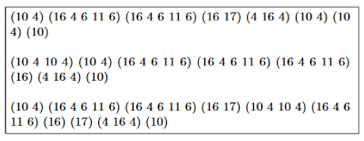
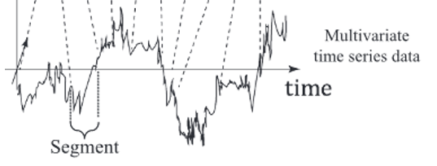
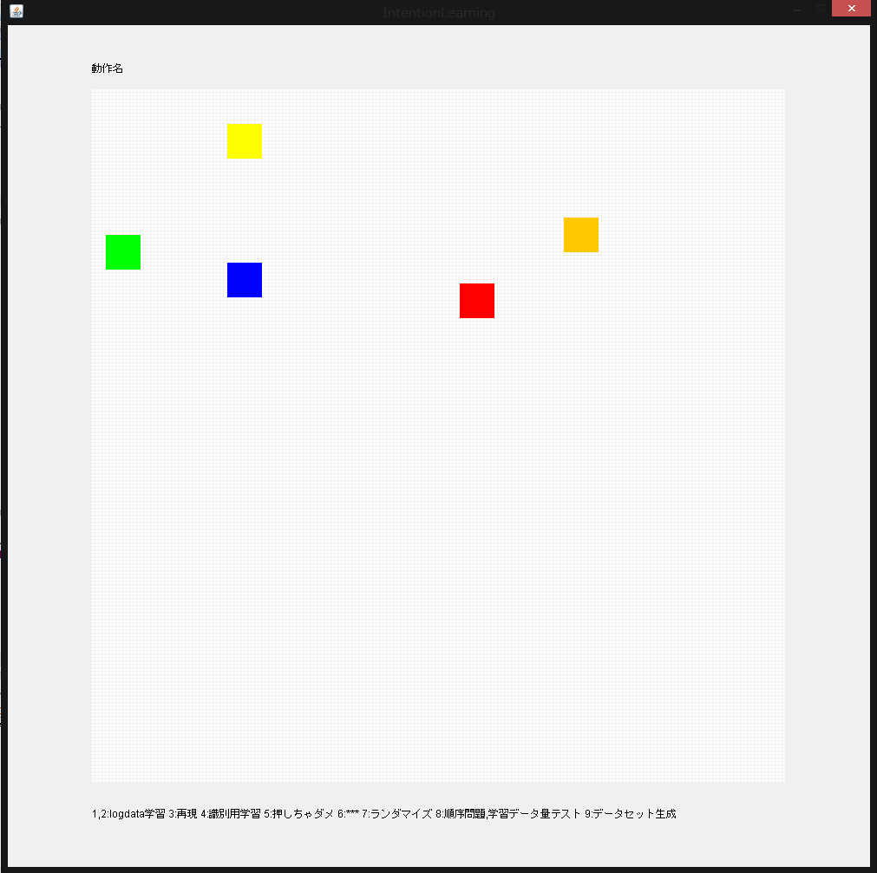
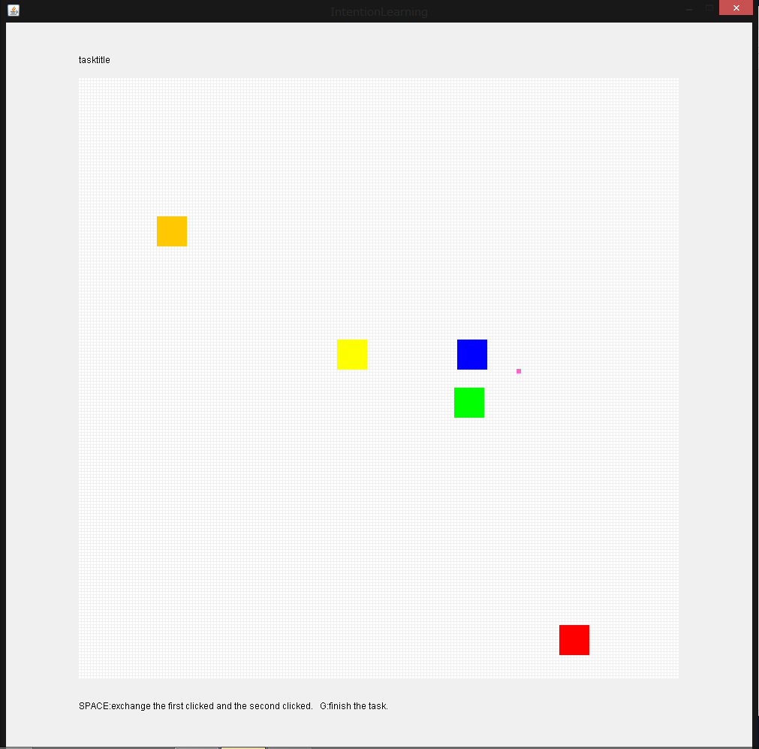
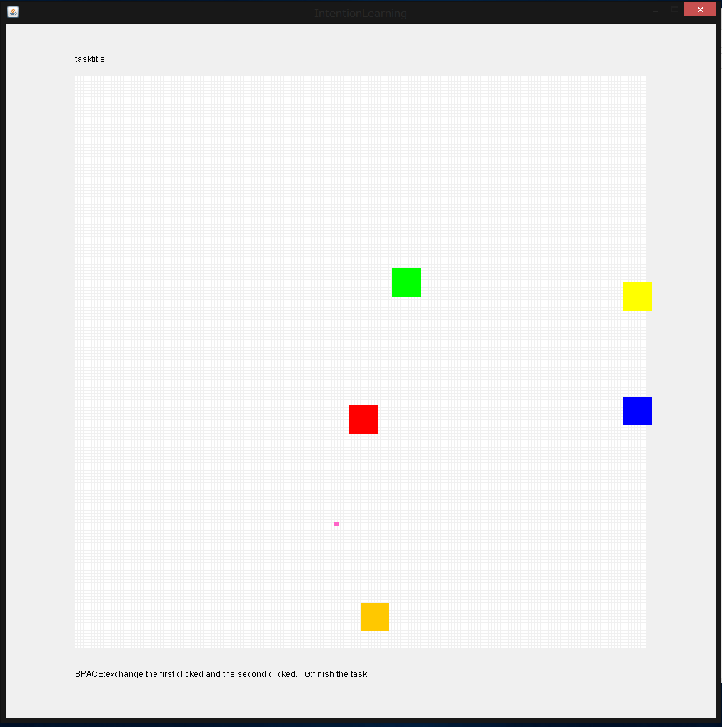
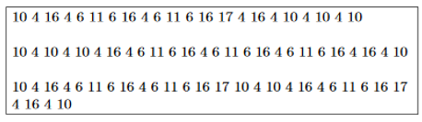
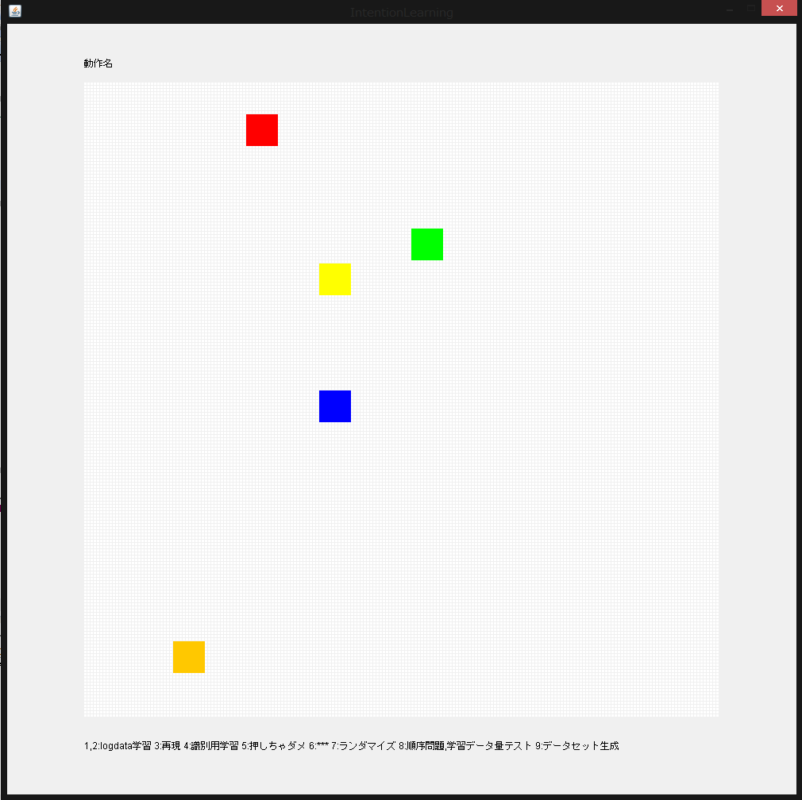
Outline
Smoothing (TMA)
sHDP-HMM
NPYLM
Start
interval
interval
・・・
Goal

Slide 11
Current works
Making GUI to collect human motions with kinect
Smoothing the motion data by TMA
Survey for understanding and coding sHDP-HMM
Chinese Restaurant Process (CRP [4])
Example of execution of sampling based on Dirichlet process
Dirichlet Process Mixture model (DPM [4])
Generation model based on Dirichlet Process
By using this, clustering can be performed without specifying the number of clusters.
Chinese Restaurant Franchise (CRF [5])
Example of execution of sampling based on Hierarchical Dirichlet process

Slide 12
Outline
Smoothing (TMA)
sHDP-HMM
NPYLM
Start
interval
interval
・・・
Goal

Slide 13
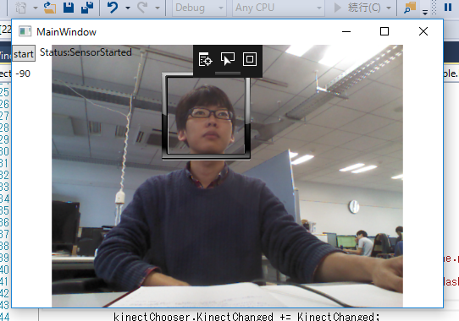
Obtain and smoothing the motion data
Collect human motions with kinect
C#
Skeleton data
7 points × 3D

Slide 14
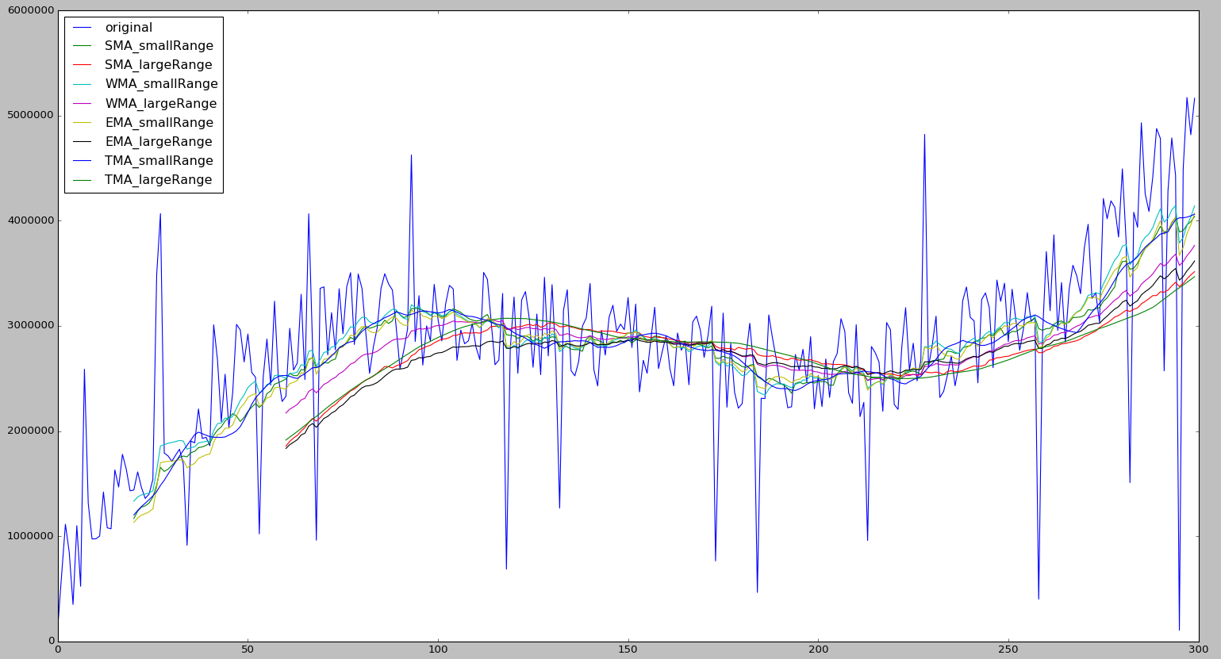
Obtain and smoothing the motion data
Smoothing
Motion data is smoothed by Moving Average (MA).
"accuracy" and "precision" are trade-off.
accuracy : Closeness to true position.
precision : Closeness to immediately previous/next position.

Slide 15
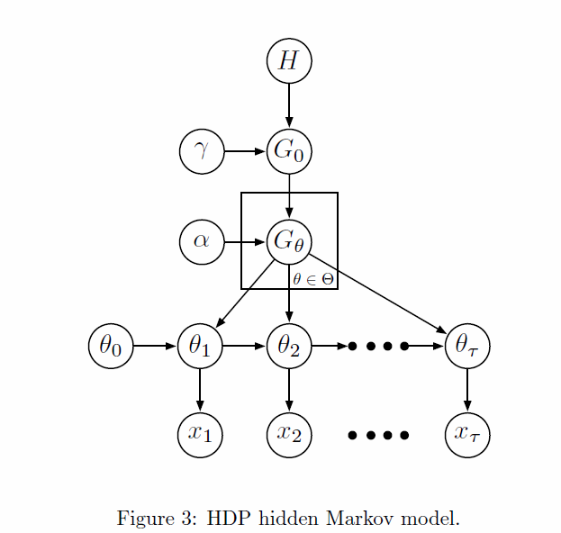
sHDP-HMM
Extended HMM which can be used without specifying the number of hidden states.
Transition function is generated by Dirichlet Process.
These atoms mean parameters of
probability distribution function of
outputs.
To share atom in each distribution,
the stochastic process is
constructed hierarchically
Graphical model of HDP-HMM [2]

Slide 16
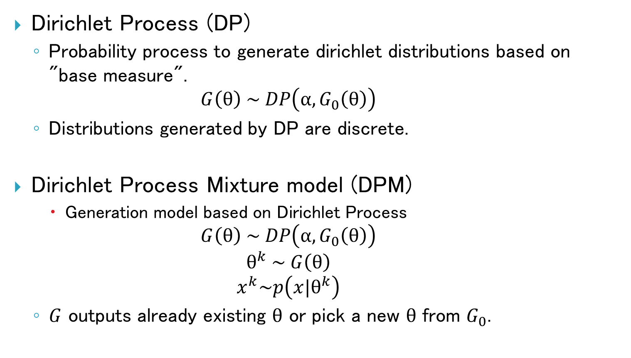
DPM
Dirichlet Process (DP)
Probability process to generate dirichlet distributions based on "base measure".
$$G\left(θ\right) \sim DP\left(α, G_{0}\left(θ\right)\right)$$
Distributions generated by DP are discrete.
Dirichlet Process Mixture model (DPM)
Generation model based on Dirichlet Process
$$G\left(θ\right) \sim DP\left(α, G_{0}\left(θ\right)\right)$$
$$θ^{k} \sim G\left(θ\right)$$
$$x^{k}\sim p\left(x|θ^{k}\right)$$
$G$ outputs already existing $θ$ or pick a new $θ$ from $G_{0}$.

Slide 17
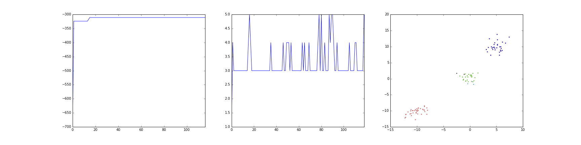
DPM
Example of DPM
Clustering of sample data generated by GMM.
Base measure is "Normal Wishart distribution".
α = 0.5 , β = 0.33
ν= 15 , S = [[1, 0], [0, 0.1]]

Slide 18
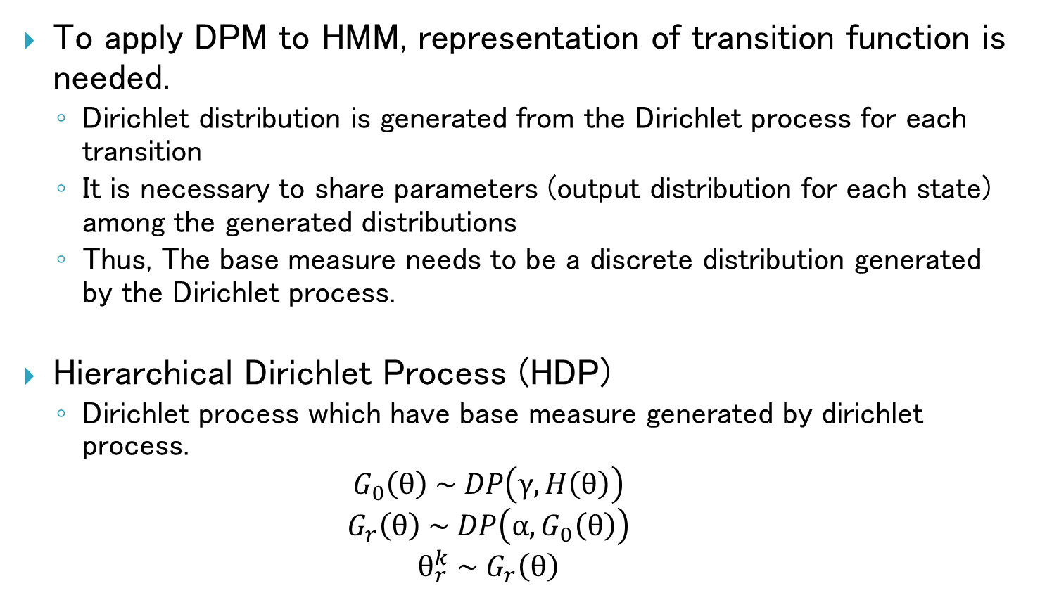
DPM for HMM
To apply DPM to HMM, representation of transition function is needed.
Dirichlet distribution is generated from the Dirichlet process for each transition
It is necessary to share parameters (output distribution for each state) among the generated distributions
Thus, The base measure needs to be a discrete distribution generated by the Dirichlet process.
Hierarchical Dirichlet Process (HDP)
Dirichlet process which have base measure generated by dirichlet process.
$$G_{0}\left(θ\right) \sim DP\left(γ, H\left(θ\right)\right)$$
$$G_{r}\left(θ\right) \sim DP\left(α, G_{0}\left(θ\right)\right)$$
$$θ_{r}^{k} \sim G_{r}\left(θ\right)$$

Slide 19
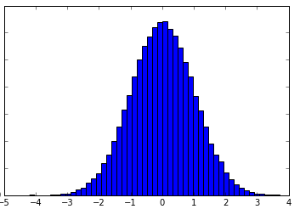
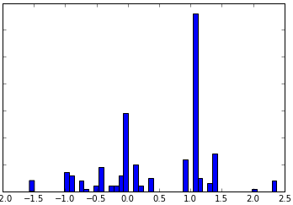
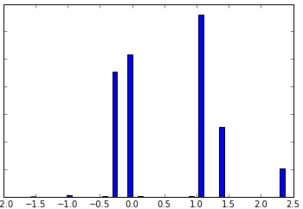
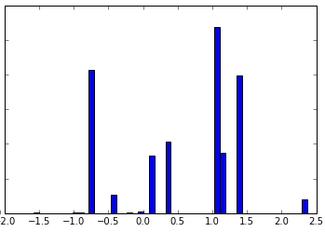
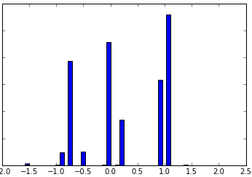


sHDP-HMM
Example of HDP(CRF)
Base measure is Gaussian distribution.
α=5, γ=1
Base measure H
Global distribution $G_{0}$
Local distribution $G_{r}$

Slide 20
Conclusion and what to do next
Summarize
Segmentation of continuous motion is helpful to find important intermediate states.
Motion data acquired from Kinect can be smoothed by MA.
the examples show how DPM and HDP work.
What to do next
sHDP-HMM
Test of learning HDP.
Apply HDP to HMM
Apply sHDP-HMM to encoding motion.
NPYLM

Slide 21
References
[1] Taniguchi, Tadahiro, and Shogo Nagasaka. "Double articulation analyzer for unsegmented human motion using pitman-yor language model and infinite hidden markov model." System Integration (SII), 2011 IEEE/SICE International Symposium on. IEEE, 2011.
[2] Teh, Yee Whye, and Michael I. Jordan. "Hierarchical Bayesian nonparametric models with applications." Bayesian nonparametrics 1 (2010).
[3]持橋大地, 山田武士, and 上田修功. "ベイズ階層言語モデルによる教師なし形態素解析." 情報処理学会研究報告 2009-NL (2009): 190.
[4]平博順. "石井健一郎, 上田修功, 続・わかりやすいパターン認識 (教師なし学習入門), pp. 326, オーム社, 2014." 人工知能: 人工知能学会誌 30.3 (2015): 404.
[5] Takenaka, Kazuhito, et al. "Contextual scene segmentation of driving behavior based on double articulation analyzer." 2012 IEEE/RSJ International Conference on Intelligent Robots and Systems. IEEE, 2012.
[6] Fox, Emily B., et al. "An HDP-HMM for systems with state persistence." Proceedings of the 25th international conference on Machine learning. ACM, 2008.
[7] Skeletal Joint Smoothing White Paper , https://msdn.microsoft.com/ja-jp/library/jj131429.aspx

Slide 22
Appendix

Slide 23
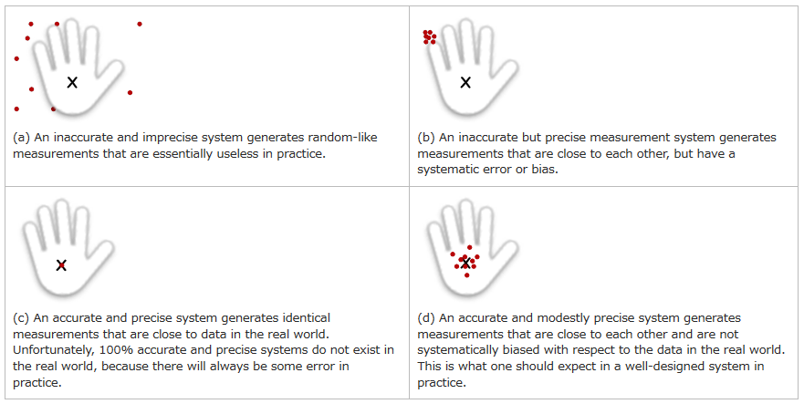
時系列データの平滑化
マイクロソフトもキネクトの平滑化について言及
「精度」と「正確度」のトレードオフ
フィルタは複数適用可能
↓
今回のデータは
「焦点」よりも「軌跡」
Skeletal Joint Smoothing White Paper
https://msdn.microsoft.com/ja-jp/library/jj131429.aspx

Slide 24
ディリクレ過程の atom

