Slide 1

Networking Extension
For GameMaker Studio HTML5 Export

Slide 2


Why GameMaker?
GameMaker simplifies computer game development.
Duration to learn making a scrolling background:
Gamemaker: 5 minutes
Unity (similar): 1 hour official tutorial video

Slide 3
Facts
Over 750,000 registered users (16 Feb 2015)
Low cost and flexible for small teams and developers
income made from applications, games and engines
HTML5 Exportability since September 2011
http://gamemaker.wiki/game-maker-versions

Slide 4



Browser Applications
Platform Independent
Convenient
Updates
piracy-proof
low system requirement
malware-free
low distribution cost
wide potential audience
available anywhere
etc.
https://html5test.com/results/desktop.html
http://www.vinnylingham.com/top-20-reasons-why-web-apps-are-superior-to-desktop-apps.html

Slide 5
Issues
“HTML5 Exportability since September 2011”
Feature compatibility problem: Networking functionality.
Effect: Inability to develop multiplayer browser application.
Consequence: Lost potential to become popular.
http://docs.yoyogames.com/source/dadiospice/002_reference/networking/index.html

Slide 6

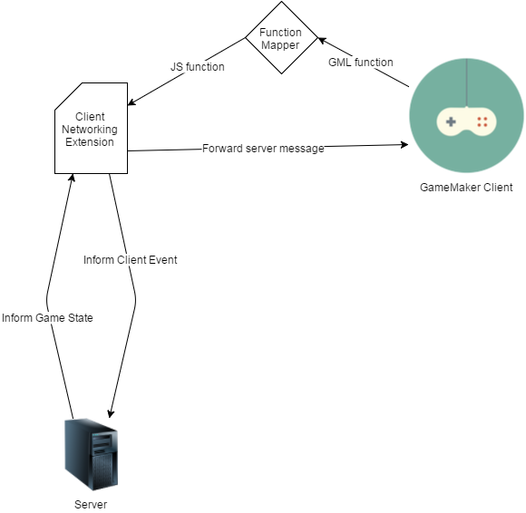
Solution: Networking Extension
Technologies:
NodeJS
Socket.io

Slide 7
NodeJS
Socket.io
“Node.js shines in real-time web applications employing push technology over websockets.”
“ Node.js operates on a single-thread, using non-blocking I/O calls, allowing it to support tens of thousands of concurrent connections”
socket.io is one of the most common websockets components out there today.
Previously encapsulations in Flash or Java Applets.
http://www.toptal.com/nodejs/why-the-hell-would-i-use-node-js
http://i-programmer.info/news/86-browsers/8783-death-of-flash-and-java.html

Slide 8


Evaluation Metrics
=
Delay
Data
Equality
Game performance
Simple variables
Treat players equally
Brian Carrig , David Denieffe , John Murphy, A relative delay minimization scheme for multiplayer gaming in differentiated services networks, p.36-es, October 30-31, 2006, Singapore

Slide 9
Delay Test
Setup
Physical clients hosting x virtual clients
Each virtual-client pings server every n seconds
Each physical client runs on a separate machine
Single device, separated from server’s local network
Ping rounds are synchronised
Records
Ping values of all virtual clients averaged per round
Ping deviation between all virtual clients per round

Slide 10
Results
x clients, each 1 requests per second
Ping and deviation start to shoot up after having roughly 1000 clients each sending a request every second
The application crashed after 1200 clients (1200 messages / second) due to a lack of processing power.
Notice the drop in framerate
clients

Slide 11
Results
x clients, each 2 requests per second
Ping and deviation again shoot up after having roughly 1000 clients each sending 2 requests every second
The application crashed after 1300 clients (2600 messages / second) due to a lack of processing power.
Notice the drop in framerate
clients

Slide 12
Results
x clients, each 10 requests per second
Ping and deviation again shoot up after having roughly 1000 clients each sending 10 requests every second
The application crashed after 950 clients (9500 messages / second) due to a lack of processing power.
Notice the drop in framerate
clients

Slide 13
Results
x clients, each 30 requests per second
Ping and deviation shoot up after having roughly 240 clients each sending 30 request every second.
The application crashed after 650 clients (19500 messages / second) due to a lack of processing power.
Notice the drop in framerate
clients

Slide 14
Conclusion
GameMaker apps do not support more than 1000 instances.
Thus far the server appears to handle well over 1000 messages per second
Socket.io is suggested to handle up to 9.000 to 10.000 messages per second on a 3.3 GHz Xeon X5470 server using one core.
http://drewww.github.io/socket.io-benchmarking/

Slide 15
Re-evaluation
Setup
Physical clients hosting x virtual clients
Each virtual-client pings server every n seconds
Each physical client runs on a separate machine
6 devices in total: 3 laptops, 2 smartphones, 1 desktop
Each device is located in Edinburgh, separated from server’s local network
Ping rounds are synchronised
Records
Ping values of all virtual clients averaged per round
Ping deviation between all virtual clients per round

Slide 16
Results
x clients, each 30 requests per second
clients

Slide 17
Conclusion (thus far)
Stable connection with 3900 clients, each sending 30 requests/second.
Stable connection when handling 3900 x 30 = 115500 messages per second
More machines required to find connection / server hard limit
http://drewww.github.io/socket.io-benchmarking/
Yan Gu , Richard Fujimoto, Performance Evaluation of the ROSENET Network Emulation System, Simulation, v.85 n.5, p.319-333, May 2009

Slide 18
Timeline
Complete:
Planning
Realisation
Research
Implementation
Develop Application
In Progress:
Benchmarking
Evaluation
Dummynet
To-do:
Optimisation
Re-evaluation
Comparison
December:
January:
February:
March:
More detailed benchmarking and evaluation (Dummynet, User-friendliness (?), Research & Comparison)
Additional Research, Plan and develop improvements, contact GameMaker community
Re-evaluate with benchmarker, compare results and conclude
Finalise dissertation

Slide 19
?
Thank You For Lıstenıng

