Slide 1

Networking Extension
For GameMaker Studio HTML5 Export

Slide 2


Recall
GameMaker simplifies computer game development,
but does not provide networking support for browser export

Slide 3
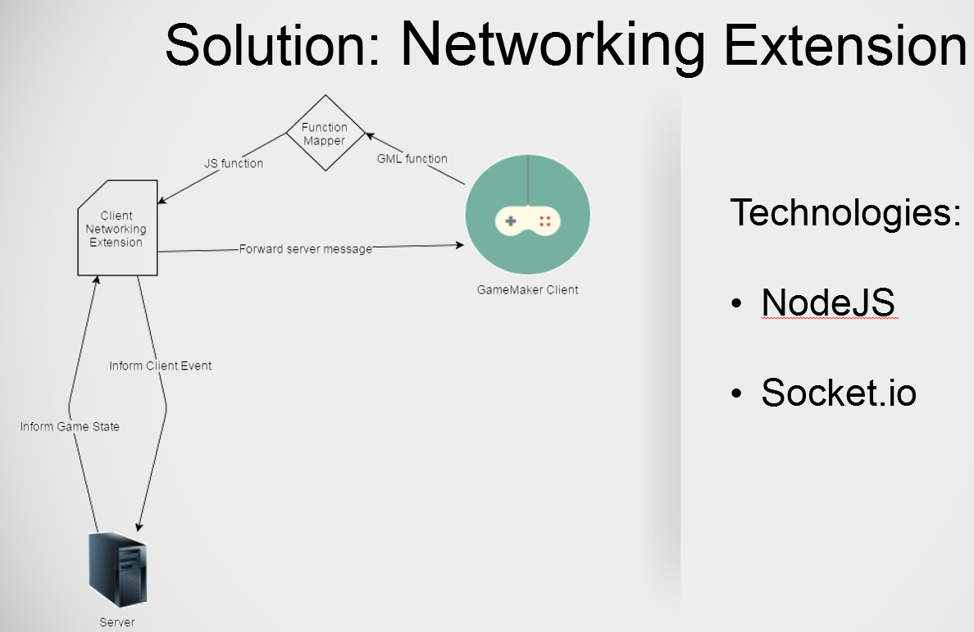
Recall
GameMaker simplifies computer game development,
but does not provide networking support for browser export

Slide 4
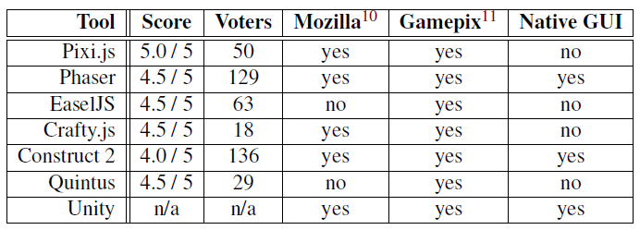
Related Tools
Developer “Favourite” Poll:
https://html5gameengine.com/

Slide 5
Related tools
Pixi.js, EaselJS, Quintus, Crafty.js and Phaser:
- Commonly used developer tools and frameworks for JavaScript browser games - No GUI provided
- Dependent on additional libraries for networking functionality
Construct 2:
- Strong competitor overall, supporting similar features as GameMaker
- Networking feature supported, but requires proper understanding of networks
Unity:
Generally designed for 3D games
Complicated to learn
Large overhead when creating 2D games

Slide 6
Related work: 39js
Previous attempt for creating a networked GameMaker browser application
However:
Scripted implementation, thus lacking maintainability
Does not represent game state, but only mediates messages back and forward
No use of design patterns
Complicated to update once a project becomes large
Untested “alpha stage”
Performance metrics not included

Slide 7
Own Development
Socket.io details are abstracted away from: developers do not have to think of “how do networks work?”.
A singleton central controller maintains the logic, assigning tasks to client instances depending on the newly received message.
A client class holds public methods for updating client states and handling messages. (ia. connect(), disconnect(), send_message(), update() and return_ping())
Use of the module pattern, keeps the data for the client instances private. This data is synchronized with that of the real client. (ia. username, x, y, mouse_x, mouse_y, hspeed, vspeed, room_name)

Slide 8
Evaluation: Server Specification
Hardware
Windows 7 64-bit platform
12.6GB available physical memory
Intel(R) Core(TM) i7-2600K CPU@3.40GHz
Software
Node v0.12.3
Socket.io v1.3.7
Network - Local: 54.0Mb/s download, 3.0Mb/s upload
- Dummynet: 5Mb/s download, 1Mb/s upload

Slide 9
Evaluation: Concurrent Connections
Impact on server memory (RSS), CPU, and its affect on the latency
How many concurrent connections does the server support?
How many messages per second per client can the server handle? ..and for how many clients?

Slide 10
Evaluation: Concurrent Connections
Impact on server memory (RSS), CPU, and its affect on the latency
How many concurrent connections does the server support?
How many messages per second per client can the server handle? ..and for how many clients?
Setup
Variable number of concurrent connections cc, up to 15 instances with each simulating at most 500 clients.
Clients do not contact the server after establishing a connection.
Data is recorded after each every increment of 100 connected clients

Slide 11
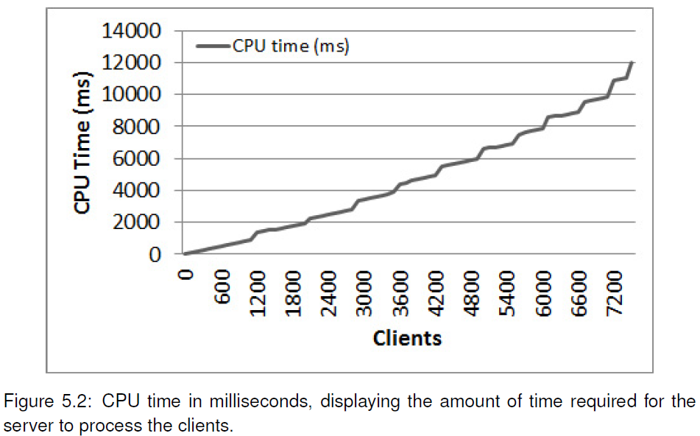
Evaluation: Concurrent Connections

Slide 12
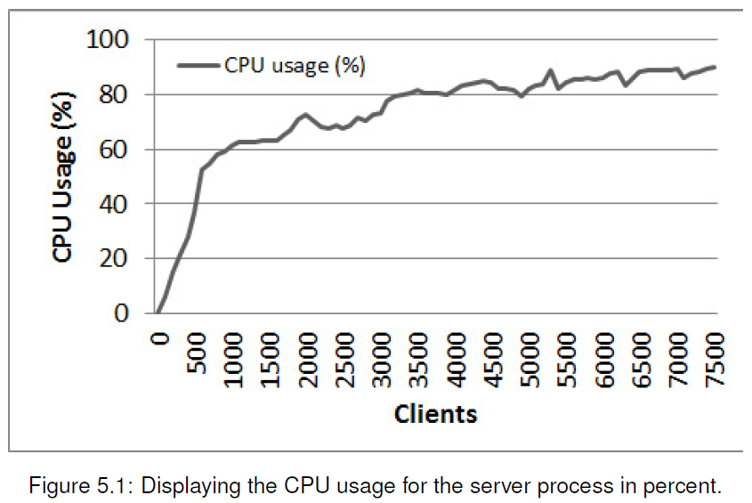
Evaluation: Concurrent Connections

Slide 13
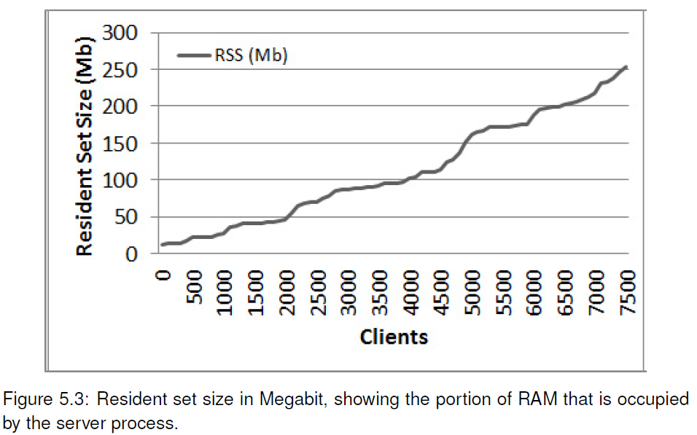
Evaluation: Concurrent Connections

Slide 14
Evaluation: Message Broadcasting
Impact on server memory (RSS), CPU, and its affect on the latency
How many concurrent connections does the server support?
How many messages per second per client can the server handle? ..and for how many clients?
Setup
N clients simultaneously connected to the server
Each client attempts to broadcast x messages per second
experiment terminates when RTT extends the 200ms threshold

Slide 15
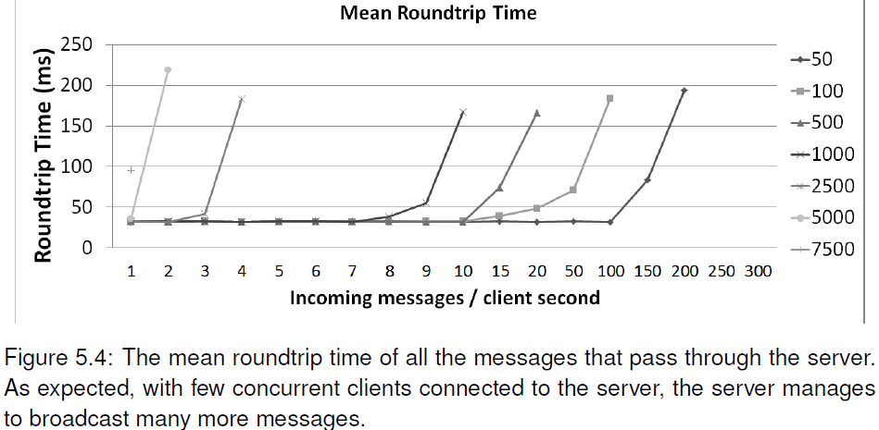
Evaluation: Message Broadcasting

Slide 16
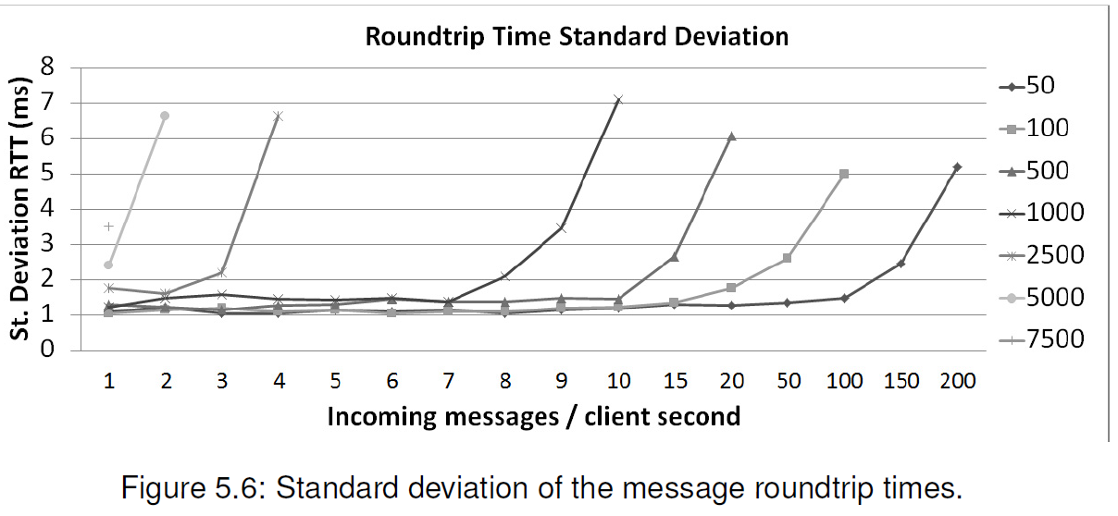
Evaluation: Message Broadcasting

Slide 17
Evaluation: Location-wise fairness
Latency difference depending on client-server location variability
How does distance affect the latency between the server and its clients?

Slide 18
Evaluation: Location-wise fairness
Latency difference depending on client-server location variability
How does distance affect the latency between the server and its clients?
Setup
Clients send 8-byte messages every second for 2 minutes
The message latency is averaged per 2 minute intervals
The server was located in Edinburgh (UK)

Slide 19
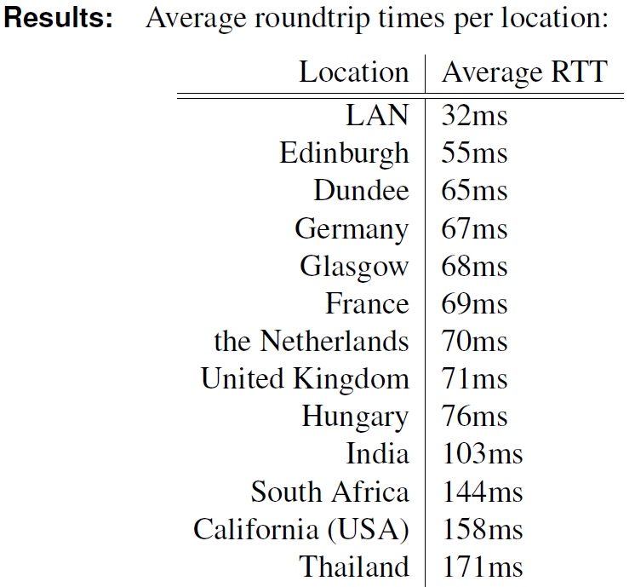
Evaluation: Location-wise fairness

Slide 20
Evaluation: Location-based fairness
Latency difference depending on client-server location variability
How does distance affect the latency between the server and its clients?
Fairness considering clients at different locations:
LAN
Edinburgh
UK
Europe
World

Slide 21
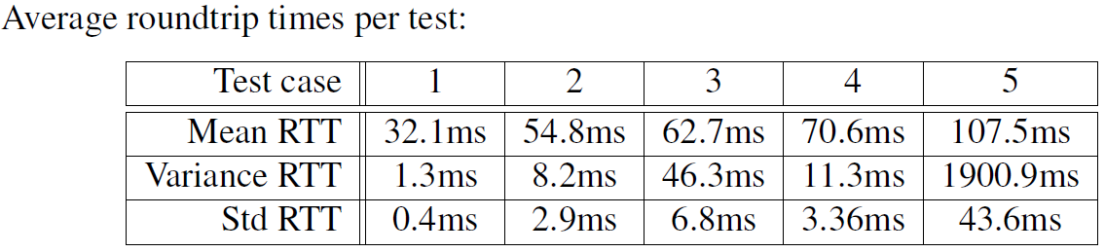
Evaluation: Location-based fairness
Latency difference depending on client-server location variability
How does distance affect the latency between the server and its clients?
Fairness considering clients at different locations:
LAN
Edinburgh
UK
Europe
World

Slide 22
Conclusion
Evaluations return latency values within commonly accepted range for gaming purposes within most areas of the world.
Each client takes up a relatively small, constant amount of memory in the server. (roughly 20MB for 5000 clients)
The server processor usage follows a logarithmic trend wrt. the number of clients
The server has a clear threshold at which it can broadcast messages reliably. Beyond this point, it needs to buffer messages to the next round, recursively making the situation worse.
Distance strongly affects the network quality

Slide 23
Solutions
Distance: spread servers locations, let clients act as server (peer-to-peer).
Next problem: there won’t be a central “game state” anymore
Scalability: The server reliably supports up to 1000 clients, each broadcasting 10 messages per second. 2D browser games do not usually expect this load. Install more servers, assign clients to a specific server (common solution)

Slide 24

Timeline
Complete:
Planning
Realisation
Research
Implementation
Develop Application
Benchmarking
Evaluation
Dummynet
Comparison
To-do (NOW):
Code Optimisation
Create example templates for other developers
Insert extension in large scale project (?)
Finalising the report

Slide 25
?
Thank You For Lıstenıng

