Slide 1


HTML5 Export
Networking Extension

Slide 2


Why GameMaker?
GameMaker is software meant to simplify computer game development.
You can learn how to get a scrolling background up and running in 5 minutes.
For similar game development platforms, such as Unity, an official video tutorial that teaches how to do it is an hour long.

Slide 3
Facts
Currently, the free tool has over 750,000 registered users, who are able to buy additional development modules to extend their creative capacity.
It is a popular product amongst small teams and developers working to a budget, thanks to its flexibility and low cost.
Developers make a living based on the income of their distributed software, including not only games but also other applications and entire game engines.
The rise of GameMaker HTML5 in September 2011 allowed GameMaker applications to be executed in web browsers. More export platforms were supported shortly after.
http://gamemaker.wiki/game-maker-versions

Slide 4



Browser Applications
Platform Independent:
Most browsers on desktops, tablets, mobile phones and other consoles support JavaScript and HTML5. As long as this is the case, the application can be accessed instantly.
Convenient:
Web applications can be executed directly within the browser and do not require a user to wait to “download” files to the drive, nor go through an installation process (which may require admin approval).
Updates:
Patches and updates applied to the application are seamless
Also, piracy-proof, low system requirement, malware-free, low distribution cost, wide potential audience, available anywhere, etc.
https://html5test.com/results/desktop.html
http://www.vinnylingham.com/top-20-reasons-why-web-apps-are-superior-to-desktop-apps.html

Slide 5
Issues
“The rise of GameMaker HTML5 in September 2011 allowed GameMaker applications to be executed in web browsers”
Not all features are directly compatible however. One of these is the networking functionality, which causes an inability to develop browser applications that can communicate with other clients.
Today, in the world of social networking and competitive gaming, many applications benefit from having direct contact with other clients. These applications have a much greater potential to become more popular with the end-users as they support social interactions.
http://docs.yoyogames.com/source/dadiospice/002_reference/networking/index.html

Slide 6

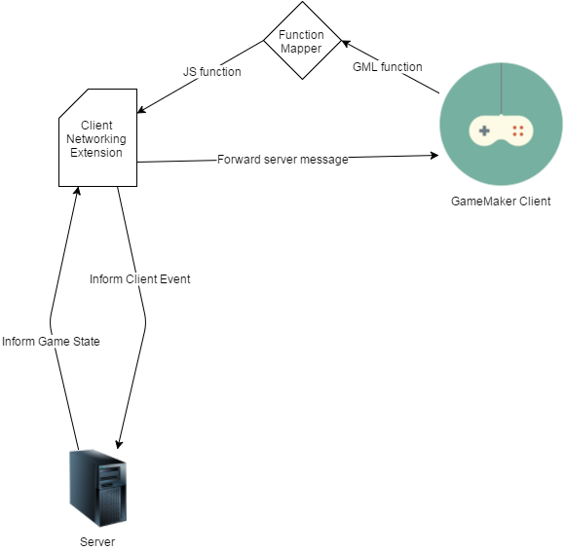
Solution
Networking Extension
An extension which GameMaker can communicate with, and is capable of solving the networking task.
Technologies:
NodeJS
Socket.io

Slide 7
NodeJS
Socket.io
“Node.js shines in real-time web applications employing push technology over websockets.”
“ Node.js operates on a single-thread, using non-blocking I/O calls, allowing it to support tens of thousands of concurrent connections”
socket.io is one of the most common websockets components out there today.
NodeJS is the first tool for working in the non-blocking, event-driven I/O paradigm.
Previously these features had to be encapsulated within sandboxed environments like Flash or Java Applets, for which browser support nowadays has more or less vanished.
http://www.toptal.com/nodejs/why-the-hell-would-i-use-node-js
http://i-programmer.info/news/86-browsers/8783-death-of-flash-and-java.html

Slide 8



Benchmarks
=
Speed
Data
Equality
Reliability
The speed at which packets are forwarded. Measured as ping in milliseconds
The amount of data that is forwarded in games is typically small. Only simple integer and string variables are transmitted.
Each player should be treated equally by the network.
Failure to do so will result in unfair gameplay.
Missing packets may not be vital as game state quickly updates.
With TCP, loss of packets may lead to delay (re-transmission).

Slide 9
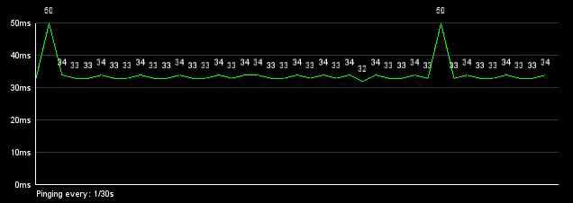
Speed Test
Benchmarker-X
Controlled Ping Test in practice
A single client with x virtual clients that each individually connect to the server.
Every virtual client sends a ping request every n seconds.
Ping roundtrip times are measured, the behaviour is visually displayed (live), and recorded in a log.

Slide 10
Results
x clients, each 1 requests per second
Ping and deviation start to shoot up after having roughly 1000 clients each sending a request every second
The application crashed after 1200 clients (1200 messages / second) due to a lack of processing power.
Notice the drop in framerate
clients

Slide 11
Results
x clients, each 2 requests per second
Ping and deviation again shoot up after having roughly 1000 clients each sending 2 requests every second
The application crashed after 1300 clients (2600 messages / second) due to a lack of processing power.
Notice the drop in framerate
clients

Slide 12
Results
x clients, each 10 requests per second
Ping and deviation again shoot up after having roughly 1000 clients each sending 10 requests every second
The application crashed after 950 clients (9500 messages / second) due to a lack of processing power.
Notice the drop in framerate
clients

Slide 13
Results
x clients, each 30 requests per second
Ping and deviation shoot up after having roughly 240 clients each sending 30 request every second.
The application crashed after 650 clients (19500 messages / second) due to a lack of processing power.
Notice the drop in framerate
clients

Slide 14
Conclusion
The graphs suggest that applications developed with GameMaker do not support more than 1000 instances without resulting in the application slowing down, and thus causing the ping consistency to fluctuate.
Thus far the server appears to handle well over 1000 messages per second, but the tests are cut short by the limitation of computational strength when forcing over 1000 virtual clients into one client.
Socket.io is suggested to handle up to 9.000 to 10.000 messages per second on a 3.3 GHz Xeon X5470 server using one core.
http://drewww.github.io/socket.io-benchmarking/

Slide 15


Timeline
Optimisation
Re-evaluation
Research
Develop Application
Part two
Part Four
Part Sıx
Part One
Part Fıve
Planning
Realisation
Part three
Benchmarking
Evaluation
Dummynet
Part Seven
Implementation
Comparison
December:
January:
February:
March:
April:
More detailed benchmarking and evaluation (Dummynet, User-friendliness (?), Research & Comparison
Additional Research, Plan and develop improvements
Re-evaluate with benchmarker, contact GameMaker community
Compare results and conclude
Finalise dissertation

Slide 16
?
Thank You For Lıstenıng
Will be answerıng questıons now

