Slide 1
Technische Presentatie

Slide 2
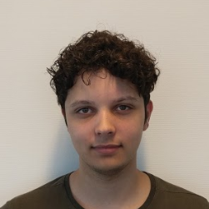


Welkom
Wie zijn wij
Ricky
van den Berg
Rik
Basting
Michael
van Zundert

Slide 3
Inhoudsopgave
Microsoft Flow
Flows
Custom Connector
API
datastructuur
Actions
Flows
Node-Red
Stack
Deployment
Flows
Alternatieven

Slide 4
Microsoft Flow
1
CM services integreren in het Microsoft Flow Platform

Slide 5
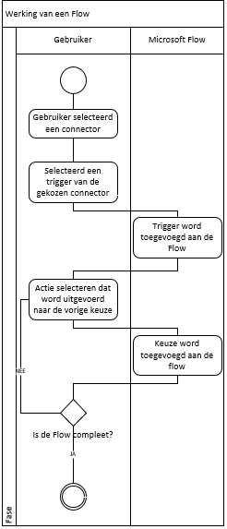

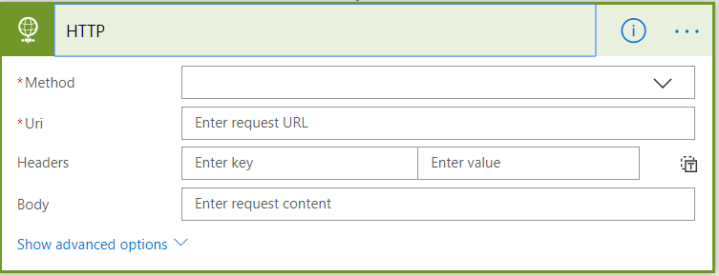
Flows
Connector
Triggers
Acties
Cm.com Acties
SendSms
TextToSpeech
Number validation

Slide 6
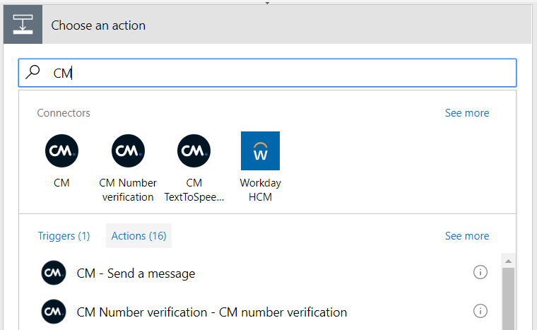
Custom Connector
Cm.com Custom Connector
Acties
SendSms
TextToSpeech
Number validation
Publish Custom Connector
Authenticatie
Testen

Slide 7
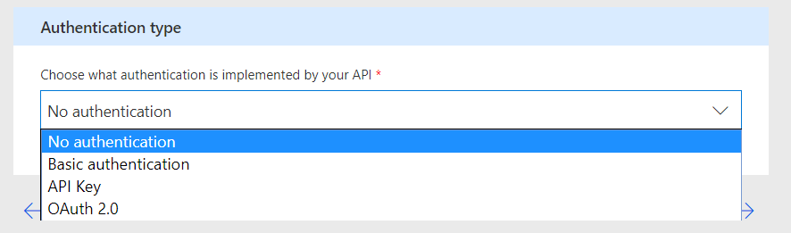
Custom Connector
Authenticatie
Basic authentincation
Gebruiker Gegevens
Api Key
Header
Oauth 2.0
Client Gegevens
Authorization Url
Token Url
Refresh Url

Slide 8
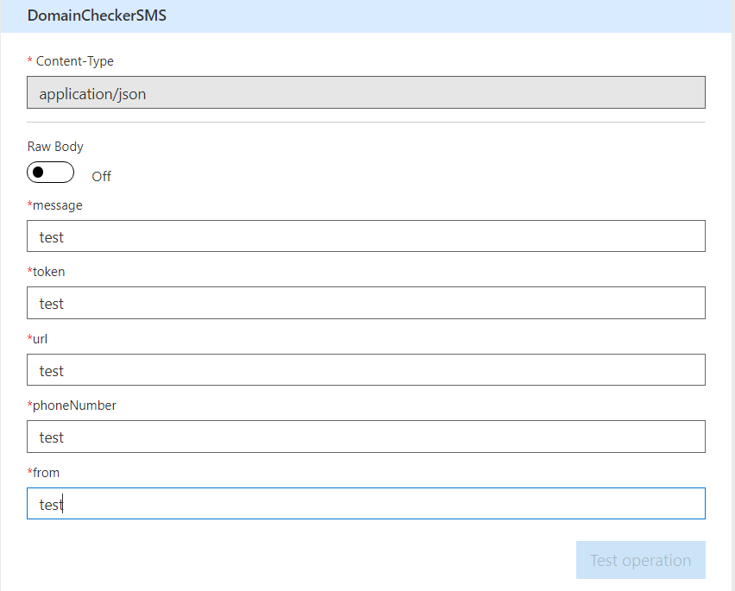
Custom Connector
Testen
Actions
Response

Slide 11
This is a slide title
Here you have a list of items
And some text
But remember not to overload your slides with content
Your audience will listen to you or read the content, but won’t do both.

Slide 12
BIG concept
Bring the attention of your audience over a key concept using icons or illustrations

Slide 13
You can also split your content
White
Is the color of milk and fresh snow, the color produced by the combination of all the colors of the visible spectrum.
Black
Is the color of coal, ebony, and of outer space. It is the darkest color, the result of the absence of or complete absorption of light.

Slide 14
In two or three columns
Yellow
Is the color of gold, butter and ripe lemons. In the spectrum of visible light, yellow is found between green and orange.
Blue
Is the colour of the clear sky and the deep sea. It is located between violet and green on the optical spectrum.
Red
Is the color of blood, and because of this it has historically been associated with sacrifice, danger and courage.

Slide 15
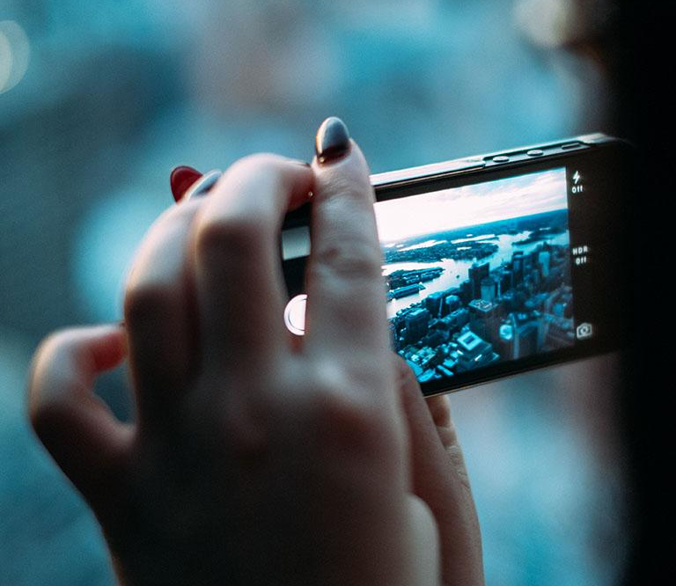
A picture is worth a thousand words
A complex idea can be conveyed with just a single still image, namely making it possible to absorb large amounts of data quickly.

Slide 16
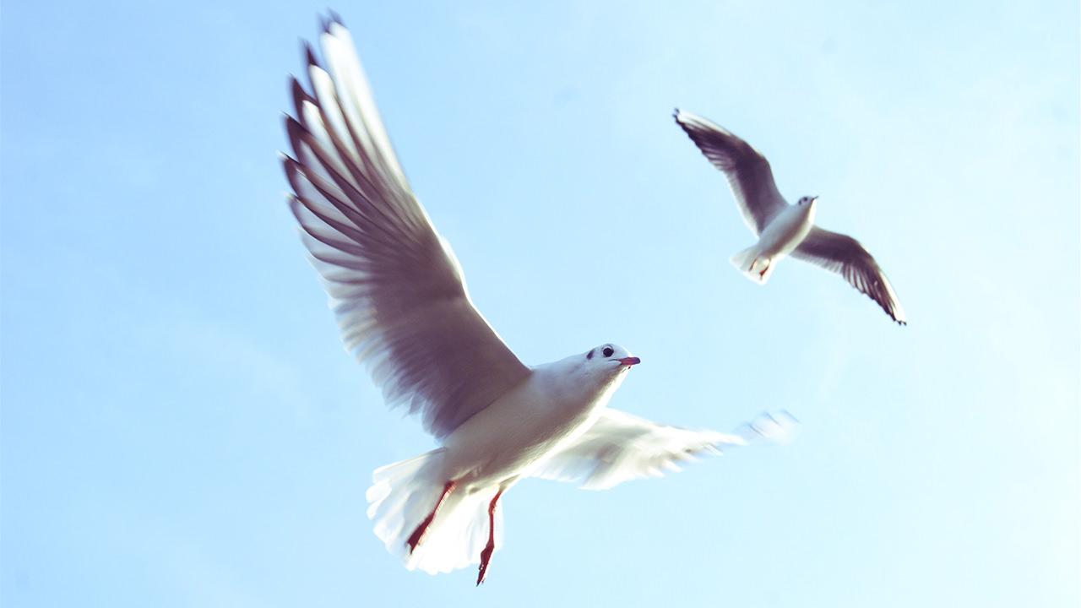
Want big impact?
Use big image.

Slide 17
Use charts to explain your ideas
White
Gray
Black

Slide 18
And tables to compare data
 | A | B | C
Yellow | 10 | 20 | 7
Blue | 30 | 15 | 10
Orange | 5 | 24 | 16

Slide 19
Maps
our office

Slide 20
89,526,124
Whoa! That’s a big number, aren’t you proud?

Slide 21
89,526,124$
185,244 users
100%
That’s a lot of money
And a lot of users
Total success!

Slide 22
Our process is easy
first
second
last

Slide 23
Our sales funnel
20%
40%
60%
80%
Diagram featured by http://slidemodel.com
100%

Slide 24
Let’s review some concepts
Yellow
Is the color of gold, butter and ripe lemons. In the spectrum of visible light, yellow is found between green and orange.
Blue
Is the colour of the clear sky and the deep sea. It is located between violet and green on the optical spectrum.
Red
Is the color of blood, and because of this it has historically been associated with sacrifice, danger and courage.
Yellow
Is the color of gold, butter and ripe lemons. In the spectrum of visible light, yellow is found between green and orange.
Blue
Is the colour of the clear sky and the deep sea. It is located between violet and green on the optical spectrum.
Red
Is the color of blood, and because of this it has historically been associated with sacrifice, danger and courage.

Slide 25
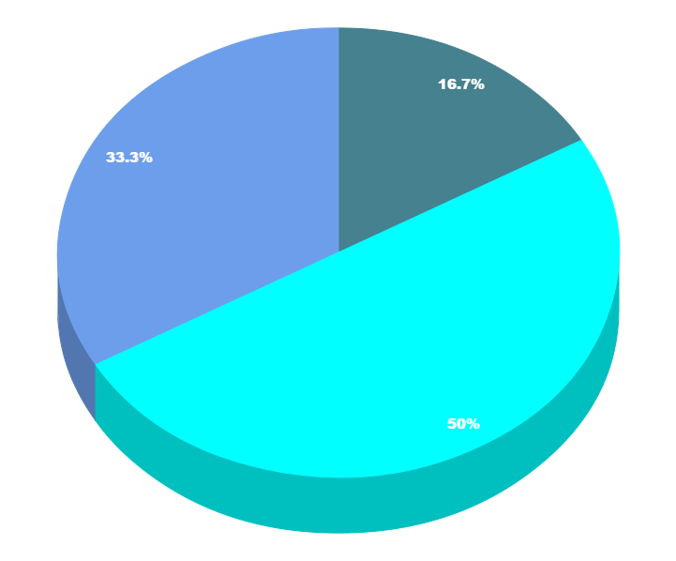
You can copy&paste graphs from Google Sheets

Slide 26
Place your screenshot here
Android project
Show and explain your web, app or software projects using these gadget templates.

Slide 27
Place your screenshot here
iPhone project
Show and explain your web, app or software projects using these gadget templates.

Slide 28
Place your screenshot here
Tablet project
Show and explain your web, app or software projects using these gadget templates.

Slide 29
Place your screenshot here
Desktop project
Show and explain your web, app or software projects using these gadget templates.

Slide 30
Thanks!
Any questions?
You can find me at:
@username
user@mail.me

Slide 31
Credits
Special thanks to all the people who made and released these awesome resources for free:
Presentation template by SlidesCarnival
Photographs by Unsplash

Slide 32

Presentation design
This presentation uses the following typographies and colors:
Titles: Nixie One
Body copy: Muli
You can download the fonts on this page:
http://www.google.com/fonts#UsePlace:use/Collection:Nixie+One|Muli:300,400,300italic,400italic
Click on the “arrow button” that appears on the top right
Aquamarina #00e1c6 / Turquoise #19bbd5 / Skyblue #2c9dde /
Light gray #c6daec / Dark blue #0e293c
You don’t need to keep this slide in your presentation. It’s only here to serve you as a design guide if you need to create new slides or download the fonts to edit the presentation in PowerPoint®

Slide 33
SlidesCarnival icons are editable shapes.
This means that you can:
Resize them without losing quality.
Change fill color and opacity.
Change line color, width and style.
Isn’t that nice? :)
Examples:

Slide 34
😉
Now you can use any emoji as an icon!
And of course it resizes without losing quality and you can change the color.
How? Follow Google instructions https://twitter.com/googledocs/status/730087240156643328
✋👆👉👍👤👦👧👨👩👪💃🏃💑❤😂😉😋😒😭👶😸🐟🍒🍔💣📌📖🔨🎃🎈🎨🏈🏰🌏🔌🔑 and many more...

